Slide 1

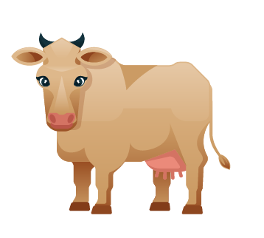
COWSERS
Math Game

Slide 2

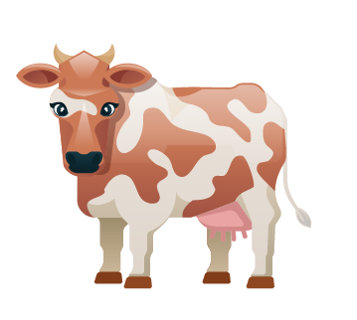
OUR IDEA
Our idea is to create a singleplayer version of the math game "Bulls and Cows", which can help you to improve your logical skills.

Slide 3
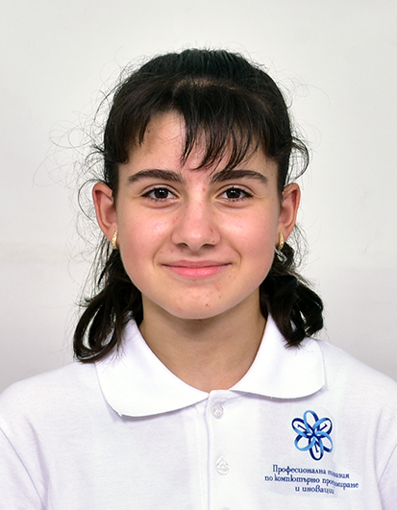
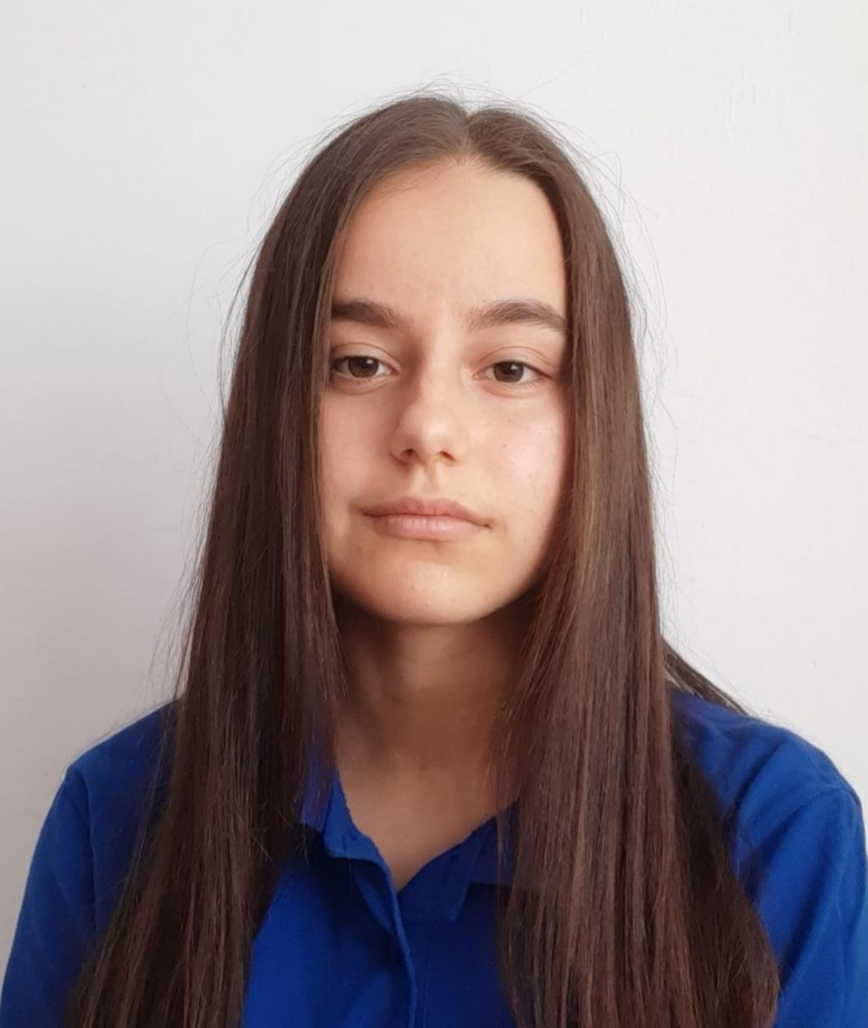
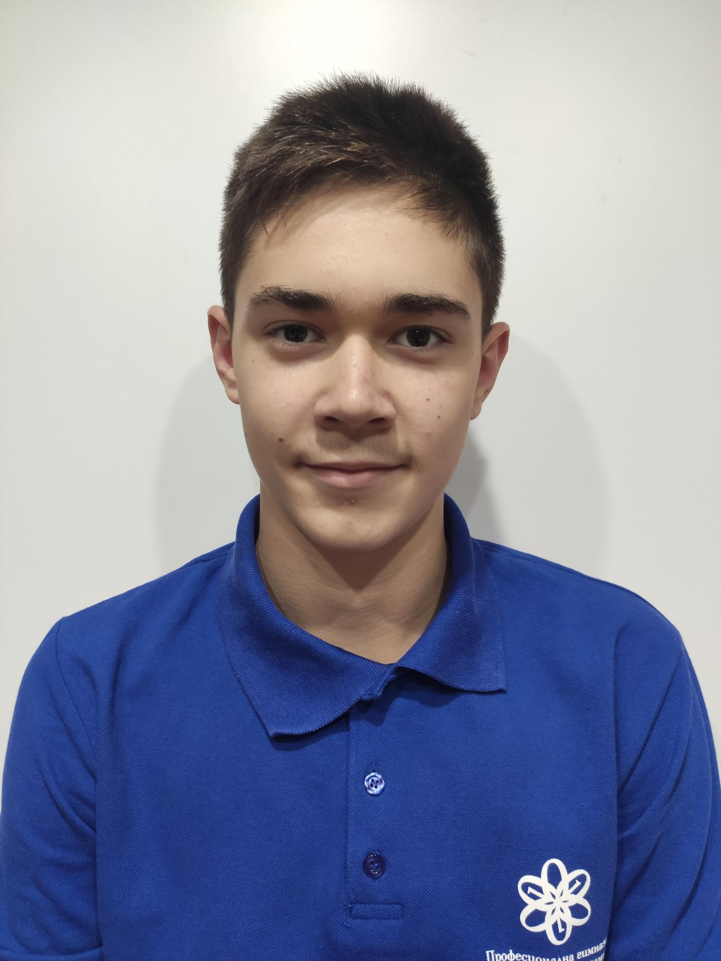
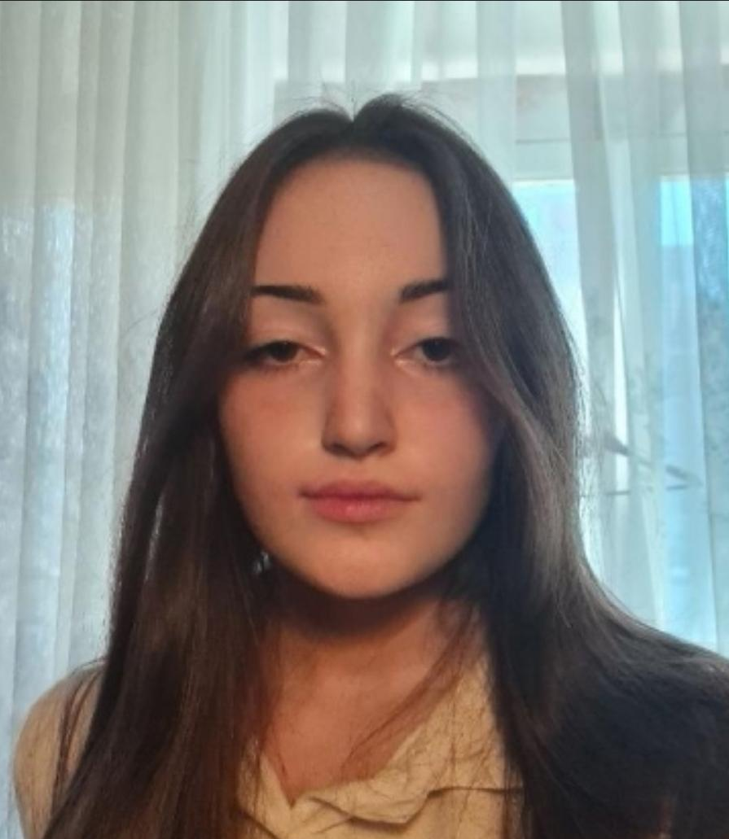
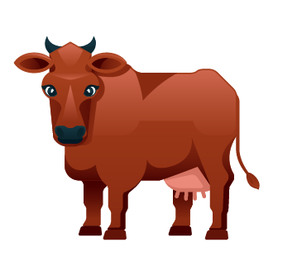
OUR TEAM
Svetoslav Zhelev
Polina Dineva
Iva Nedkova
Yana Ilcheva
Scrum trainer
Back-end developer
Back-end developer
QA engineer

Slide 4

STAGES OF REALIZATION
We chose the theme of the game
We assigned roles
We created a logo
We made the README file
We wrote the code for the game
We created the presentation and the documentation

Slide 5
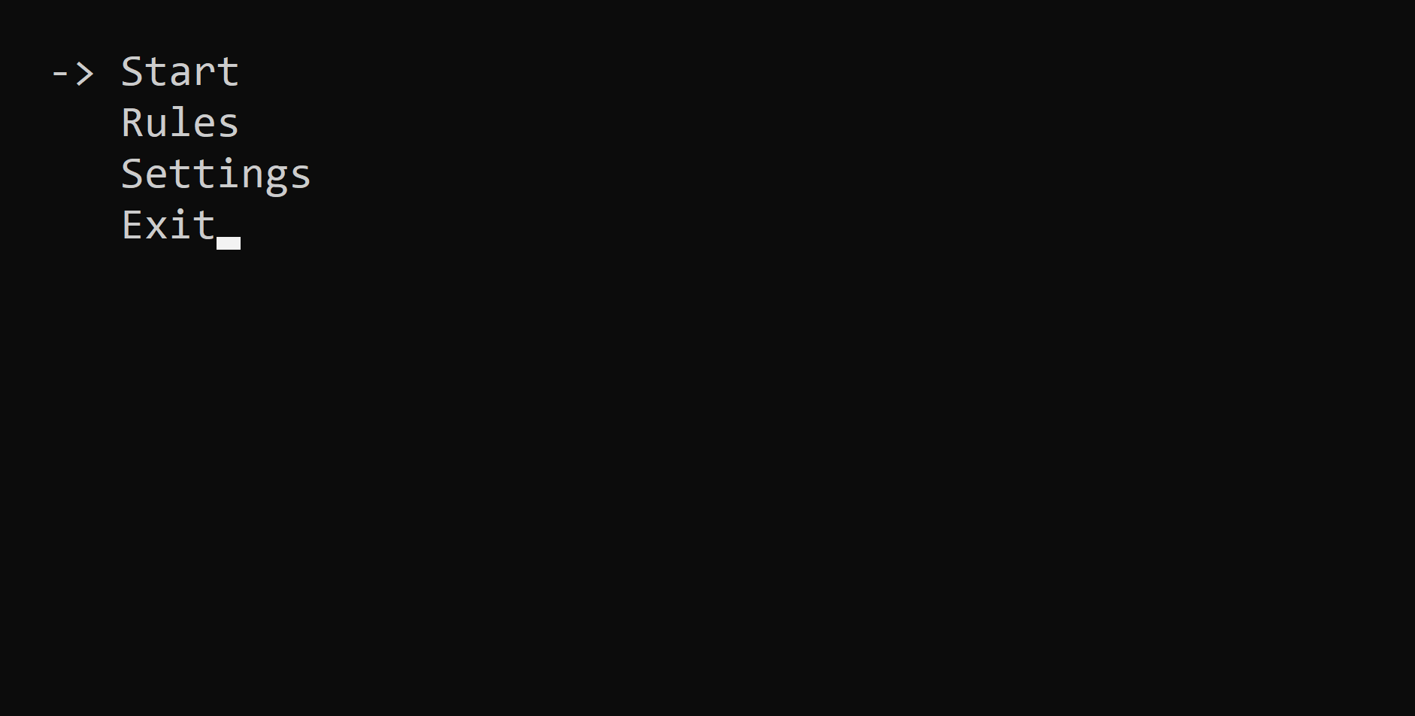
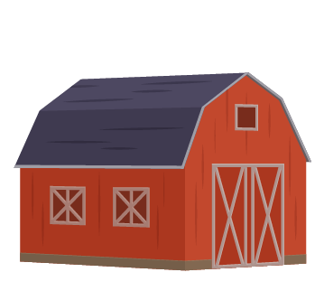
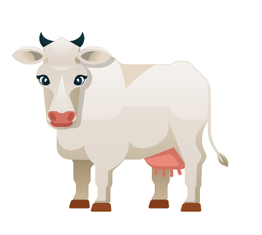
DEMO OF OUR PROJECT

Slide 6









USED TECHNOLOGIES

Slide 7
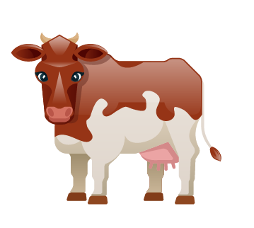
THANK YOU FOR YOUR ATTENTION!

