Slide 1
An introduction to Java source code analysis and transformation with Spoon
Authors: the contributors of Spoon.
Feel free to remix and extend.
Pull requests welcome at https://github.com/INRIA/spoon/
Latest version at https://github.com/SpoonLabs/spoon-incubator/tree/master/doc

Slide 2
Spoon: What is it?
Spoon parses Java source code and creates an Abstract Syntax Tree (AST)
Usage for static analysis:
  Eg Micro/Design pattern detection
  Eg Architectural rule checking
  Eg Metrics
Usage for source-to-source code transformation:
  Eg Automatic instrumentation & logging
  Eg Automatic refactoring
  Eg Automatic repair
Very powerful API (better than JavaParser)

Slide 3
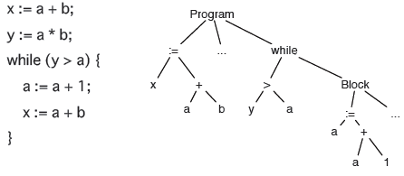
Abstract Syntax Tree
An Abstract Syntax Tree is a data structure representing source code. It abstracts over the raw parse tree or token sequence.

Slide 4
Astract Syntax Tree
There can be many different ASTs for he same programming language
  Typed vs untyped AST nodes
  Use enum instead of classes
  Different ways to traverse the AST
  Read-only or read-write
Compilers have an (implicit | undocumented | unmodifiable) AST. Libraries exist to compute and manipulate ASTs.
Which AST is the best for Java?
The AST

Slide 5
Tools for analyzing Astract Syntax Trees
Software for Java AST
  Spoon
  SrcML
  JDT
  JavaC
  IntelliJ AST
  JavaParser
  ANTLR
  See also binary transformation:
  Javassist, ASM, SOOT

Slide 6
Example: Spoon
Spoon provides Java ASTs:
That can be analyzed
That can be transformed
With a powerful API

Slide 7
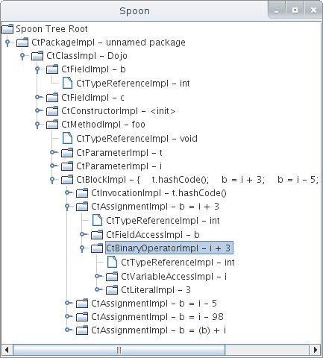
Graphical understanding of an AST
java spoon.Launcher -g -i srcDir
public class Dojo {
public int b;
public double c;
void foo(Object t, int i) {
t.hashCode();
b=i+3;
b=i-5;
b=i-98;
b=b+i;
}
}

Slide 8
Source Code Analysis

Slide 9
AST analysis
AST analysis is useful in a number of different use cases:
For implementing Lint tools / bad smells detection (similar to Lint, FindBugs, PMD, Checkstyle, JLint)
Verification of architectural rules & contracts
  Only use constructor through factory
  (similar to SonarQube rules)
Visualization
  Eg “Visualizing Project Evolution through Abstract Syntax Tree Analysis”

Slide 10
Basics of AST Analysis with Spoon
// navigation
class.getFields()
field.getDefaultExpression()
if.getThenBranch();
method.getBody();
// queries
list1 = methodBody.getElements(new TypeFilter(CtAssignment.class));
// collecting all deprecated classes
list2 = rootPackage.getElements(new AnnotationFilter(Deprecated.class));
// creating a custom filter to select all public fields
list3 = rootPackage.getElements(
new AbstractFilter<CtField>(CtField.class) {
public boolean matches(CtField field) {
return field.getModifiers.contains(ModifierKind.PUBLIC);
}}
);

Slide 11
Spoon Analysis #1: Detecting empty catch blocks
public class CatchProcessor extends AbstractProcessor<CtCatch> {
public void process(CtCatch element) {
if (element.getBody().getStatements().size() == 0) {
getFactory().getEnvironment().report(this, Severity.WARNING,
element, "empty catch clause "
+element.getPosition().toString());
}
}
}
$ java -cp spoon.jar spoon.Launcher -i sourceFolder -p CatchProcessor
empty catch clause in Foo.java:312

Slide 12
Spoon Analysis #2: Detecting public fields
public class PublicFieldProcessorWarning extends AbstractProcessor<CtField<?>>{
@Override
public void process(CtField<?> arg0) {
if (arg0.hasModifier(ModifierKind.PUBLIC)) {
getEnvironment().report(this, Severity.WARNING, arg0,
"Found a public field");
}
}
}

Slide 13
Source Code Transformation

Slide 14
API for code transformation
A source code transformation tool provides you with an API.
Scope | Name | Description
generic | replace(element) | replaces an element by another one.
generic | insertBefore(element) | inserts the current element ("this") before another element in a code block.
generic | insertAfter(element) | inserts the current element ("this") after another element in a code block.
block | insertBegin(element) | adds an element at the begin of a code block.
block | insertEnd(element) | appends an element at the end of a code block.
throw | setThrownExpression(e) | sets the expression returning a throwable object.
assignment | setAssignment(e) | sets the expression to be assigned in a variable.
if | setElseStatement(stmt) | sets the "else" statement of an if/then/else.
Excerpt of Spoon's transformation API

Slide 15
Spoon Transformation #1: adding not-null checks
public class NotNullCheckAdderProcessor extends
AbstractProcessor<CtParameter<?>> {
@Override
public boolean isToBeProcessed(CtParameter<?> element) {
return !element.getType().isPrimitive();// only for objects
}
public void process(CtParameter<?> element) {
// we declare a new snippet of code to be inserted
CtCodeSnippetStatement snippet = getFactory().Core().createCodeSnippetStatement();
// this snippet contains an if check
snippet.setValue("if(" + element.getSimpleName() + " == null "
+ ") throw new IllegalArgumentException(
\"[Spoon inserted check] null passed as parameter\");");
// we insert the snippet at the beginning of the method body
element.getParent(CtMethod.class).getBody().insertBegin(snippet);
}
}

Slide 16
Spoon Transformation #2 (driven by annotations)
public @interface Bound {
double min();
}
public void openUserSpacePort(@Bound(min = 1025) int a) {
// code to open a port
}
public class Bound2Processor extends
AbstractAnnotationProcessor<Bound, CtParameter<?>> {
public void process(Bound annotation, CtParameter<?> element) {
// we declare a new snippet of code to be inserted
CtCodeSnippetStatement snippet = getFactory().Core()
.createCodeSnippetStatement();
// this snippet contains an if check
snippet.setValue("if("
+ element.getSimpleName() + " < " + annotation.min() + ")"
+" throw new RuntimeException(\"[Spoon check] Bound violation\");");
// we insert the snippet at the beginning of the method body
element.getParent(CtMethod.class).getBody().insertBegin(snippet);
} // end process
}

Slide 17
Usage in Research
See https://scholar.google.com/scholar?hl=en&as_sdt=0,5&sciodt=0,5&cites=18020575005067751853&scipsc=&q=&scisbd=1
"Dynamic patch generation for null pointer exceptions using metaprogramming." Software Analysis, Evolution and Reengineering (SANER), 2017 IEEE 24th International Conference on. IEEE, 2017.
"Automatic inference of code transforms for patch generation." Proceedings of the 2017 11th Joint Meeting on Foundations of Software Engineering, ESEC/FSE. Vol. 2017. 2017.
"Visualizing Project Evolution through Abstract Syntax Tree Analysis." Software Visualization (VISSOFT), 2016 IEEE Working Conference on. IEEE, 2016.
"Investigating the energy impact of android smells." Software Analysis, Evolution and Reengineering (SANER), 2017 IEEE 24th International Conference on. IEEE, 2017.
"Automatic detection of GUI design smells: The case of blob listener." Proceedings of the 8th ACM SIGCHI Symposium on Engineering Interactive Computing Systems. ACM, 2016.
…..

Slide 18
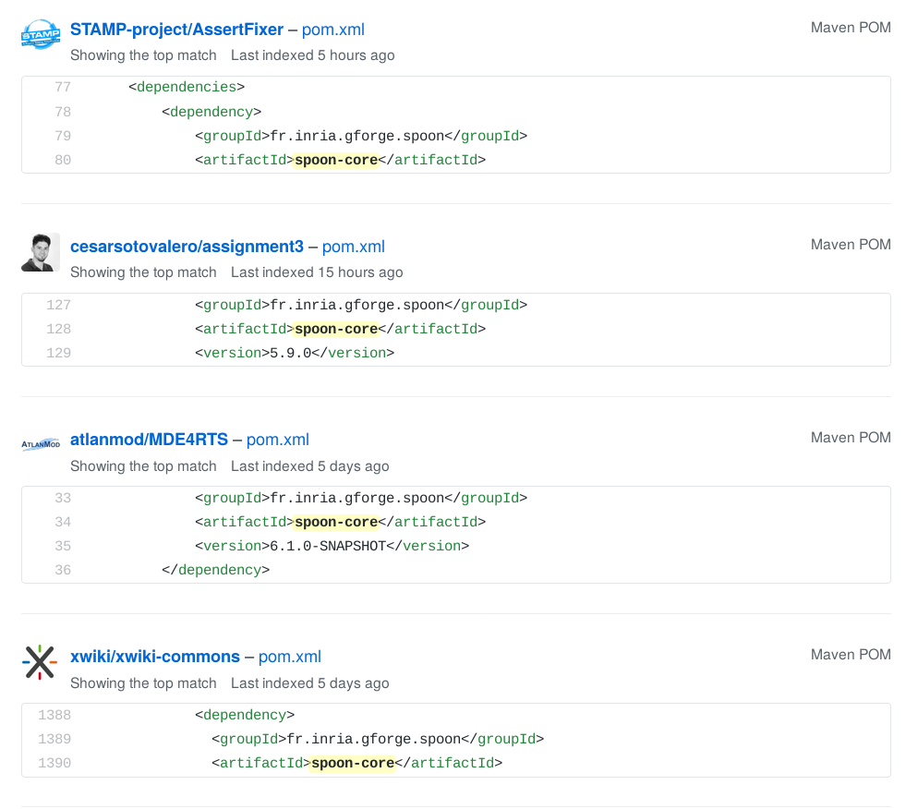
Usage in Industry
See https://github.com/search?l=Maven+POM&o=desc&q=%22spoon-core%22&s=indexed&type=Code

Slide 19
Spoon: key metrics
Old and mature
  2200+ commits since 2006
Active on Github
  500+ stars, 100 forks
  39 contributors, 700+ issues
Top software engineering
  Continuous integration, strong test discipline
  100% of changes are code-reviewed (PR)
  Emphasis on API stability over time

