Slide 1
Dependency Injection in Android

Slide 2
Agenda
Intro
Dagger
More Dagger – Dagger 2
Beyond Dagger – RoboJuice, Transfuse, AndroidAnnotations
Demos

Slide 3
Intro
What's DI?
When it's good?
When it's not?
JSR-330
Injection methods: constructor, field, method parameter

Slide 4
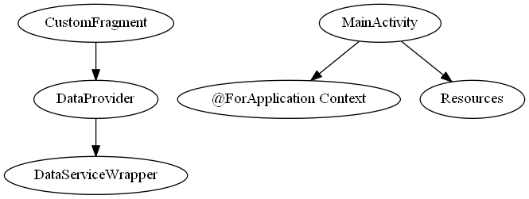
Dagger
ObjectGraph
@Module
@Provides
@Singleton
Scoped graphs
Notes:
@Module
- injects
- library
- complete

