Slide 1
Game Recommendations System
Mikołaj Drozd, Maksymilian Kochan, Mikołaj Komarnicki
Supervisor: Marek Adamczyk

Slide 2

Project inspiration
Previously we wanted to build multiple different models based on various methods which could be later compared and maybe joined into more efficient advanced hybrid model.
However, we changed our directions into building more interesting model based around graph embeddings with Cleora.

Slide 3
Data and preprocessing
Firstly we thought of using multiple game, user and recommendation attributes such as game genre, game rating or hours in game in moment of posting opinion.
Later we decided to ignore those properties and focus on graph representation of games and users relations alone (recommendations).
A few data improvements have been introduced to the graph such as keeping only users satisfying minimal amount of recommendations to improve work of models and more importantly reduce total size of data. For further simplification of the model we decided to use only positive opinions.

Slide 4

Evaluation Methods for suggested models
Every model in its final form returns for given user most probable games in order of descending probability.
Every dataset split is made on 70:30 proportions and after training evaluated by following:
Predictive quality metric:
Average Recall@10 = $\frac{\# of Hits }{\# of Expected Hits}$
Ranking quality metrics:
MRR (Mean Reciprocal Rank) - $\frac{1}{\left|Q\right|}\sum_{i=1}^{\left|Q\right|}{\frac{1}{rank_{i}}}$ (if none are found, rank = MAX_RANK)
HR@10 (Hit Rate) - $\frac{Number of Hits}{Total Number of Queries}$
Each query has at least one answer. Only the highest ranking true positive is considered in both metrics and is considered a hit if it appears in first 10 recommendations

Slide 5
First recommendation model based on Random Walk
Heuristically improvised model based on Random Walk:
Each user goes amount of edges deep through the graph on each step choosing random edge from node. For each game algorithm collects number of times the node has been visited throughout all Random Walk iterations.
After the model training, for each user there are all games visited by algorithm starting from him, with number of times they were visited.

Slide 6
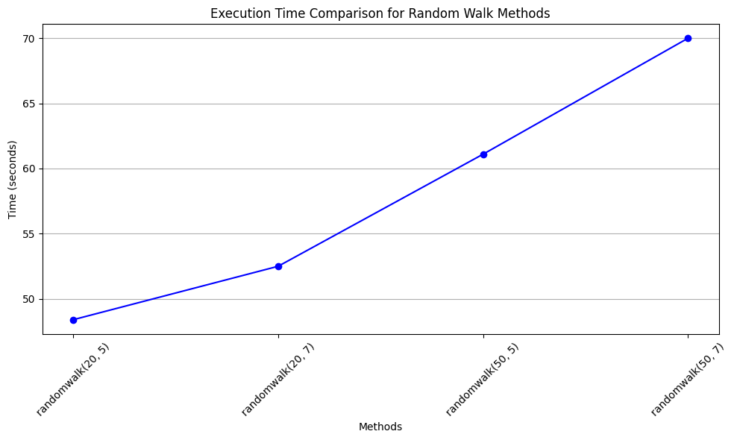
Random Walk model
Tested multiple different variations of hyperparameters (depth, iterations) and their results for all mentioned metrics.

Slide 7
Cleora embedding
Graph is built as explained previously. More precisely it is a biparite graph which is exactly what cleora wants to have in its input data.
Cleora product embeddings trained for 1024 and 4096 features and for both 4 and 5 markov propagations.
All 4 models have been experimented later in testing phase.

Slide 8
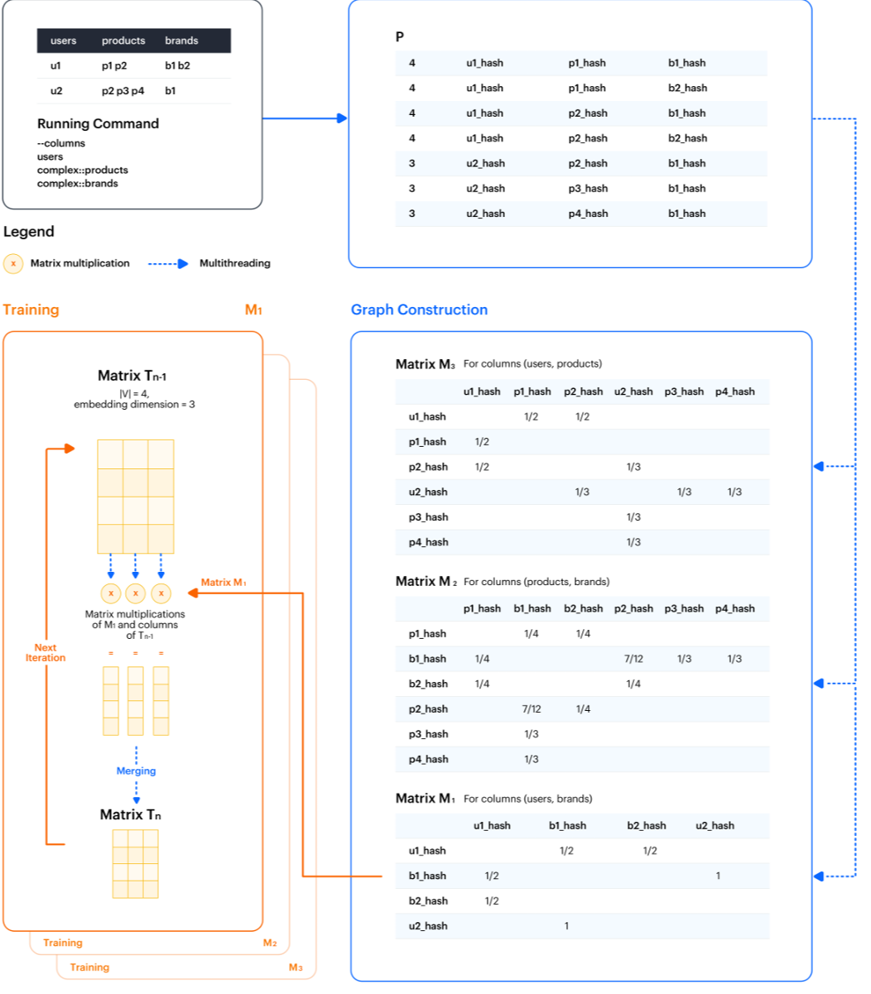
Cleora Architecture
Given input create first matrix P which is specified by user commands
Later for each relations pair requested by user seperate matrix is created
Training is conducted by multiplying each matrix by the embedding matrix consisting of specified amount of features
User specifies amount of total multiplications that matches his demands. Lower iterations tend to approximate the co-occurance, higher give contextual similarity

Slide 9
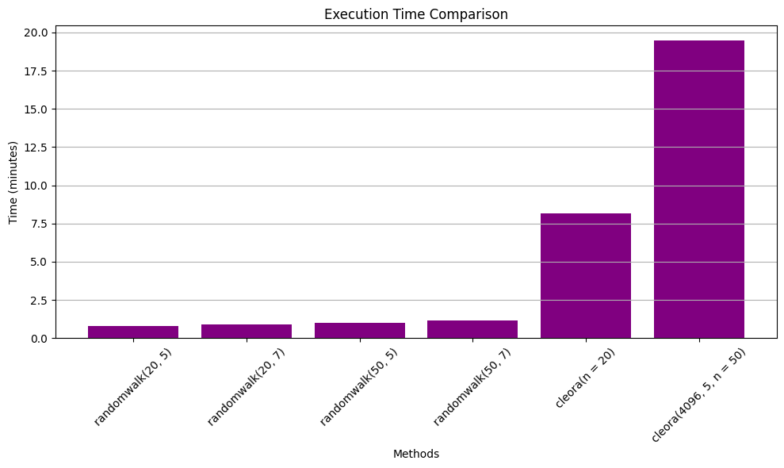
Random Walk upgraded model
Hybrid based on Random Walk with Cleora embeddings for products instead of incrementing them. All game propositions for user are kept by the similarity between the game and the closest game the user has recommended.

Slide 10
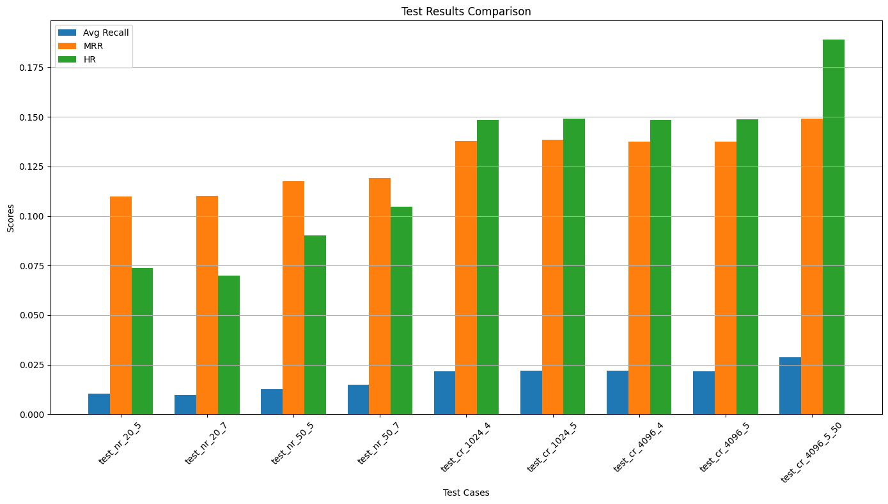
Comparison between naive random walk and cleora upgraded version

Slide 11
Double level Cleora embedding
Based around the initial embeddings calculated between apps. Now the graph is constructed with 2 types of edges:
user – app (initial edges based on recommendations)
app – app (pairs of most similar games)
The whole graph could be treated as biparite graph having users and similar games in one column and games in between edges in other column
Now, the graph is treated as input and fed into cleora. This should give user-user and product-product similarities as well as user-product similarities that could potentially be used in final model.

Slide 12
Thank you for your time

