Slide 1
Domain vocabulary challenges in hydrology
Sylvain Grellet, Global Water Info IG

Slide 2
Hydrologic Vocabularies
Not started yet; several people are interested across RDA GWIIG and OGC HydroDWG
Goals:
Identify water-related ontologies
Engage with RDA Vocab Services IG
Use cases
Service and practice documentation
Recs on vocab publication and APIs
Encourage publication of exemplar water-related vocabularies using best practice methods

Slide 3
Hydrologic Vocabularies Discussion
2 core aspects
A: International standards (GWML2, HY_Features, Observations & Measurements, …) do define an overarching conceptual view on the domain that could lead to reference ontologies
B: But those standards do not enumerate list of possible values for a given information element
Ex : GWML2 defines how/where to describe porosity of a HydrogeoUnit but not the reference vocabulary to be used

Slide 4
Hydrologic Vocabularies Discussion
A: from OGC standards to reference ontologies
Ontologies are in the process to be generated out of GWML2 and HY_Feature (with more or less complete coverage). There is already one for ISO 19156/OGC Observations and Measurements (om-lite, sam-lite)
The process often used is a mixture of automatic owl generation from the OGC logical model (using ISO 19150-2) and ontology expertise
This exercise is highly linked with OGC ELFIE
JSON-LD will be the basis for the data structure
JSON-LD context will then need to point to properties defined in reference ontologies

Slide 5
Hydrologic Vocabularies Discussion
B: possible values for information elements
Way more complex situation
Overlaps with many domains
Chemistry (water quality analysis), biodiversity (species identification), sampling methods, ….
Units of measures
Many reference vocabularies (ex : national ones) are not available (yet) using semantic web best practices (ex : within French Water Information System)

Slide 6
Hydrologic Vocabularies: further use cases
Identify use cases and audiences for semantic dataset annotation and discovery; explore varying "annotation depth" as required for different use cases;
Tools for efficient semantic annotation;
Additional use cases beyond discovery, eg reasoning use cases and tools, and requirements to the data model

Slide 7
Hydrologic Vocabularies: next steps
Recently (or soon to be) available ontologies
OM, HY_Features, GWML2
Test them
Vocabularies
Create an organized list of available vocabularies for water data, and their metadata model
Chemistry
Taxa
SamplingMethods,
…
Collect feedback/success stories on their use
Explore overlaps and complementarity of available vocabularies identify gaps;

Slide 8
Hydrologic Vocabularies: next steps
Vocabularies
“Easiest”
Units of measure : QUDT VS UCUM VS local/national/registry registries
Chemistry: ex CHEBI, many systems refer to CAS registry
Biodiversity : biodiv community is well advanced on taxa list sharing. Ex : in France MNHN TaxRef is based on several others (WoRM, Fauna Europaea, …), GBIF taxonmy
Sampling methods : at least for chemical parameters (often an ISO, CEN methods), more difficult for others
Microbiology seems possible…
More difficult
? physical parameters ? : pH
envionmental parameters : météorology during species observations (sunny, foggy, …)
calculated indicators like in hydrobiology (in France IBGN, IBD), waste water (COD/BOD of residual water), …
sampling methods other than for chemical parameters

Slide 9
Cross-domain ontology for discovery; ontology construction and improvement; semantic annotation of use cases
Ilya Zaslavsky, Global Water Info IG

Slide 10
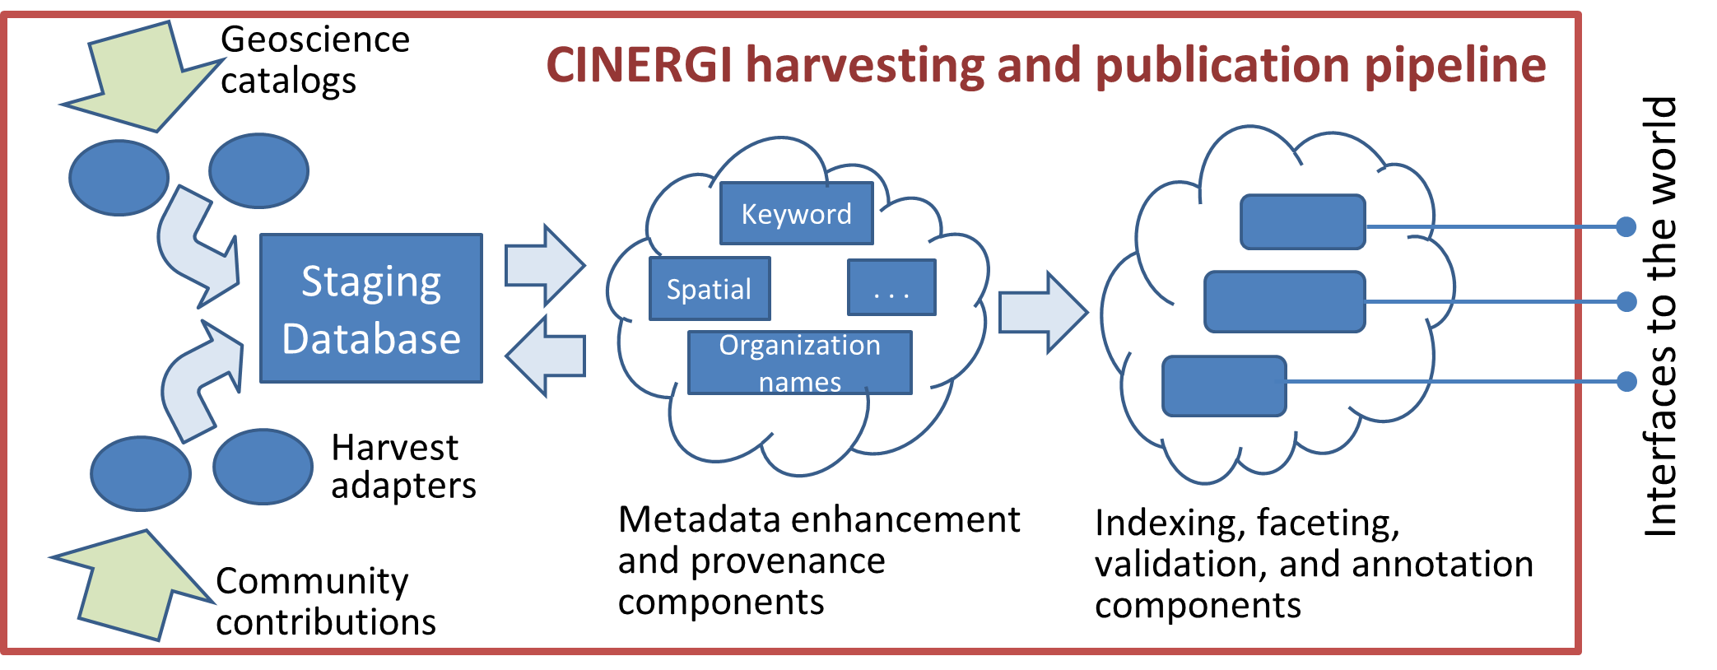
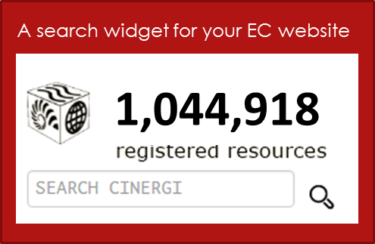

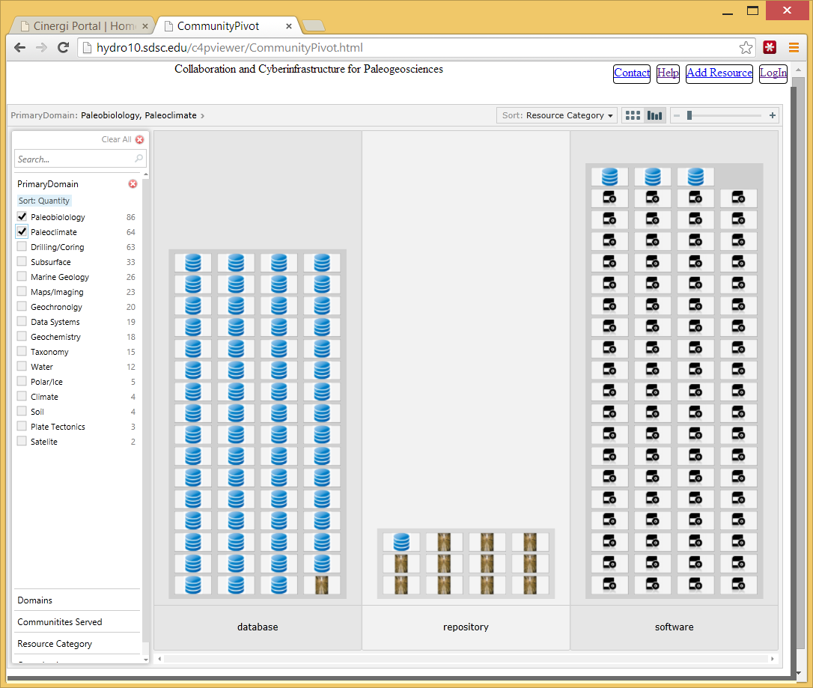
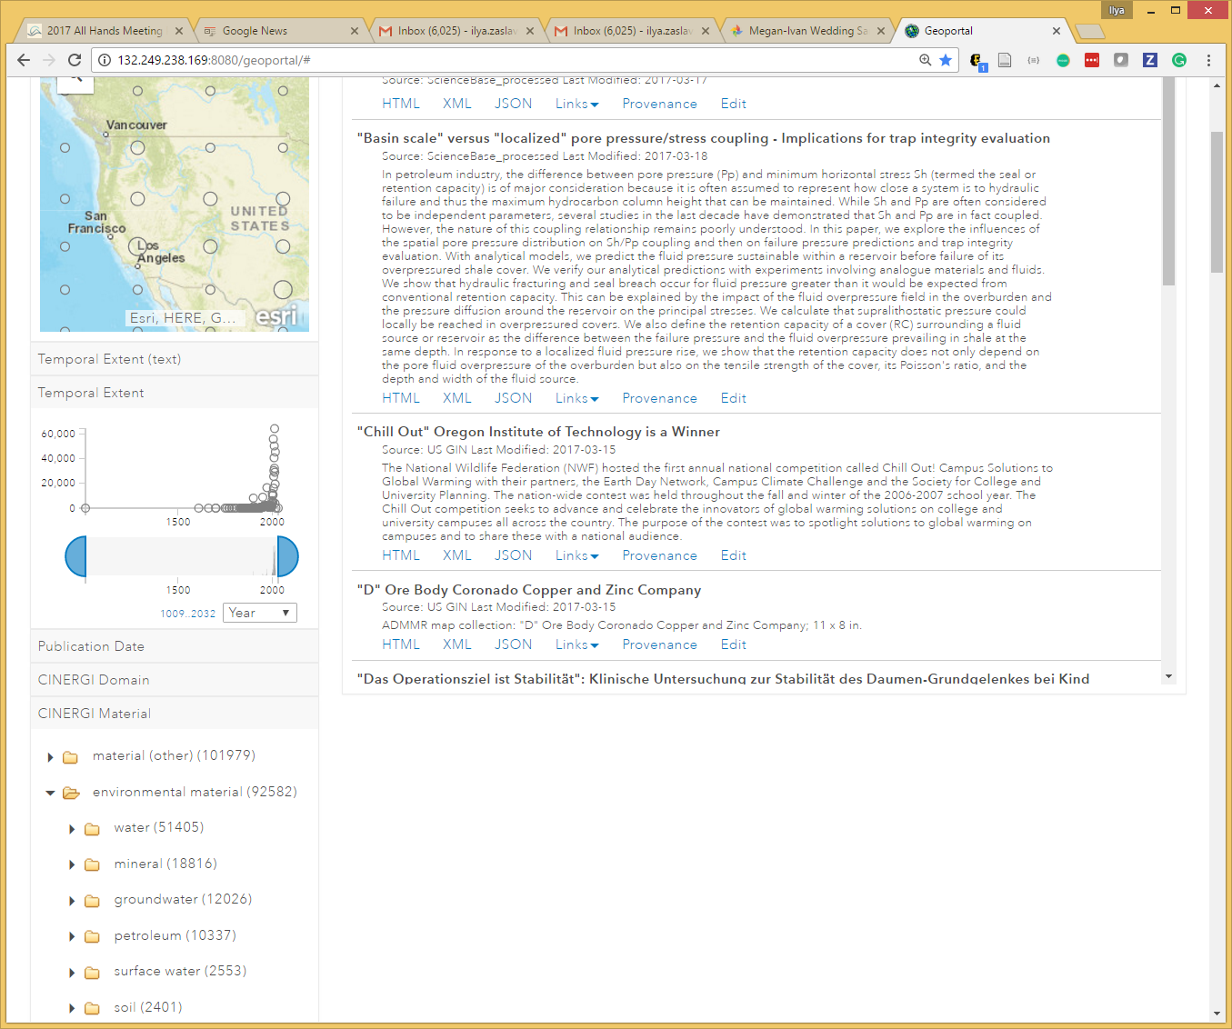
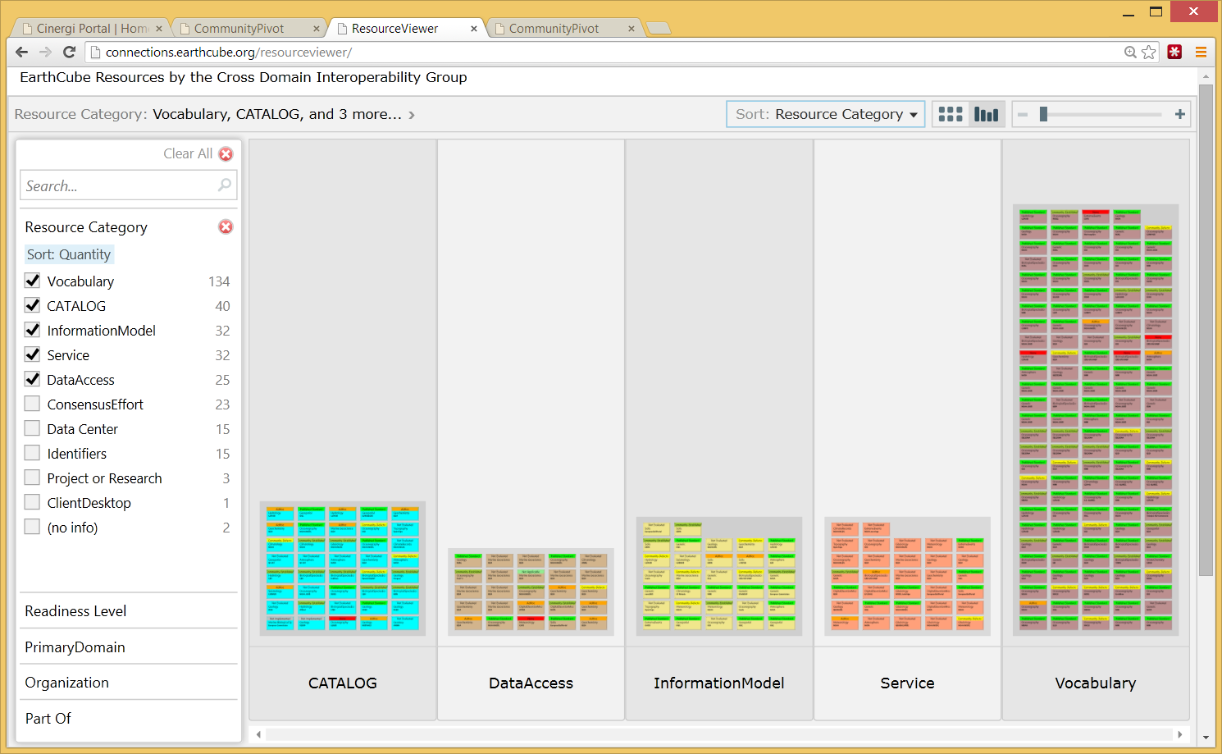
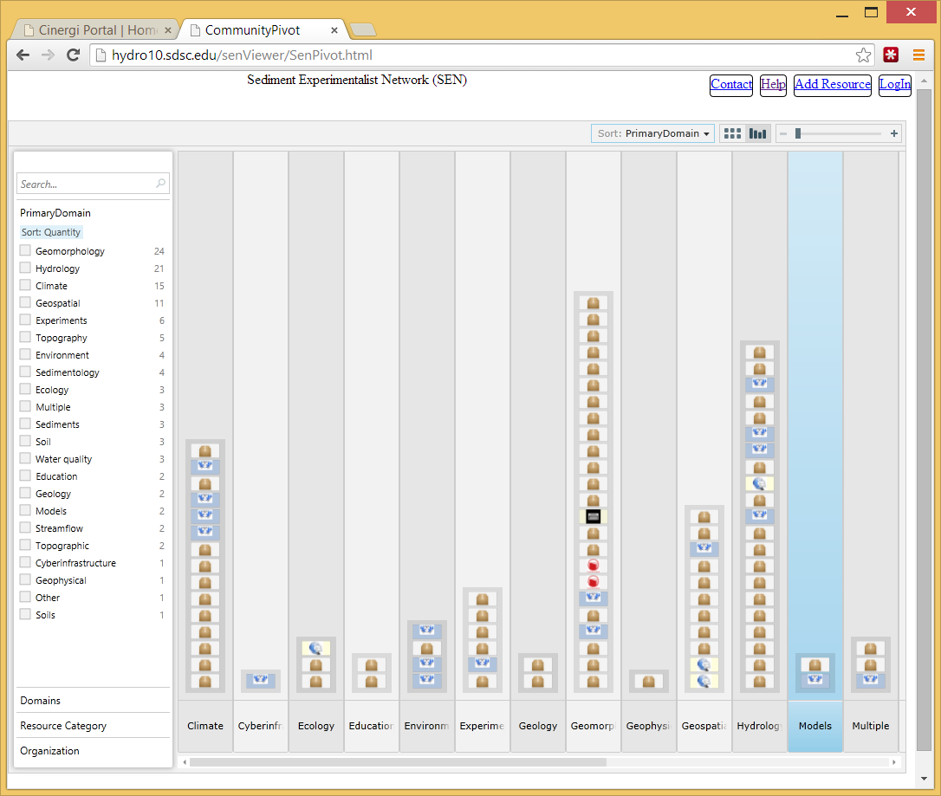
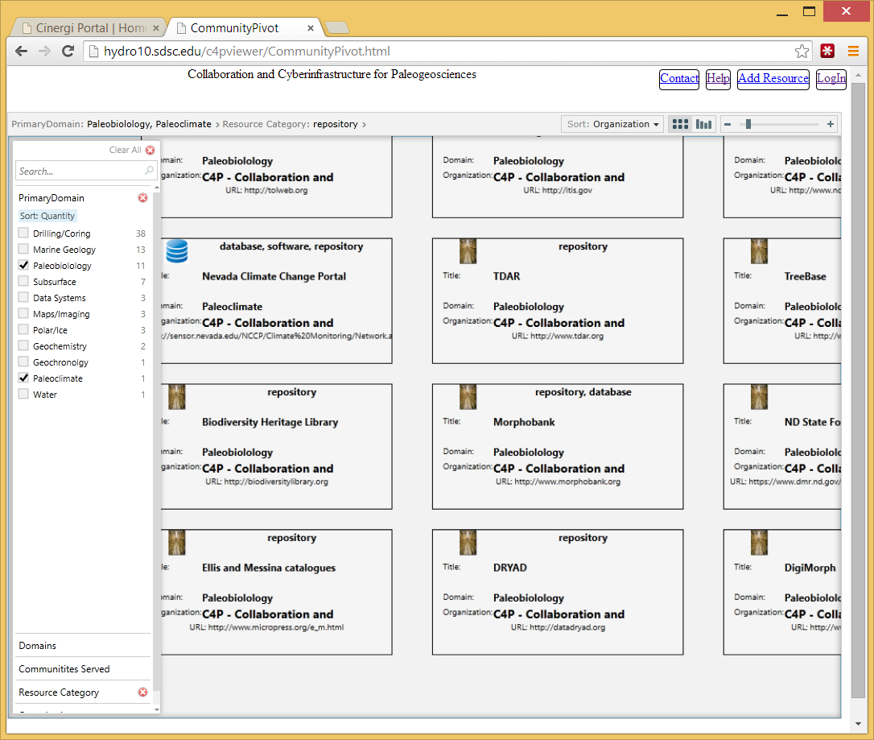
Cross-domain ontology and semantic annotation in CINERGI
Domain Inventories
Domain workshops
From 25+ sources
Content Enhancement
RCN (Research Coordination Networks)
High-level assets
Sources
Portal
http://cinergi.sdsc.edu/

Slide 11

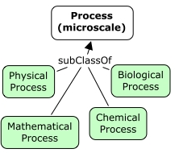
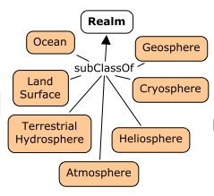

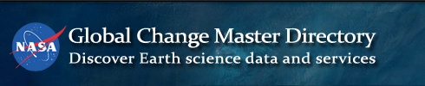
GeoSciGraph and Ontologies
GeoSciGraph ontology management system provides semantic infrastructure.
It relies on a cross-domain ontology of geoscience terms, amalgamating several independently developed ontologies or taxonomies
Some included ontologies:
SWEET
ENVO
CHEBI
YAGO (geo features)
NASA GCMD (equipment, providers)
GeoSciML
Geochronology
EDAM Bioinformatics (software terms and operations)
Also: VIAF
Added annotation properties for combining ontology fragments
(cinergiFacet, cinergiParent)

Slide 12
Semantic annotation of use cases
EarthCube Use Cases WG: 50 science use cases from different domains
The descriptions are registered and “semantically-enhanced” through CINERGI; use cases are first class citizens
The “relevancy” of ontologies might be *partially* measured by how successfully (completely) a collection of real-life use cases is indexed based on such ontologies (under different scenarios: discovery, integration, modeling, reasoning, etc.)

