Slide 1
SensorThings API in INSPIRE
108th OGC Technical Committee
Stuttgart, Germany
Kathi Schleidt
11 September 2018

Slide 2
INSPIRE Background I
Directive 2007/2/EC establishing an Infrastructure for Spatial Information in the European Community
Covers 34 Spatial Data Themes grouped into 3 Annexes
OGC based conceptual models created by TWGs, formalized in Implementing Rules (IR), XSD generated from UML published
Implementing Rules also govern download services
Finalization date for data from Annex II & III fall 2020
Current status: >100 000 datasets; ~7,000 institutions (and rising. Note: To date, most available datasets have not been harmonized)

Slide 3
INSPIRE Background II
Most Themes with spatial focus, classic SDI. Examples:
Administrative units
Cadastral parcels
Land Use & Land Cover
Hydrographic Networks
Protected sites
Elevation
Utility and governmental services
All require Observational or Measurement Data!!!
Environmental monitoring facilities
Geology
Atmospheric conditions & Meteorological geographical features
Oceanographic geographical features
Environmental monitoring facilities
Geology
Atmospheric conditions & Meteorological geographical features
Oceanographic geographical features

Slide 4
SOS in INSPIRE
Question how to serve observational data in INSPIRE
Theoretically possible via WFS, but not really satisfactory
Decision reached to analyse suitability of SOS
2011 first guidance document for use of O&M in INSPIRE https://inspire.ec.europa.eu/id/document/tg/d2.9-o%26m-swe
Technical Guidance for implementing download services using the OGC Sensor Observation Service finalized 2016 https://inspire.ec.europa.eu/tags/sos
but...
SOS scares folks!
What about trying SensorThings API???

Slide 5
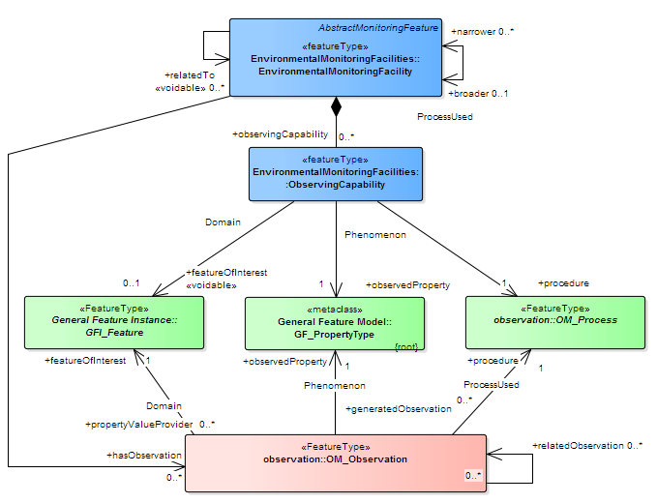
INSPIRE EF
Environmental MonitoringFacility
0..* +observingCapability
Observing Capability
0..1 +featureOfInterest
1 +observedProperty
1 +procedure
GFI_Feature
GF_Property
OM_Process
1 +observedProperty
1 +procedure
0..1 +featureOfInterest
OM_Observation
+hasObservation 0..*

Slide 6
INSPIRE EF
Environmental MonitoringFacility
EF
0..* +observingCapability
Obs
Caps
Observing Capability
0..1 +featureOfInterest
1 +observedProperty
1 +procedure
GFI_Feature
FoI
GF_Property
ObsProp
OM_Process
Process
1 +observedProperty
1 +procedure
0..1 +featureOfInterest
OM_Observation
Observation
+hasObservation 0..*

Slide 7
INSPIRE EF
EF
Obs
Caps
FoI
ObsProp
Process
Observation

Slide 8
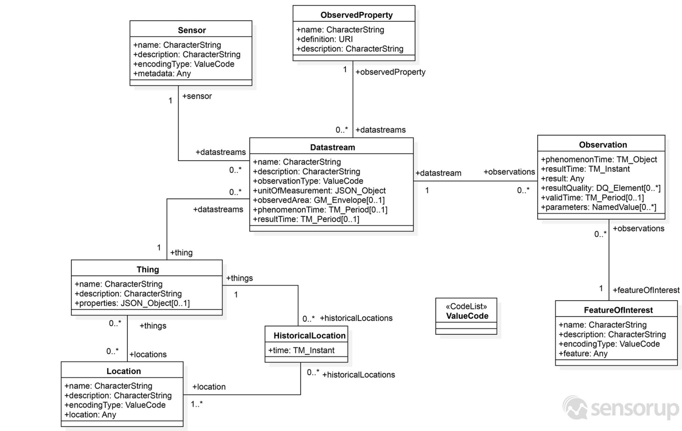
INSPIRE EF
EF
Obs Caps
FoI
ObsProp
Process
ObsProp
Observation
Process
ObsCaps
Observation
EF
FoI

Slide 9
INSPIRE EF Details
Class level mapping clear, but what to do with the mandatory attributes?
EF Requirements on Thing:
measurement Regime
mobile
operational Activity Period
Provide JSON Object in Thing properties!

Slide 10
INSPIRE EF Details - Thing
INSPIRE | STA
inspireId
localId | ID
namespace | PROPERTIES/namespace
name | NAME
mediaMonitored | PROPERTIES/mediaMonitored
measurementRegime | PROPERTIES/measurementRegime
mobile | PROPERTIES/mobile
operationalActivityPeriod
beginPosition | PROPERTIES/beginTime
endPosition | PROPERTIES/endTime

Slide 11

INSPIRE EF Details - Datastream
EF Requirements on Datastream:
observing Time
process Type
result Nature
online Resource
featureOfInterest
observedProperty
procedure
But – no properties slot!!!

Slide 12
INSPIRE EF Details - Datastream
INSPIRE | STA
Id | ID
observing Time
beginPosition | PHENOMENON_TIME_START
endPosition | PHENOMENON_TIME_END
process Type | PROPERTIES/processType
result Nature | PROPERTIES/resultNature
online Resource | PROPERTIES/onlineResource
featureOfInterest | FEATURE_ID – from Observations
observedProperty | OBS_PROPERTY_ID
procedure | SENSOR_ID

Slide 13
Conclusions
SensorThings API is well suited for provision of measurement data under INSPIRE
This does require an extension, adding properties element to other classes
This has been proposed for the 1.1 Version of STA
Some issues pertaining to the INSPIRE download services Implementing Rules still open, but should be fairly simple to align (just as has been done for SOS, WFS, WCS...)
So much simpler to deploy and configure
And even simpler to utilize data!
http://service.datacove.eu:8080/SensorThingsServer-1.0_BRGM/v1.0

