Slide 1
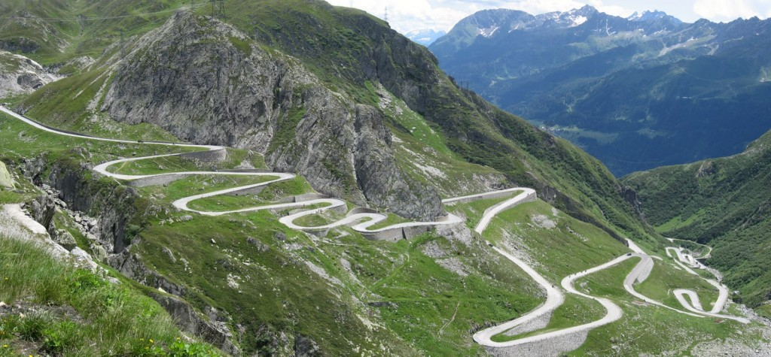



The long and winding road to O&M
O&M V0.86
O&M V0.86 [1] created 2002, partially as a response to 9/11
Work done by the OGC Sensor Web Enablement Group (SWE)
The intent is visible, the data model unrecognizable → still a long way to go from this embryo stage!
[1]: https://www.ogc.org/standards/om
O&M
V0.86
2002

Slide 2


The long and winding road to O&M
GeoSciML [1] created 2003 under the CGI Interoperability Working Group
Emphasis on the "interpreted geology"
Includes Geologic Unit, Mapped Feature, Earth Material, Geologic Structure
Additionally Borehole and other observational artefacts
[1]: http://geosciml.org/
O&M
V0.86
2002
2003

Slide 3
The long and winding road to O&M
SOS V1
SOS V1 [1] created 2006
Work also done by the OGC Sensor Web Enablement Group (SWE)
First OWS tailored for provision of Observational data
[1]: https://www.ogc.org/standards/sos
O&M
V0.86
2002
2003
SOS
2006

Slide 4

The long and winding road to O&M
INSPIRE
INSPIRE [1]: Infrastructure for Spatial Information in Europe
Foresees specifications for:
Metadata: Currently based on 19115 utilizing CSW, Good Practice available for GeoDCAT-AP
Data Specifications: 34 Spatial data themes
Network Services: OGC Web Services tailored for EU requirements
Roadmap [2] details implementation timeline (2010 - 2021)
[1]: https://inspire.ec.europa.eu/
[2]: https://inspire.ec.europa.eu/inspire-roadmap
O&M
V0.86
2002
2003
SOS
2007
2006

Slide 5
The long and winding road to O&M
O&M
First version of O&M [1] created 2007
Extracted and genericized from GeoSciML
Defines a conceptual schema encoding for:
Observations
Features involved in sampling when making observations
Generic enough to support all environmental media and far beyond
[1]: https://www.ogc.org/standards/om
O&M
V0.86
2002
2003
SOS
O&M V1
2007
2006
2007

Slide 6

Observational (Meta)Data
Room 236
observed Property:
Color
host:
Kathi
Observation
Swatch Comparison
observer:
procedure:
color:
YELLOW
featureOfInterest:
result:
featureOfInterest:
result:
HAPPY
expression:
Kathi
observer:
procedure:
Face Recognition
"smiley": {
"color": "Yellow",
"expression": "Happy"
}
host:
observed Property:
Expression
Room 236

Slide 7
The long and winding road to O&M
INSPIRE EMF (JRC Prototyping Tender)
Developing and prototyping INSPIRE technical specifications for air, water, waste and biodiversity environmental monitoring facilities
Objective: To demonstrate how INSPIRE can be used to underpin the development of Shared Environmental Information Systems (SEIS)
Main Tasks:
prepare HARMONISED metadata and data specifications for the INSPIRE data theme "Environmental Monitoring Facilities“ (EMF) related to the environmental acquis in the areas of air, waste, water, and biodiversity;
implement and demonstrate INSPIRE Network Services based on the INSPIRE metadata, data specifications and service standards;
O&M
V0.86
2002
2003
SOS
O&M V1
2007
2006
INSPIRE EMF
2007
2008

Slide 8
The long and winding road to O&M
INSPIRE CAFE (JRC Prototyping Tender)
Develop and prototype INSPIRE technical specifications for air quality reporting under the Clean Air For Europe (CAFE) programme, as required by EU Directive 2008/50/EC, or the Ambient Air Quality Directive
Implementation utilized both O&M and SOS
Work was done in conjunction with the SensorsAnywhere (SANY) FP6 IP
Results laid the foundation for current EU air quality reporting to EEA
O&M
V0.86
2002
2003
SOS
O&M V1
2007
INSPIRE CAFE
2006
INSPIRE EMF
2007
2009
2008

Slide 9
The long and winding road to O&M
INSPIRE TWGs
Thematic Working Groups with ~10 experts for each of the 34 Spatial Data Themes
Defined UML data models based on the INSPIRE Generic Conceptual Model (GCM)
Three development cycles, including public review
UML Models transformed to XML Schema (XSD) for provision via OGC Web Services
O&M
V0.86
TWG
2013
2002
2003
SOS
O&M V1
TWG
2007
INSPIRE CAFE
2006
INSPIRE EMF
2007
2011
2009
2008
TWG
2012

Slide 10

The long and winding road to O&M
INSPIRE Technical Guidance for SOS
INSPIRE Technical Guidance for SOS [1] created by INSPIRE MIG sub-group MIWP-7a
Provides alignment between the technical functionality specified for SOS and the legal requirements for INSPIRE Download Services (previously only available for WFS, WMS, CSW)
Enabled utilization of SOS as an INSPIRE Download Service
[1]: https://inspire.ec.europa.eu/id/document/tg/download-sos
O&M
V0.86
TWG
SOS
2013
2002
2016
2003
SOS
O&M V1
TWG
2007
INSPIRE CAFE
2006
INSPIRE EMF
2007
2011
2009
2008
TWG
2012

Slide 11
The long and winding road to O&M
OGC SensorThings API V1.0
OGC SensorThings API [1] provides an open, geospatial-enabled and unified way to interconnect Internet of Things (IoT) devices, data, and applications over the Web
API based on OData (short for Open Data Protocol: ISO/IEC 20802)
REST API serving JSON (GeoJSON used for spatial objects)
Powerful queries utilizing underlying data-graph enable complex requests
Data Model based on O&M
[1]: https://www.ogc.org/standards/sensorthings
O&M
V0.86
TWG
SOS
STA
2013
2002
2016
2016
2003
SOS
O&M V1
TWG
2007
INSPIRE CAFE
2006
INSPIRE EMF
2007
2011
2009
2008
TWG
2012

Slide 12
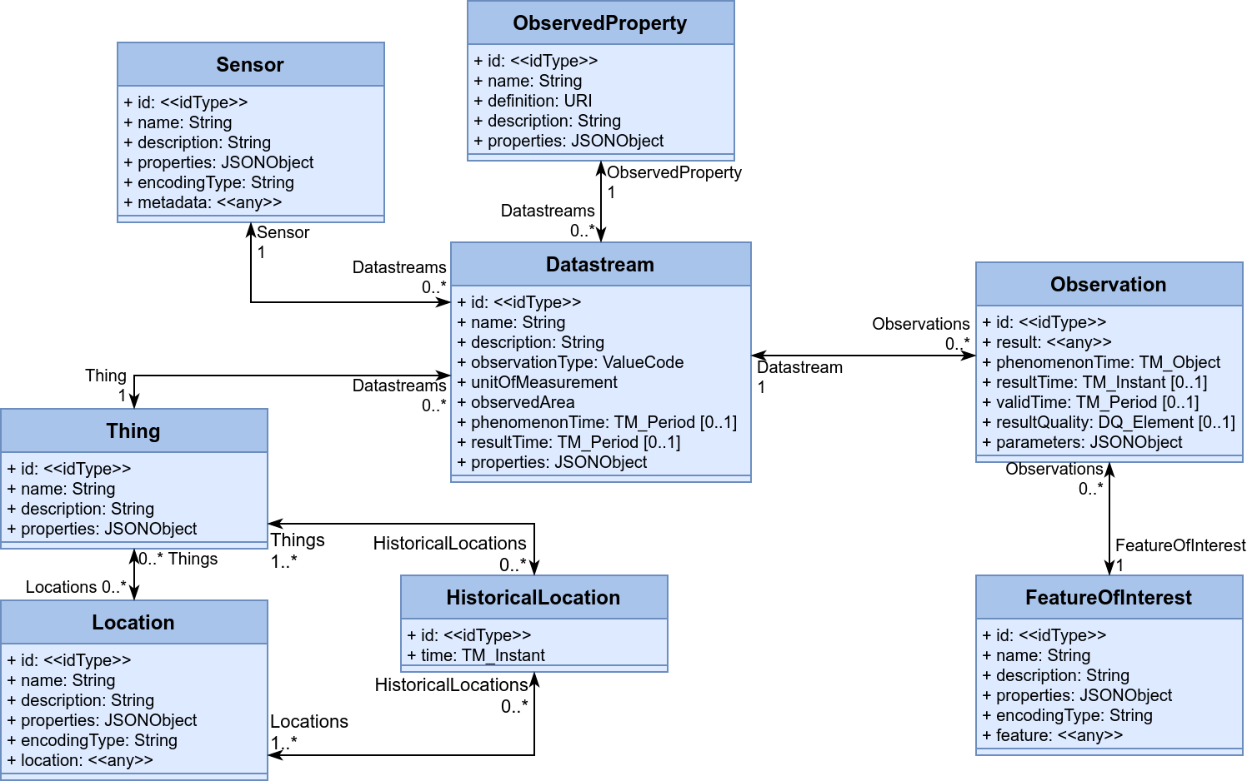
OGC SensorThings API V1.0

Slide 13
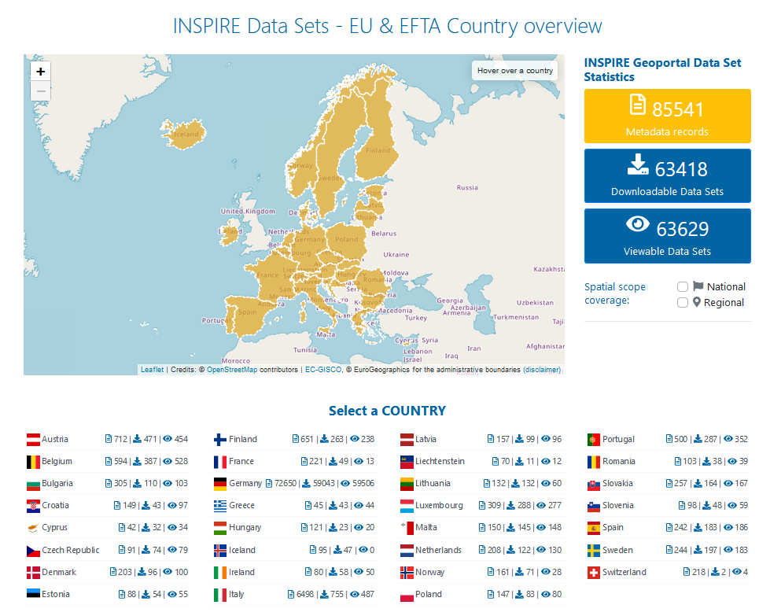
The long and winding road to O&M
INSPIRE Deadline
Still not quite there, but getting closer
INSPIRE
Deadline
O&M
V0.86
TWG
SOS
STA
2013
2020
2002
2016
2016
2003
SOS
O&M V1
TWG
2007
INSPIRE CAFE
2006
INSPIRE EMF
2007
2011
2009
2008
TWG
2012

Slide 14

The long and winding road to O&M
INSPIRE SensorThings Good Practice
Enables use of SensorThings [1] as an INSPIRE Download Service
Lightweight replacement for SOS
Data Mapping for INSPIRE Environmental Monitoring Facilities available
Requires SensorThings V1.1 for the provision of INSPIRE attributes as JSON properties
Includes alignment with Download Service requirements
Created by the API4INSPIRE Project [2] (also worked on OGC API Features Good Practice)
[1]: https://inspire.ec.europa.eu/good-practice/ogc-sensorthings-api-inspire-download-service
[2]: https://datacoveeu.github.io/API4INSPIRE/
INSPIRE
Deadline
O&M
V0.86
TWG
STA GP
SOS
STA
2013
2020
2020
2002
2016
2016
2003
SOS
O&M V1
TWG
2007
INSPIRE CAFE
2006
INSPIRE EMF
2007
2011
2009
2008
TWG
2012

Slide 15
The long and winding road to O&M
INSPIRE
Deadline
O&M
V0.86
TWG
STA GP
SOS
STA
2013
2020
2020
2002
2016
2016
2003
SOS
O&M V1
TWG
2007
INSPIRE CAFE
2006
INSPIRE EMF
2007
2011
2009
2008
TWG
2012

Slide 16
Timeline
2000: Fog
2003: GeoSciML
2006: SOS
2007: INSPIRE Directive
2007: O&M V1
2008: INSPIRE EMF
2009: INSPIRE CAFÉ
~2011-2013: INSPIRE TWGs
2016: SOS as INSPIRE Download Service
2016: STA
2020: INSPIRE Deadline
2020: STA GP
2023: world as we know it ends ;)

Slide 17
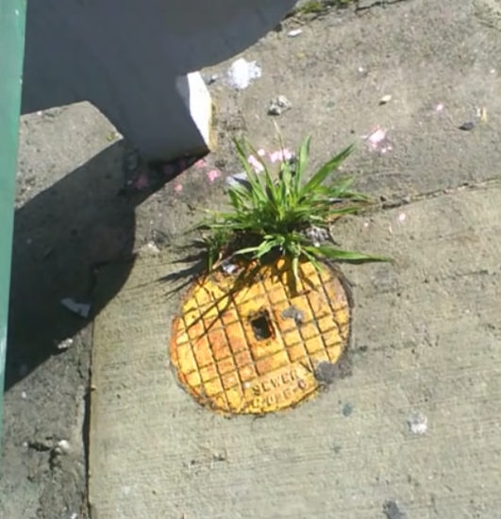

Slide 18
The long and winding road to O&M
INSPIRE
Deadline
O&M
V0.86
TWG
STA GP
SOS
STA
2013
2020
2020
2002
2016
2016
2003
SOS
O&M V1
TWG
2007
INSPIRE CAFE
2006
INSPIRE EMF
2007
2011
2009
2008
TWG
2012

