Slide 1

Revenue Forecasting

Slide 2
Problem Statement
Retailer wants to forecast sales for their product based on the sales history of each category.
Hence these sales forecasts can be used to estimate company’s success or performance in the coming year
Sales or revenues forecasting is very important for retail operations which help them to plan their budgets or investments in a period (monthly, yearly)

Slide 3
Main Tasks
Time Series Model.
Building a monthly forecasts framework of the next 12 months for each product category (3 product categories) with past sales history using time series model.

Slide 4
Task 2
Regression model
Building a monthly forecasts framework of the next 12 months for “WomenClothing” product category with other attributes

Slide 5
Data
Weather data
Temperature,
wind speed
Humidity
Visibility
Precipitation
Event/Holidays data
Year
Month-Date
Event
Day category(federal holidayor event)

Slide 6
Macro Economic Data
CPI
GDP
Cotton production,
Mill usage
Unemployment rate etc.

Slide 7
Time Series Model.
Challenges??
Missing Data
Thoughts!!
Multiple Imputation

Slide 8
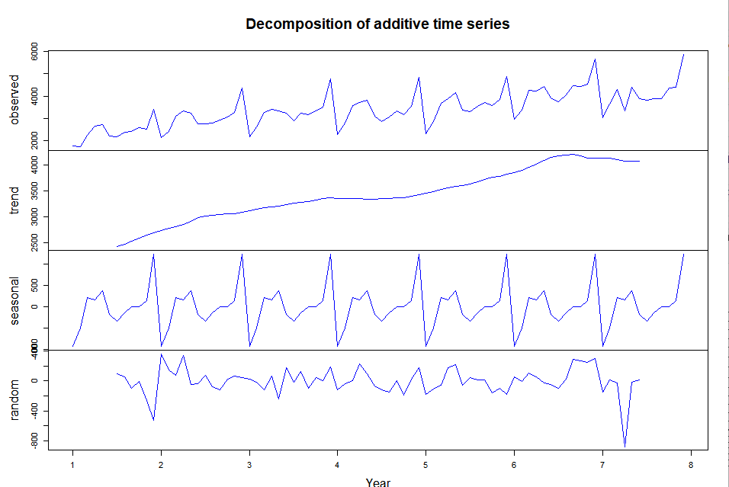
Wc Decomposed Time Series
Decompose will provide us with the info on seasonality , trend and randomness

Slide 9
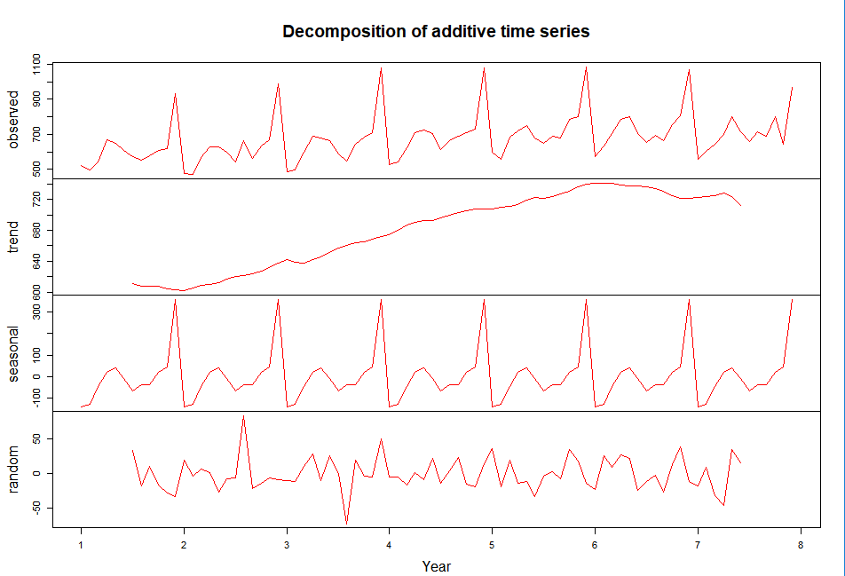
Mc Decomposed Time Series

Slide 10
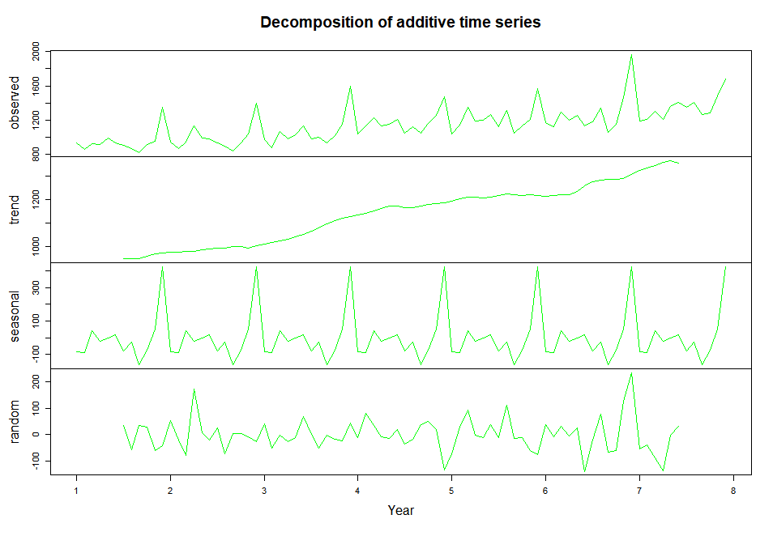
Oc Decomposed Time Series

Slide 11
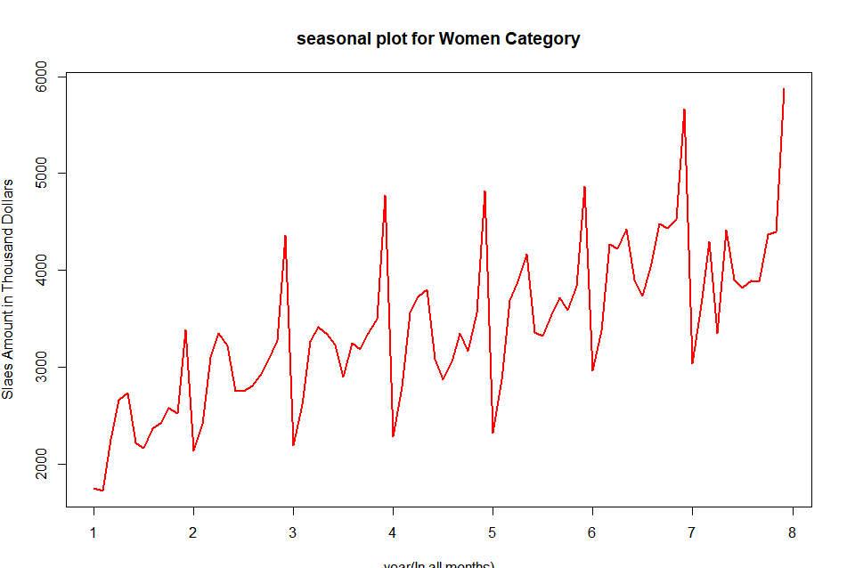

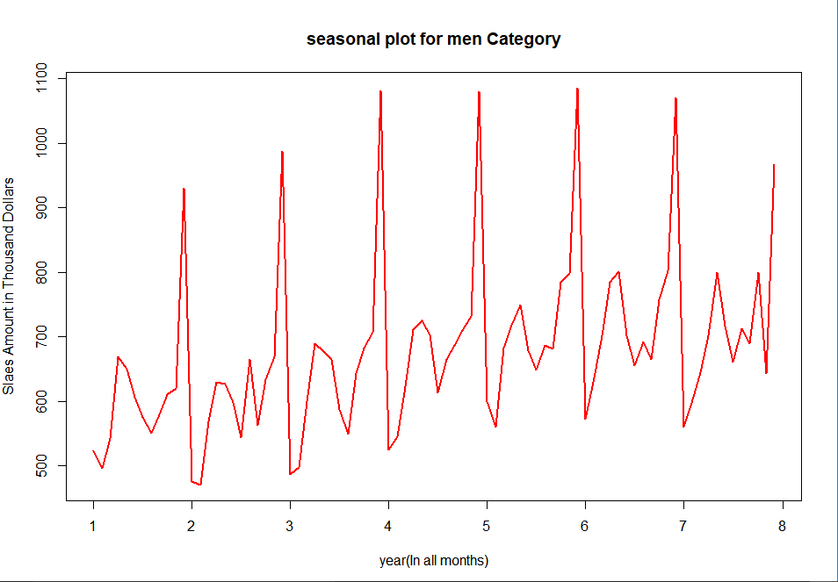

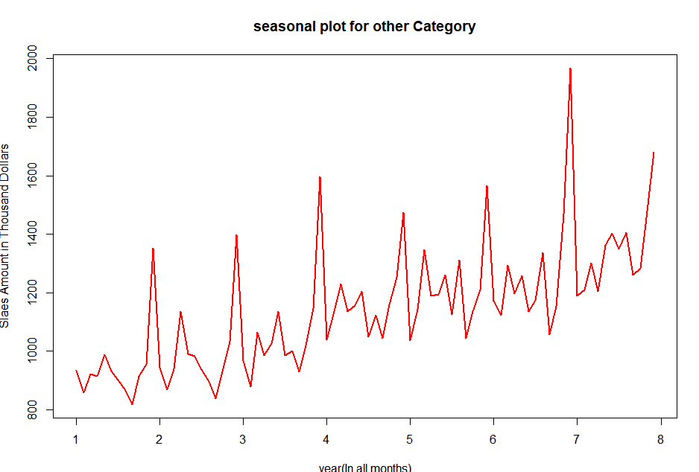

Sales Data

Slide 12
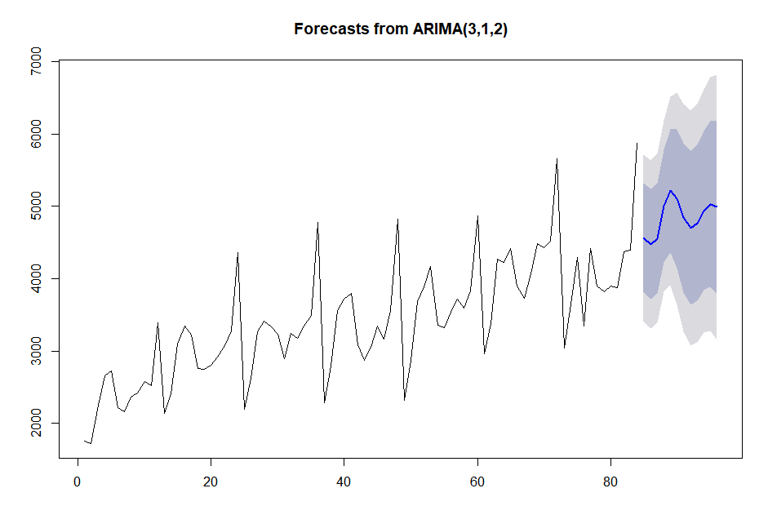
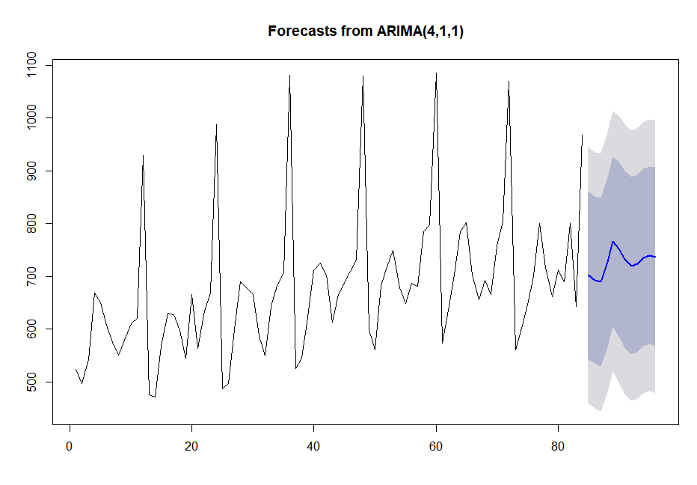
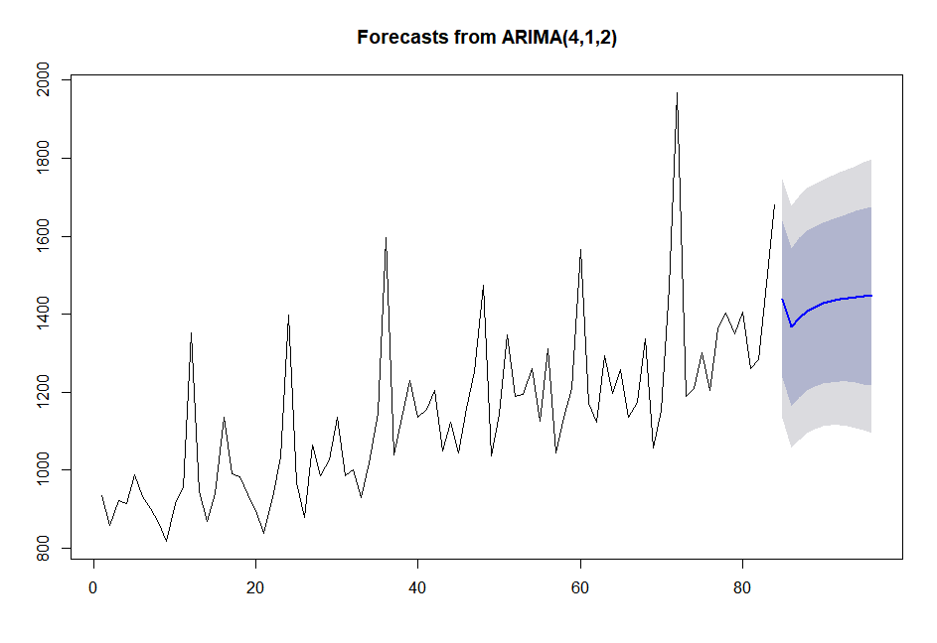
Auto Arima

Slide 13
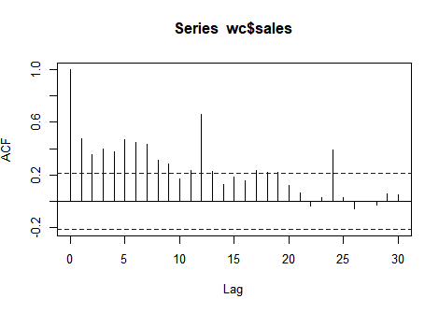
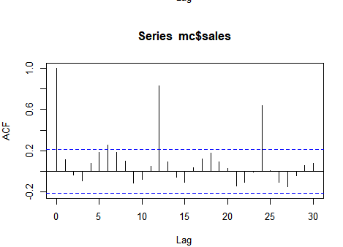
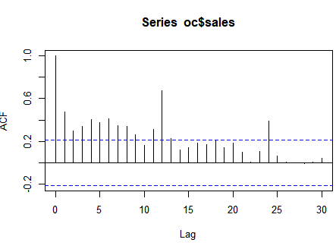
ACF

Slide 14
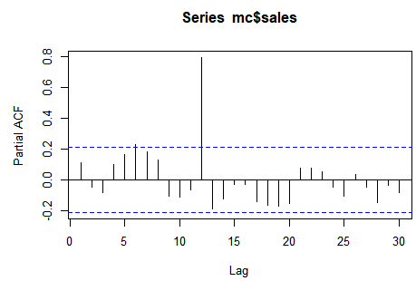
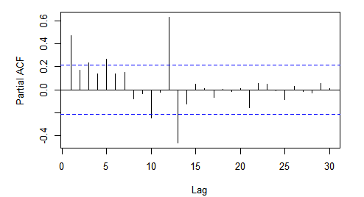
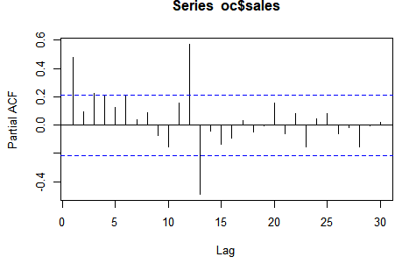
PACF

Slide 15
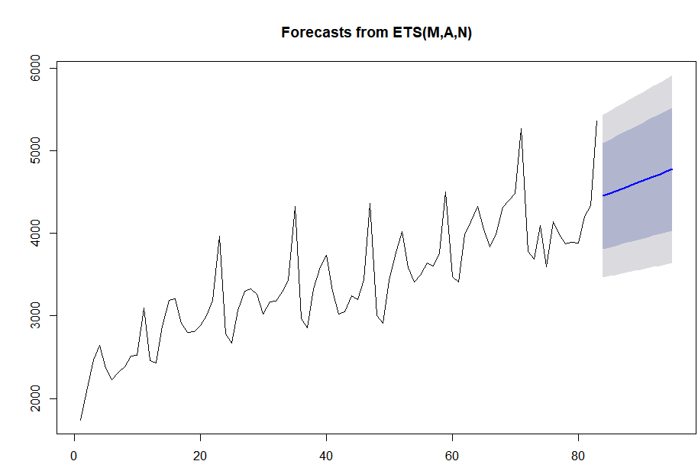
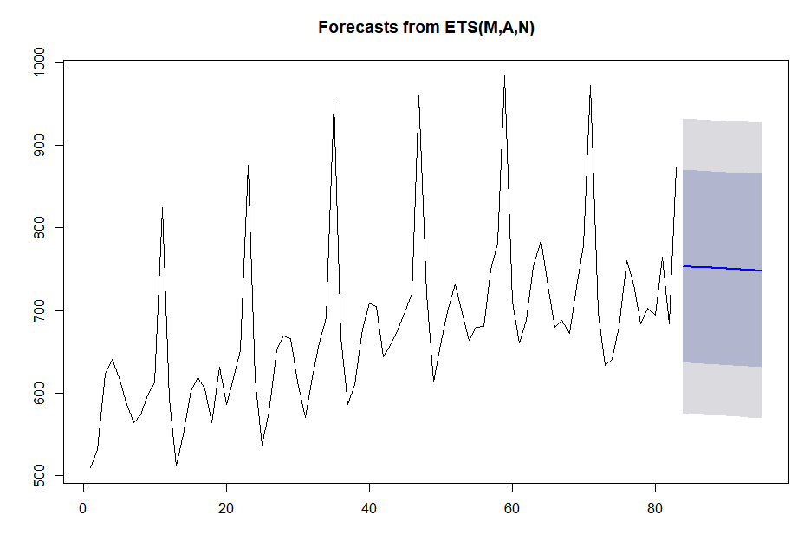
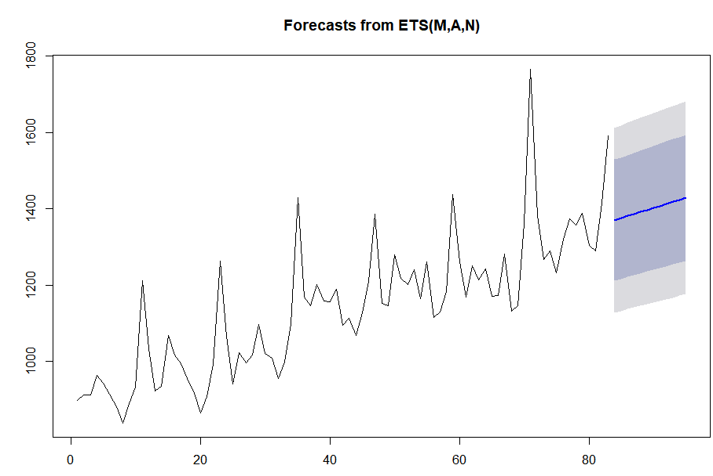
Exponential moving average on women clothing

Slide 16
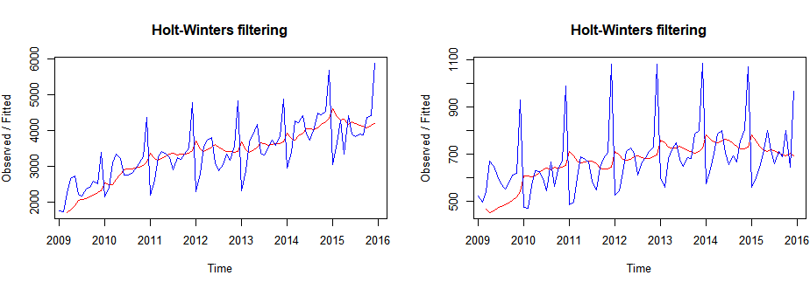
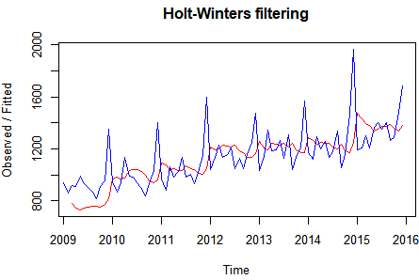
HoltWinters Model

Slide 17
Evaluation Methodology
Auto Arima MAPE:17.94018%
Exponential Moving Average MAPE:11.93397%
Holtwinter MAPE:21.06934%

Slide 18
Regression model

Slide 19
Macro Economic Data: This data is provided for the period from 2009 to 2016 with the details
like CPI, GDP, Cotton production, mill usage, unemployment rate etc.
Macro economic data is provided in month

Slide 20
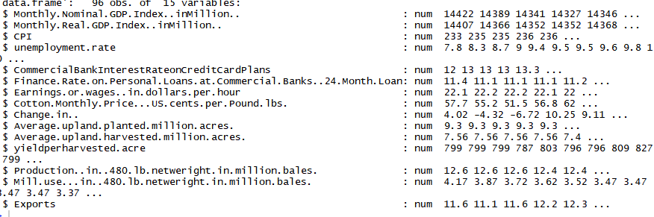
Structure of Macro Economic Data

Slide 21
Event/Holidays data: It’s obvious that we shop more during the holidays or during festivals data is provided from the period 2009 to 2016.
information like Year, Month-Date, Event, Day category(federal holiday or event)
Event/Holidays data is provided with the details of individual dates

Slide 22

Structure of Holiday Data

Slide 23
Weather data: This is obtained for the period from 2009 to 2016 from different sources and has the information about the weather conditions like temperature, wind speed, humidity, visibility, precipitation etc.
The weather data is provided day-wise

Slide 24
Challenges??
Missing Data
Thoughts!!
Central Imputation

Slide 25
Model Building

Slide 26
Model 1 – Random Forest
Why this model?
Tree based learning algorithms are considered to be one of the best and mostly used supervised learning methods.
Tree based methods empower predictive models with high accuracy, stability and ease of interpretation.
It is a type of ensemble learning method, where a group of weak models combine to form a powerful model

Slide 27
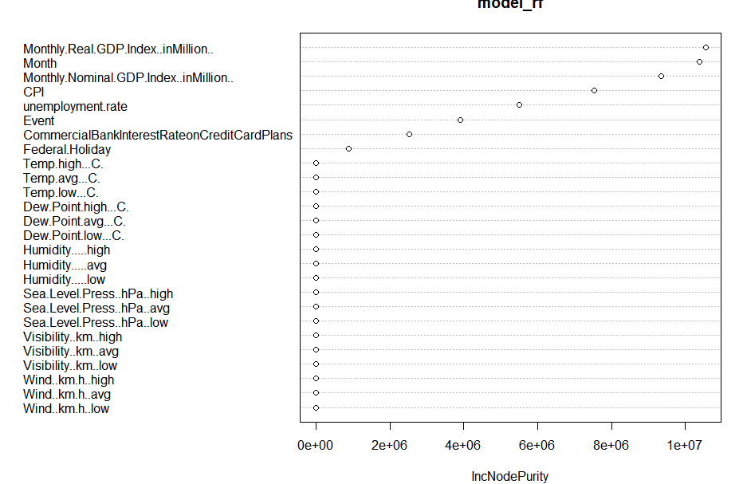
Feature selection using the variable importance plot

Slide 28
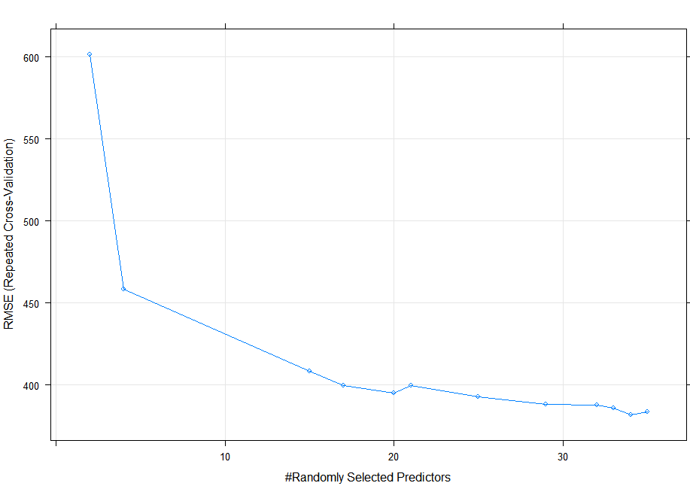
Random Forest with C.V
RMSE was used to select the optimal model using the smallest value. The final value used for the model was mtry = 34.

Slide 29
Model 2 - XGBoost
Why this model?
XGBoost is similar to gradient boosting framework but more efficient. It has both linear model solver and tree learning algorithms. So, what makes it fast is its capacity to do parallel computation on a single machine.
XGBoost only works with numeric vectors. Therefore, you need to convert all other forms of data into numeric vectors.

Slide 30
Gradient Boosting model (MAPE: 7.260587%) linear regression (MAPE:14.93414%)

Slide 31
Evaluation Methodology
Gradient Boosting model | MAPE: 7.260587%
Random Forest with C.V | MAPE 10.77889%
Random Forest | MAPE:11.95964%
linear regression | MAPE:14.93414%
XGBoost | MAPE 44.4667%

Slide 32


