Slide 1
ISO & GeoDCAT-AP metadata implementation pilot
European Commission SEMIC Group (DG DIGIT) and DG JRC, Publications Office of the European Union
& Member States
<Paloma Abad (Spain)>
2nd Meeting – November 20, 2024

Slide 2
Pilot progress Spain
Testing focus
The tests that we have carried out have been using the API
1. In the 1st transformations, we have detected errors due to XML metadata (e.g. licence).
2. We are including the HVD keywords but we have doubts about how the schema will be included in XML.
3. We are also including the compliance of the new HVD regulation.
https://geodcat-ap.semic.eu/api/
The HVD we are transforming are the datasets published in CODSI about 300 resources.

Slide 3
Pilot progress <Participant (Member State / Country)>
Progress achieved / Issues
We are working on improving the XML metadata files for transformation to geodCAT-AP
1. We are including the HVD keywords but we have doubts about how the schema will be included in XML.
2. licence unique.
3. We are also including the compliance of the new HVD regulation.

Slide 4
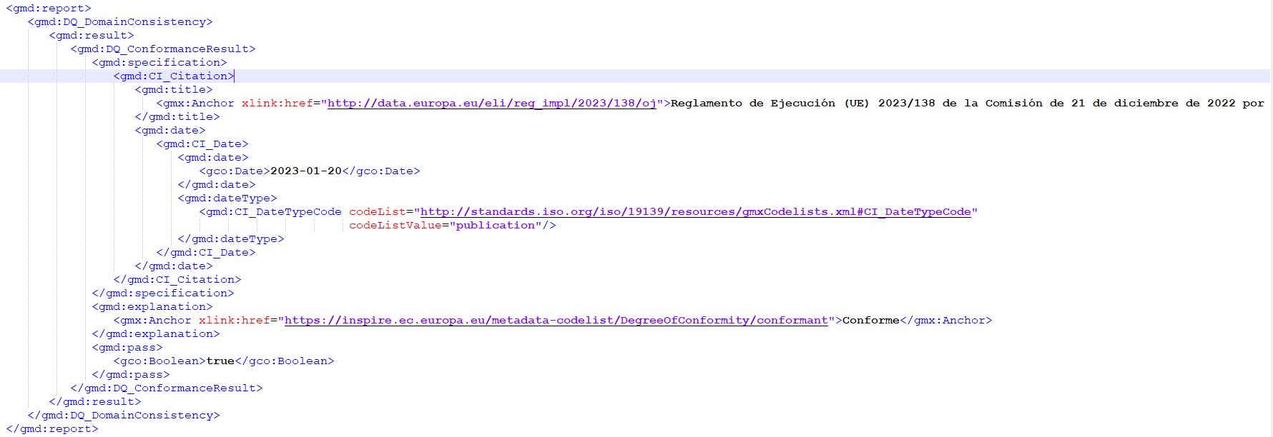
Pilot progress Spain
Example the DQ_ConformanceResult

Slide 5
Pilot progress Spain
Expectations / Proposals
For further testing, it would be useful the API with last GeoDCAT-AP XSLT transformation
https://geodcat-ap.semic.eu/api/
Do you have a manual (tutorial) to install XSLT on GeoNetwork?

