Slide 1
Overview Pilot status and ongoing activities
European Commission SEMIC Group (DG DIGIT) and DG JRC, Publications Office of the European Union
& Member States
Joint Research Centre (JRC)
4th Meeting – April 28, 2025

Slide 2

Overview 4th Meeting - Meeting objectives
Agenda
Overview – Pilot status and ongoing activities (JRC) - 15 min.
Pilot final report (1st working draft)
HVD (geospatial) tagging good practice candidate – Voting results (JRC)
Harvesting in data.europa.eu – How does it work? (OP / con terra) - 15 min.
Pilot issues - 65 min.
Summary (JRC)
Discussion (selected issues) (All)
Pilot way forward (All) - 15 min.
Brainstorming
DCAT-AP schema plugin for GeoNetwork – Updates (BE Flanders) - 5 min.
AoB (All) - 5 min.
https://github.com/INSPIRE-MIF/GeoDCAT-AP-pilot/tree/main/meetings/2025-04-28

Slide 3

Overview Timeline
ISO & GeoDCAT-AP Metadata Implementation Pilot
Work is progressing.
Main result: HVD (geospatial) tagging good practice candidate.
Discussion on GitHub issues ongoing.
Pilot Final report: 1st working draft available.
Final Report
Outputs to GeoDCAT-AP
Kick-off
Working Group Testing
Feedback &
Results
Discussion &
Results consolidation
Oct. 2024
Oct. 2024 – Jan. 2025
End Jan. 2025
Feb. – May. 2025
Jun. 2025
Kick-off Meeting
2 Oct.
Second Meeting
20 Nov.
Third Meeting
23 Jan.
Fourth Meeting
28 Apr.

Slide 4
Overview Past Meeting
Third Meeting minutes
Available at:
https://github.com/INSPIRE-MIF/GeoDCAT-AP-pilot/tree/main/meetings/2025-01-23

Slide 5
Overview Pilot final report
Based on participants’ progress reports shared in the 2nd & 3rd Meetings
1st working draft
Structure
Abstract
Acknowledgements
Executive summary
1 Introduction and purpose
1.1 GeoDCAT-AP 3.0.0
1.2 ISO & GeoDCAT-AP Metadata Implementation Pilot
2 Pilot description
2.1 Objectives
2.2 Pilot participants
2.3 Outputs and Results
2.4 Expected benefits
2.5 Timeline
2.6 Pilot repository
3 Background, initial expectations and proposals
3.X <Each participant>
3.X.1 Testing focus
3.X.2 Preliminary work and experience
3.X.3 Initial expectations and proposals
4 Pilot results
4.X <Each participant>
4.X.1 Summary of results
4.X.2 Issues identified
4.X.3 Conclusions
5 High-Value (geospatial) dataset tagging good practice
6 Conclusions
List of abbreviations and definitions
List of figures and tables
Annexes

Slide 6
Overview Pilot final report
1st working draft
Almost ready – Integrating participants contributions from past meetings.
Plan
First working draft to be shared by 30 April 2025.
Additional contributions by participants by 21 May 2025.
Refining: Initial expectations and proposals
Completion of results: GitHub issues / Conclusions
5th Pilot Meeting – Week from 26 to 30 May 2025.
GitHub issues discussion.
Final report.
https://github.com/INSPIRE-MIF/GeoDCAT-AP-pilot/tree/main/final-report

Slide 7
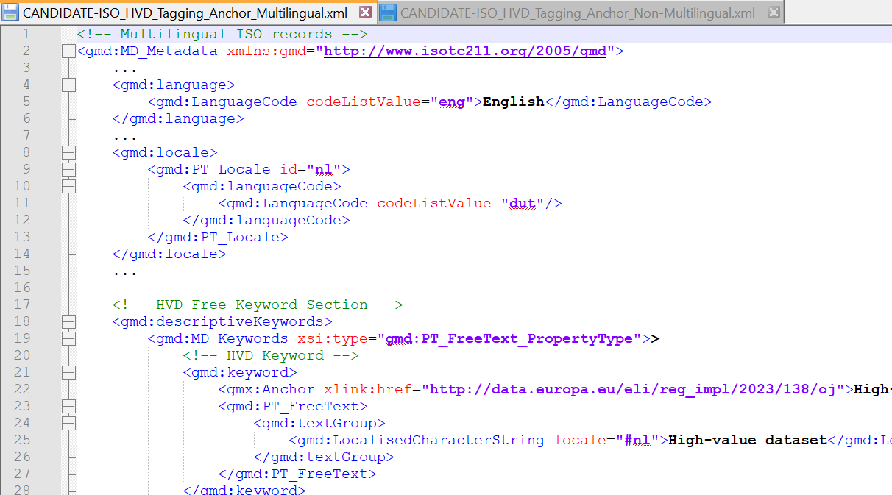
Overview HVD (geospatial) tagging good practice
Candidate good practice
Available at:
ISO Multilingual
& Non-multilingual
options
https://github.com/INSPIRE-MIF/GeoDCAT-AP-pilot/tree/main/good-practices/hvd-tagging
https://github.com/INSPIRE-MIF/GeoDCAT-AP-pilot/blob/main/good-practices/hvd-tagging/CANDIDATE-ISO_HVD_Tagging_Anchor_Non-Multilingual-clarification.xml
https://github.com/INSPIRE-MIF/GeoDCAT-AP-pilot/blob/main/good-practices/hvd-tagging/CANDIDATE-ISO_HVD_Tagging_Anchor_Multilingual-clarification.xml

Slide 8
Overview HVD (geospatial) tagging good practice
Candidate good practice status
Voting results for potential endorsement by INSPIRE MIG-T.
Initiated on 19 Dec. 2024.
Closed on 28 Feb. 2025.
19 Member States / countries voted:
BE, HR, CY, CZ, DE, DK, EE, FI, HU, IE, IS, IT, LU, NL, NO, RO, SE, SK, ES.
Initially received:
17 positive votes / 1 vote against endorsement./ 1 Abstain
After conciliation meetings (April 2025):
19 positive votes received so far.
ISO Multilingual
& Non-multilingual
options
Potential endorsement in the 82nd INSPIRE MIG-T Meeting

