Slide 1
ISO & GeoDCAT-AP metadata implementation pilot
European Commission SEMIC Group (DG DIGIT) and DG JRC, Publications Office of the European Union
& Member States
Lars Storgaard, Agency for Climate Data, DK
2nd Meeting – November 20, 2024

Slide 2
Pilot progress Lars Storgaard, Agency for Climate Data, DK
Testing focus
Tested metadata from national spatial data catalogue, geodata-info.dk.
I have tested the transformation: iso-19139-to-dcat-ap.xsl
Limited number of metadata tested so far. I have tested metadata for DK INSPIRE Address.
Metadata is stored in geodata-info as ISO19115-3 metadata and transformed to ISO19139 before transformed to DCAT-AP.

Slide 3
Pilot progress Lars Storgaard, Agency for Climate Data, DK
Progress achieved / Issues
After transformation I manually compared source (ISO19139) and output (DCAT-AP) metadata.
I used SAXON to execute the transformation, see next slide.
I have identified these issues
INSPIRE/HVD-tagging on legislation level and on theme and category level
gmd:abstract -> dcat:description but gmd:purpose - > N/A? dcat:description?
Declaration of conformity -> dcat:conformsTo and prov:Activity?
All formats (gmd:distributionFormat) is listed in each dcat:Distribution

Slide 4
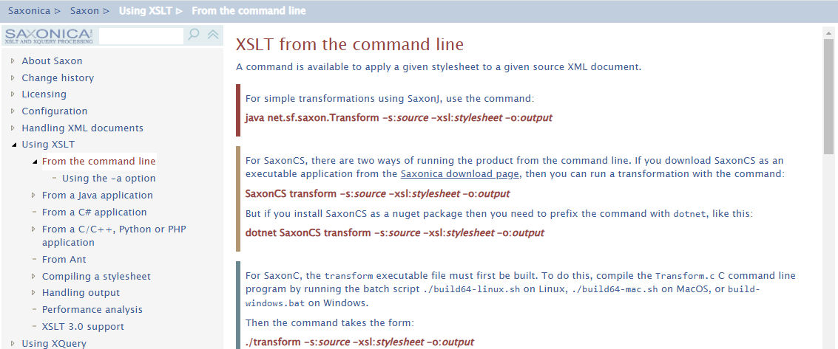
Pilot progress Lars Storgaard, Agency for Climate Data, DK
Method to run the XSLT transformation
https://github.com/Saxonica/Saxon-HE/releases/tag/SaxonHE12-5
3 parameters:
-s: source
-xsl: stylesheet
-o: output
Input: ISO1939 metadata.xml
XLST: iso-19139-to-dcat-ap-xsk
Output-file

Slide 5
Pilot progress Lars Storgaard, Agency for Climate Data, DK
Expectations / Proposals
Expectation: Metadata can fulfill reporting obligation to both INSPIRE and HVD.
Proposals:
gmd:purpose - > dcat:description
Agreed way to tagged metadata as HVD on legislation and category level – proposal in https://github.com/INSPIRE-MIF/hvd-inspire/issues/3
Focus on how to indicate the format(s) supported by the distribution

