Slide 1
ISO & GeoDCAT-AP metadata implementation pilot
European Commission SEMIC Group (DG DIGIT) and DG JRC, Publications Office of the European Union
& Member States
con terra for data.europa.eu
2nd Meeting – November 20, 2024

Slide 2
Pilot progress con terra for data.europa.eu
Testing focus
data.europa.eu harvests geocatalogues via a component called “geoharvester”
It currently maps ISO 19139 to GeoDCAT-AP 2
We will update to GeoDCAT-AP 3
We will implement the changes apparent in the XSLT ^{[1]}
The new version will not be available on data.europa.eu immediately (we need to coordinate with other partners)
Testing: Look at GeoDCAT-AP metadata harvested from selected geocatalogues
[1] https://github.com/semiceu/iso-19139-to-dcat-ap/
Notes:
We currently harvest 42 geocatalogues
Testing focus
Briefly contextualise the situation in your Member State / Country… (e.g. catalogues designated for reporting HVDs, DCAT version used by the National open data catalogue, etc.)
Identify the scope you selected for your testing activities (e.g. GeoDCAT-AP Specification and/or XSLT Transformation)…
Enumerate the typologies and volume / amount of ISO metadata selected for your tests, tools available for this purpose, etc...

Slide 3

Harvesting for data.europa.eu
Open Data Catalogue
Update to GeoDCAT 3.0
DCAT-AP
Harvesting
DCAT-AP
Geocatalogue
GeoDCAT-AP
CSW
Geoharvesting
ISO 19139
Requests metadata
Translates ISO 19139 to GeoDCAT-AP
Notes:
We are harvesting the geocatalogues of Italy, Danmark, Netherlands, 3 regional geocatalogues from Spain, Slovakia
Belgium, Finland – Open Data Catalogues (which include the metadata from the geoportals)
Harvesting of metadata via CSW endpoints (well established standard by the OGC, also used for INSPIRE Discovery Services)
dataset and service metadata (ISO 19139 – standard for geo-spatial metadata, also used by INSPIRE)
Mapping ISO 19139 to GeoDCAT-AP

Slide 4
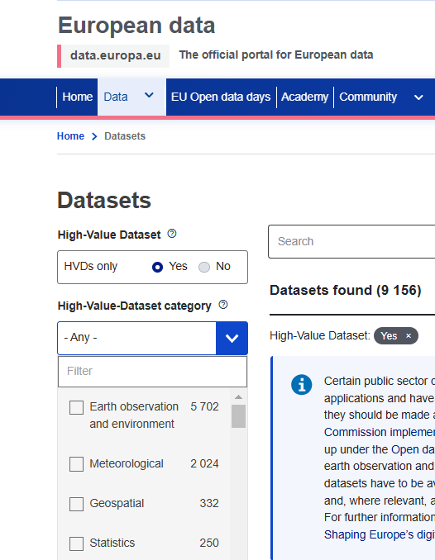
Pilot progress con terra for data.europa.eu
Progress achieved / Issues
Plan to implement in January 2025
The geoharvester has its own XSLT which we will align to GeoDCAT-AP 3
Derive information on HVD?
We will not assume that all INSPIRE metadata of certain categories are also HVD
applicableLegislation → INSPIRE could be derived (to be decided), no Open Data Directive
dct-ap:hvdCategory → to de decided
Notes:
Christian from Denmark talked about their concern to have false positives
Goal of this slide:
Briefly describe the analysis performed…
Explain how you plan to execute, or already executed, the XSLT transformation…
Any good practices to be highlighted (e.g. specific tagging of HVDs), results or findings identified until the date…
Preliminary issues encountered…

Slide 5
Pilot progress con terra for data.europa.eu
Expectations / Proposals
First version on geoharvester aligned to GeoDCAT-AP 3
We hope for quick resolutions should issues arise
We can provide transformed metadata in GeoDCAT-AP 3 (XML) to interested partners for testing

