Slide 1
Specific bits: Good practices ISO & GeoDCAT-AP metadata implementation pilot
European Commission SEMIC Group (DG DIGIT) and DG JRC, Publications Office of the European Union
& Member States
Joint Research Centre (JRC)
2nd Meeting – November 20, 2024

Slide 2

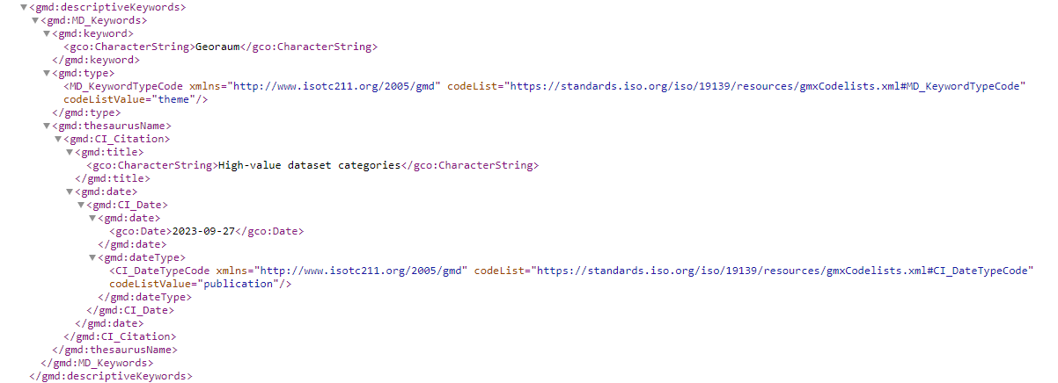
Good practices (candidates) Tagging HVDs in geospatial ISO metadata
German Good practice – See https://github.com/INSPIRE-MIF/hvd-inspire/issues/3
North Rhine-Westphalia - Use of the ‘gco:CharacterString’ encoding to tag HVD category.
Examples:
Geospatial: Link to metadata
Mobility: Link to metadata
Earth Observation and Environment: Link to metadata

Slide 3
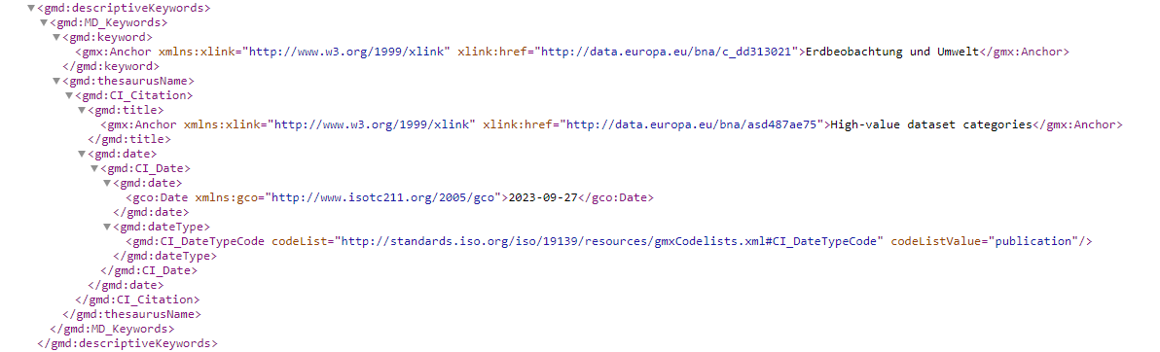
Good practices (candidates) Tagging HVDs in geospatial ISO metadata
German Good practice – See https://github.com/INSPIRE-MIF/hvd-inspire/issues/3
Federal level - Use of the ‘gmx:Anchor’ encoding to tag HVD category.
Example: Geospatial: Link to metadata
Both types of examples have already been successfully transformed to DCAT-AP and are available as HVD in the national Open Data Portal: e.g.
Example: https://www.govdata.de/suche/daten/meeresregionen1f4c9

Slide 4
Good practices (candidates) Tagging HVDs in geospatial ISO metadata
Danish Good practice
INSPIRE Addresses – See https://github.com/INSPIRE-MIF/hvd-inspire/issues/3
Example: Link to metadata - ISO19139 output: Link to output
Tagged as INSPIRE and HVD using anchors with links to legislations:
<gmd:keyword>
<gmx:Anchor xlink:href="https://eur-lex.europa.eu/eli/dir/2007/2/2019-06-26">INSPIRE</gmx:Anchor>
</gmd:keyword>
<gmd:keyword>
<gmx:Anchor xlink:href="https://eur-lex.europa.eu/eli/reg_impl/2023/138/oj">Høj-værdi datasæt</gmx:Anchor>
</gmd:keyword>
Also tagged with relevant HVD-category:
<gmd:keyword>
<gmx:Anchor xlink:href="http://data.europa.eu/bna/c_ac64a52d">Geospatiale data</gmx:Anchor>
</gmd:keyword>
From this thesaurus:
<gmd:thesaurusName>
<gmd:CI_Citation>
<gmd:title>
<gmx:Anchor xlink:href="http://data.europa.eu/bna/asd487ae75">High-value dataset categories</gmx:Anchor>
</gmd:title>
…
</gmd:thesaurusName>

Slide 5
Good practices (candidates) Tagging HVDs in geospatial ISO metadata
Danish Good practice
INSPIRE Addresses – See https://github.com/INSPIRE-MIF/hvd-inspire/issues/3
Example: Link to metadata - ISO19115-3 output: Link to output
Tagged as INSPIRE and HVD using anchors with links to legislations:
<mri:keyword>
<gcx:Anchor xlink:href="https://eur-lex.europa.eu/eli/dir/2007/2/2019-06-26">INSPIRE</gcx:Anchor>
</mri:keyword>
<mri:keyword>
<gcx:Anchor xlink:href="https://eur-lex.europa.eu/eli/reg_impl/2023/138/oj">Høj-værdi datasæt</gcx:Anchor>
</mri:keyword>
Also tagged with relevant HVD-category:
<mri:keyword>
<gcx:Anchor xlink:href="http://data.europa.eu/bna/c_ac64a52d">Geospatiale data</gcx:Anchor>
</mri:keyword>
From this thesaurus:
<mri:thesaurusName>
<cit:CI_Citation>
<cit:title>
<gcx:Anchor xlink:href="http://data.europa.eu/bna/asd487ae75">High-value dataset categories</gcx:Anchor>
</cit:title>
…
</mri:thesaurusName>

