Slide 1
Overview Pilot status and ongoing activities
European Commission SEMIC Group (DG DIGIT) and DG JRC, Publications Office of the European Union
& Member States
Joint Research Centre (JRC)
5th Meeting – June 3, 2025

Slide 2

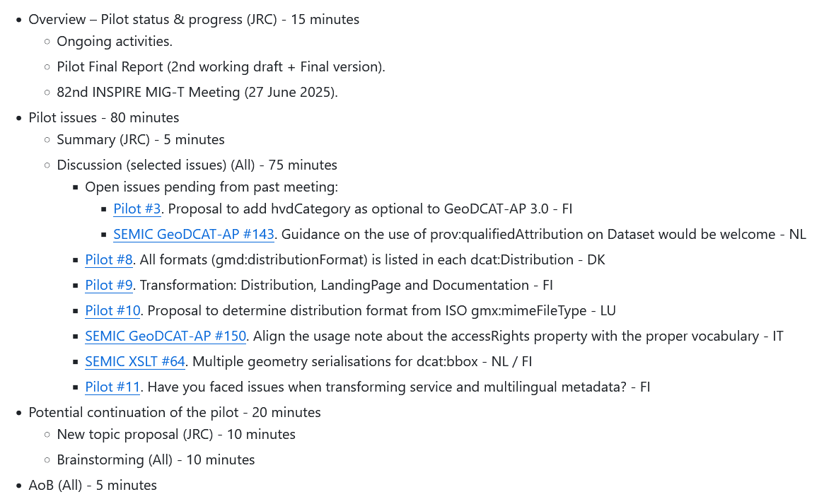
Overview 5th Meeting - Meeting objectives
Agenda
https://github.com/INSPIRE-MIF/GeoDCAT-AP-pilot/blob/main/meetings/2025-06-03/

Slide 3
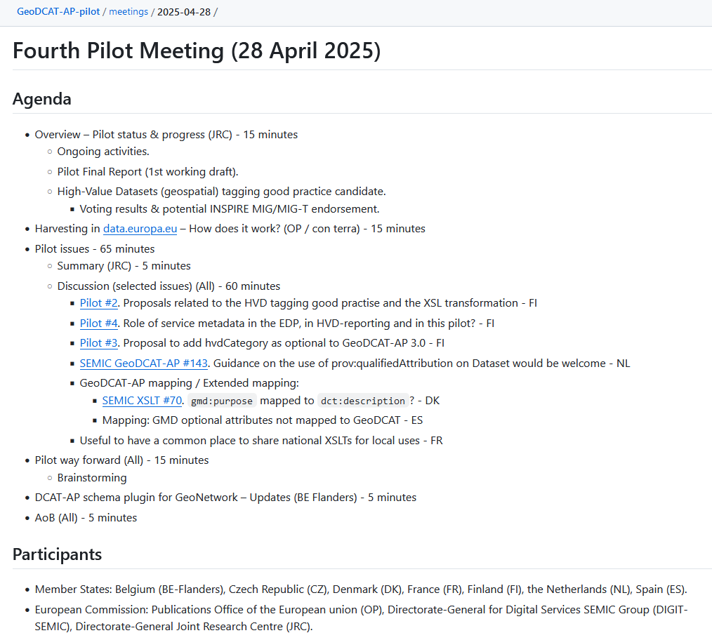
Overview Past Meeting
Fourth Meeting minutes
Available at:
https://github.com/INSPIRE-MIF/GeoDCAT-AP-pilot/tree/main/meetings/2025-04-28

Slide 4
Overview Pilot final report
2nd working draft
Available – Draft based on contributions from CZ, DK, FI, NL and the OP.
Check on missing contributions.
Plan
Work in a third (hopefully final) draft by 17 June 2025.
Final Conclusions. But also: Abstract, Executive summary, References.
Call for volunteers.
Presentation at the 6th Pilot Meeting – Week from 22 to 26 June 2025.
https://github.com/INSPIRE-MIF/GeoDCAT-AP-pilot/blob/main/final-report/ISO%26GeoDCAT-AP_Pilot_report_v2-Draft.docx

Slide 5
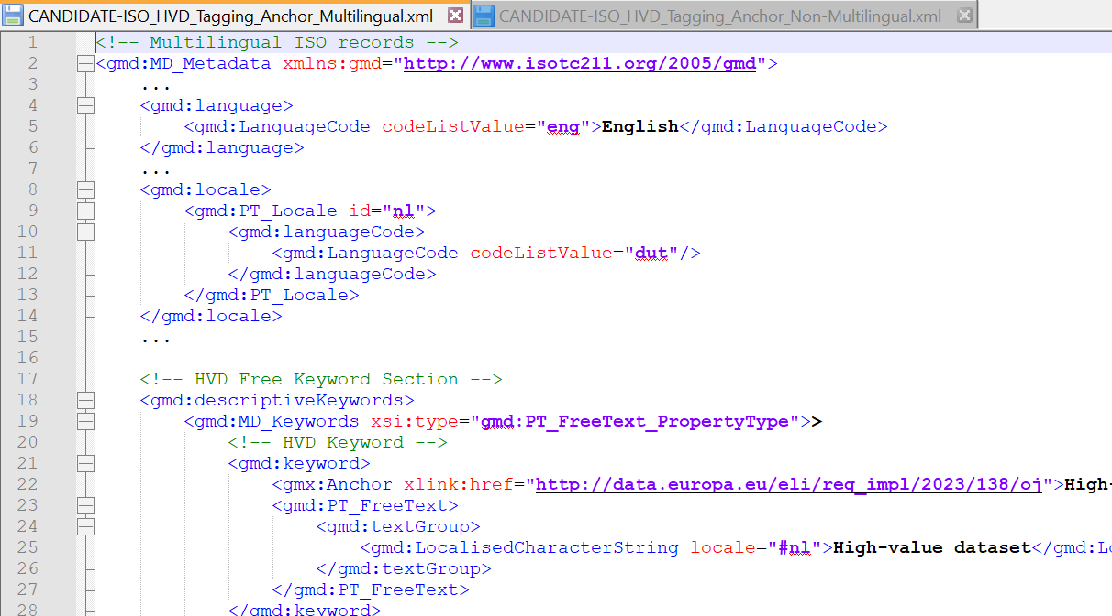
Overview HVD (geospatial) tagging good practice
Candidate good practice
Available at:
ISO Multilingual
& Non-multilingual
options
https://github.com/INSPIRE-MIF/GeoDCAT-AP-pilot/tree/main/good-practices/hvd-tagging
https://github.com/INSPIRE-MIF/GeoDCAT-AP-pilot/blob/main/good-practices/hvd-tagging/CANDIDATE-ISO_HVD_Tagging_Anchor_Non-Multilingual-clarification.xml
https://github.com/INSPIRE-MIF/GeoDCAT-AP-pilot/blob/main/good-practices/hvd-tagging/CANDIDATE-ISO_HVD_Tagging_Anchor_Multilingual-clarification.xml

Slide 6
Overview HVD (geospatial) tagging good practice
82th INSPIRE MIG-T Meeting
Pilot status, results and conclusions (presentation).
Candidate good practice status
Voting results for potential endorsement by INSPIRE MIG-T.
19 Member States / countries voted in favour (after conciliation meetings):
BE, HR, CY, CZ, DE, DK, EE, FI, HU, IE, IS, IT, LU, NL, NO, RO, SE, SK, ES.
ISO Multilingual
& Non-multilingual
options
Potential endorsement at the 82nd INSPIRE MIG-T Meeting

