Slide 1
Research exercise Building an AI-powered metadata editor for geospatial data
5th Meeting ISO & GeoDCAT-AP Metadata Implementation Pilot, 3 June 2025
Ilyas TIOUASSIOUINE, Margherita DI LEO, Jordi ESCRIU, Hagar LOWENTHAL European Commission, Joint Research Centre (JRC)
Notes:
We want through this exercise to capture possible existing issues of using AI for metadata edition in the geospatial sector and generate findings and caveats in the process.

Slide 2
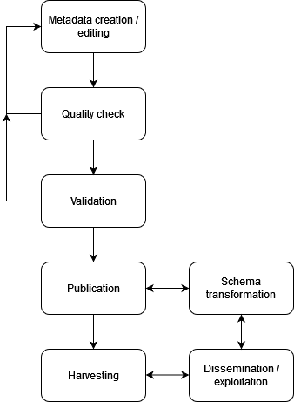
Research exercise AI-powered metadata editor
Motivation and challenges
Renewed interest for automated metadata edition
(cf. world bank metadata editor)
-> but few space for AI or NLP
Existing AI-tools for metadata edition
(cf. Ex Libris Alma in the librarian sector)
-> but few for geospatial data

Slide 3
Research exercise AI-powered metadata editor
Focus on metadata production and challenges
Metadata production
requires good knowledge and understanding of the data
is a tedious task for humans to perform
when done by humans is prone to mistake and shortcomings

Slide 4

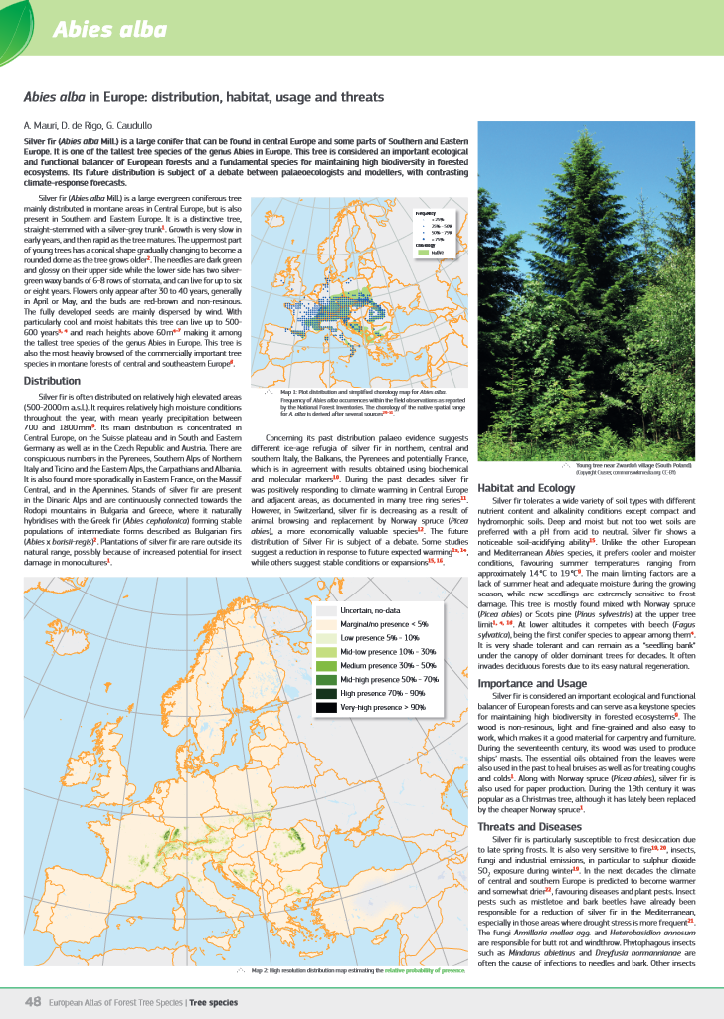

Research exercise AI-powered metadata editor
How we envision to proceed
Project started on 01/05/2025
⚙️
AI metadata editor
Metadata
Doc

Slide 5
Research exercise AI-powered metadata editor
Early lessons learned
Good generative results can be obtained with SLMs and RAG-like architecture even if the documentation is not optimal.
It is not possible to produce metadata out of only data: to produce satisfactory metadata with AI we also need “meta”-documentation.
Although GeoDCAT documentation is extensive it may lack the level of details needed for LLM-operability (cf. definition of the property description: …).

Slide 6


Thank you
Ilyas.TIOUASSIOUINE@ec.europa.eu
Margherita.DI-LEO@ext.ec.europa.eu
This presentation has been prepared for internal purposes. The information and views expressed in it do not necessarily reflect an official position of the European Commission or of the European Union.
Except otherwise noted, © European Union (year). All Rights Reserved

