Slide 1
Overview Pilot status and ongoing activities
European Commission SEMIC Group (DG DIGIT) and DG JRC, Publications Office of the European Union
& Member States
Joint Research Centre (JRC)
3rd Meeting – January 23, 2025

Slide 2

Overview 3rd Meeting - Meeting objectives
Agenda
Overview – Pilot status and ongoing activities (JRC)
High-Value Datasets tagging
Good practice candidate – Clarifications & Voting procedure (JRC)
Discussion (All)
Pilot progress (BE-Flanders, CZ, DK, FR, IT, FI, NL, ES, SK, OP, JRC)
Way forward discussion
Updated Timeline
Analysis, classification and potential integration of issues
Pilot Report Brainstorming
DCAT-AP schema plugin for GeoNetwork – Status and call for testing (BE-Flanders)
AoB (All)

Slide 3
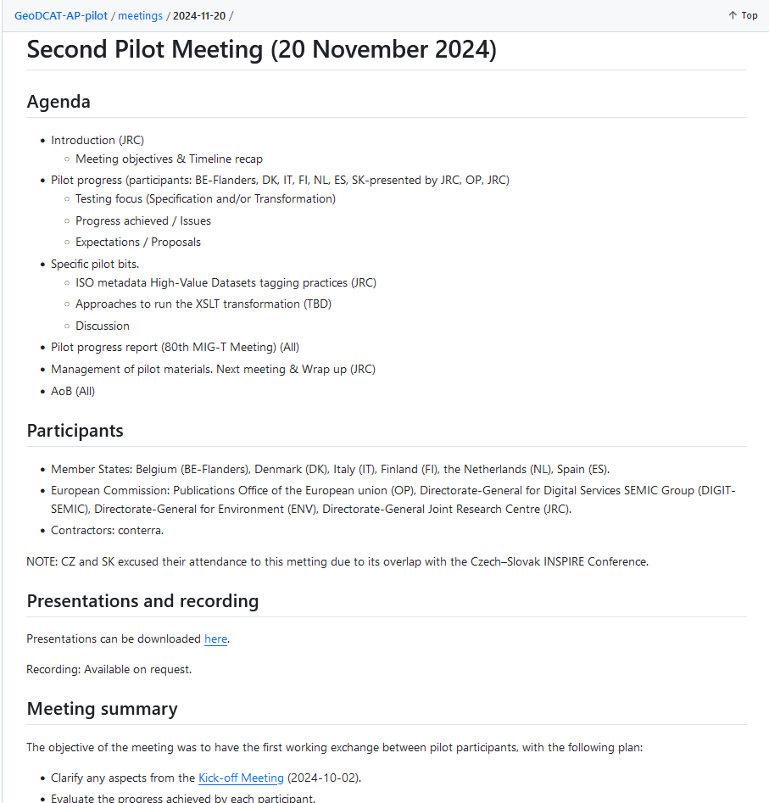
Overview 3rd Meeting - Meeting objectives
Second Meeting minutes
Available at:
https://github.com/INSPIRE-MIF/GeoDCAT-AP-pilot/tree/main/meetings/2024-11-20

Slide 4

Overview Pilot status
Initial timeline - Kick-off meeting (2024-10-02)
Work is ongoing. Participants are publishing their initial results on GitHub.
Need to collaboratively analyse the outcomes. Potential integration.
Main tangible result: HVD tagging good practice candidate.
Kick-off Meeting
Working Group Testing
Feedback & Results
GeoDCAT-AP 3 update release
2 Oct. 2024
Oct. 2024 – Jan .2025
End Jan. 2025
End Feb. 2025
From Mar. 2024
HVD tagging good practice
Final report

Slide 5
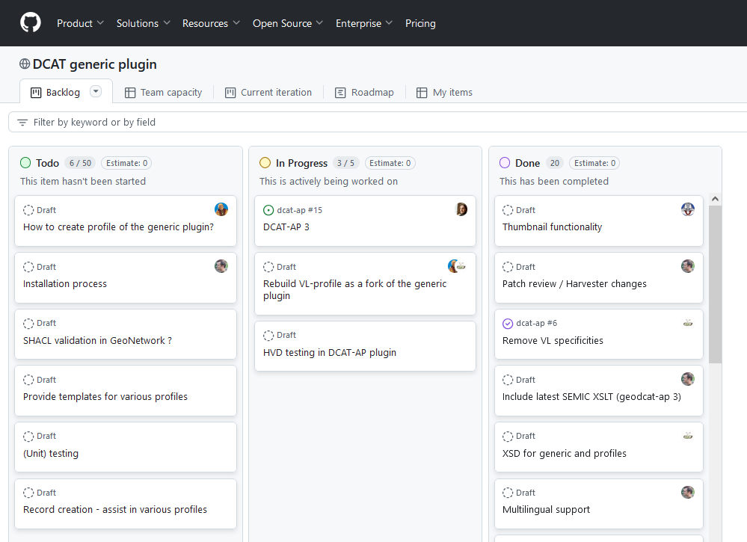
Overview Ongoing activities
Collaboration with ‘DCAT-AP schema plug-in integration in GeoNetwork’ working group
Towards common encoding and working practices
Main objectives
Agree on a good practice for tagging High-Value Datasets in geospatial ISO / INSPIRE metadata.
Integrate a DCAT-AP schema plugin in GeoNetwork.
https://github.com/orgs/metadata101/projects/2

Slide 6
Overview Ongoing activities
Collaboration with ‘DCAT-AP schema plug-in integration in GeoNetwork’ working group
Steps achieved
Sprint 3 (25-27 Nov. 2024)
1st good practice candidate proposal, ready for testing.
Sprint 4 (09-11 Dec. 2024)
Final discussions and good practice candidate agreement.
80th MIG-T (13 Dec. 2024)
Proposal shared with Member States for initiating a potential endorsement.
https://github.com/orgs/metadata101/projects/2

Slide 7
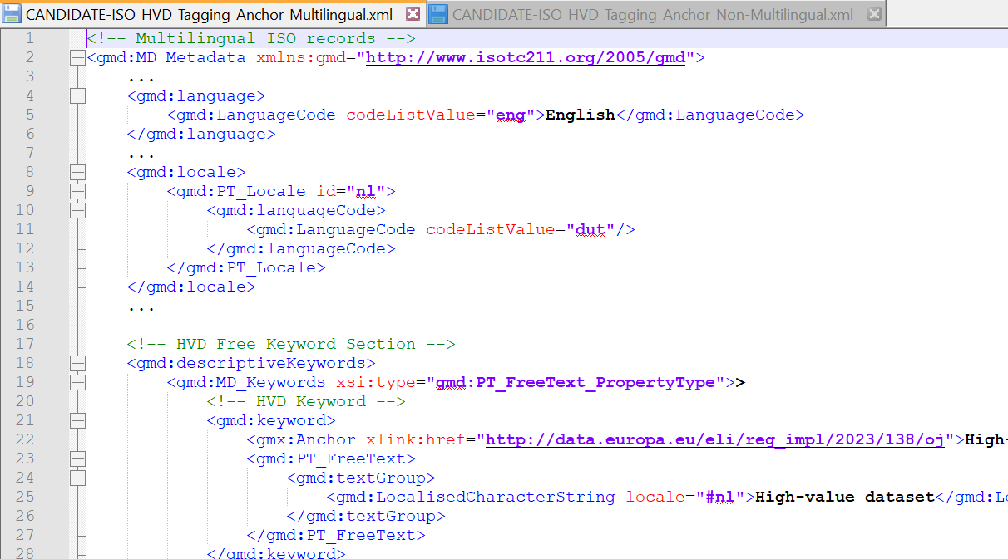
Overview Ongoing activities
Candidate good practice status
Currently under vote for potential endorsement by INSPIRE MIG-T.
Initiated on 19 Dec. 2024.
Only positive votes received so far.
7 Member States / countries voted: ES, IE, IT, RO, SK, FI, EE.
Some questions recently received from DE and NL.
Some clarifications needed on the proposal (expected for today).
Voting procedure to be extended, at least until 7 February 2025.
ISO Multilingual
& Non-multilingual
options

