Slide 1
High-Value Datasets tagging Good practice candidate – Clarifications & Voting procedure
European Commission SEMIC Group (DG DIGIT) and DG JRC, Publications Office of the European Union
& Member States
BE-Flanders
Joint Research Centre (JRC)
3rd Meeting – January 23, 2025

Slide 2

High-Value Datasets tagging Candidate good practice
25-27 Nov. & 09-11 Dec. 2024
Input examples identified
Approaches:
Keyword-based: BE-Flanders, DE, DK, NL
Data Quality report-based: ES
Encoding: mixes of ‘gmx:Anchor’ vs. ‘gco:CharacterString’
Agreed decisions
Approach:
Keyword-based (most commonly used)
Scope – Tagging of:
Referencing the High-value dataset keyword using the applicable legislation - Mandatory
Thesaurus-based keyword for HVD Category - Mandatory
Thesaurus-based keyword for HVD Sub-Category – Optional, highly recommended
Encoding: Use ‘gmx:Anchor’ encoding + Allow use of ISO multi-lingual structure

Slide 3
High-Value Datasets tagging Candidate good practice
HVD ISO Elements:
Free keyword for Identification:
Link the EU applicable legislation using the ‘High-value dataset’ (or ‘HVD’) tag
Thesaurus-Based Keyword(s) for HVD Categorization:
Category
Subcategory (optional)
Thesaurus Reference
Good practice candidate
‘DCAT-AP schema plug-in integration in GeoNetwork & Testing Pilot GeoDCAT-AP’ WG
Finally candidate agreement
Sprint 4 (09-11 Dec. 2024)
Shared for potential endorsement
80th MIG-T (13 Dec. 2024)
https://github.com/INSPIRE-MIF/GeoDCAT-AP-pilot/tree/main/good-practices/hvd-tagging
https://github.com/INSPIRE-MIF/GeoDCAT-AP-pilot/blob/main/good-practices/hvd-tagging/CANDIDATE-ISO_HVD_Tagging_Anchor_Non-Multilingual-clarification.xml
https://github.com/INSPIRE-MIF/GeoDCAT-AP-pilot/blob/main/good-practices/hvd-tagging/CANDIDATE-ISO_HVD_Tagging_Anchor_Multilingual-clarification.xml
ISO Multilingual
& Non-multilingual
options

Slide 4
High-Value Datasets tagging Candidate good practice
HVD Free Keyword
Purpose:
To classify the dataset as a High-Value Dataset (HVD) and link it to the EU applicable legislation.
Key Elements:
Keyword: Recommended use of the tag in English
<gmd:keyword> contains:
"High-value dataset“ or "HVD“
Anchor with Reference URL: Mandatory – Anchor encoding and reference to the applicable legislation (URL)
<gmx: Anchor xlink:href="http://data.europa.eu/eli/reg_impl/2023/138/oj">
Links to the EU Implementing Regulation on High-value datasets.
Benefits:
Ensures compliance with EU regulations.
Provides semantic interpretation for metadata.
NOTE:
The HVD denotation is not a keyword published in a thesaurus, it is a reference to the legislation.

Slide 5
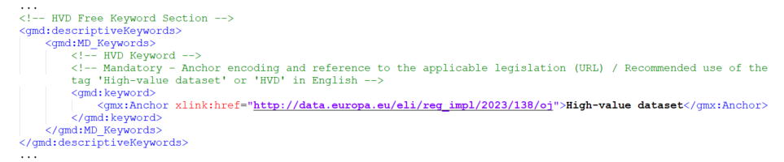
High-Value Datasets tagging Candidate good practice
HVD Free Keyword – Examples
Mandatory
Recommended
HVD

Slide 6
High-Value Datasets tagging Candidate good practice
Potential discussion
NL
HVD Thesaurus-Based Keywords – 1
Purpose:
To provide a structured classification of the dataset using a controlled vocabulary (thesaurus).
Keywords:
Mandatory Category:
<gmd:keyword> contains e.g.: Recommended use of the tag in English (even in multilingual metadata)
"Earth observation and environment"
Reference: Mandatory – Anchor encoding and the thesaurus value URL
http://data.europa.eu/bna/c_dd313021
Optional Subcategory:
<gmd:keyword> contains e.g.: Recommended use of the tag in English (even in multilingual metadata)
"Sea regions"
Reference: Mandatory – Anchor encoding and the thesaurus value URL
http://data.europa.eu/bna/c_f399050e
NOTE:
There are currently no translations of High-value dataset categories thesaurus.

Slide 7
High-Value Datasets tagging Candidate good practice
HVD Thesaurus-Based Keywords – 2
Thesaurus Reference:
<gmd:thesaurusName> provides metadata for the controlled vocabulary.
Details:
Thesaurus Title:
<gmx:Anchor>: http://data.europa.eu/bna/asd487ae75 - Mandatory – Anchor encoding and thesaurus URL
"High-value dataset categories“ - Recommended use of the tag in English
(even in multilingual metadata)
Publication Date: - Recommended date value, date type ‘publication’
<gco:Date>: 2023-09-27 - Note: the date value has been corrected
Date Type:
<gmd:CI_DateTypeCode>: publication
Benefits:
Ensures precise categorization and link to the thesaurus.
Supports semantic interoperability with EU HVD standards.
NOTE:
There are currently no translations of High-value dataset categories thesaurus.

Slide 8

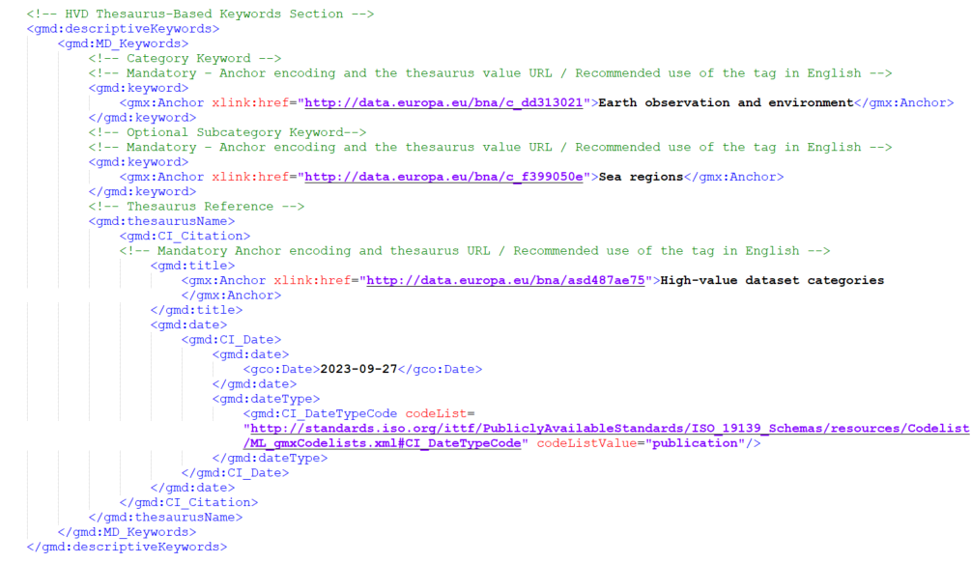
High-Value Datasets tagging Candidate good practice
HVD Thesaurus-Based Keywords – Example

Slide 9
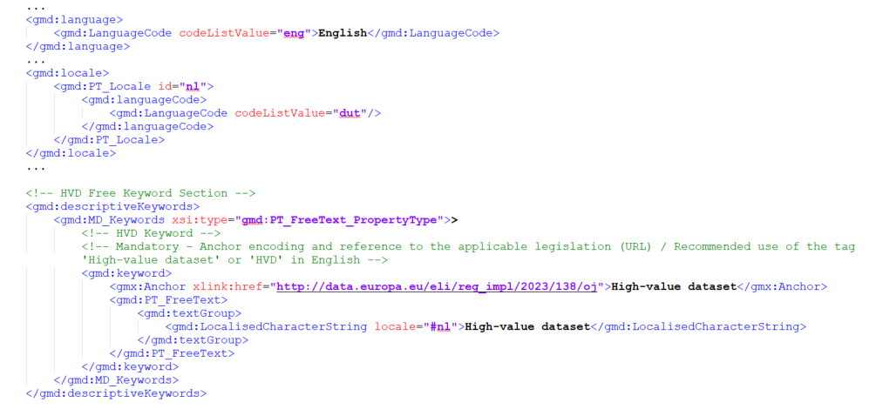
High-Value Datasets tagging Candidate good practice
HVD Free Keyword – Multilingual Example

Slide 10
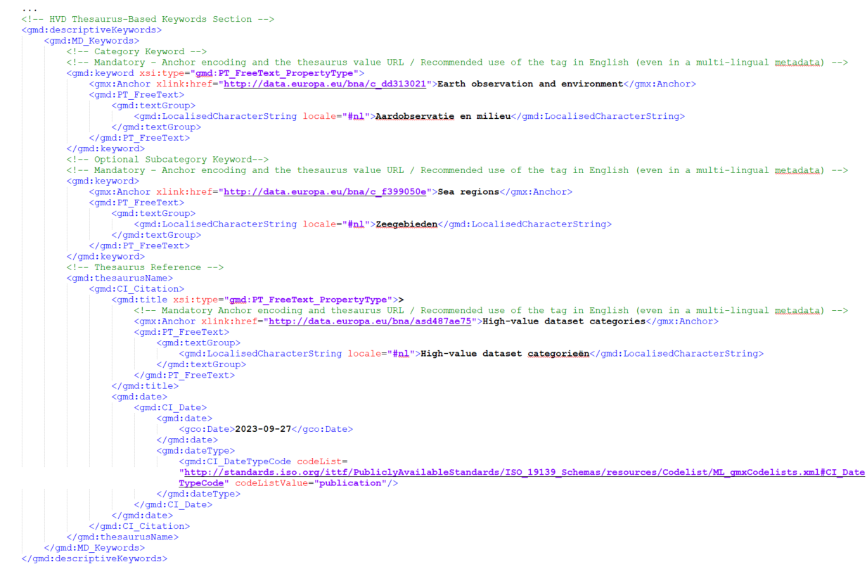
High-Value Datasets tagging Candidate good practice
HVD Thesaurus-Based Keywords –
Multilingual Example

Slide 11
High-Value Datasets tagging Candidate good practice
Voting status by INSPIRE MIG-T
Currently under vote for potential endorsement.
Initiated on 19 Dec. 2024.
Only positive votes received so far.
7 Member States / countries voted: ES, IE, IT, RO, SK, FI, EE.
Questions recently received from DE and NL, clarified.
Voting procedure
To be extended, at least until 7 February 2025.

