Slide 1
ISO & GeoDCAT-AP metadata implementation pilot
European Commission SEMIC Group (DG DIGIT) and DG JRC, Publications Office of the European Union
& Member States
Denmark
3rd Meeting – January 23, 2025

Slide 2
Pilot progress Denmark
Pilot results summary
Short term: Working towards Feb. 9th HVD deadline (datasets on Data.Europa.eu as well as qualitative reporting on progress, barriers, measures taken, etc.
Labelling of HVD datasets on the Danish geoportal has continued in line with the suggested approach (i.e. via anchored keywords)
Fundamental questions on how to proceed still remain unanswered

Slide 3
Pilot progress Denmark
Two overall approaches were considered during the pilot:
1. CSW ISO → XSLT Transformation (service + mapping) → CKAN
Problem: SEMIC API for transformation not maintained, no similar alternative identified
2. CSW DCAT (via GN 4.4.6+) → [“CSW header remover”] → CKAN
Problem: CKAN harvester not able to process/ignore csw:GetRecordsResponse element (among other things) around the RDF elements in the XML file.
Short-term solution: Manual fix
Medium-term solution: Proxy script to remove unwanted CSW wrapping
Long-term solution: Perhaps added functionality in GN 5+, different DMS for Danish portal, INSPIRE revision

Slide 4
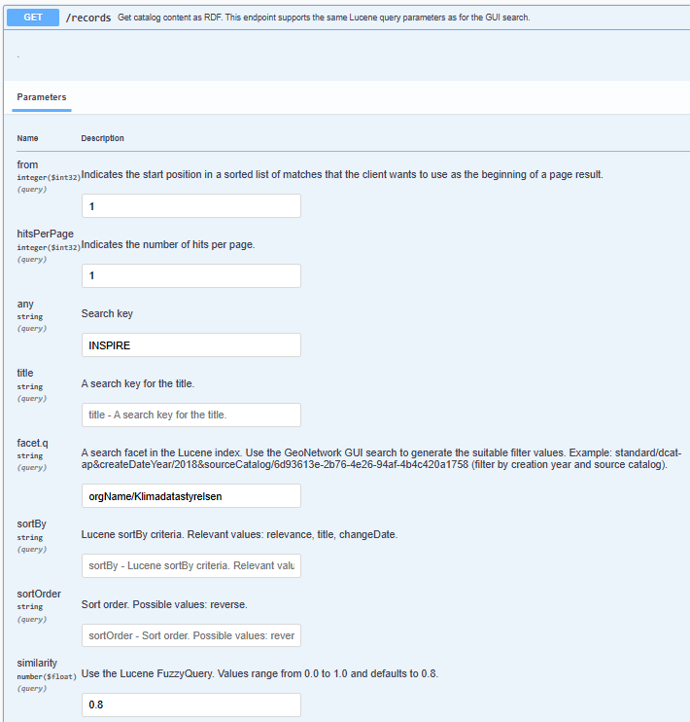
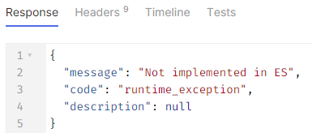
Pilot progress Denmark
A third approach that could work in the future?
Geonetwork getAsRdf (for instance https://geodata-info.dk/doc/api/index.html#/records/getAsRdf)

Slide 5
Pilot progress Denmark
Conclusions
Happy to have common ground on HVD labelling in INSPIRE metadata – remains to be worked into mapping
Need for coordination/documentation of semantic content of Geonetwork and standalone GeoDCAT-AP mapping if they diverge
Data Services remain a challenge

