Slide 1
ISO & GeoDCAT-AP metadata implementation pilot
European Commission SEMIC Group (DG DIGIT) and DG JRC, Publications Office of the European Union
& Member States
Paloma Abad (Spain)
3rd Meeting – January 23, 2025

Slide 2
Pilot progress Paloma Abad (Spain)
Pilot results summary
Official Catalogue of INSPIRE Data and Services (CODSI) has 286 HVD classified on geospatial, earth observation, environment and mobility.
We´ve included the HVD category keywords in many resources but not in all.
We´ve transformed the 286 resources via python
XSLT used https://github.com/SEMICeu/iso-19139-to-dcat-ap

Slide 3
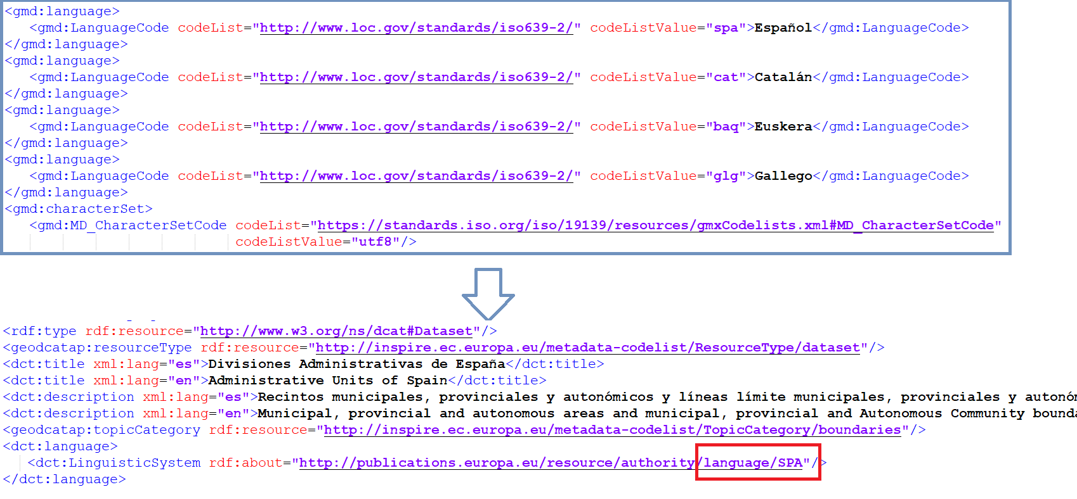
Pilot progress. Paloma Abad (Spain)
Main issues identified
Managing multiple languages #52
https://github.com/SEMICeu/iso-19139-to-dcat-ap/issues/52
If a dataset has more than one language, only the first one is kept.

Slide 4
Pilot progress. Paloma Abad (Spain)
Main issues identified
gmd:purpose to dct:description #70
https://github.com/SEMICeu/iso-19139-to-dcat-ap/issues/70
If in the ISO file there is an abstract and a purpose, in GeoDCAT the purpose is lost. In dct:description only the abstract is recognized.
Transformation: HVD Category #7
https://github.com/INSPIRE-MIF/GeoDCAT-AP-pilot/issues/7
When transforming from ISO to RDF, the INSPIRE and HVD keywords are not in the RDF file.
Add 'HVD category' and 'documentation' properties related to high-value datasets #147, https://github.com/SEMICeu/GeoDCAT-AP/issues/147

Slide 5
Pilot progress Paloma Abad (Spain)
Conclusions
Transformation to ISO metadata to GeoDCAT via python is simple
There are errors in the GeoDCAT files that I don't know if I have to correct in the ISO metadata or it is an XSLT error.
Uncertain if the February 9th deadline for submitting metadata to EDP in GeoDCAT will be delivered.
GeoDCAT-AP does not have the richness of ISO metadata. There are ISO metadata elements that are not in the Metadata Regulation, that is, they are not mandatory and disappear in GeoDCAT-AP. For example: “purpose” or “supplementalInformation”

