Slide 1
ISO & GeoDCAT-AP metadata implementation pilot
European Commission SEMIC Group (DG DIGIT) and DG JRC, Publications Office of the European Union
& Member States
Niels / Ine - NL
3rd Meeting – January 23, 2025

Slide 2
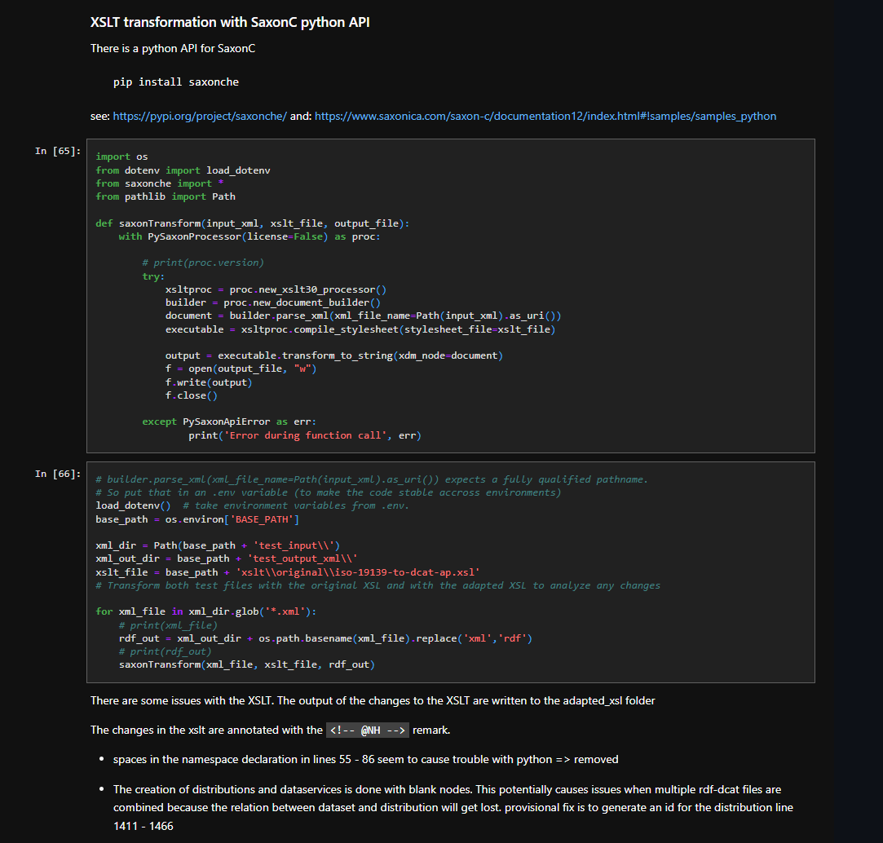
Pilot progress NL
Pilot results summary
We created a structured way of testing the XSLT and GeoDCAT-AP profile with jupyter notebook: https://github.com/Geonovum/ISO-2-DCAT/tree/main/geodcat_ap_3_xslt
We have learned a lot about how the transformation works and which solutions have been devised to unlock as much metadata as possible. We have gained insight into where the transformation is not yet working out well

Slide 3
Pilot progress – Issues XSLT NL
blank nodes for distribution, dataservice and catalogrecord:
https://github.com/SEMICeu/iso-19139-to-dcat-ap/issues/58
mapping of Distribution and DataService:
https://github.com/SEMICeu/iso-19139-to-dcat-ap/issues/59
MD_Keywords to dcat:theme transformation is incomplete:
https://github.com/SEMICeu/iso-19139-to-dcat-ap/issues/60
dcat:CatalogRecord should always have a foaf:primaryTopic:
https://github.com/SEMICeu/iso-19139-to-dcat-ap/issues/63
multiple geometry serialisations for dcat:bbox:
https://github.com/SEMICeu/iso-19139-to-dcat-ap/issues/64
clarify the statement on usage for HVD datasets:
https://github.com/SEMICeu/iso-19139-to-dcat-ap/issues/66
transformation of dct:license:
https://github.com/SEMICeu/iso-19139-to-dcat-ap/issues/68

Slide 4
Pilot progress – Issues GeoDCAT-AP / SHACL NL
misalignment between GeoDCAT-AP dct:Standard properties and XSLT transformation rules: https://github.com/SEMICeu/GeoDCAT-AP/issues/141
create the geodcat-ap shacl file as an extension to the dcat-ap shacl file:
https://github.com/SEMICeu/GeoDCAT-AP/issues/142
guidance on the use of prov:qualifiedAttribution on Dataset would be welcome: https://github.com/SEMICeu/GeoDCAT-AP/issues/143
A.7.13 Spatial resolution - text and provided example are confusing:
https://github.com/SEMICeu/GeoDCAT-AP/issues/144
conflicting namespace prefix in geodcat-ap-SHACL.ttl:
https://github.com/SEMICeu/GeoDCAT-AP/issues/145
Controlled vocabularie to be used for adms:representationTechnique:
https://github.com/SEMICeu/GeoDCAT-AP/issues/137
controlled vocabulary Theme:
https://github.com/SEMICeu/GeoDCAT-AP/issues/138
A.7.4 Resource locator - *On-line resource:
https://github.com/SEMICeu/GeoDCAT-AP/issues/139
A.7.6 Coupled resource:
https://github.com/SEMICeu/GeoDCAT-AP/issues/140

Slide 5
Pilot progress NL
Conclusions
We detected several issues in XSLT and SHACL
We expected substantive discussions about possible solutions
We expected an adjusted version of the XSLT at the end of the pilot in which improvements are included for the detected issues.
We would like clarity about where and by whom these issues are being addressed
We wonder which XSLT is used for transformation by the other member states

