Slide 1
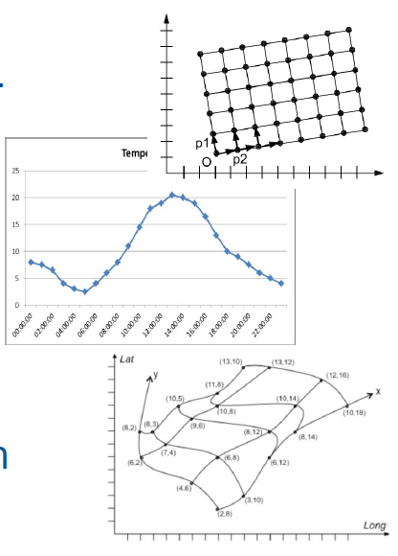

Coverages in INSPIRE

Slide 2













Use of coverages in INSPIRE 13 Data themes
EL
LC
Two different vies on coverage data:
Coverages as Features
(Provided using WCS)
Coverages as Observation Results
(Provided using SOS)
SD
GE
INSPIRE
Coverages
ER
OI
OF
SO
MF
LU
AC
NZ
EF

Slide 3




Themes using Coverages as Features (WCS)
Data models based on INSPIRE FeatureTypes coverage classes.
Regular grids:
Elevation (EL)
Land cover (LC)
Orthoimagery (OI)
Soil (SO)
Energy resources (ER).
Species distribution (SD) – App. schema deprecated.
Regular or Irregular grids:
Natural risk zones (NZ)
Geology (GE).
Data provided as coverages encoded according OGC CIS 1.0.
EL
LC
SD
GE
INSPIRE
Coverages
ER
OI
OF
SO
MF
LU
AC
NZ
EF

Slide 4
Themes using Coverages as Features (WCS)
INSPIRE Data models
(Conceptual level)
Implementation standards
(Implementation level)
D2.10.2 v1.0
INSPIRE Data specifications –
Base Models –
Coverage types
OGC 09-146r1
GML Coverage application schema
?
OGC 09-146r2
CIS 1.0
<<featureType>>
<Theme-specific coverage class 1>
…
<<featureType>>
<Theme-specific coverage class N>
INSPIRE Themes

Slide 5
Themes using Coverages as Features (WCS)
D2.10.2 v1.0
INSPIRE Data specifications –
Base Models –
Coverage types
abstract
<<featureType>>
CoverageByDomainAndRange
domainSet (any type)
rangeSet (any type)
rangeType (RecordType type)
metadata (any type)
Domain constrained to CV_Grid (*)
Regular domain
Irregular domain
<<featureType>>
RectifiedGridCoverage
Domain constrained to
CV_RectifiedGrid (*)
<<featureType>>
ReferenceableGridCoverage
Domain constrained to CV_ReferenceableGrid (*)
Regular grids
Irregular grids

Slide 6
SD
<<featureType>>
<Theme-specific coverage class>
Domain constrained to classes CV_RectifiedGrid or CV_ReferenceableGrid (*)
<<featureType>>
<Theme-specific coverage class>
Domain constrained to class
CV_RectifiedGrid (*)
NZ
ER
D2.10.2 v1.0
INSPIRE Data specifications –
Base Models –
Coverage types
abstract
<<featureType>>
CoverageByDomainAndRange
domainSet (any type)
rangeSet (any type)
rangeType (RecordType type)
metadata (any type)
Domain constrained to CV_Grid (*)
Regular domain
Irregular domain
<<featureType>>
RectifiedGridCoverage
Domain constrained to
CV_RectifiedGrid (*)
<<featureType>>
ReferenceableGridCoverage
Domain constrained to CV_ReferenceableGrid (*)
GE
EL
<<dataType>>
HydroGeologicalSurface
(to define the piezometric state of Ground Water Bodies)
surfaceRectifiedGrid (type RectifiedGridCoverage), or
surfaceReferenceableGrid (type ReferenceableGridCoverage), or
surfacePointCollection (type PointObservationCollection)
<<featureType>>
<Theme-specific coverage class>
LC
OI
SO
LU
(*) From ISO 19123:2007

Slide 7
Themes using Coverages as Observation results (SOS)
EL
LC
Data models based on ISO 19156 (O&M) observation classes.
Regular or irregular grids
Environmental monitoring facilities (EF)
Atmospheric conditions (AC)
Meteorological geographic features (MF)
Oceanographic geographic features (OF)
Geology (GE)
Data provided as discrete observation coverages, i.e. gridded data specialized observation types applying O&M.
Potentially to be provided with SOS.
SD
GE
INSPIRE
Coverages
ER
OI
OF
SO
MF
LU
AC
NZ
EF

Slide 8

Deployment of Data Sets

