Slide 1
INSPIRE Coverages
Schema Modifications for WCS

Slide 2
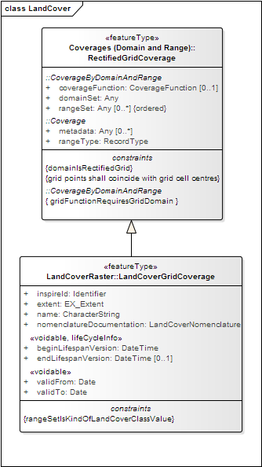
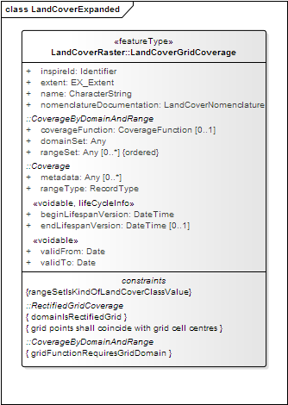
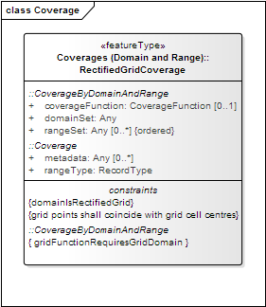

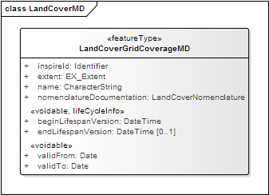
Coverage Metadata Model
Note: Metadata is a very broad concept!
The Coverage Metadata described here is NOT related to INSPIRE Metadata in accordance with ISO 19115 and provided by a Catalogue Service!

Slide 3
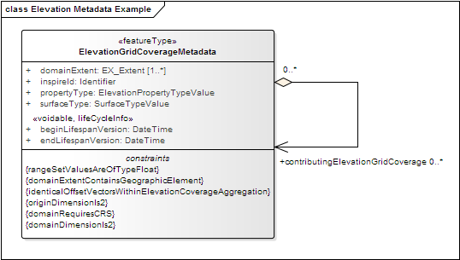
Elevation Coverage Metadata
https://schema.datacove.eu/ElevationGridCoverageMetadata.xsd

Slide 4
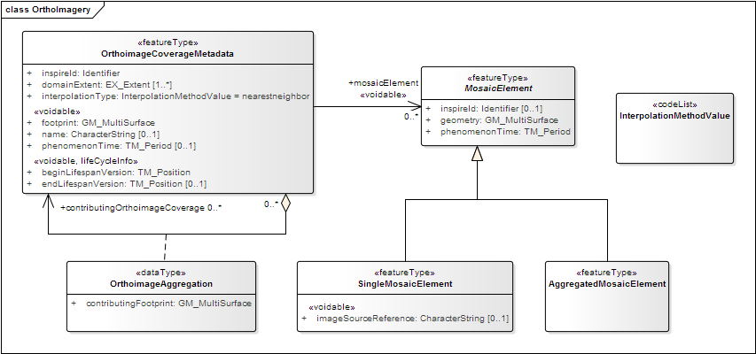
OrthoImagery Coverage Metadata
https://schema.datacove.eu/OrthoimageryMetadata.xsd

Slide 5
Land Cover Coverage Metadata
http://test.datacove.eu/LandCoverRasterMDExt.xsd

Slide 6
Schema Files
https://schema.datacove.eu/ElevationGridCoverageMetadata.xsd
https://schema.datacove.eu/OrthoimageryMetadata.xsd
http://test.datacove.eu/LandCoverRasterMDExt.xsd

Slide 7
Coverage Reality
In order to ingest coverage data into a WCS, you will need:
Your coverage data (usually a GeoTIFF, JPEG2000,…)
Your coverage metadata!
No tools yet for creation but…
Not that hard to do directly in XML Tips:
Create a basic example first
If you are doing this manually, make sure to validate!
XML editors provide a great deal of help in this process

Slide 8
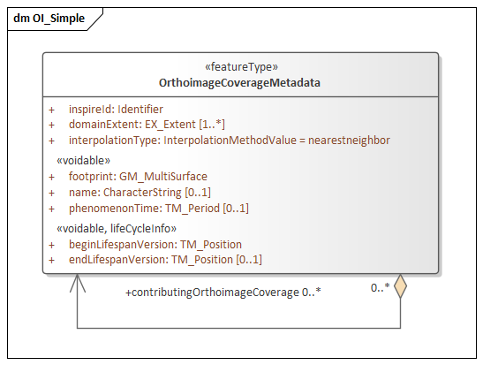
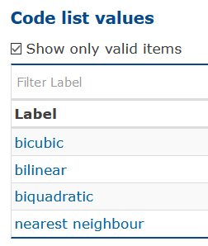
Coverage Metadata
<oi-cov:OrthoimageCoverageMetadata>
<oi-cov:inspireId>
<base:Identifier>
<base:localId>localId</base:localId>
<base:namespace>namespace</base:namespace>
</base:Identifier>
</oi-cov:inspireId>
<oi-cov:domainExtent>
<gmd:EX_Extent>
<gmd:description>
<gco:CharacterString>description</gco:CharacterString>
</gmd:description>
<gmd:geographicElement>
<gmd:EX_GeographicBoundingBox>
<gmd:westBoundLongitude>
<gco:Decimal>0</gco:Decimal>
</gmd:westBoundLongitude>
<gmd:eastBoundLongitude>
<gco:Decimal>10</gco:Decimal>
</gmd:eastBoundLongitude>
<gmd:southBoundLatitude>
<gco:Decimal>0</gco:Decimal>
</gmd:southBoundLatitude>
<gmd:northBoundLatitude>
<gco:Decimal>10</gco:Decimal>
</gmd:northBoundLatitude>
</gmd:EX_GeographicBoundingBox>
</gmd:geographicElement>
</gmd:EX_Extent>
</oi-cov:domainExtent>
<oi-cov:footprint>
<gml:MultiSurface>
<gml:surfaceMember>
<gml:Polygon>
<gml:exterior>
<gml:LinearRing>
<gml:posList>
10 0 10 10 0 10 0 0 10 0
</gml:posList>
</gml:LinearRing>
</gml:exterior>
</gml:Polygon>
</gml:surfaceMember>
</gml:MultiSurface>
</oi-cov:footprint>
<oi-cov:interpolationType xlink:href="http://inspire.ec.europa.eu/codelist/InterpolationMethodValue/XXX"/>
<oi-cov:name>name</oi-cov:name>
<oi-cov:phenomenonTime>
<gml:TimePeriod>
<gml:beginPosition>beginPosition</gml:beginPosition>
<gml:endPosition>endPosition</gml:endPosition>
</gml:TimePeriod>
</oi-cov:phenomenonTime>
<oi-cov:beginLifespanVersion>beginLifespanVersion</oi-cov:beginLifespanVersion>
</oi-cov:OrthoimageCoverageMetadata>
<oi-cov:OrthoimageCoverageMetadata>
<oi-cov:inspireId>
<base:Identifier>
<base:localId>localId</base:localId>
<base:namespace>namespace</base:namespace>
</base:Identifier>
</oi-cov:inspireId>
<oi-cov:domainExtent>
<gmd:EX_Extent>
<gmd:description>
<gco:CharacterString>description</gco:CharacterString>
</gmd:description>
<gmd:geographicElement>
<gmd:EX_GeographicBoundingBox>
<gmd:westBoundLongitude>
<gco:Decimal>0</gco:Decimal>
</gmd:westBoundLongitude>
<gmd:eastBoundLongitude>
<gco:Decimal>10</gco:Decimal>
</gmd:eastBoundLongitude>
<gmd:southBoundLatitude>
<gco:Decimal>0</gco:Decimal>
</gmd:southBoundLatitude>
<gmd:northBoundLatitude>
<gco:Decimal>10</gco:Decimal>
</gmd:northBoundLatitude>
</gmd:EX_GeographicBoundingBox>
</gmd:geographicElement>
</gmd:EX_Extent>
</oi-cov:domainExtent>
<oi-cov:footprint>
<gml:MultiSurface>
<gml:surfaceMember>
<gml:Polygon>
<gml:exterior>
<gml:LinearRing>
<gml:posList>
10 0 10 10 0 10 0 0 10 0
</gml:posList>
</gml:LinearRing>
</gml:exterior>
</gml:Polygon>
</gml:surfaceMember>
</gml:MultiSurface>
</oi-cov:footprint>
<oi-cov:interpolationType xlink:href="http://inspire.ec.europa.eu/codelist/InterpolationMethodValue/XXX"/>
<oi-cov:name>name</oi-cov:name>
<oi-cov:phenomenonTime>
<gml:TimePeriod>
<gml:beginPosition>beginPosition</gml:beginPosition>
<gml:endPosition>endPosition</gml:endPosition>
</gml:TimePeriod>
</oi-cov:phenomenonTime>
<oi-cov:beginLifespanVersion>beginLifespanVersion</oi-cov:beginLifespanVersion>
</oi-cov:OrthoimageCoverageMetadata>
Attribute | Value
inspireId::localId | ortoimatge-satellit-sentinel-2-mensual-v1r0-desembre-2020-sen2irc8bf04.tif
inspireId::namespace | catalunya
domainExtent::description | Mosaic of the territory of Catalonia covered by raster file sen2irc8bf04.tif produced by ICGC, with a spatial resolution of 10 meters and 8 bits of radiometric resolution. The image is made from rectified images captured by the multispectral sensor (MSI) of Sentinel-2 satellites in the framework of the Copernicus program. It contains information about the the near infrared, red and green bands (IRC) of the electromagnetic spectrum.
domainExtent::westBoundLongitude | -0.196395
domainExtent::eastBoundLongitude | 3.492119
domainExtent::southBoundLatitude | 40.430026
domainExtent::northBoundLatitude | 43.171704
footprint::posList | 43.171704 -0.196395 43.171704 3.492119 40.430026 3.492119 40.430026 -0.196395 43.171704 -0.196395
interpolationType | http://inspire.ec.europa.eu/codelist/InterpolationMethodValue/bilinear
name | sen2irc8bf04.tif
phenomenonTime::beginPosition | 2020-12-03 00:00:00
phenomenonTime::endPosition | 2020-12-28 23:59:59
beginLifespanVersion | 20210222

Slide 9
Coverage Metadata
<oi-cov:OrthoimageCoverageMetadata>
<oi-cov:inspireId>
<base:Identifier>
<base:localId>ortoimatge-satellit-sentinel-2-mensual-v1r0-desembre-2020-sen2irc8bf04.tif</base:localId>
<base:namespace>catalunya</base:namespace>
</base:Identifier>
</oi-cov:inspireId>
<oi-cov:domainExtent>
<gmd:EX_Extent>
<gmd:description>
<gco:CharacterString>Mosaic of the territory of Catalonia covered by raster file sen2irc8bf04.tif produced by ICGC, with a spatial resolution of 10 meters and 8 bits of radiometric re</gco:CharacterString>
</gmd:description>
<gmd:geographicElement>
<gmd:EX_GeographicBoundingBox>
<gmd:westBoundLongitude>
<gco:Decimal>-0.196395</gco:Decimal>
</gmd:westBoundLongitude>
<gmd:eastBoundLongitude>
<gco:Decimal>3.492119</gco:Decimal>
</gmd:eastBoundLongitude>
<gmd:southBoundLatitude>
<gco:Decimal>40.430026</gco:Decimal>
</gmd:southBoundLatitude>
<gmd:northBoundLatitude>
<gco:Decimal>43.171704</gco:Decimal>
</gmd:northBoundLatitude>
</gmd:EX_GeographicBoundingBox>
</gmd:geographicElement>
</gmd:EX_Extent>
</oi-cov:domainExtent>
<oi-cov:footprint>
<gml:MultiSurface>
<gml:surfaceMember>
<gml:Polygon>
<gml:exterior>
<gml:LinearRing>
<gml:posList>
43.171704 -0.196395 43.171704 3.492119 40.430026 3.492119 40.430026 -0.196395 43.171704 -0.196395</gml:posList>
</gml:LinearRing>
</gml:exterior>
</gml:Polygon>
</gml:surfaceMember>
</gml:MultiSurface>
</oi-cov:footprint>
<oi-cov:interpolationType xlink:href="http://inspire.ec.europa.eu/codelist/InterpolationMethodValue/bilinear"/>
<oi-cov:name>sen2irc8bf04.tif</oi-cov:name>
<oi-cov:phenomenonTime>
<gml:TimePeriod>
<gml:beginPosition>2020-12-03 00:00:00</gml:beginPosition>
<gml:endPosition>2020-12-28 23:59:59</gml:endPosition>
</gml:TimePeriod>
</oi-cov:phenomenonTime>
<oi-cov:beginLifespanVersion>20210222</oi-cov:beginLifespanVersion>
</oi-cov:OrthoimageCoverageMetadata>
Attribute | Value
inspireId::localId | ortoimatge-satellit-sentinel-2-mensual-v1r0-desembre-2020-sen2irc8bf04.tif
inspireId::namespace | catalunya
domainExtent::description | Mosaic of the territory of Catalonia covered by raster file sen2irc8bf04.tif produced by ICGC, with a spatial resolution of 10 meters and 8 bits of radiometric resolution. The image is made from rectified images captured by the multispectral sensor (MSI) of Sentinel-2 satellites in the framework of the Copernicus program. It contains information about the the near infrared, red and green bands (IRC) of the electromagnetic spectrum.
domainExtent::westBoundLongitude | -0.196395
domainExtent::eastBoundLongitude | 3.492119
domainExtent::southBoundLatitude | 40.430026
domainExtent::northBoundLatitude | 43.171704
footprint::posList | 43.171704 -0.196395 43.171704 3.492119 40.430026 3.492119 40.430026 -0.196395 43.171704 -0.196395
interpolationType | http://inspire.ec.europa.eu/codelist/InterpolationMethodValue/bilinear
name | sen2irc8bf04.tif
phenomenonTime::beginPosition | 2020-12-03 00:00:00
phenomenonTime::endPosition | 2020-12-28 23:59:59
beginLifespanVersion | 20210222

Slide 10
Coverages Online!
<oi-cov:OrthoimageCoverageMetadata>
<oi-cov:inspireId>
<base:Identifier>
<base:localId>ortoimatge-satellit-sentinel-2-mensual-v1r0-desembre-2020-sen2irc8bf04.tif</base:localId>
<base:namespace>catalunya</base:namespace>
</base:Identifier>
</oi-cov:inspireId>
<oi-cov:domainExtent>
<gmd:EX_Extent>
<gmd:description>
<gco:CharacterString>Mosaic of the territory of Catalonia covered by raster file sen2irc8bf04.tif produced by ICGC, with a spatial resolution of 10 meters and 8 bits of radiometric re</gco:CharacterString>
</gmd:description>
<gmd:geographicElement>
<gmd:EX_GeographicBoundingBox>
<gmd:westBoundLongitude>
<gco:Decimal>-0.196395</gco:Decimal>
</gmd:westBoundLongitude>
<gmd:eastBoundLongitude>
<gco:Decimal>3.492119</gco:Decimal>
</gmd:eastBoundLongitude>
<gmd:southBoundLatitude>
<gco:Decimal>40.430026</gco:Decimal>
</gmd:southBoundLatitude>
<gmd:northBoundLatitude>
<gco:Decimal>43.171704</gco:Decimal>
</gmd:northBoundLatitude>
</gmd:EX_GeographicBoundingBox>
</gmd:geographicElement>
</gmd:EX_Extent>
</oi-cov:domainExtent>
<oi-cov:footprint>
<gml:MultiSurface>
<gml:surfaceMember>
<gml:Polygon>
<gml:exterior>
<gml:LinearRing>
<gml:posList>
43.171704 -0.196395 43.171704 3.492119 40.430026 3.492119 40.430026 -0.196395 43.171704 -0.196395</gml:posList>
</gml:LinearRing>
</gml:exterior>
</gml:Polygon>
</gml:surfaceMember>
</gml:MultiSurface>
</oi-cov:footprint>
<oi-cov:interpolationType xlink:href="http://inspire.ec.europa.eu/codelist/InterpolationMethodValue/bilinear"/>
<oi-cov:name>sen2irc8bf04.tif</oi-cov:name>
<oi-cov:phenomenonTime>
<gml:TimePeriod>
<gml:beginPosition>2020-12-03 00:00:00</gml:beginPosition>
<gml:endPosition>2020-12-28 23:59:59</gml:endPosition>
</gml:TimePeriod>
</oi-cov:phenomenonTime>
<oi-cov:beginLifespanVersion>20210222</oi-cov:beginLifespanVersion>
</oi-cov:OrthoimageCoverageMetadata>
Now we have all required to import our coverages:
sen2irc8b_202012.tif
sen2irc8b_202012_INSPIRE_MD.xml

Slide 11

Thanks for your attention!
Kathi Schleidt
Kathi@DataCove.eu

