Slide 1

Antonio Rotundo
Simplification implementation in Italy
21/11/2022

Slide 2
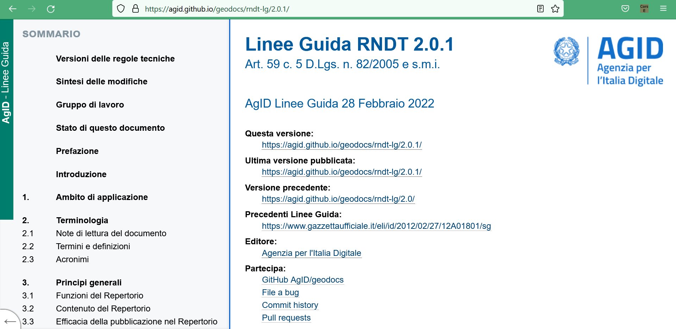
The national metadata profile
aligned to and extending INSPIRE metadata TGs 2.0

Slide 3
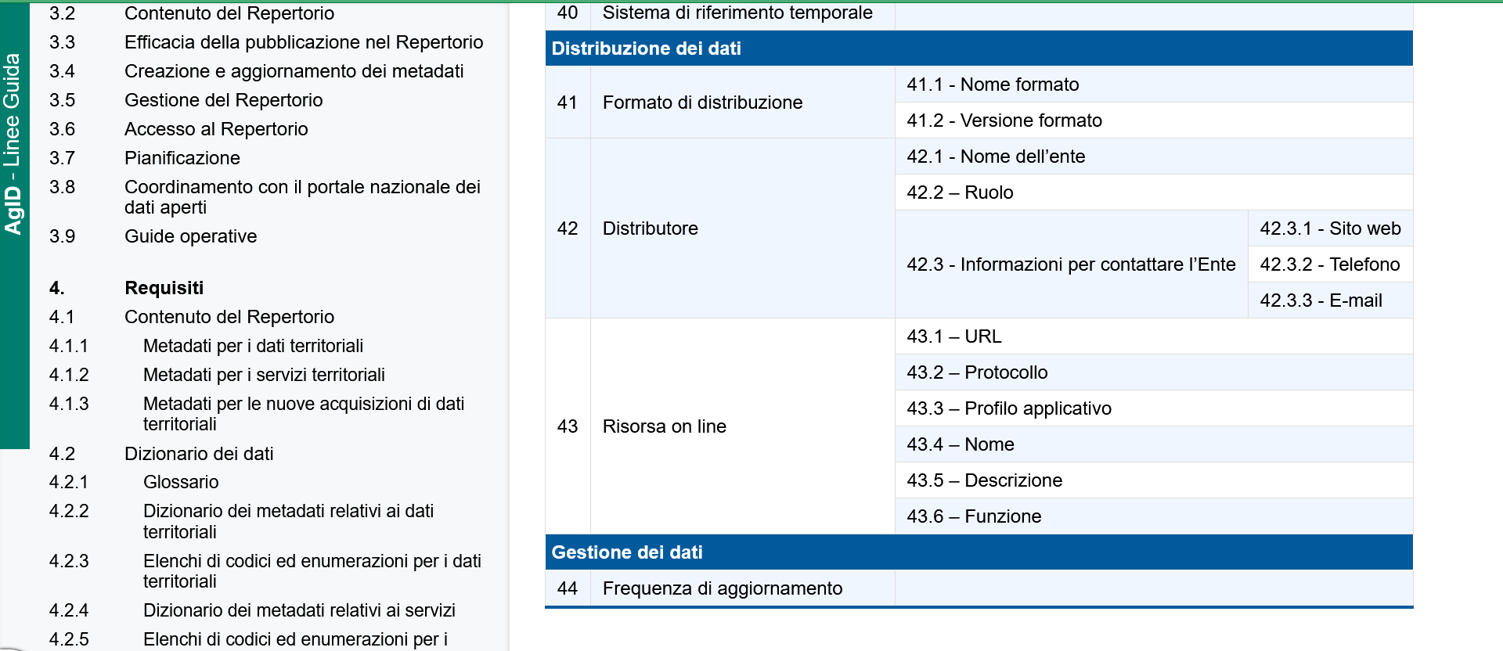
Implementation of part A
metadata elements proposed in the Part A of the good practice already included as mandatory elements in the national profile:
Protocol
Application profile

Slide 4
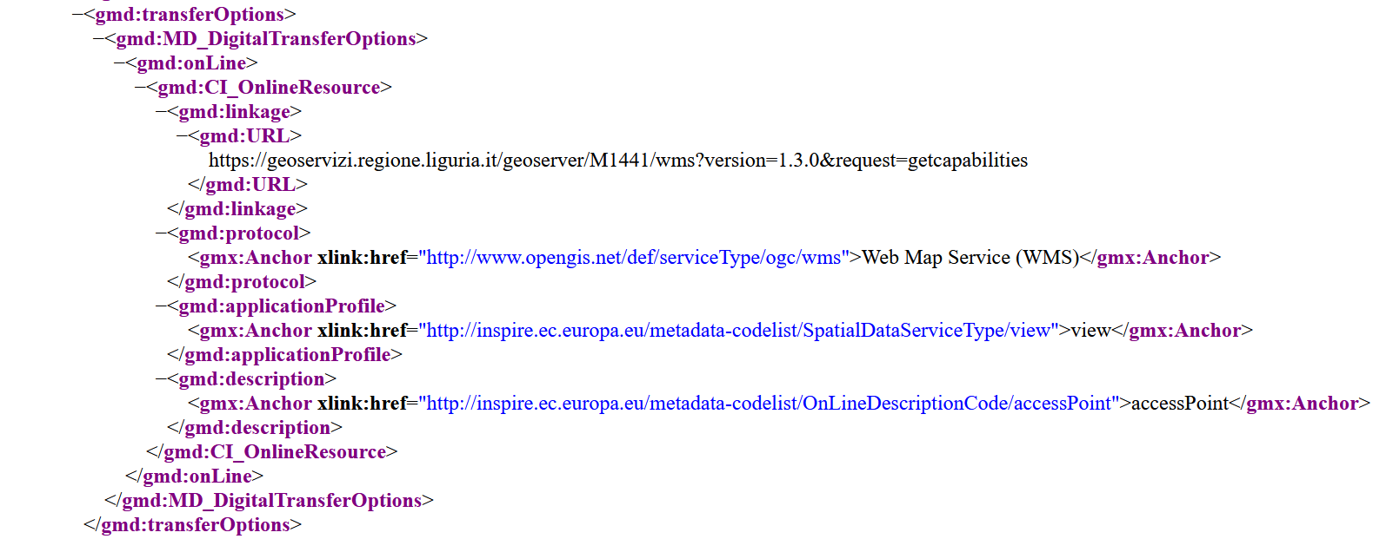
Example
The metadata elements gmd:protocol and gmd:applicationProfile are encoded by using the mandatory element gmx:Anchor with the URIs coming from the INSPIRE registers:
INSPIRE Protocol value register
Spatial data service type register

Slide 5
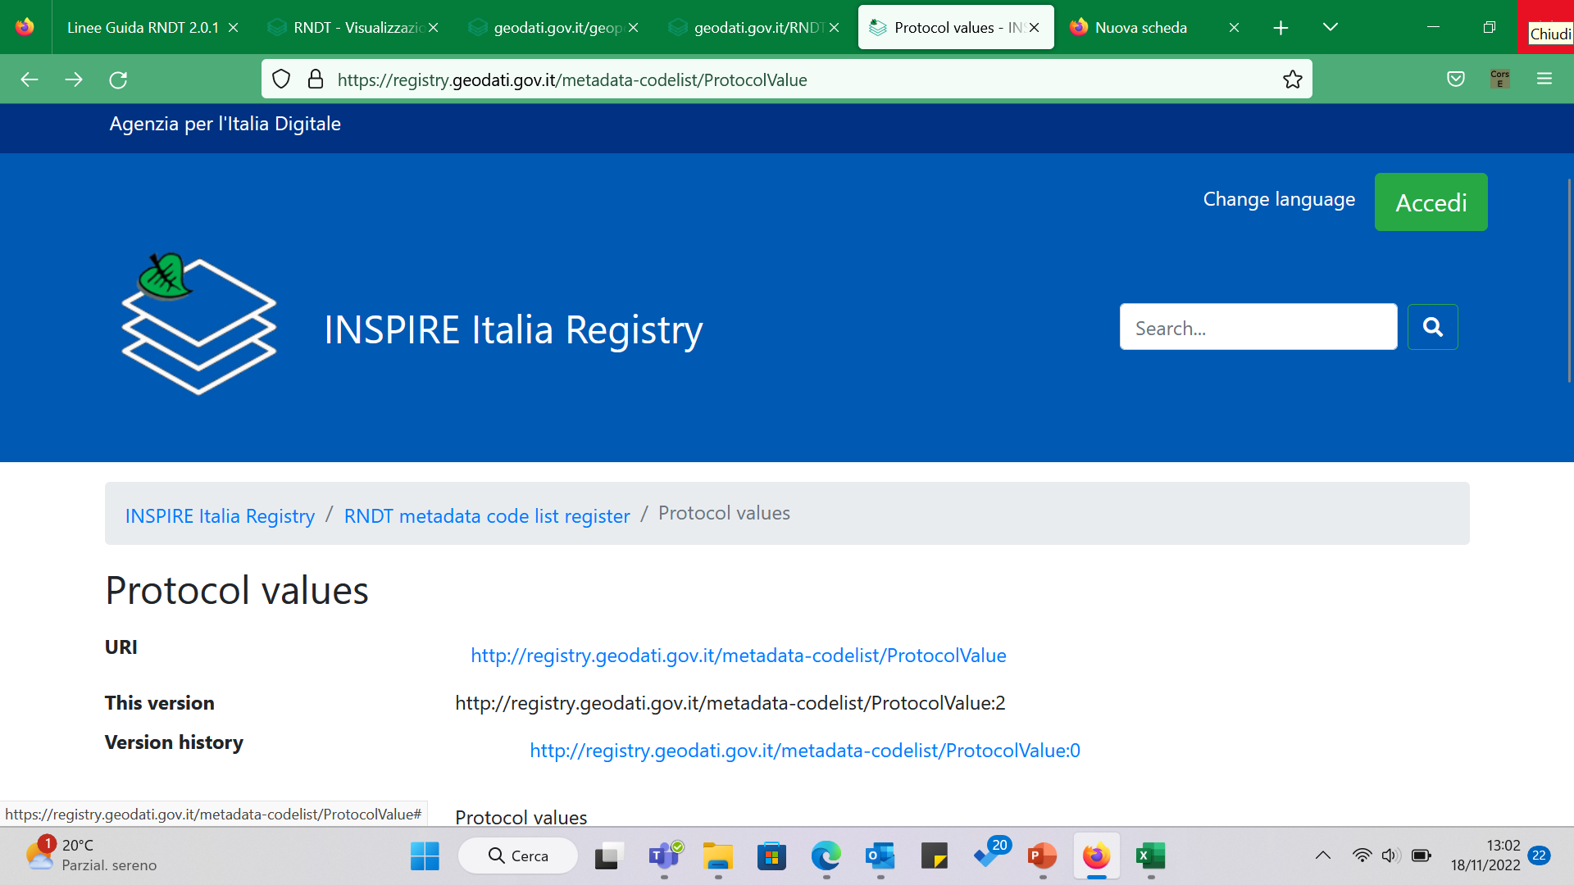
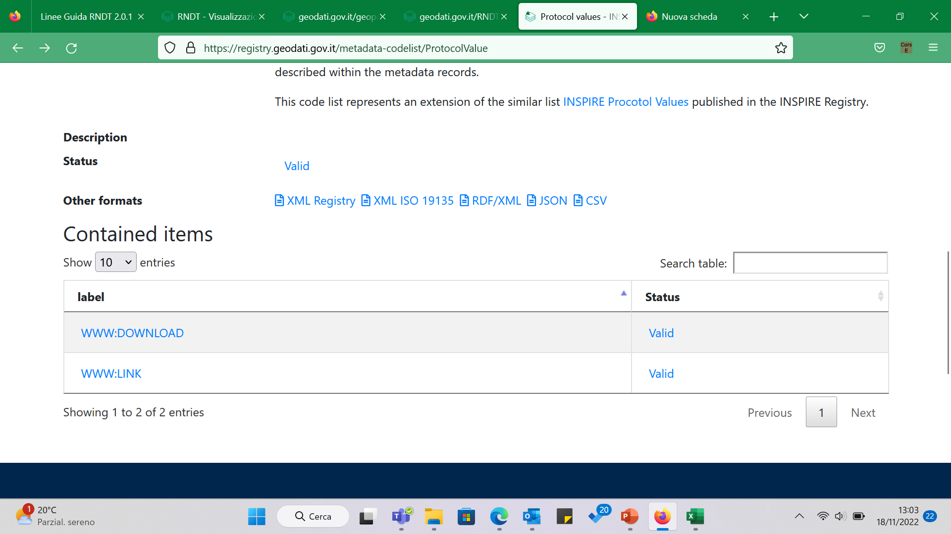

Extensions to INSPIRE registers
As the metadata elements protocol and applicationProfile are required for all types of online resource (and not only for view and download services as in Part A of the good practice), some extensions in the INSPIRE Protocol value register have been needed.
Those extensions are published in the national registry.
The extensions cover the following cases:
a web page with further instructions for accessing the data set described through metadata (→ (external) URI: https://www.w3.org/TR/xlink/);
direct access for downloading the data set described through metadata (→ URI: https://registry.geodati.gov.it/metadata-codelist/ProtocolValue/www-download).

Slide 6
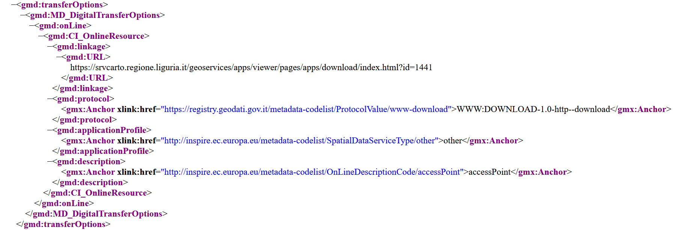
Example

Slide 7
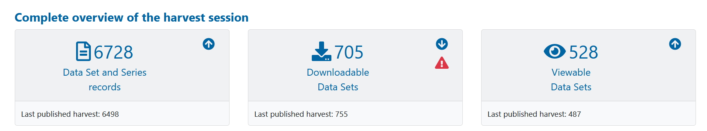
Implementation of the Part B
Not implemented yet, but data and service providers look forward to using the new approach
Why?
Low level of accessibility to Italian INSPIRE data sets with the current approach
But the number of services documented is relevant
2115
Services
CONCLUSIONS: with the simplification approach, a considerable increase in the level of accessibility is expected

Slide 8

rotundo@agid.gov.it
agid.gov.it

