Slide 1

Links to MIWP Action 2.4 Central INSPIRE Infrastructure Components Revamped INSPIRE Geoportal (GeoNetwork)
JRC INSPIRE Team
INSPIRE Good Practice – Data-Service Linking Simplification Webinar November 21st, 2022

Slide 2
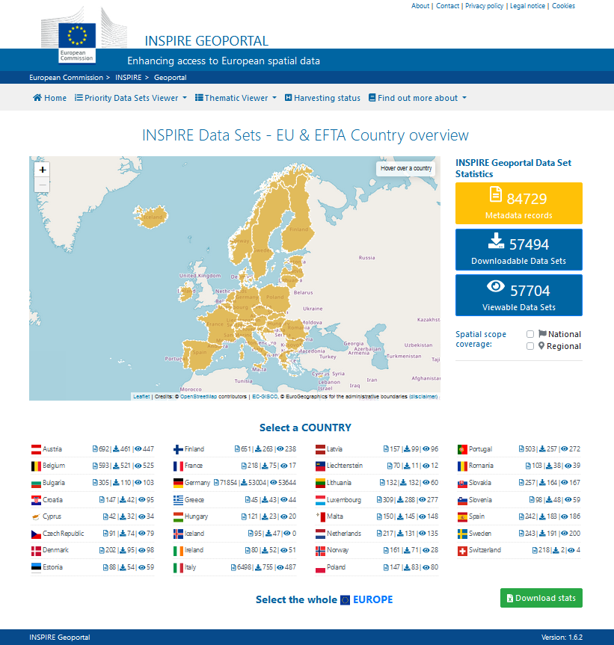
INSPIRE Geoportal
Revamp
https://inspire-geoportal.ec.europa.eu
Main access point to INSPIRE Infrastructure tools and resources.
Based on own development.
Main focus: INSPIRE M&R.
Being revamped using a GeoNetwork-based backend.

Slide 3
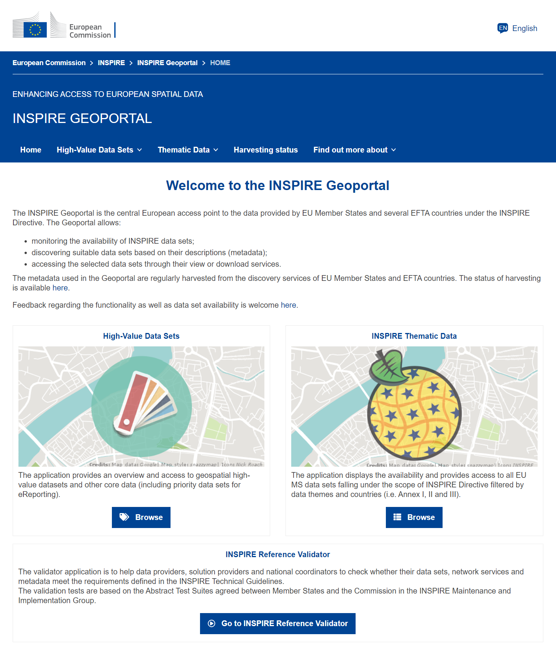
INSPIRE Geoportal
Revamp – User interface
User interface
Available – Filtering by High Value Datasets (HVDs).
To be launched when the Implementing Act on HVDs is entering into force.
Ready to be launch – Additional developments to integrate the new user interface with the new backend: GeoNetwork.

Slide 4
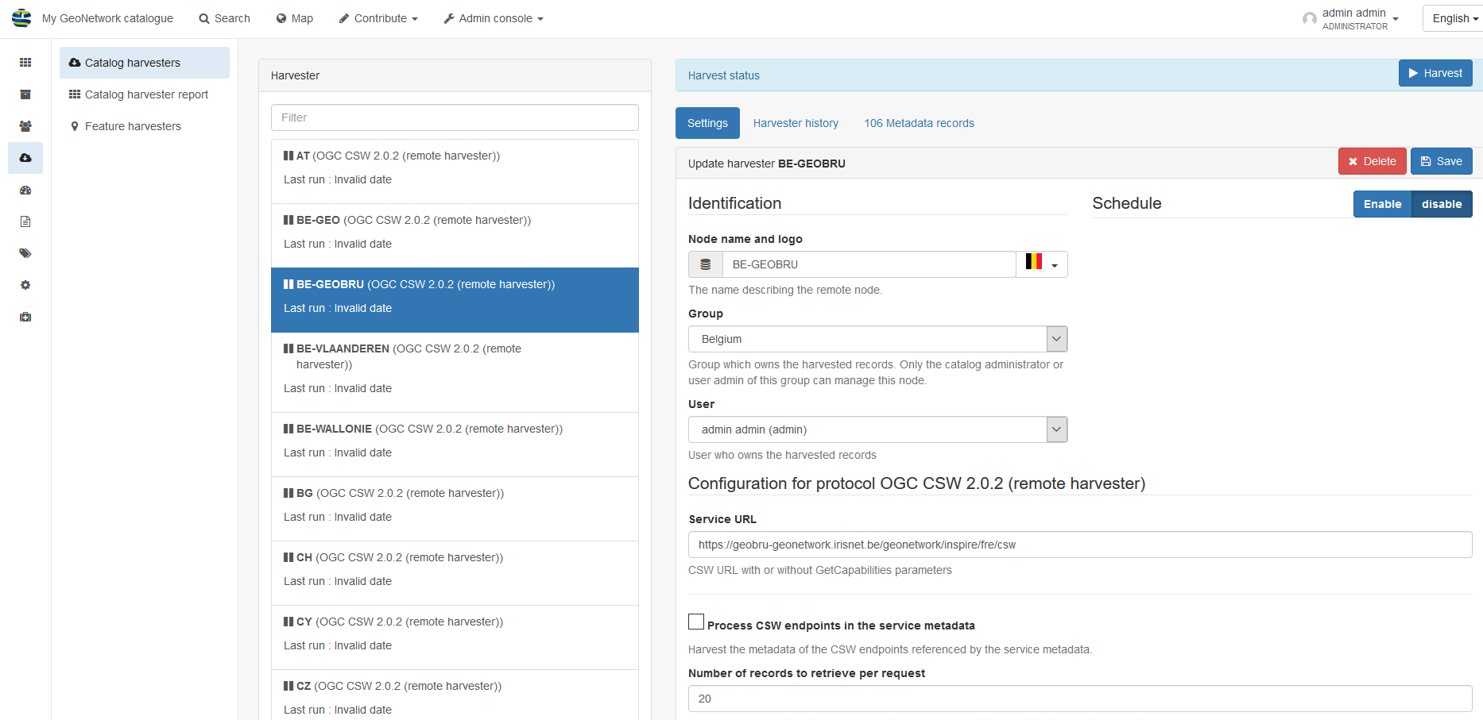

INSPIRE Geoportal
Revamp – Backend: GeoNetwork (AWS cloud)
Prototype:
Available and revised
Working system:
Delivered
JRC Testing finished
Working in the launch

Slide 5
INSPIRE Geoportal revamp Overview
70 MIG-T – Beta-testing plan announcement.
7th July 2022
1st Training session - Revamped INSPIRE Geoportal backend.
15th July 2022
Ad-hoc Online Survey (beta-testing feedback).
22nd July 2022 - 15th October 2002
2nd Q&A Training session - Revamped INSPIRE Geoportal backend.
5th October (today)
3rd Training session – Revamped INSPIRE Geoportal (backend + frontend/UI).
Beginning November 2022 – DELAYED
INSPIRE Geoportal revamp.
End November 2022
M&R round 2022.
15th December 2022

Slide 6
Revamped INSPIRE Geoportal (GeoNetwork) Data-Service Linking Simplification Implementation
INSPIRE Model: Simplified
[O] Coupled Resources
[M] Resource Locator
Service MD in Discovery Service [O]
Service MD in Download/View Service [M]*
Dataset MD in Discovery Service [M]
General Service MD [M]
[O] INSPIRE compliant Service MD
INSPIRE Ext MD [O]
LEGEND:
[M]: Mandatory
[O]: Optional
[O] Spatial Dataset Identifier
Layer / FeatureType / Entry [M]
[M] Coupled Resource

Slide 7
Revamped INSPIRE Geoportal (GeoNetwork) Data-Service Linking Simplification Implementation
Implementation of the Data-Service Simplification good practice Part A has been taken into account in the current developments for the GeoNetwork backend.
Not completed. Lack of a final good practice specification (not achieved till now, end November 2022).
Further tests of the revamped INSPIRE Geoportal are needed to check which is the current functionality achieved.
Part B pending.
Implementation of the good practice will need future developments. Funding options to be explored from end 2023.
Meanwhile, are any MS/countries interested in co-funding?

Slide 8

Thank you!
Jordi.ESCRIU@ec.europa.eu
© European Union 2020
Unless otherwise noted the reuse of this presentation is authorised under the CC BY 4.0 license. For any use or reproduction of elements that are not owned by the EU, permission may need to be sought directly from the respective right holders.

