Slide 1

Dutch implementation example
INSPIRE Good Practice – Data-Service Linking Simplification Webinar
Ine de Visser

Slide 2
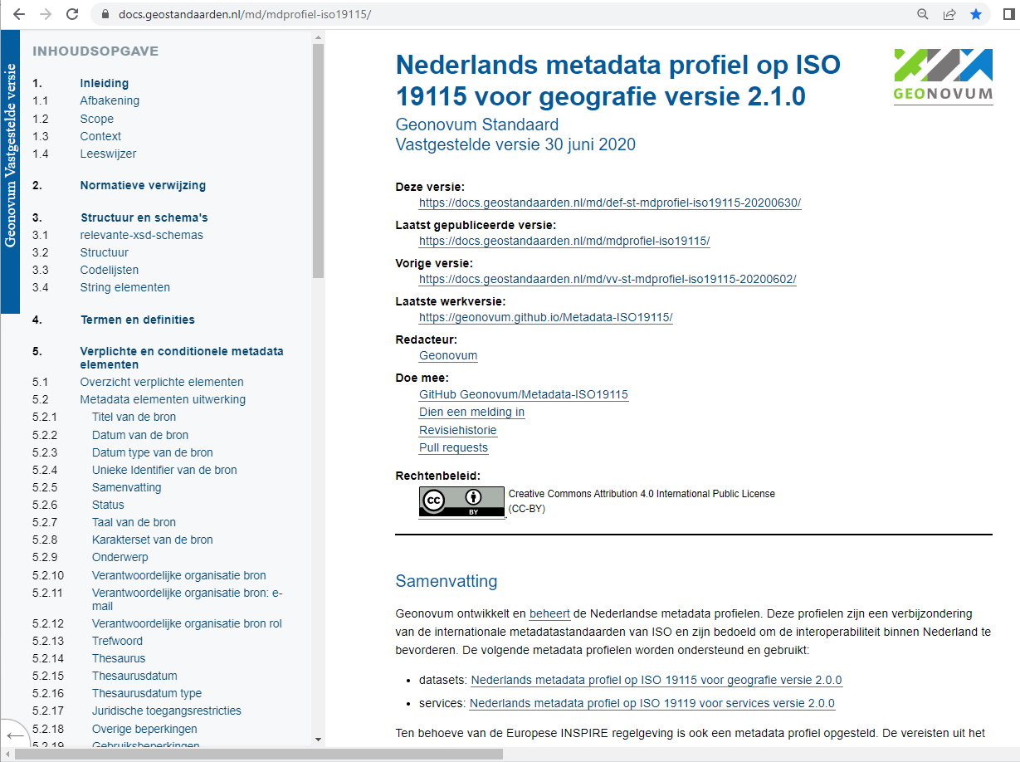
Dutch metadata profile

Slide 3
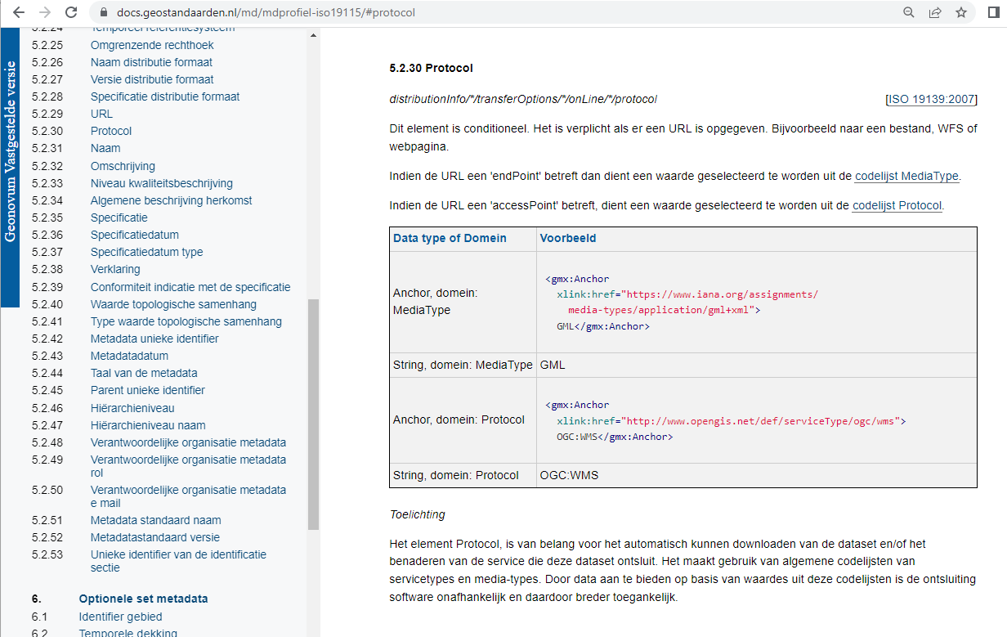
Protocol element

Slide 4
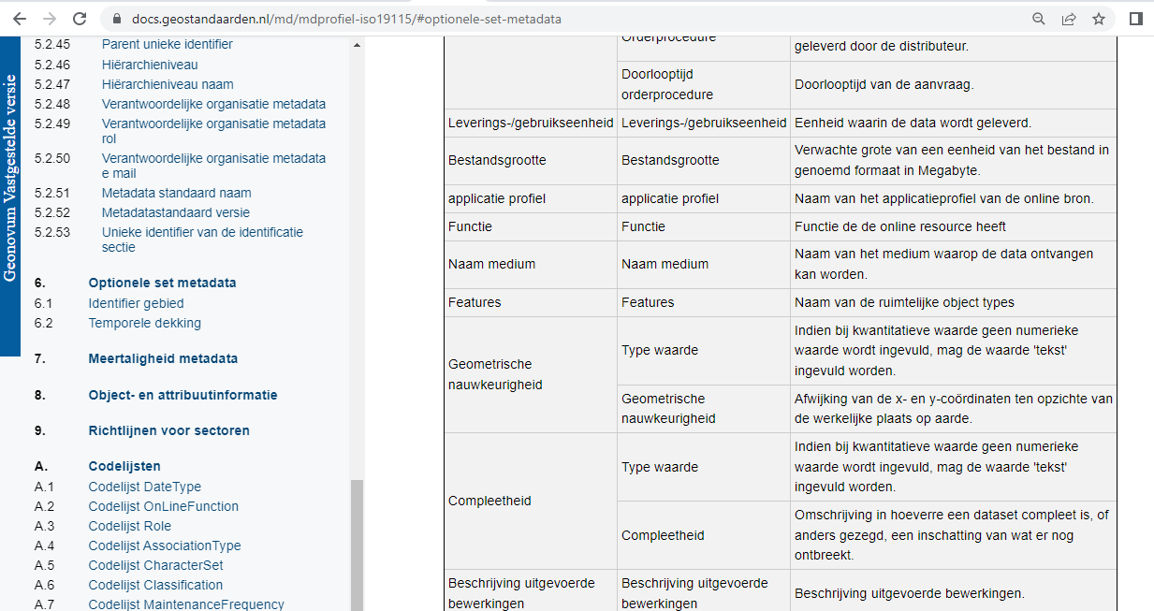
Optional application profile element

Slide 5
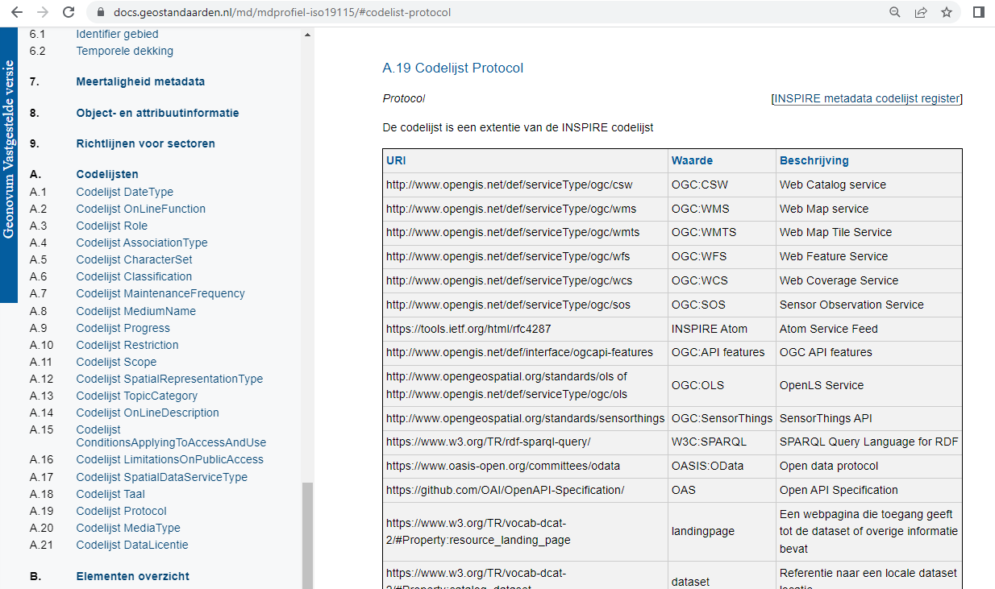
Protocol codelist

Slide 6
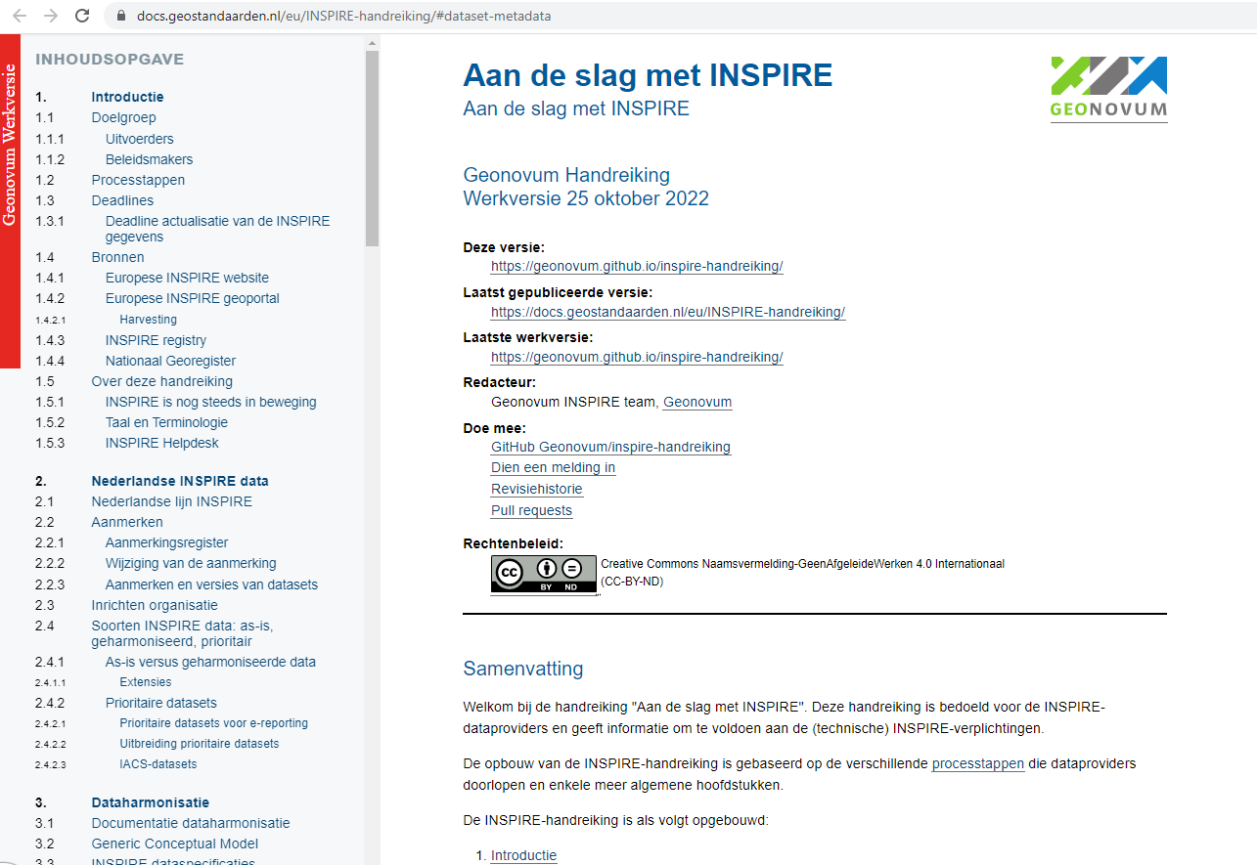
Dutch INSPIRE guide

Slide 7
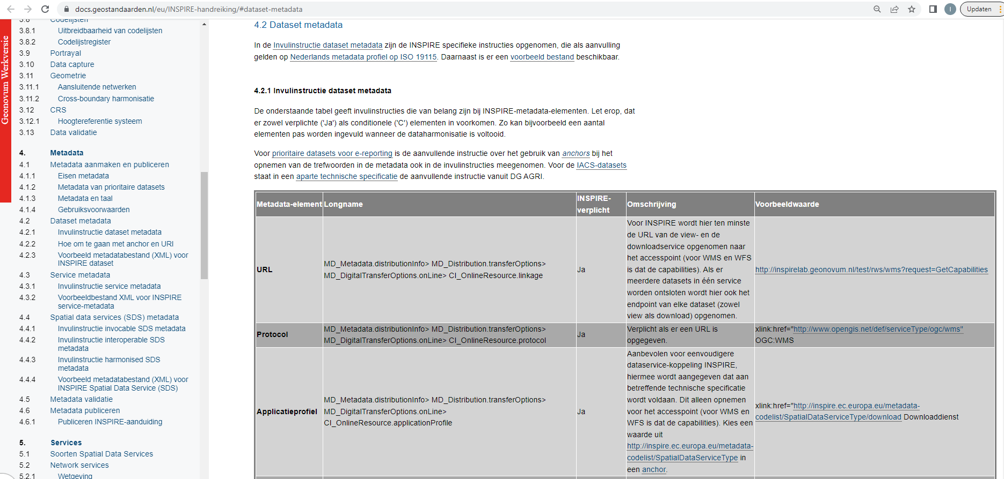
Instructions data service linking

Slide 8
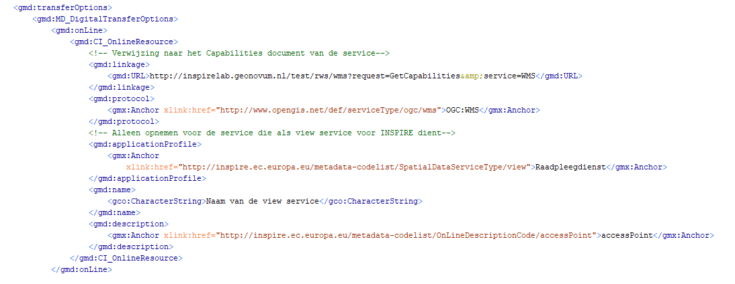
XML example

Slide 9
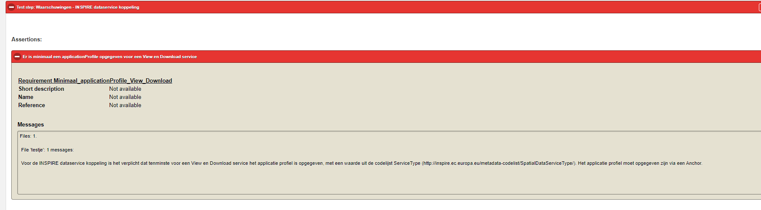
Validation warnings data service linking

Slide 10
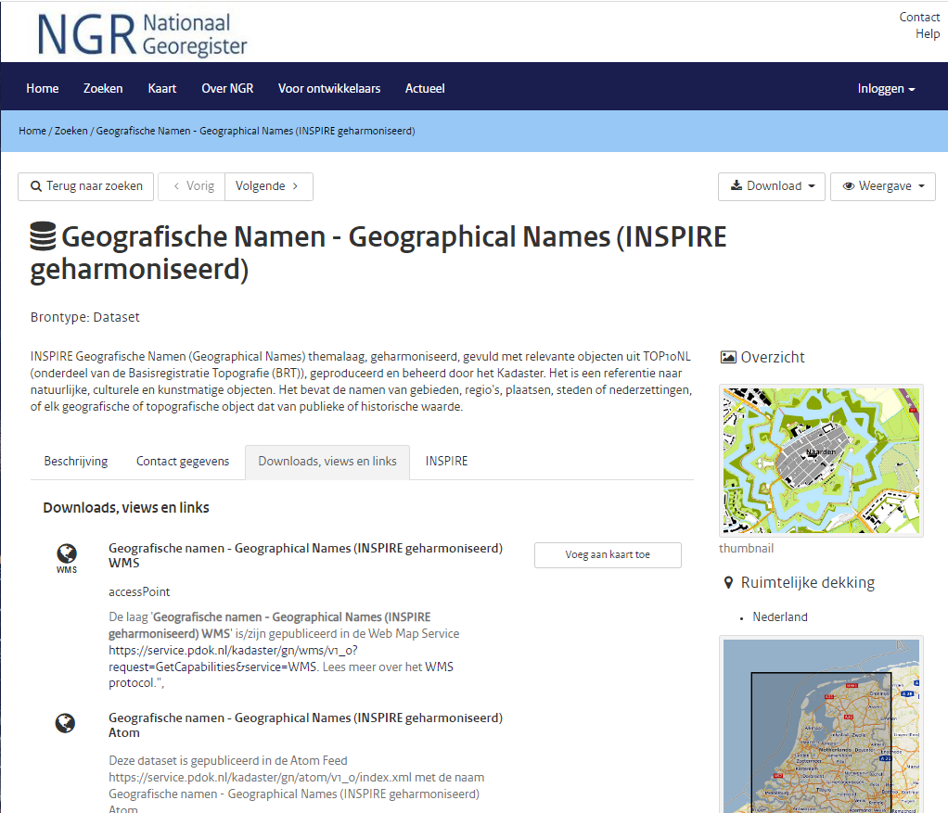
Example of linked view and download service

Slide 11
Links
The (minor) changes in the data set metadata needed on the resource locator elements is implemented in:
The Dutch metadata profile (https://docs.geostandaarden.nl/md/mdprofiel-iso19115/)
INSPIRE guide https://docs.geostandaarden.nl/eu/INSPIRE-handreiking/#dataset-metadata.
The validator (http://validatie.geostandaarden.nl/etf-webapp/testprojects) returns warnings if the requirements on data service linking are not met.
The INSPIRE data is available via view and download services in the Dutch Nationaal Georegister: https://www.nationaalgeoregister.nl/geonetwork/srv/dut/catalog.search#/search?facet.q=category%2Finspire&resultType=details&sortBy=relevance&fast=index&_content_type=json&from=1&to=50

Slide 12
Bedankt!

