Slide 1


INSPIRE Modernisation
Introduction to INSPIRE Good Practices
Jordi Escriu
(on behalf of the EC-JRC INSPIRE Team)
Pushing WMS services to their limits - Smart solutions as candidate INSPIRE Good Practices, 8th February 2022

Slide 2


INSPIRE The geospatial pineapple
One of the biggest geospatial data sharing initiatives in the world (7000+ providers).
Multi-faceted Spatial Data Infrastructure framework
Legal: Directive, Implementing provisions, transposition in MS.
Organisational:
Governance structure with National contact points / structures, Multiple Commission Services.
Maintenance and Implementation Work programme;
Technical: Reusing building blocks from standardisation bodies (OGC, ISO, etc.)
Full stack of guidelines for discoverability, metadata, data encoding and data sharing.
Status of implementation
Directive entered into force in 2007 / Roadmap finished by December 2021.
Lights and shadows. Objectives partially achieved. Heterogeneity of implementations across EU. Pan European coverage yet do be achieved.

Slide 3
What is ahead New Policy context
“Europe fit for the Digital Age” priority of the new European Commission:
Data-driven innovation.
Adding value to Europe’s economy and society.
European Strategy for Data:
Establishment of a single market for data through sector-specific data spaces.
Different actors interplaying in the data economy (public sector, businesses, citizens, and academia)
Open Data Directive (and forthcoming Implementing Act):
Provision and sharing of public sector High-Value Datasets (many of them geospatial).
INSPIRE: Public-sector contribution to the Green Deal data space.

Slide 4

What is ahead Technological trends
New data sources.
Application Programming Interfaces (APIs) – From data collection to data connection.
Novel architectures.
Agile standards.
Mature tools.
Data-driven and proven community practices

Slide 5

INSPIRE Evaluation & Future JRC Science for Policy Report
INSPIRE - A Public Sector Contribution to the European Green Deal Data Space
https://publications.jrc.ec.europa.eu/repository/handle/JRC126319
Prepared with Geonovum and DG ENV.
Sneak peek:
Overview of the status
Policy and technological context
Lessons learned
Vision for the technological evolution
Actions and roadmap
Prototype reference framework

Slide 6
INSPIRE Future Vision
INSPIRE should ‘blend in’ with the broader ecosystem of spatial and non-spatial data, infrastructures, technologies and policies.
This will mean opening up to a broader community of implementers and users, and to a wider range of applications and use cases.
Making the INSPIRE framework more flexible and agile will significantly lower the entry level to the sharing and utilisation of data.
Technical approaches need to be simplified by reusing well-adopted standards and technologies.

Slide 7
Addressing the challenge Maintenance and Implementation Work programme (MIWP 2021-2024)
Context for modernising the technological framework of INSPIRE.
6 core actions
1.1 Towards a digital ecosystem for the environment and sustainability
2.1 Need-driven data prioritisation
2.2 Roadmap for priority-driven implementation
2.3 Simplification of INSPIRE implementation
2.4 Central infrastructure components
3.1 GreenData4all initiative

Slide 8
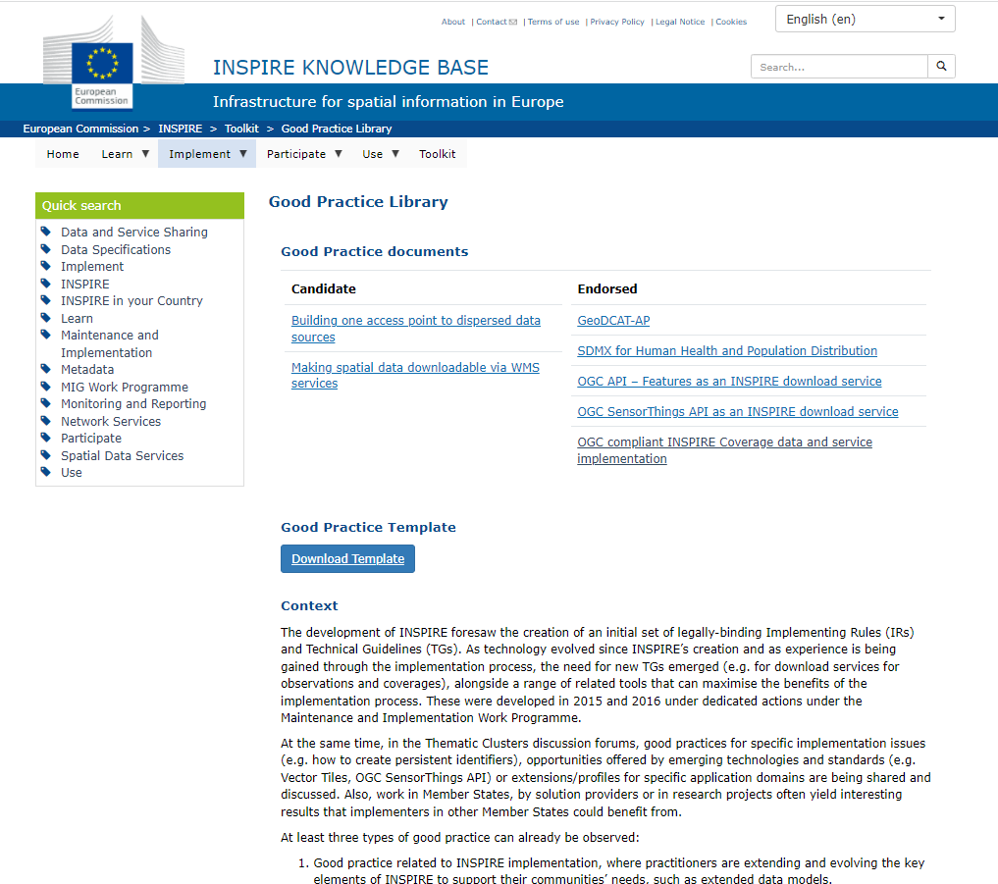
Opening and Mainstreaming INSPIRE INSPIRE Good Practices
Fast track for proposing new technical approaches.
Good Practice library available.
Procedure for proposing Good Practices and subsequent potential endorsement:
Step1. Initiation.
Step 2. Submission as candidate (MIG-T).
Step 3. Outreach.
Step 4. Submission (MIG).
Step 5. Legal scrutiny.
Step 6. Feedback.
https://inspire.ec.europa.eu/portfolio/good-practice-library

Slide 9
Today’s webinar INSPIRE Good Practices on WMS
Outreach for two good practices candidates
Initiated and submitted by (GUGIK), Poland:
Making spatial data downloadable via WMS services.
Marcin Grudzień, GUGIK.
Building one access point to dispersed data sources.
Marcin Grudzień, GUGIK

Slide 10








Keep in touch
ec.europa.eu/
europeancommission
europa.eu/
@EuropeanCommission
@EU_Commission
EUTube
@EuropeanCommission
EU Spotify
European Commission
Notes:
Delete/update as appropriate

Slide 11


Thank you!
Jordi.ESCRIU@ec.europa.eu
© European Union 2020
Unless otherwise noted the reuse of this presentation is authorised under the CC BY 4.0 license. For any use or reproduction of elements that are not owned by the EU, permission may need to be sought directly from the respective right holders.

