Slide 1

Training on Re3gistry/INSPIRE Registry and ETF/INSPIRE Reference Validator
JRC INSPIRE Team
May 29-31, 2024

Slide 2
Housekeeping rules
Please mute your microphone when you are not talking.
If, during the registration, you did not consent to having your picture taken and recorded during the event, please make sure to keep your camera off.
During the Q&A sessions at the end of each training part, please raise your hand in order to be given the floor.
During the whole training, you can ask questions in the chat: our team will do the best to address these in real-time.

Slide 3
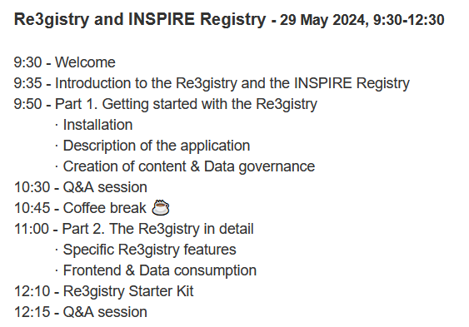

The trainings
What: overview of the Re3gistry and ETF open source software tools and their INSPIRE implementations (Registry and Reference Validator).
To whom: everyone – from new to experienced users, developers & admins.
How: through a mix of theoretical notions & hands-on demonstration .
Notes:
We will open a GitHub issue to gather additional feedback.

Slide 4
Introduction to the Re3gistry and the INSPIRE Registry
JRC INSPIRE Team & Bilbomatica
Re3gistry and INSPIRE Registry training May 29, 2024

Slide 5

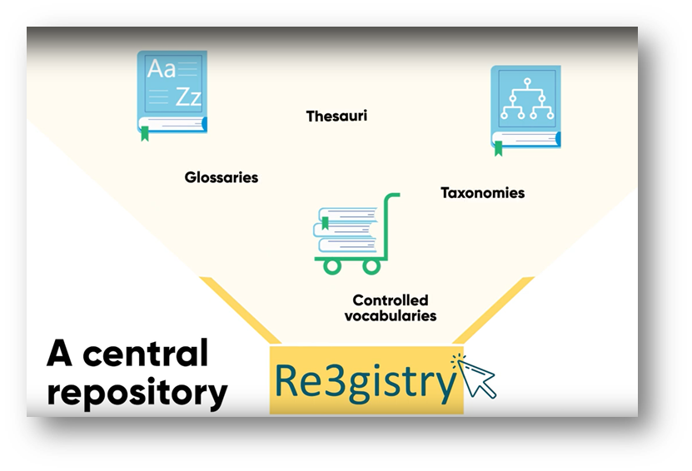
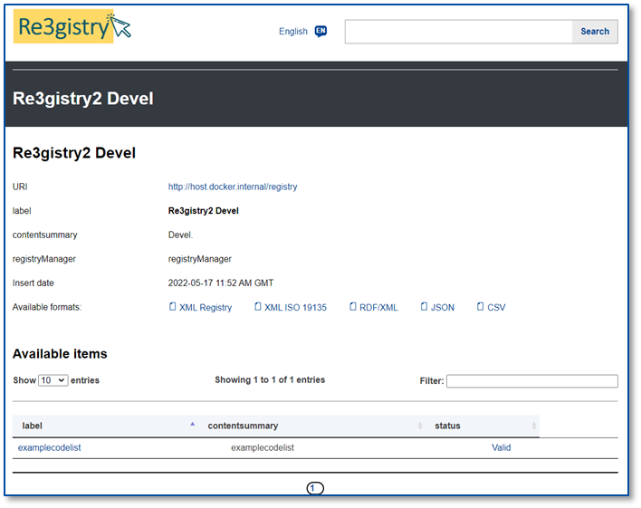
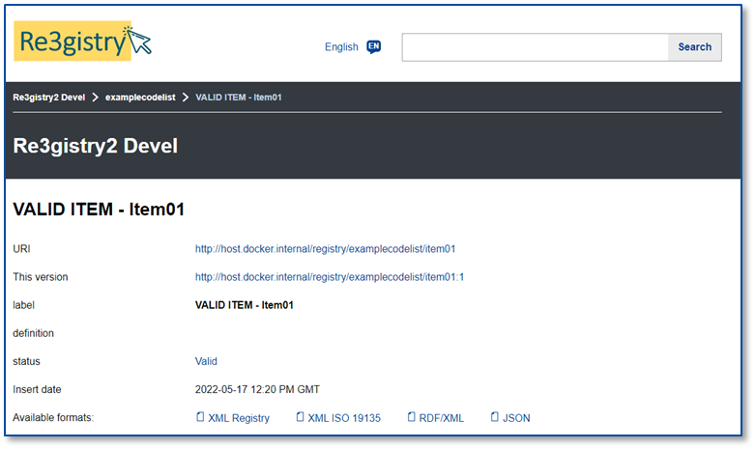
About
The Re3gistry provides a central access point, where commonly shared reference codes, their labels and descriptions.
It can be easily browsed by humans while retrieved by machines through its REST API.
https://joinup.ec.europa.eu/collection/are3na/solution/re3gistry
Version 2.0 introduced key features such as an interactive administration interface.
The latest version available is v2.5.3.

Slide 6

What is the Re3gistry useful for?
Avoid common mistakes (such as entering synonyms) or misspellings when filling out online forms.
Facilitate the internationalisation of user interfaces and registered items, by providing multilingual labels.
Ensure semantic interoperability when exchanging data between systems and applications.
Increase the value of references codes if widely reused and referenced.

Slide 7
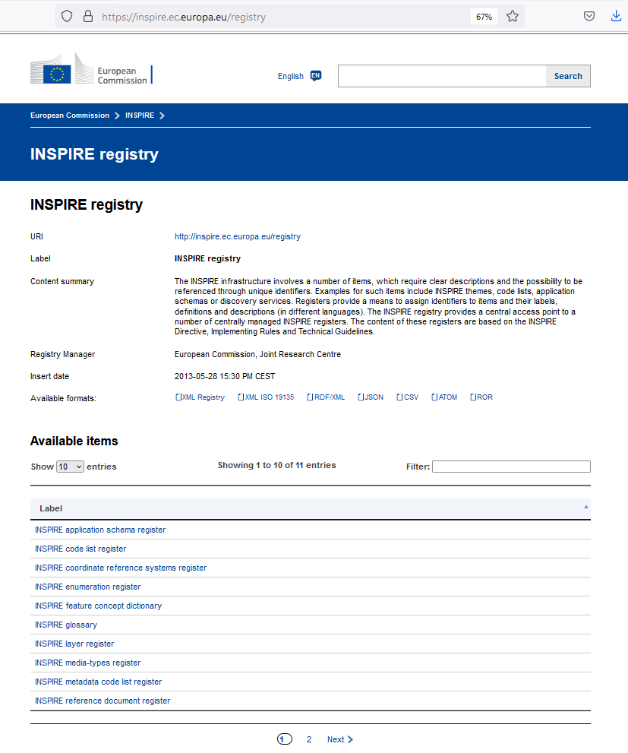

Background
2013 - the European Commission’s Joint Research Centre (JRC) starts the development of the Re3gistry to satisfy the semantic interoperability requirements set by the INSPIRE Directive: the INSPIRE Registry is implemented.
2020 - Given its high reusability potential, it was decided to be released as a generic open-source project to support semantic interoperability across any organisation.

Slide 8
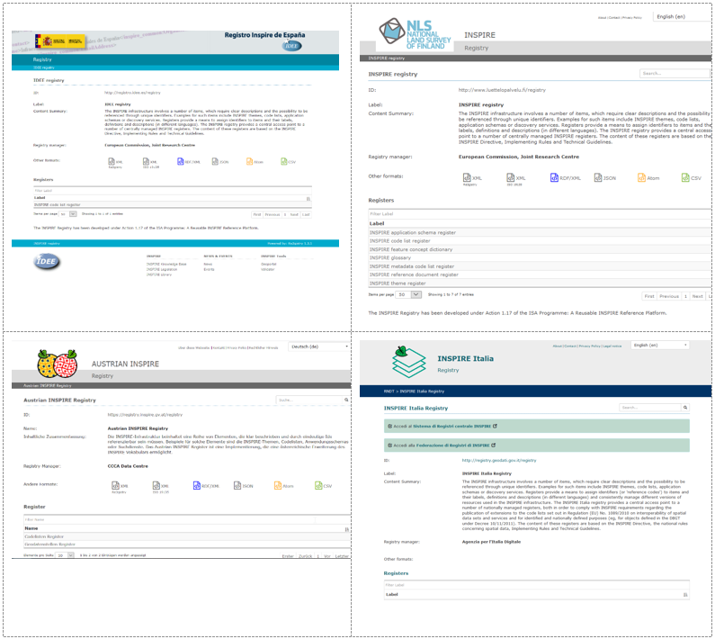

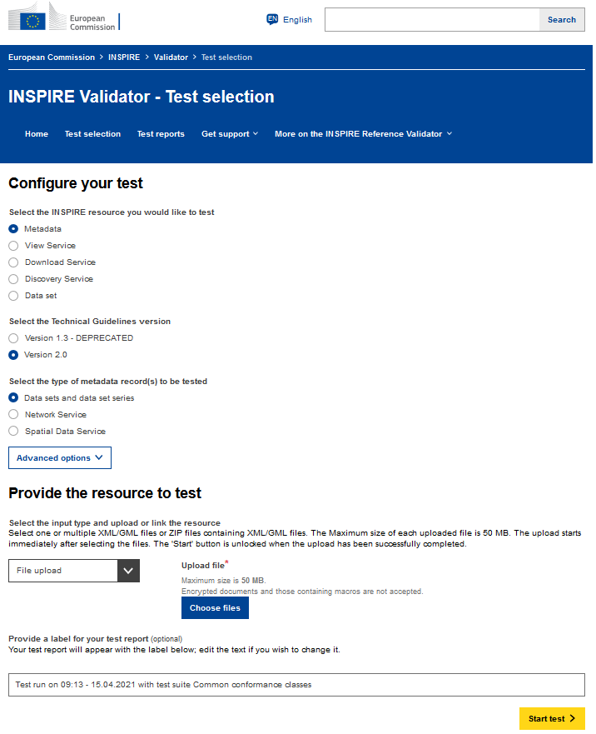
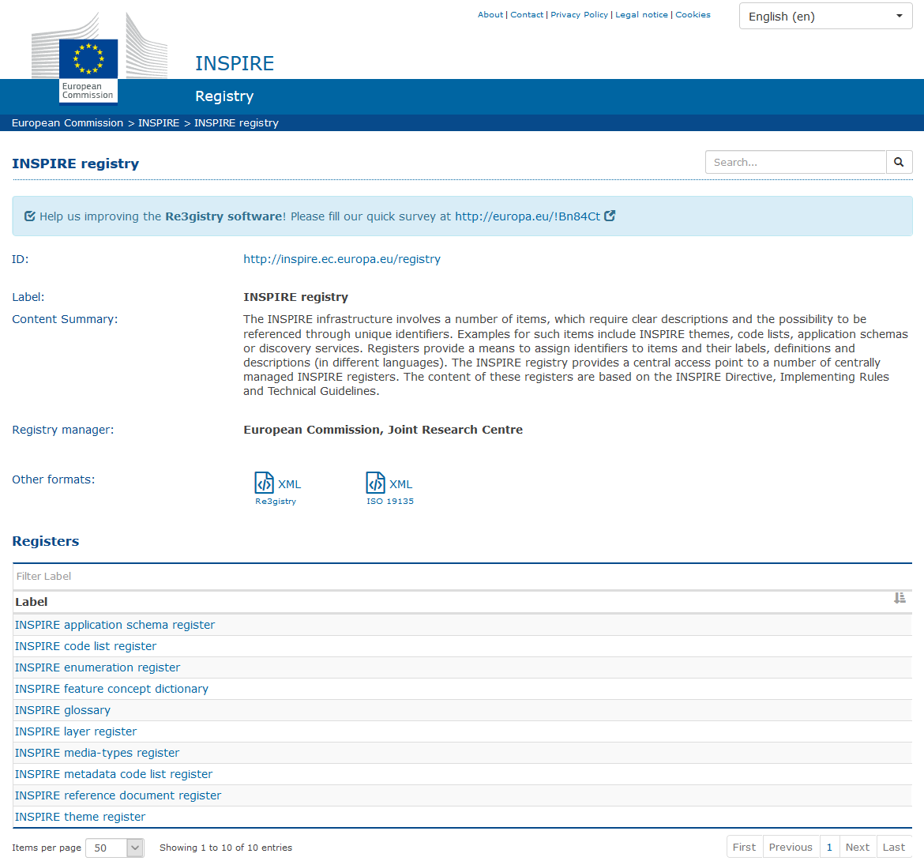

INSPIRE Registry
Part of the Core INSPIRE Central Components of the European Infrastructure.
Reusability and implementations in MS.
INSPIRE Geoportal
INSPIRE Reference Validator
INSPIRE Registry

Slide 9
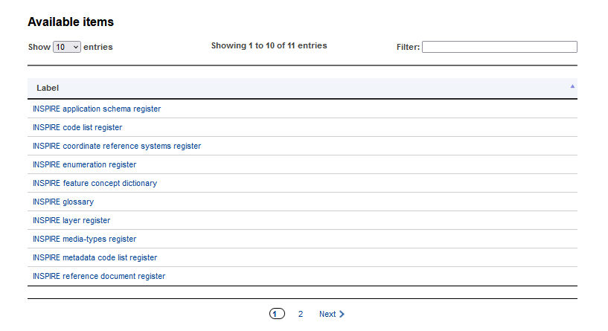
INSPIRE Registry Contents
Different registers available
https://inspire.ec.europa.eu/registry

Slide 10
Re3gistry Open Source - OSGeoLive
Reusable open source software, licensed under EUPL.
Included in OSGeoLive package:
https://live.osgeo.org/en/overview/re3gistry_overview.html
Easiest flexible way to install the application.

Slide 11
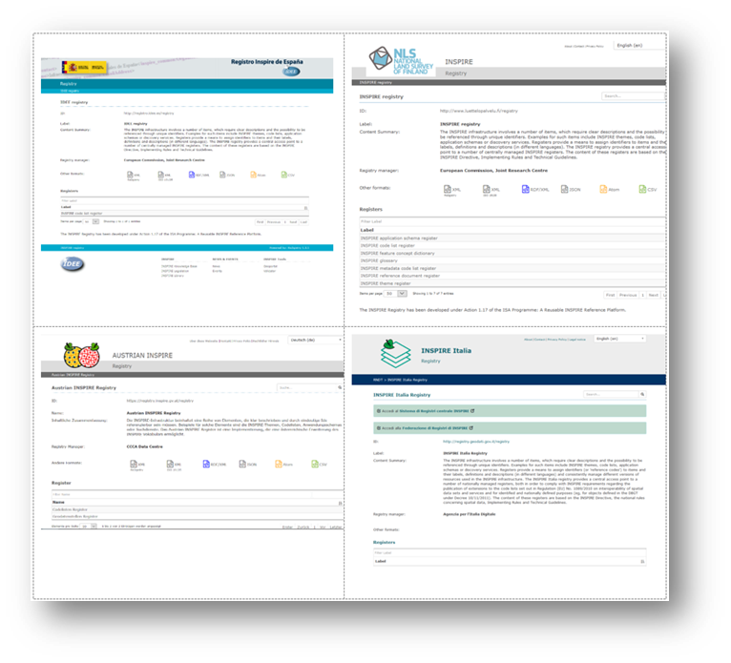
Re3gistry Who is using it?
The European Commission:
The INSPIRE Registry is the first and most popular instance based on the Re3gistry software.
The Publications Office of the European Union recently analysed the capabilities of the Re3gistry software for the publication of Corporate Reference Data Sets.
Agencies and companies in the Member States &
EFTA countries
Different EU-funded projects, private companies and organisations outside Europe
(e.g. Republic of Colombia).
Austria, Belgium, Czech Republic, Finland, Germany, Italy, Netherlands, Republic of North Macedonia, Slovakia, Spain.
https://joinup.ec.europa.eu/collection/are3na/solution/re3gistry/re3gistry-reusers

Slide 12
Re3gistry Core features
Collaborative platform.
Intuitive user friendly interface (web-app) for administrators and users.
Different options for managing the registers and reference codes, either based on:
ISO 19135 standard, or
Simplified workflow.
Highly flexible and customisable data models.
Multi-lingual content support.
Persistent identifiers.
Support for versioning (historic trace of versions).
RESTful API with content negotiation (including OpenAPI 3 descriptor).
Free-text search.
Supported formats:
HTML, ISO 19135 XML, JSON, RDF/XML, Re3gistry XML, CSV, ATOM.
Service formats can be easily added or customised (default formats: JSON and ISO 19135 XML).
Multiple authentication options.
Possibility to add externally governed items referenced through URIs.
INSPIRE register federation format support (option to automatically create the RoR format).

Slide 13
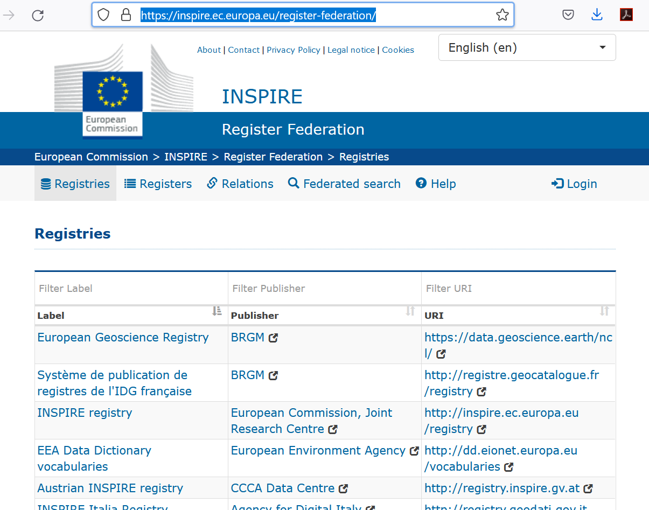
Register Federation Tool (RoR) Example: INSPIRE Register Federation
Tool that allows to create a distributed federation of registers.
The European Commission is implementing an INSPIRE Register Federation in the scope of the INSPIRE Directive.
The Register of Registers (RoR), is the central access point to the federation.
Provides information about the registers included in the federation and their relationships.
Allows searching for registers and the items contained in them.
Can be publicly accessed via graphic user interface or API.
https://inspire.ec.europa.eu/register-federation/

Slide 14
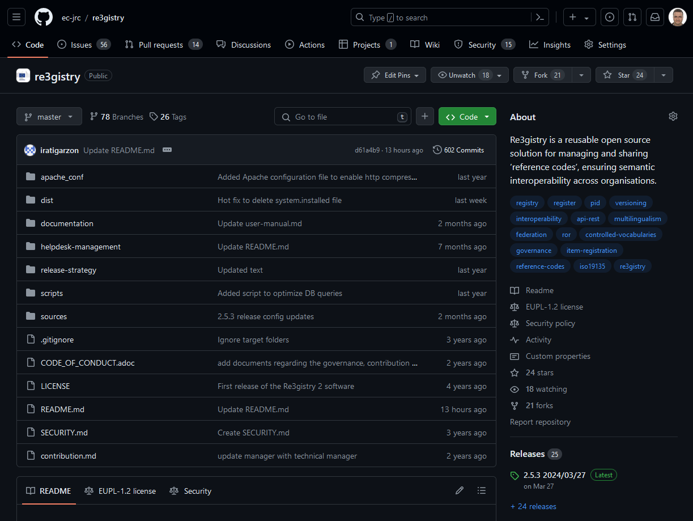
Re3gistry & RoR GitHub repository
Code repository:
https://github.com/ec-jrc/re3gistry
Release strategy:
https://github.com/ec-jrc/re3gistry/tree/master/release-strategy
Issue helpdesk:
https://github.com/ec-jrc/re3gistry/issues

Slide 15
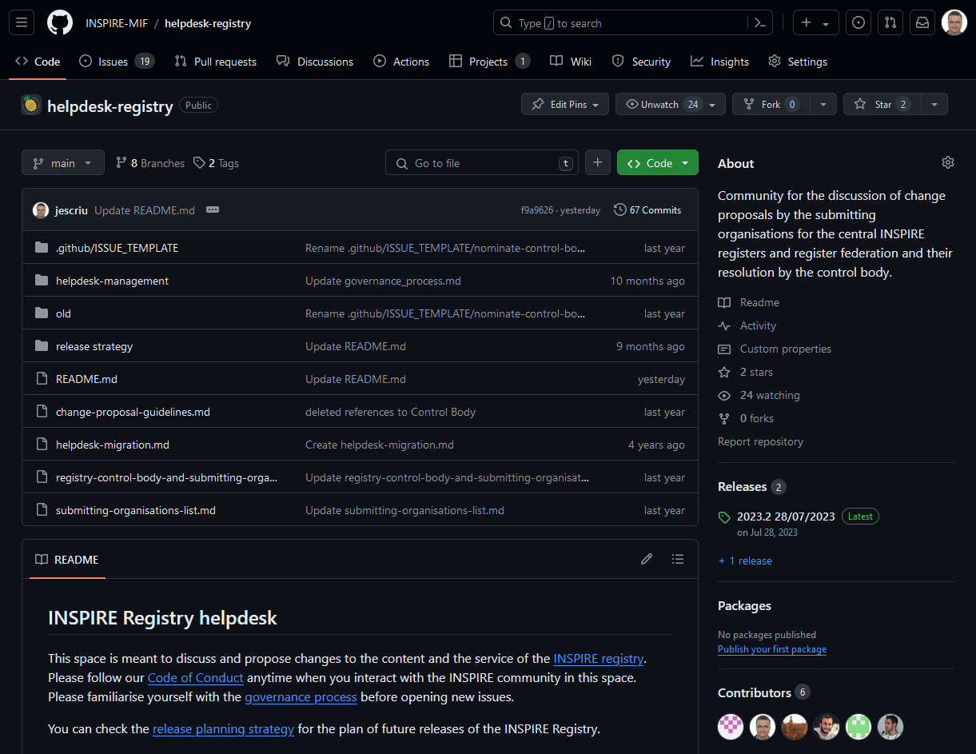
INSPIRE Registry GitHub repository
Code repository:
https://github.com/INSPIRE-MIF/helpdesk-registry
Release strategy:
https://github.com/INSPIRE-MIF/helpdesk-registry/tree/main/release%20strategy
Issue helpdesk:
https://github.com/INSPIRE-MIF/helpdesk-registry/issues

Slide 16
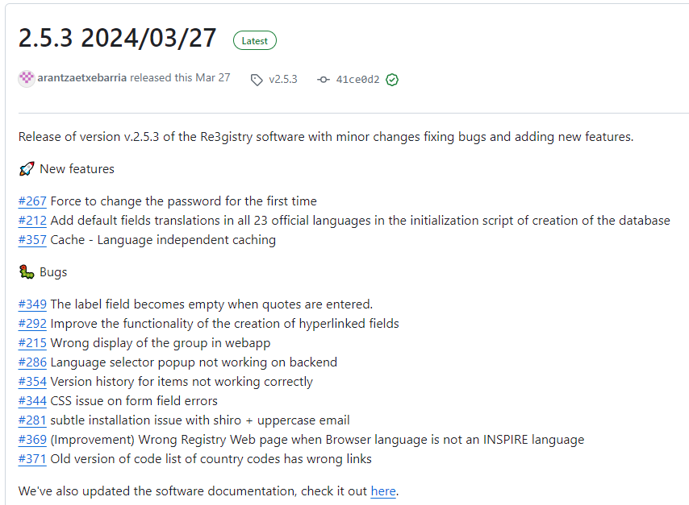
Re3gistry Latest releases
Latest releases:
March 2024 (v2.5.3)
https://github.com/ec-jrc/re3gistry/releases/tag/v2.5.3
December 2023 (v2.5.2)
https://github.com/ec-jrc/re3gistry/releases/tag/v2.5.2
Next release:
June 2024 (v2.6.0)

Slide 17
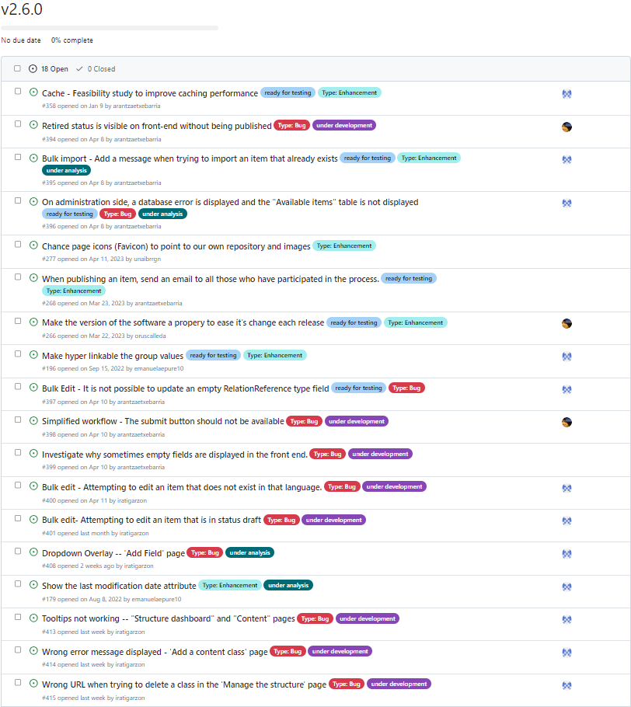
Re3gistry Next release
Release v2.6.0 - June 2024
Milestone:
https://github.com/ec-jrc/re3gistry/milestone/9
Focused on making improvements in:
Caching
Bulk edit functionality
Email notifications.
Addressing an in-depth testing of the application to make a robust and reliable version.

Slide 18
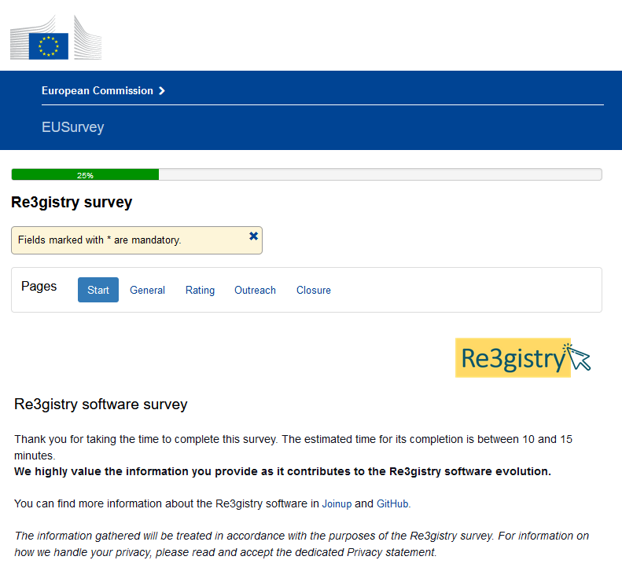
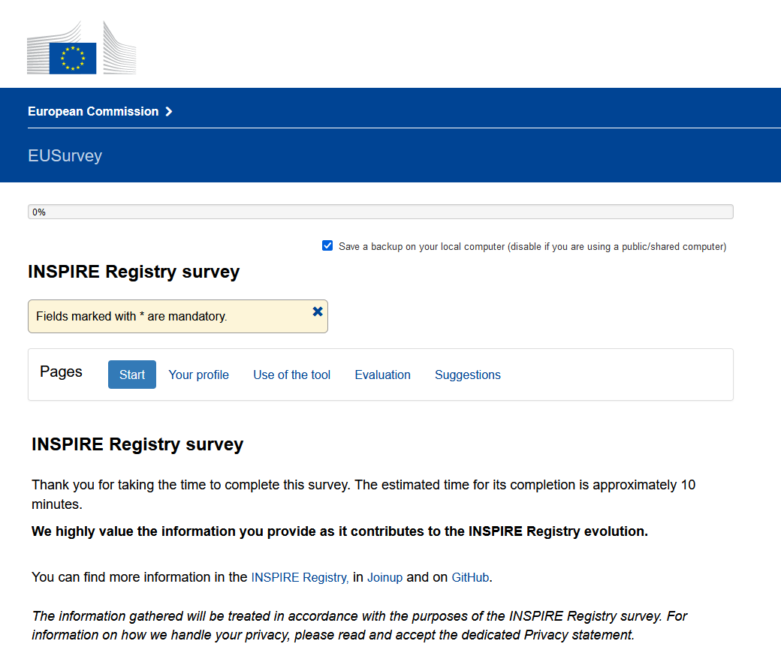
Re3gistry and INSPIRE Registry Surveys
Take part in our surveys !!
Re3gistry software
https://ec.europa.eu/eusurvey/runner/Re3gistry_Survey
INSPIRE Registry
https://ec.europa.eu/eusurvey/runner/INSPIRE_Registry_Survey

Slide 19




Community & Communication channels
GitHub - Re3gistry Helpdesk
INSPIRE Registry Helpdesk
Re3gistry last news - Join up
OSGeoLive 16 - Re3gistry software
Re3gistry - Promotional video

Slide 20
Demonstrations today
9:50 - Part 1. Getting started with the Re3gistry
Installation
Description of the application
Creation of content & Data governance
10:30 - Q&A session
10:45 - Coffee break ☕
11:00 - Part 2. The Re3gistry in detail
Specific Re3gistry features
Frontend & Data consumption
12:10 - Re3gistry Starter Kit
12:15 - Q&A session

Slide 21



Thank you!
Jordi.ESCRIU@ec.europa.eu
@JordiEscriu
© European Union 2020
Unless otherwise noted the reuse of this presentation is authorised under the CC BY 4.0 license. For any use or reproduction of elements that are not owned by the EU, permission may need to be sought directly from the respective right holders.

