Slide 1
Training on Re3gistry / INSPIRE Registry
JRC INSPIRE Team & Bilbomatica
May 29, 2024

Slide 2

Re3gistry Software / INSPIRE Registry
“Sharing meanings, connecting minds”
Notes:
As first introduction, I would like to show you a video that summarises the functionality and usability of the tool as a central repository for managing and sharing terms, concepts and reference codes in general.

Slide 3

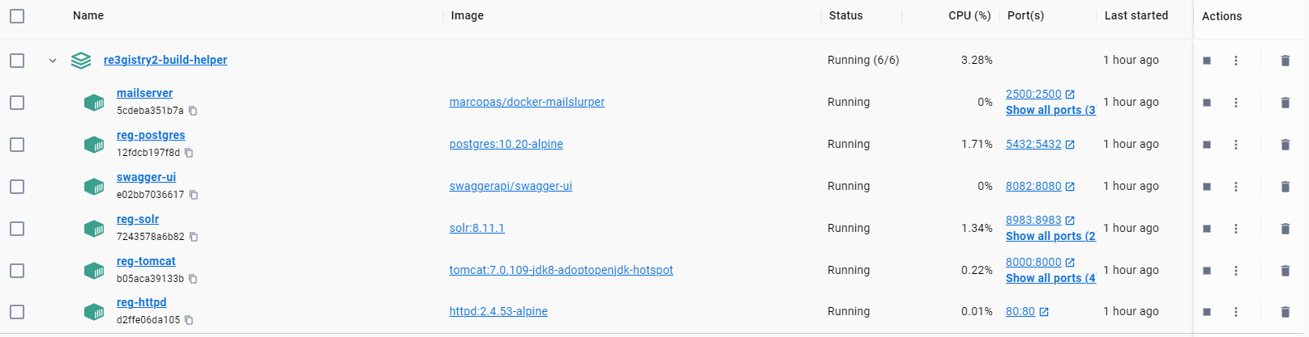
Installation Options
allows consistent environments and easier scaling but requires more initial setup.

Slide 4

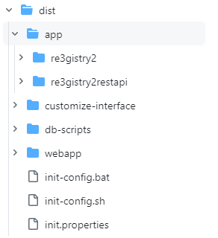
Installation Options
Provides an easier setup and fastest deployment.
Git hub https://github.com/ec-jrc/re3gistry/tree/master/dist/app

Slide 5
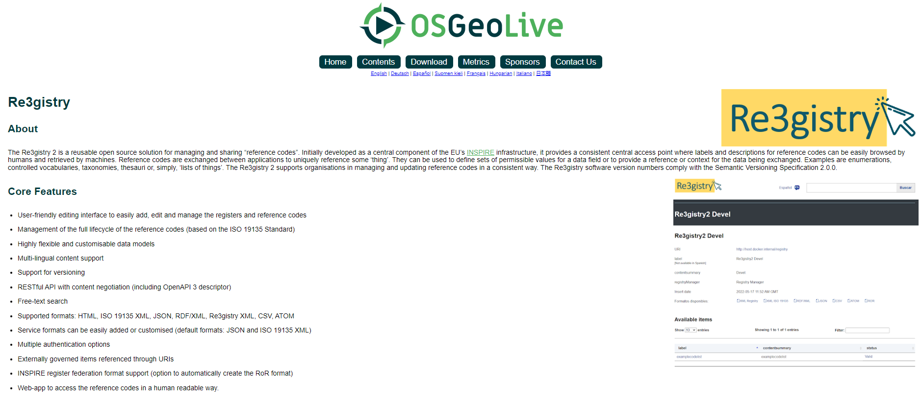
Installation Options
OsGeo Live is a Linux based distribution ready to deploy multiple open source applications. You can try and deploy a Re3gistry instance easily.

Slide 6

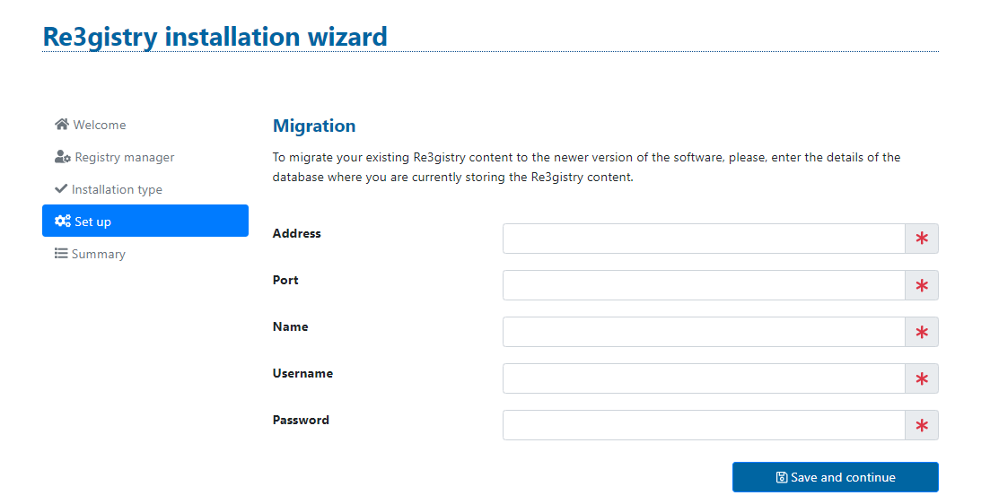
Migration
Uuids are unique identifiers of a reference code, for the migration to work properly it is important not to make manual modifications to the database.
The Re3gistry software allows to easily migrate your data from previous versions. You just need the new and the old database and automatically all the items will be updated to the new version.

Slide 7


Slide 8
Workflow status (based on the ISO 19135 Standard)
DRAFT
Submitting organisation
SUBMITTED
ACCEPTED WITH CHANGES
ACCEPTED
NOT ACCEPTED
Control body
VALID
Registry Manager

Slide 9
Workflow status (based on the ISO 19135 Standard)
VALID
INVALID
SUPERSEDED
RETIRED
INVALID: If it is considered an error on a "valid" reference code. Generally, it is replaced by a new "valid" reference code (successor).
SUPERSEDED:The reference code has been replaced by a new or a different "valid" reference code (successor)
RETIRED: When a reference code is no longer recommended for use and its replacement is not planned

Slide 10
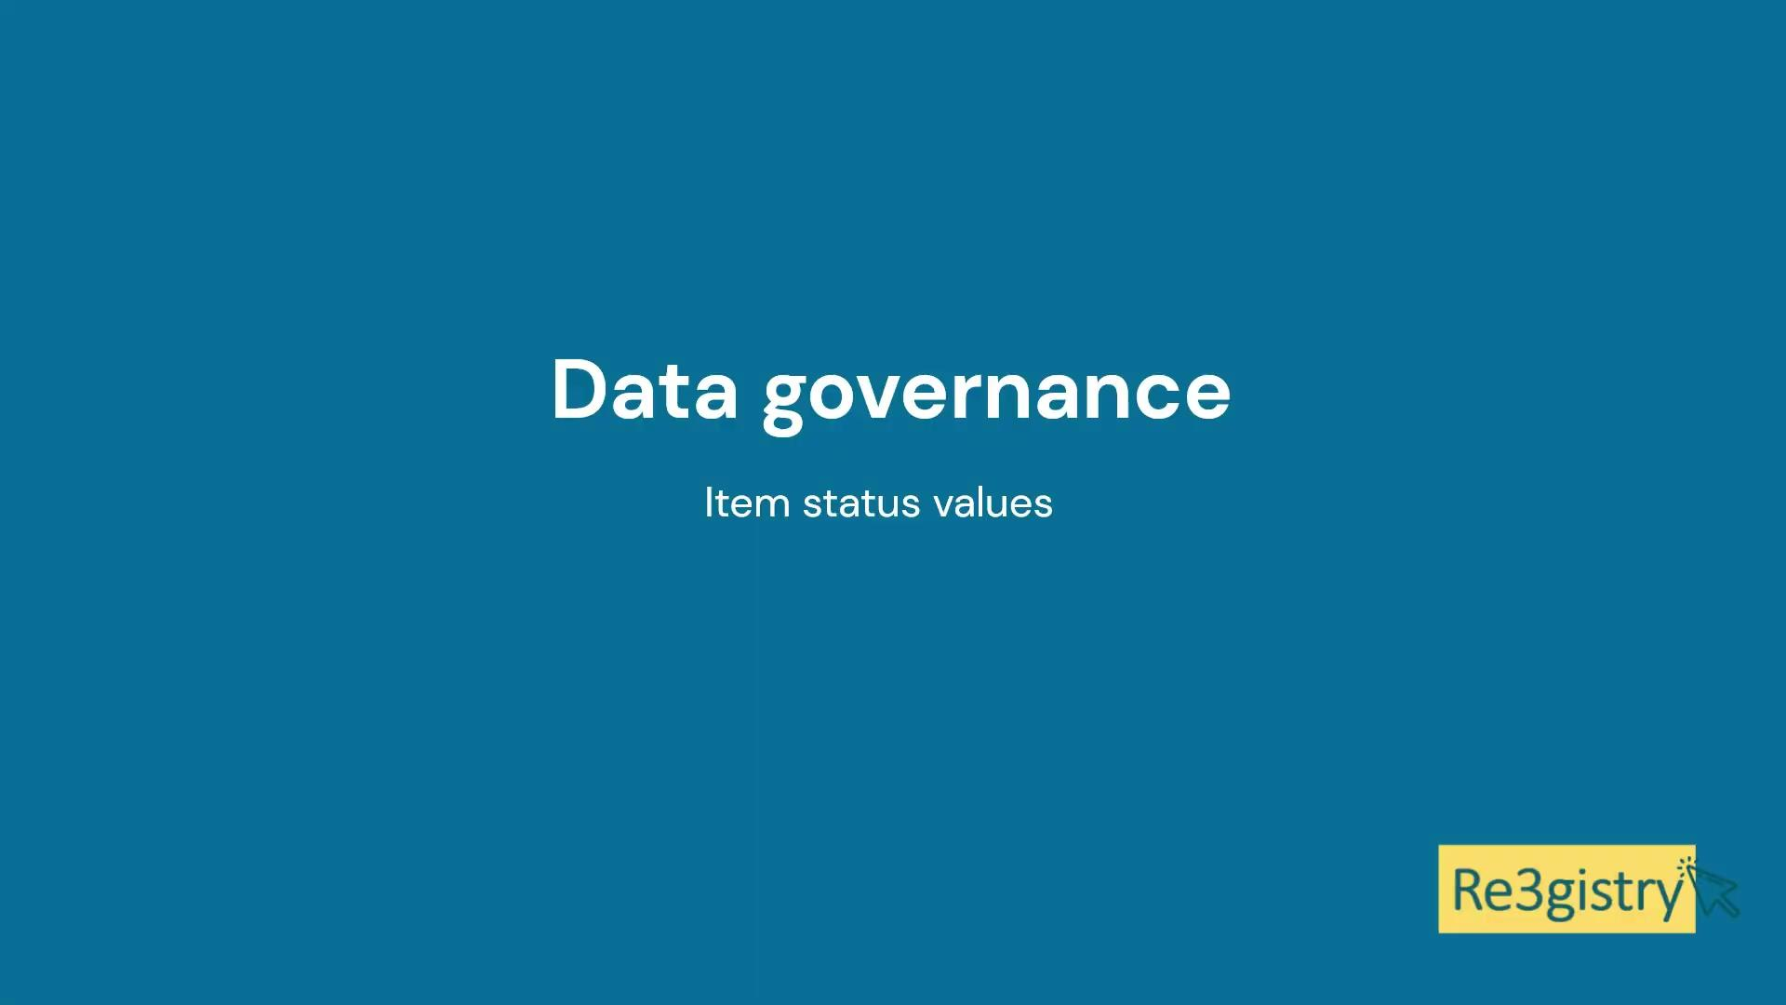

Slide 11

Q&A SESSION

Slide 12

Coffee break 15’

Slide 13
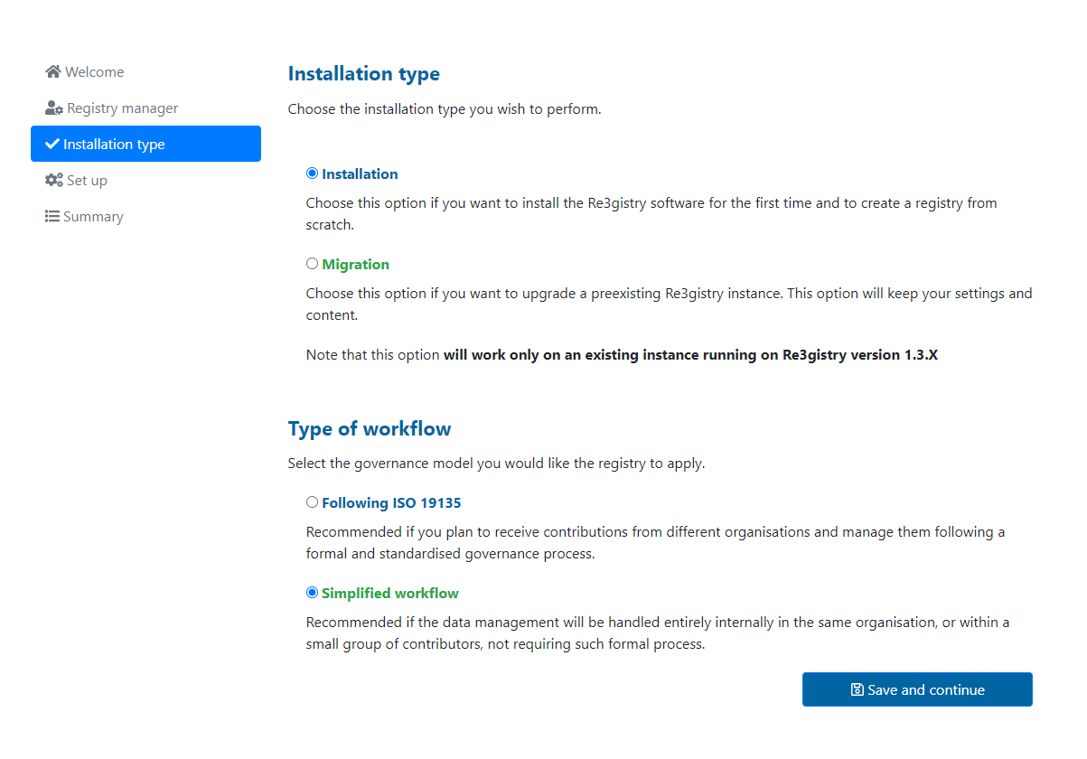
Simplified workflow
The purpose of this functionality is to make the use of the Re3gistry more flexible and applicable in other areas.
It is possible to select the option Simplified workflow in the Re3gistry Software installation.

Slide 14
Simplified workflow
It allows you to publish directly without having to go through each of the steps and statuses established when making a change proposal.
Therefore, you would not need a Submitting Organisation to make the change nor the approval of the Control Body.
It is centralised in a single user
This option is available since v2.4.0 version

Slide 15


Slide 16
Users and groups
Depending on the user's role (the group they belong to), the tabs displayed in the menu bar change:
Registry Manager
Register Manager
Register Submitter
Control Body

Slide 17
Registry manager features
The Registry manager, has the highest privileges in the system and can perform different tasks:
Make any action and publications on the reference codes.
Manage the structural elements of the system.
Manage both users and groups
Manage data export (cache)

Slide 18
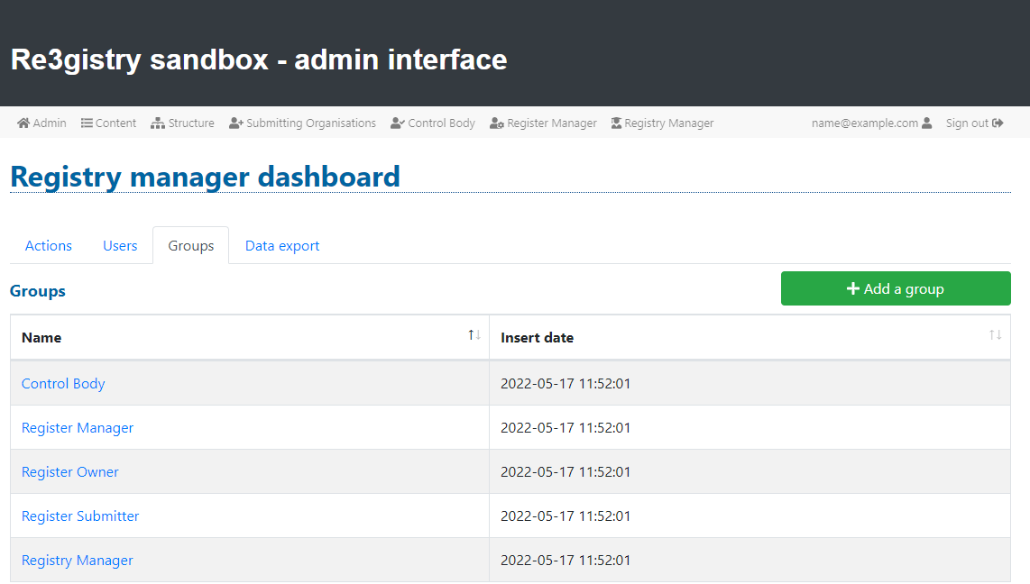
Registry manager - Users and groups
When an instance is installed from scratch, the possible user roles that the Re3gistry creates by default are:
Registry manager
Register owner
Register manager
Control body
Submitting organisations
The system is highly flexible in managing the roles:
The user is assigned to one or more groups.
One group can be associated to one or more registers

Slide 19
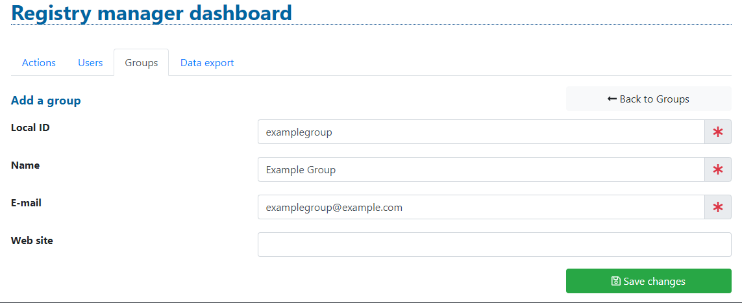
Registry manager - Users and groups
The Re3gistry creates default groups during installation, but custom groups can also be created. The Registry Manager is responsible for creating new groups:

Slide 20
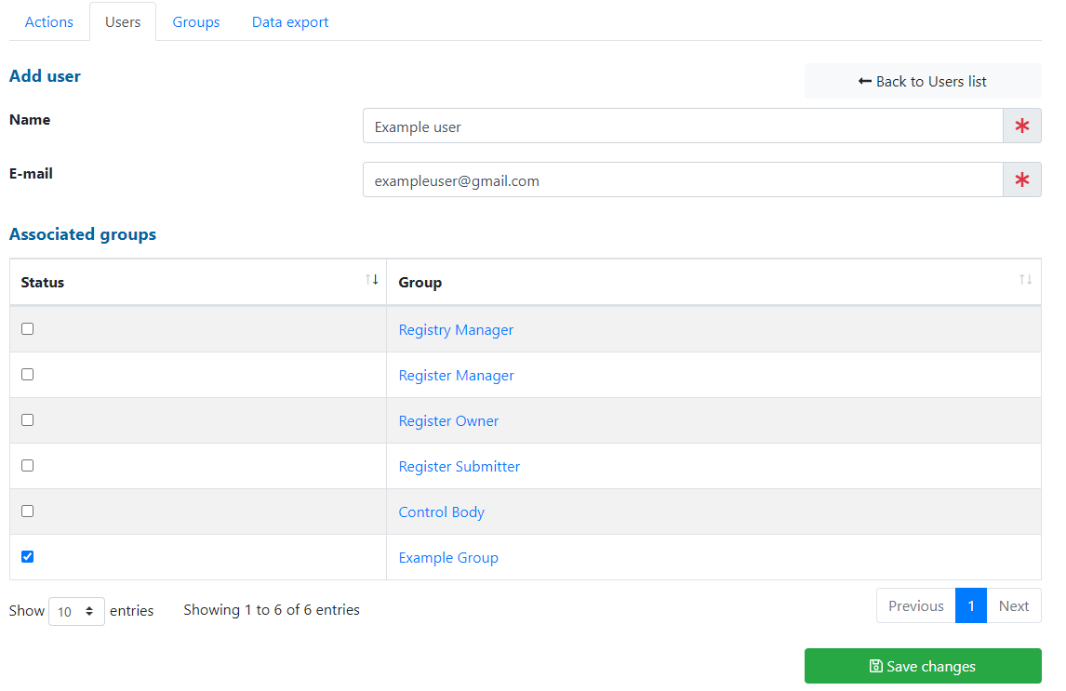
Registry manager - Users and groups
New users can be created by the Registry Manager.
When created, users are assigned to an existing group.
To enhance security protocols:
An email containing activation and deletion link of the account is sending.
The email will also include a temporary password that must be changed before logging in for the first time.

Slide 21
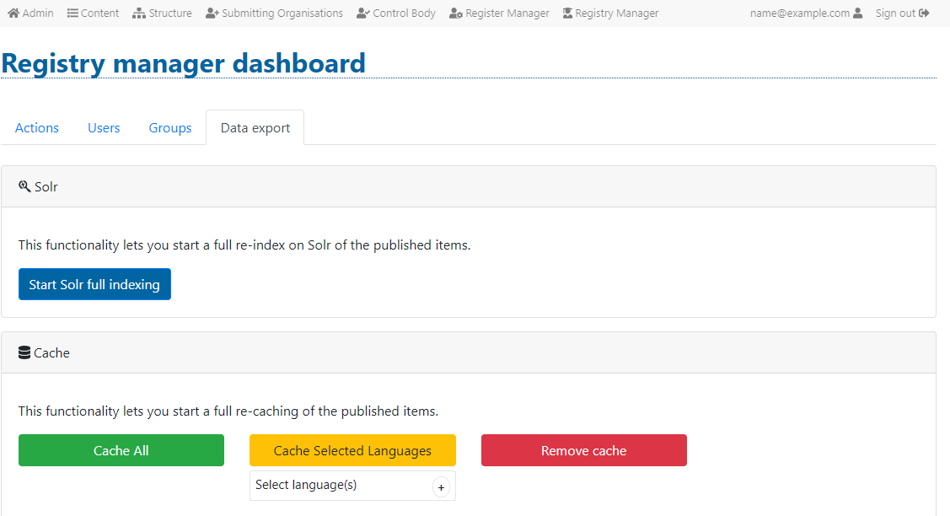
Registry manager - Data export
The Data export subtab allows the registry manager to run a complete SOLR index and a complete CACHE of the items presented in the system.
Solr: This option helps to easily run a full export of the registry data to the Solr index on the published items.
Button "Cache all": This option helps to run a full cache of the active languages of the system.
Button "Cache all - Selected languages": This option helps to run a full cache on the languages you select in the widget among the existing ones. This option is available since v2.5.3 version
Button "Remove cache": This option helps to remove the index of all the cache items.

Slide 22
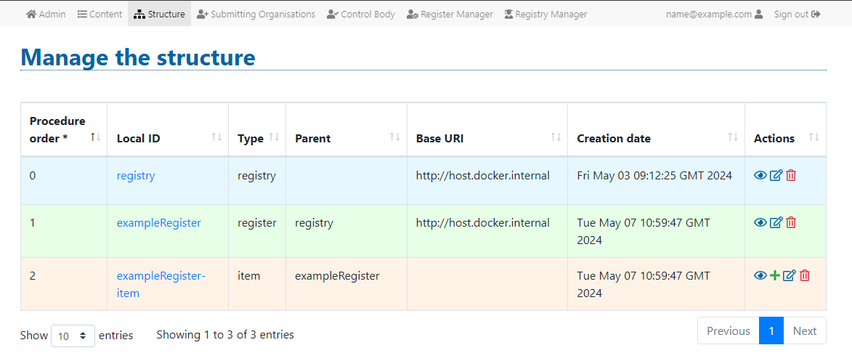
Structure
The structure tab gives the user access to the management of the data model for each entity in the registry system by graphically adding and managing the fields.
The main page of the structure tab contains the list of content classes available in the system.
A content class is automatically created every time that a new register is created or added in the content tab.

Slide 23

Structure
Manage the content
To make modifications in management of the data model , you can use the icons displayed in the actions column.
View/Manage fields
Edit
Delete

Slide 24
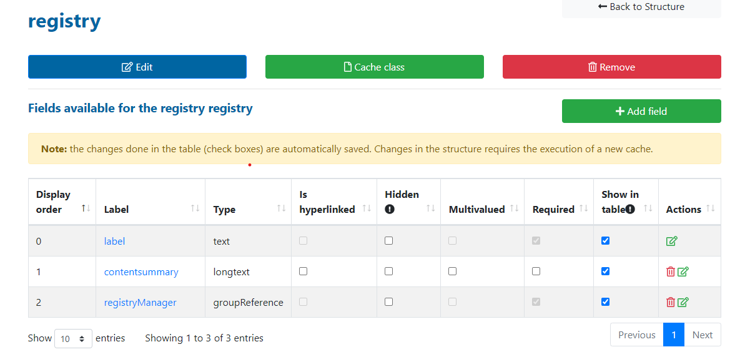
Structure
Structure dashboard
In the structure dashboard, various aspects can be configured:
Field display order.
Establish hyperlinks for fields
Determinate field visibility in the public interface
Enable multivalued selections
Set fields as required
Displaying fields in the available items table on the content page.

Slide 25
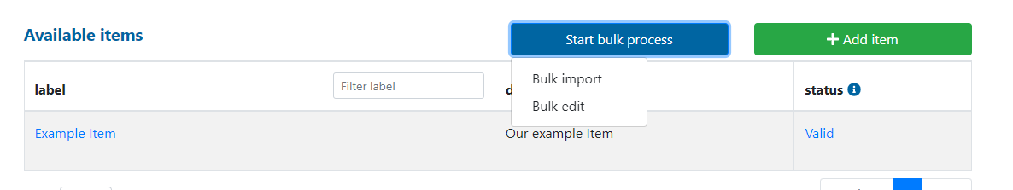
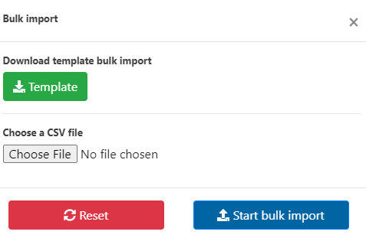
Advanced editing
Bulk Import/Bulk edit
Bulk import and bulk edit is a feature to allow users to insert and make modifications to multiple items at the same time. This option is available since v2.5.2 version
To initiate a bulk edit or import, begin by uploading a .csv file containing the
specific fields you wish to modify. Upon clicking the bulk import/edit button,
a pop-up will appear, providing the option to download a template.

Slide 26
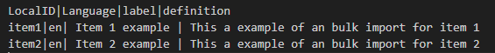
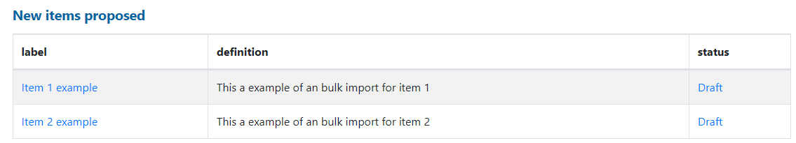
Advanced editing
Bulk Import
To perform a bulk import, you need to fill in all the fields listed in the template. The fields in the template are separated by pipes (|) . It is crucial to maintain the same structure.
When the process is complete, a congratulations message will be displayed, and the proposed items will appear in the table at the bottom.
Template
Information of the items to import

Slide 27

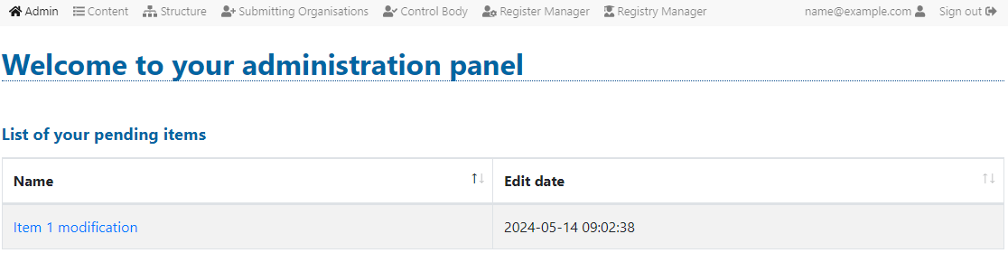
Advanced editing
Bulk edit
To perform a bulk edit, it is mandatory to enter the item’s ID an the language. Fields that remain unchanged should be left blank.
If we navigate to the 'Admin' tab, we can observe that the item has been edited.
Template
Information of the item to edit

Slide 28
Available formats
XML Registry: A Registry specific XML format
XML ISO 19135: Geographic ReGister XML
RDF/XML: Is a syntax, defined by the W3C, to express (i.e. serialize) an RDF graph as an XML document.
JSON: Is a text format that is completely language independent
CSV: A CSV (comma-separated values) file is a text file that has a specific format which allows data to be saved in a table structured format.
ATOM: The Atom Syndication Format is an XML language used for web feeds
ROR: An INSPIRE specific format meant to share items through INSPIRE applications

Slide 29
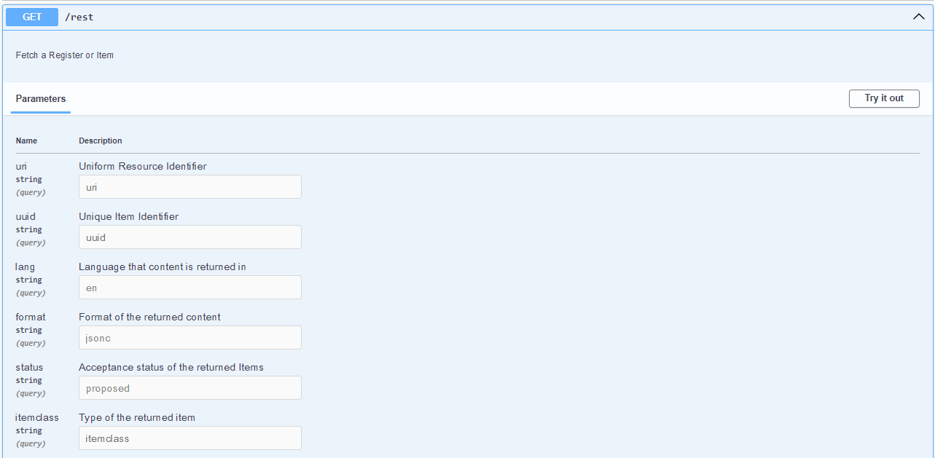
API Swagger
The API Swagger brings a easy to understand explanation for the API of the Re3gistry2
Just one endpoint is needed to bring all needed data to the frontend
This makes the frontend fully customizable

Slide 30
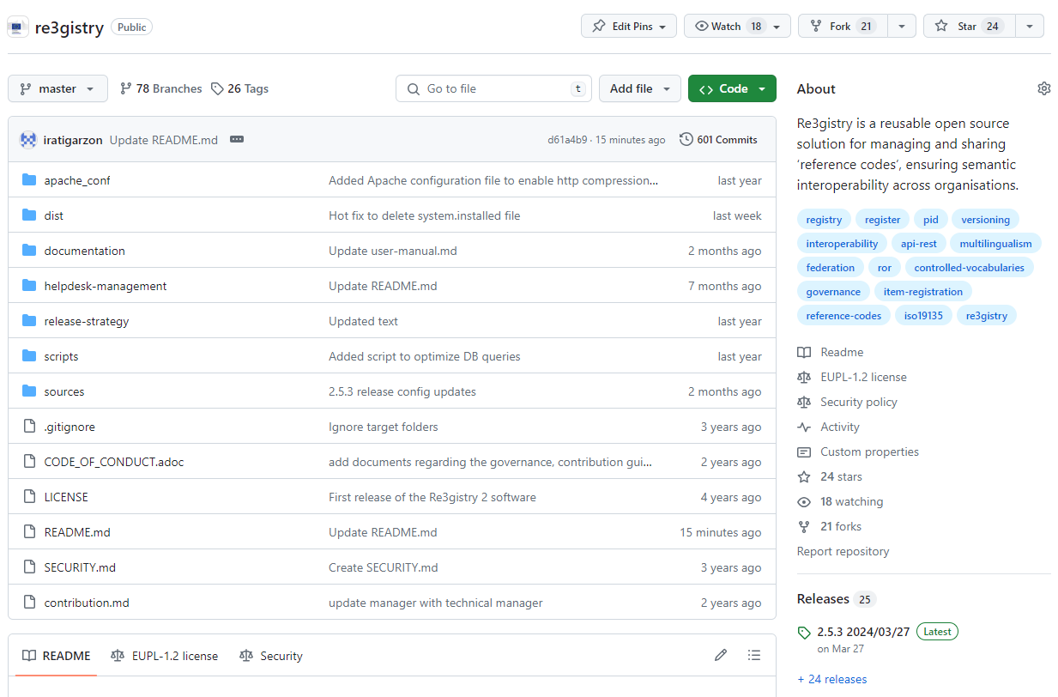
Re3gistry software in Github
The Re3gistry software code is exposed on a github repository
https://github.com/ec-jrc/re3gistry
As a reusable open-source software, contributions are welcome as explained in the contribution section.
https://github.com/ec-jrc/re3gistry/blob/master/contribution.md

Slide 31
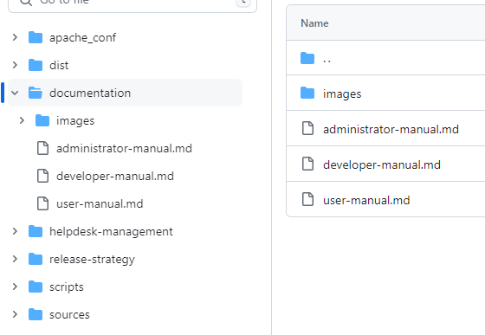
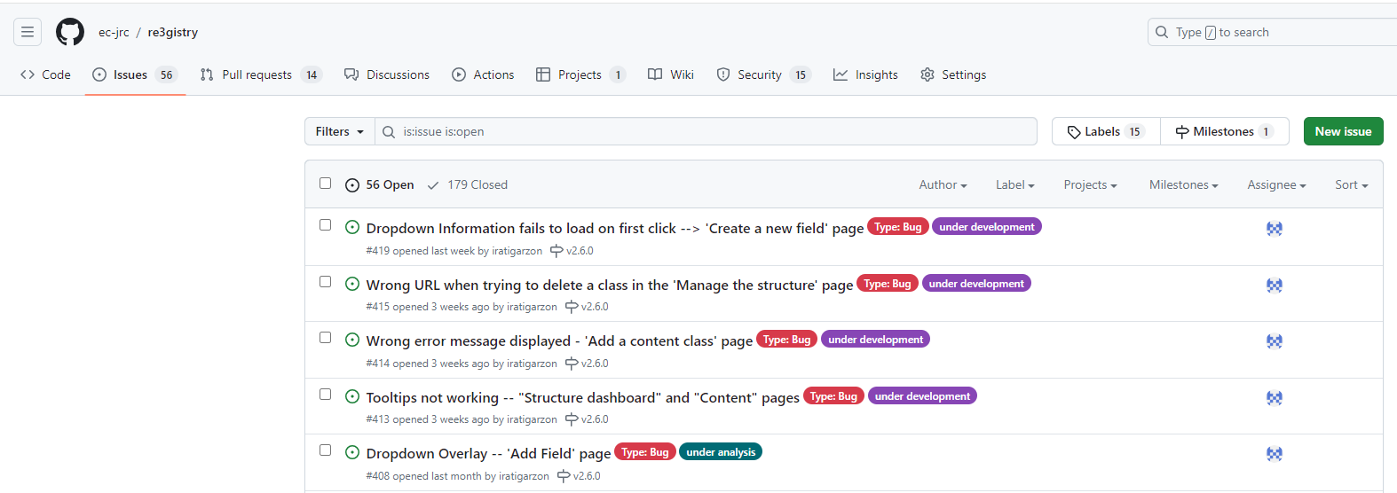
Re3gistry software in Github
A documentation is available, focusing on the different user profiles that the tool can have (administrator, developer, user)
This is updated in each of the versions
For bug reporting, a helpdesk is available. https://github.com/ec-jrc/re3gistry/issues
Proposals and improvements are also welcome

Slide 32
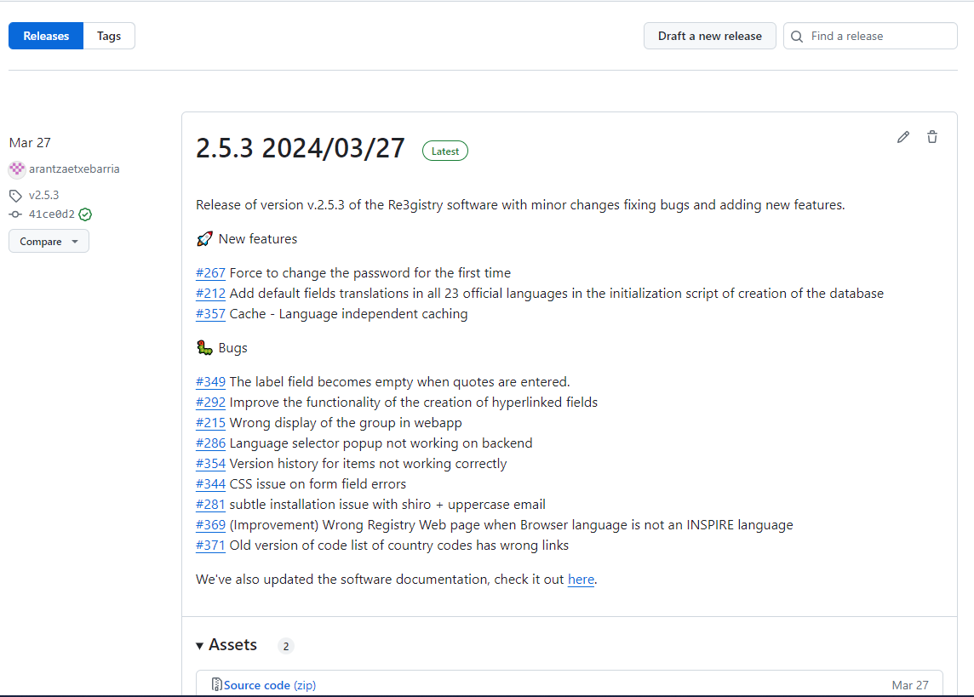
Re3gistry Software Github - Change log
You can view the different versions available
https://github.com/ec-jrc/re3gistry/releases
Latest release
March 2024 (v2.5.3)
https://github.com/ec-jrc/re3gistry/releases/tag/v2.5.3
Next release
A new release is scheduled for the end of June tha will be a major release v2.6.0

Slide 33
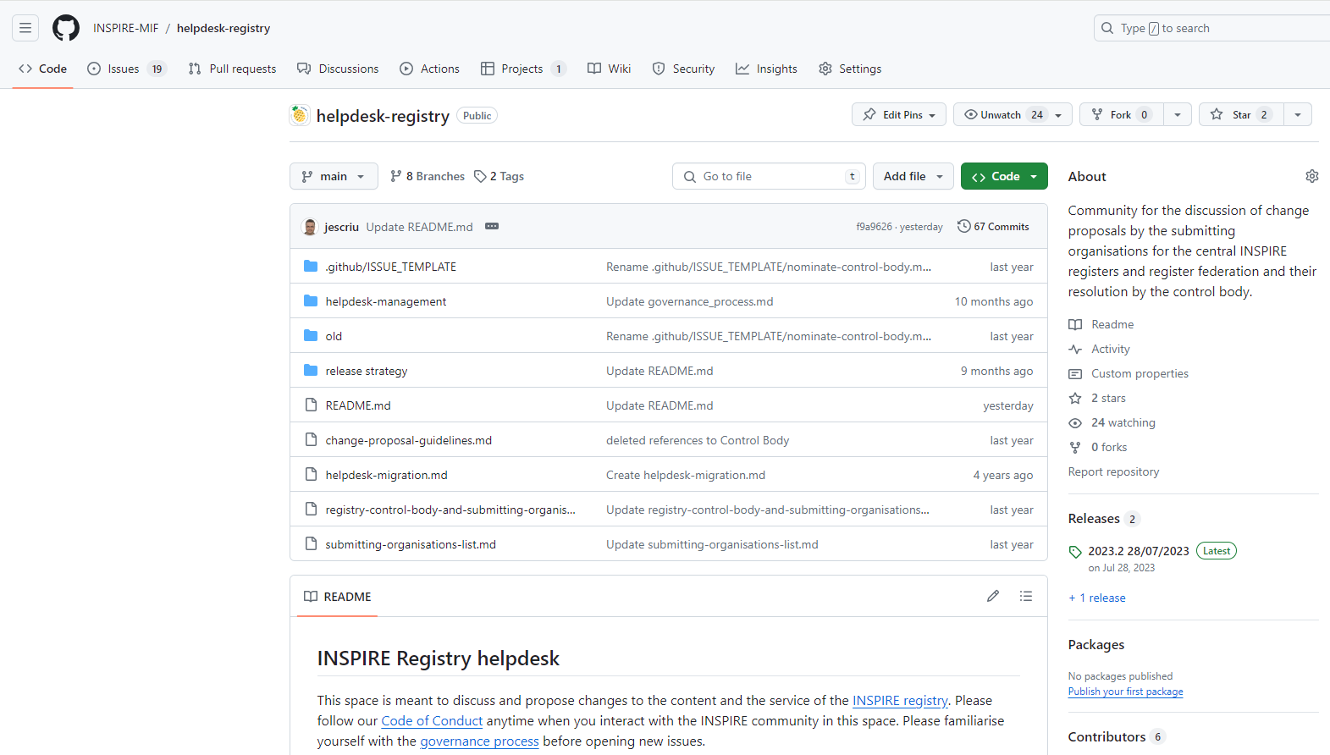
INSPIRE Registry Github
The INSPIRE Registry repository available here:
https://github.com/INSPIRE-MIF/helpdesk-registry
The helpdesk is an space to discuss and propose changes to the content of the INSPIRE registry
https://github.com/INSPIRE-MIF/helpdesk-registry/issues

Slide 34
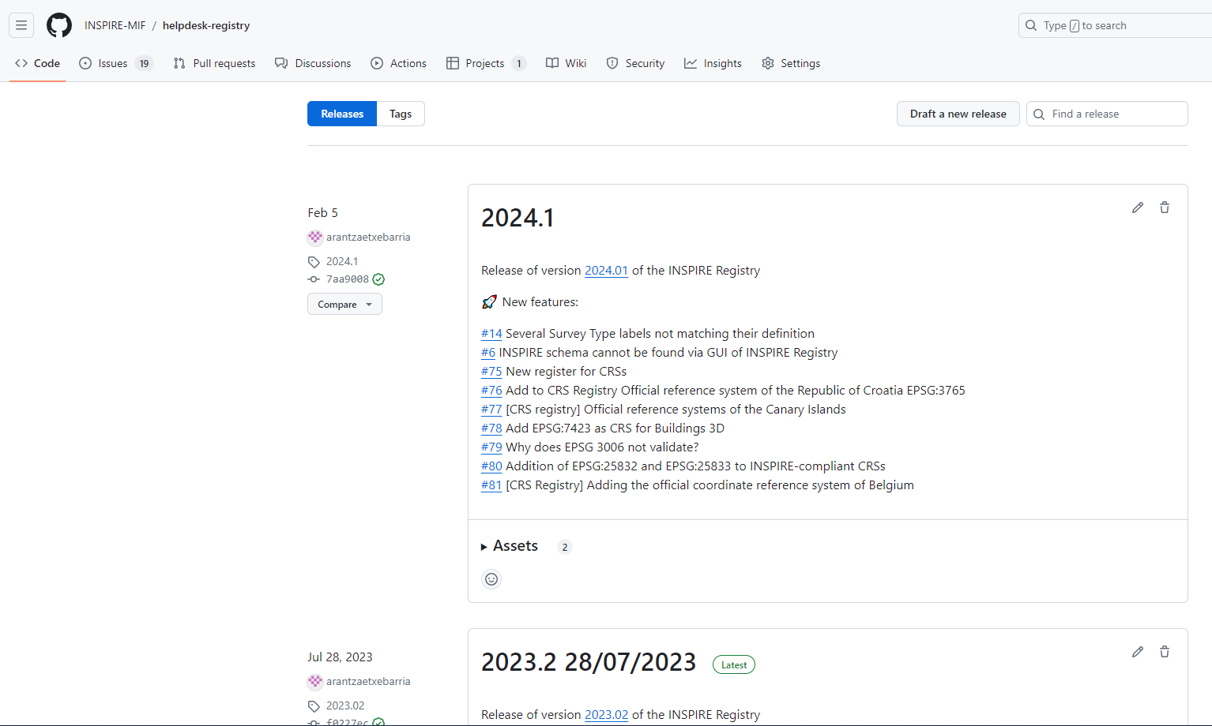
INSPIRE Registry Github - Change log
Latest release
2024.01 https://github.com/INSPIRE-MIF/helpdesk-registry/releases
Next releases
2024.1b - Intermediate release to Carry out pending changes derived from the amendment of Commission Regulation (EU) No 1089/2010)
A new release is scheduled for the end of July 2024.2

Slide 35
Q&A SESSION

Slide 36
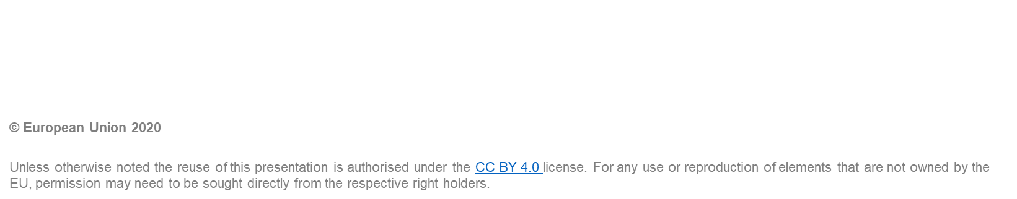

Thank you

