Slide 1
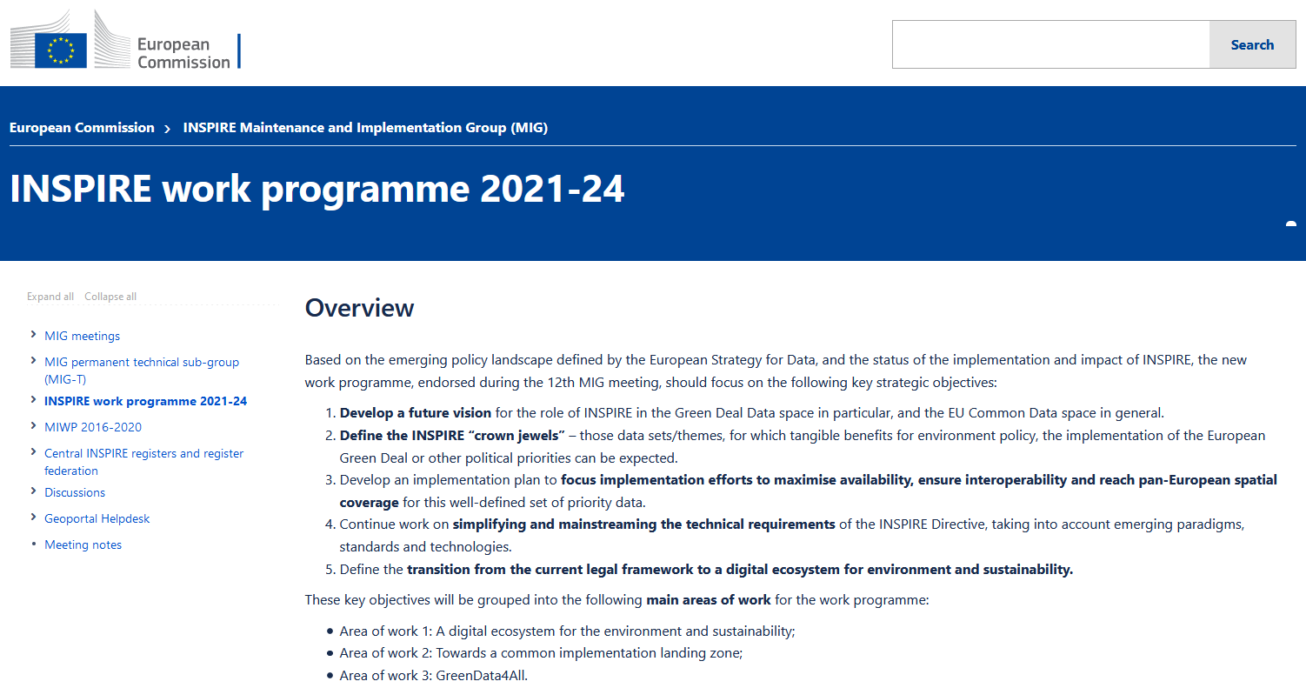
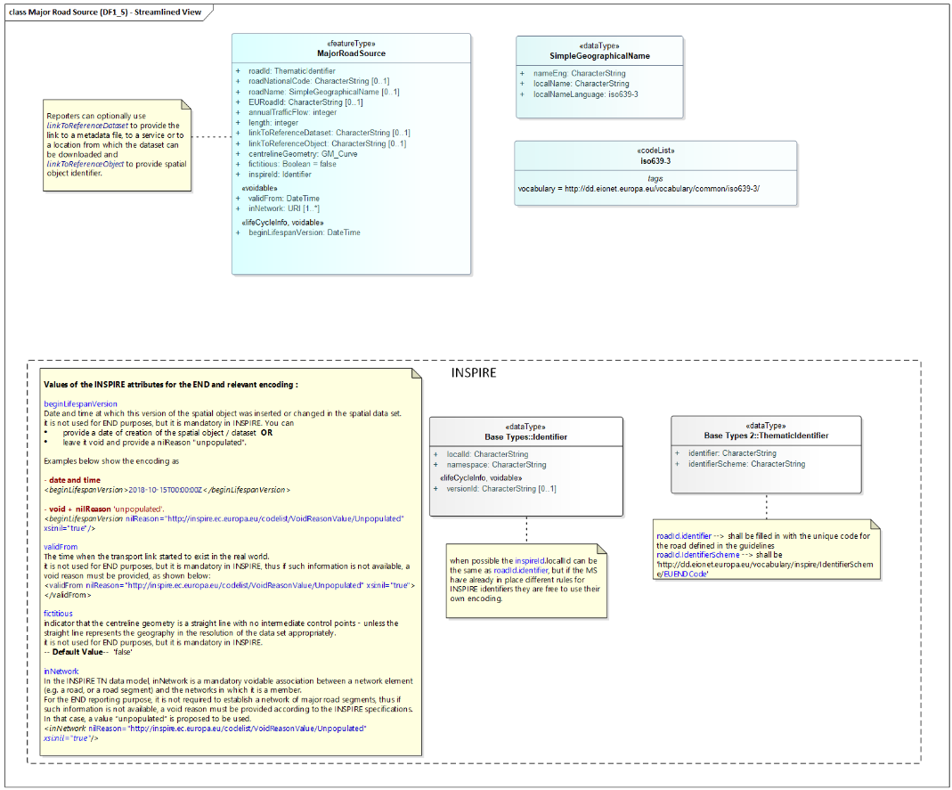
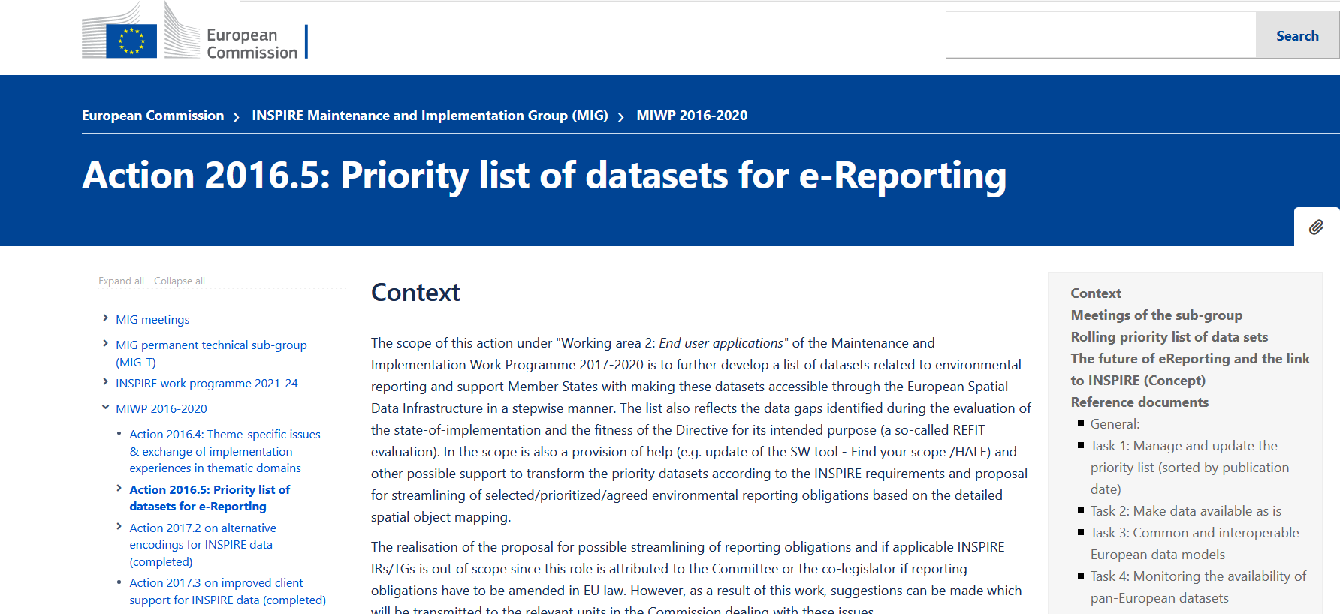
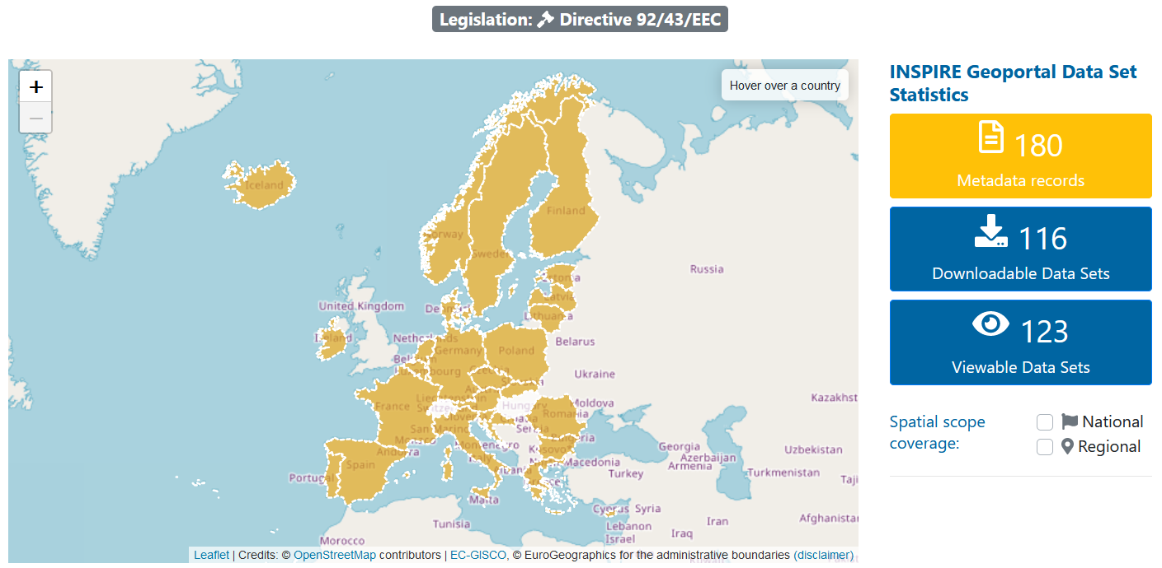
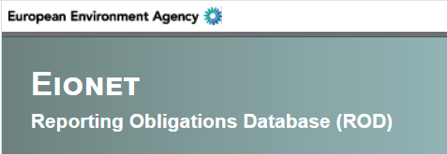
21th April 2021
Joint meeting of Eionet NRC EIS & INSPIRE subgroup action 2.1 on “needs-driven data prioritisation”
INSPIRE priority list of data sets for eReporting -
Methodology for PDS progress
Common and interoperable European data models
Darja Lihteneger, EEA

Slide 2
Outline
Methodology for PDS progress – status
Common and interoperable European data models - overview

Slide 3
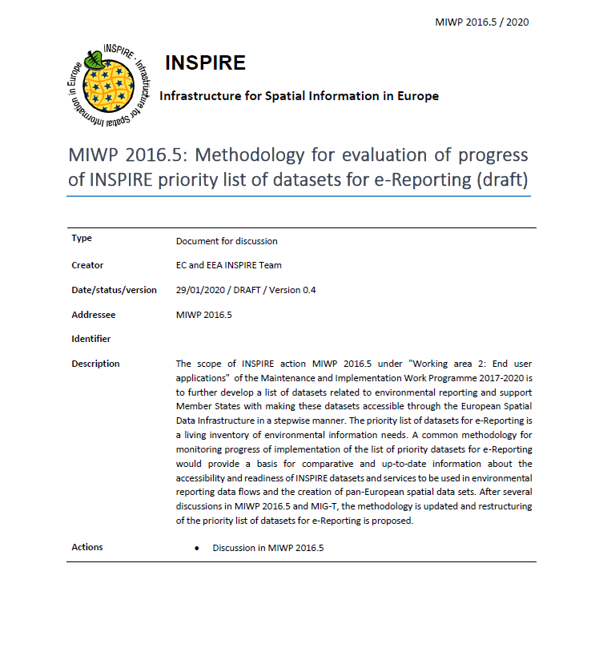
Methodology for PDS progress – implementation targets
Purpose: common approach in monitoring progress of available priority data sets
Implementation targets:
Geographic coverage
Temporal references
INSPIRE data model harmonisation
Related to environmental reporting obligations and used in reporting data flows
https://webgate.ec.europa.eu/fpfis/wikis/display/InspireMIG/Action+2016.5%3A+Priority+list+of+datasets+for+e-Reporting?preview=/299729499/448270134/MIG_2016.5_PDS_Methodology_v2.pdf

Slide 4
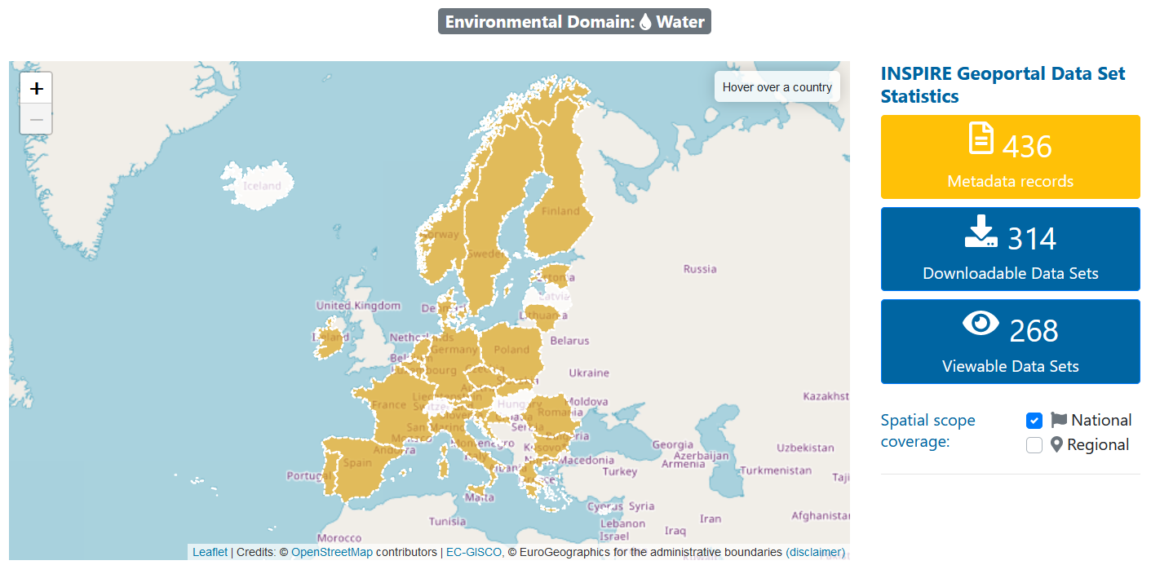
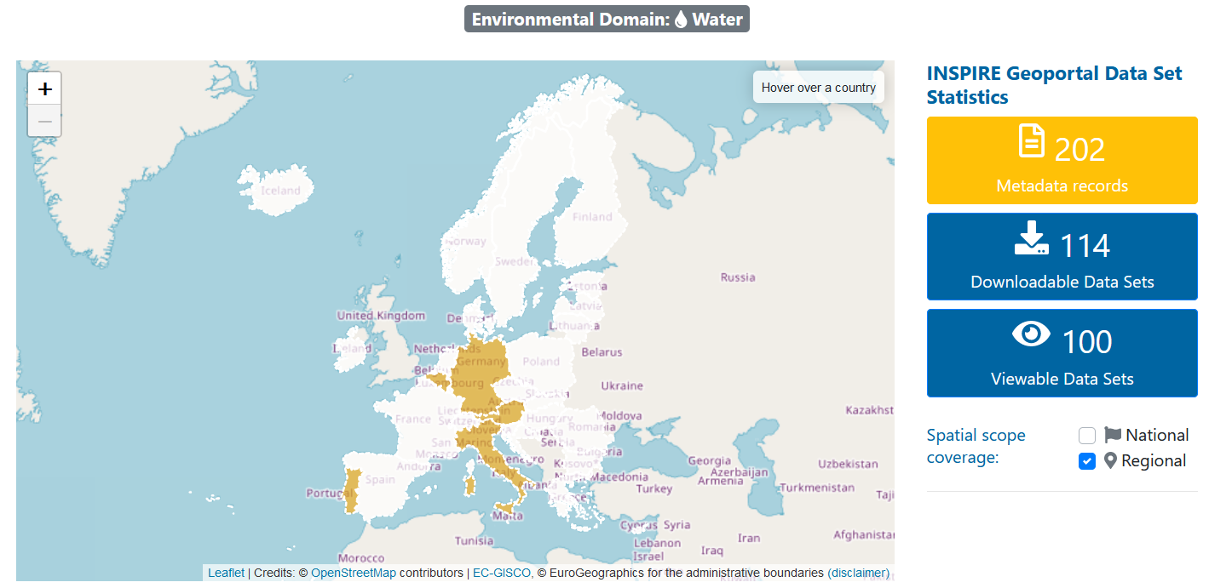
Methodology for PDS progress – geographic coverage
National / regional coverage:
Provided through spatial scope and monitoring indicators
Function / filter in INSPIRE Geoportal
Derogations:
Legal basis in legislation
Information provided to DG ENV
Reported data or reference data:
The PDS list was updated to distinguish between reference data and reported data
Example – reference data: Bio-geographical regions
Reported data: BWD – bathing waters

Slide 5
Methodology for PDS progress – temporal reference
Scope: to ensure that the most up-to-date priority datasets are made fully available through the INSPIRE Geoportal
Important temporal aspects
Indication of actual reporting year
Time series
Temporal information provided according to the INSPIRE Metadata Regulation (one or several of the following):
Temporal extent of the described resource,
Date of publication,
Date of last revision or,
Date of creation
Proposal related to metadata provision:
Apply all relevant keywords of priority datasets
Temporal reference by promoting use of temporal extent
Indicating reporting year in other metadata elements, e.g.:
Resource title
Resource abstract
Keyword
Proposal related to priority list of datasets
Mapping between the priority list of datasets and corresponding INSPIRE spatial data themes
Included in PDS Version 2.1
Heterogeneity

Slide 6
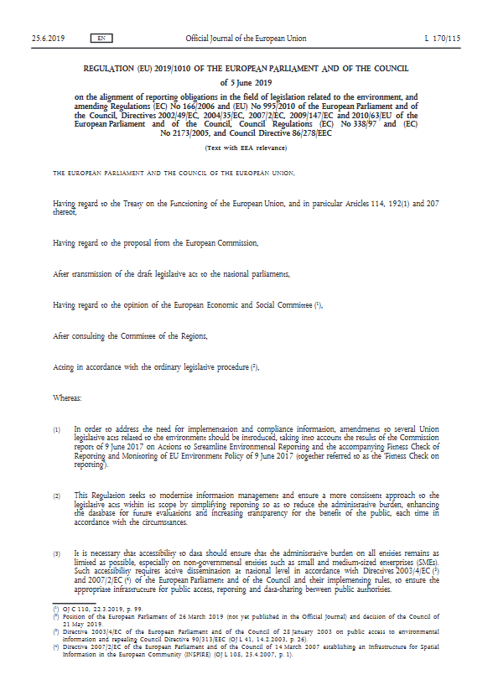
Methodology for PDS progress – harmonisation
Scope: Priority datasets should be made available under harmonised conditions
Availability of data sets:
Datasets as-is
Harmonised datasets with INSPIRE requirements
Harmonisation activities and examples:
Country
Data providers
Associations
Thematic communities
Initiatives, programmes, projects (cross-border, European)
Exchanging information on harmonisation activities for eReporting use case
USE CASE:
Environmental reporting obligations and and alignment with INSPIRE / streamlining reporting obligations
Reporting communities, EC, EEA

Slide 7
Reporting obligations and INSPIRE alignment
Implemented and reported
Reporting information is included in the PDS list
Reporting obligation | Reporting information | Reporting frequency | Reporting deadline
AQD - Air Quality Directive | https://aqportal.discomap.eea.europa.eu/ | Annually | 30/09/2021
WFD - Water Framework Directive – River Basin Management Plans | https://cdr.eionet.europa.eu/help/WFD/WFD_780_2022 | 72 months | 22/03/2022
BWD - Bathing Waters Directive | https://cdr.eionet.europa.eu/help/BWD | Annually | After 1 January and before the start of the bathing season
Industrial emissions – EU-Registry on Industrial | https://cdr.eionet.europa.eu/help/euregistry | Annually | 30/09/2021
Nationally designated areas – CDDA | https://cdr.eionet.europa.eu/help/cdda/ | Annually | 15/03/2022
Invasive Alien Species | https://easin.jrc.ec.europa.eu/easin/Services/Reporting | 72 months | 01/06/2025

Slide 8
Reporting obligations and INSPIRE alignment
Alignment with INSPIRE in progress
Reporting obligation | Reporting – legal instrument | Reporting frequency | Reporting deadline
Environmental Noise Directive Major noise sources Strategic noise maps Noise action plans | https://rod.eionet.europa.eu/instruments/585 | Full cycle 5 years | 30/06/2025 31/12/2022 18/01/2024
Floods Directive Units of Management and Competent Authorities Flood Risk Management Plans – 2022 Flood Hazard Maps and Flood Risk Maps Preliminary Flood Risk Assessment and Areas of Potential Significant Flood Risk | https://rod.eionet.europa.eu/instruments/630 | Review 6 years Continuous Review 6 years Review 6 years Review 6 years | Continuous 22/03/2022 2025
Urban Waste Water Treatment Directive | https://rod.eionet.europa.eu/instruments/543
Drinking Water Directive (New Directive) | https://rod.eionet.europa.eu/instruments/545
Sewage Sludge Directive
Revision of the Natura 2000 Standard Data Form

Slide 9
INSPIRE harmonisation - approaches
Conceptual data modelling – common European data models (from practice):
Use INSPIRE data model as is and include link between environmental data and INSPIRE data (linked approach: e.g. CDDA)
Extend INSPIRE data model to provide environmental data (e.g. AQD, IAS, WFD, BWD, END) (INSPIRE data model extension information)
Direct use of INSPIRE data model to provide environmental data (e.g. END noise contours of strategic noise maps)
Needed
Harmonisation
INSPIRE legislation, technical guidelines
Reporting obligation (legislation), technical guidelines
Standards
Technology
Knowledge
Capacity

Slide 10
Relevance for INSPIRE Action 2.1
Managing the priority list of datasets for e-Reporting
Combine methodology for PDS progress with methodology for prioritisation
Exchange information on harmonised European data models (INSPIRE alignment) – support to streamlining of reporting obligations and INSPIRE
Support to availability of datasets
Improve functionalities of INSPIRE Geoportal

Slide 11
Thank you
More information:
Darja.Lihteneger@eea.europa.eu

