Slide 1


EdStem & Datacamp Tutorials
INSY 336 - DataHandl&Coding for Analytics
Instructor: Prof. Kyunghee Lee
TA: Yanda Tao
Fall 2025 - Section 001 & 002

Slide 2
EdStem

Slide 3
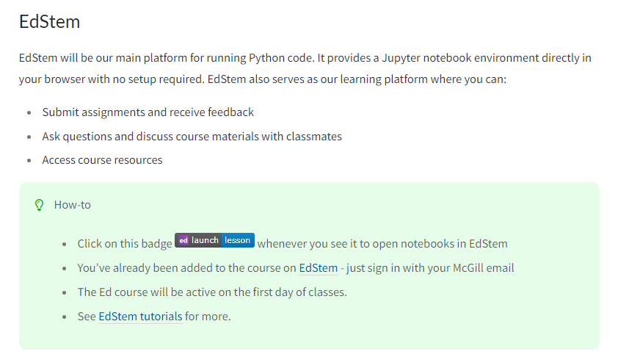
Introduction of EdStem
Click here to access the EdStem platform.
You can find this page in this Link.

Slide 4
The Interface of EdStem
At the top of the page, you can select which section you want to access in the EdStem platform: Lessons or Discussion
Click here to access the discussion page
Click here to access the Lessons page.
The discussion page is used to check announcements for this course, communicate with classmates, ask questions to the TA or professor, and answer questions from your peers.
Lessons page contains:
Assignments
Exams
Quiz

Slide 5
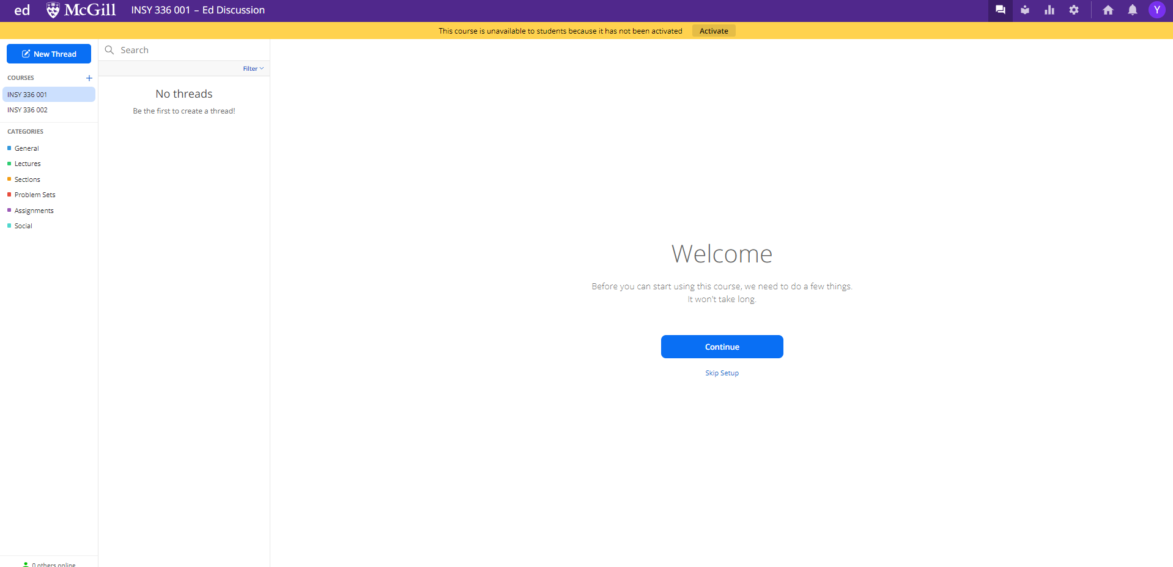
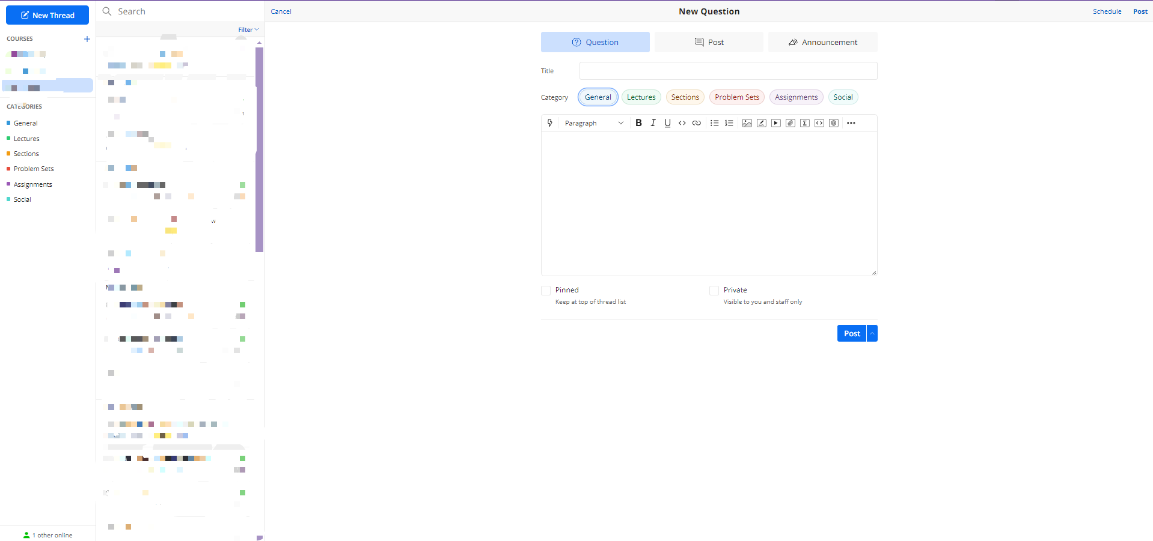
Discussion Page
Select type of your thread “Question” or “Post”
Select category of your thread.
To enter this page, you can click this button.
If you don’t want your thread to be seen by others (except the TA and the professor), you can mark it as Private.
Click this to create a new thread

Slide 6
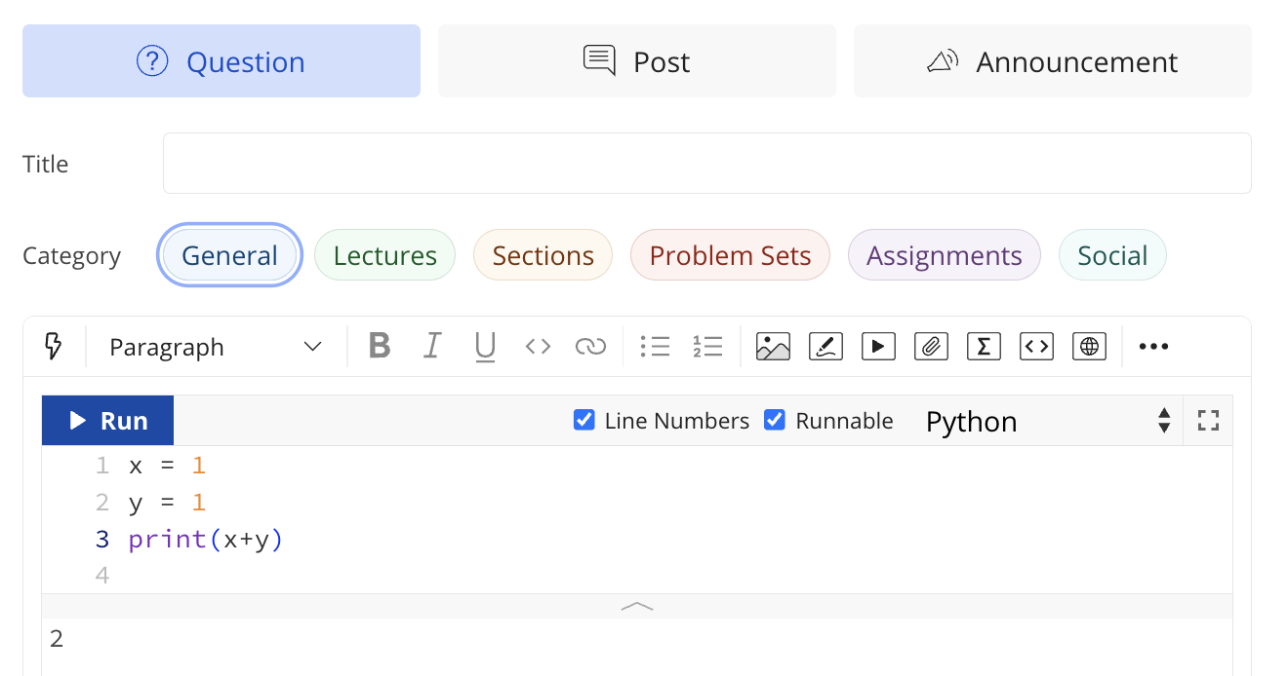
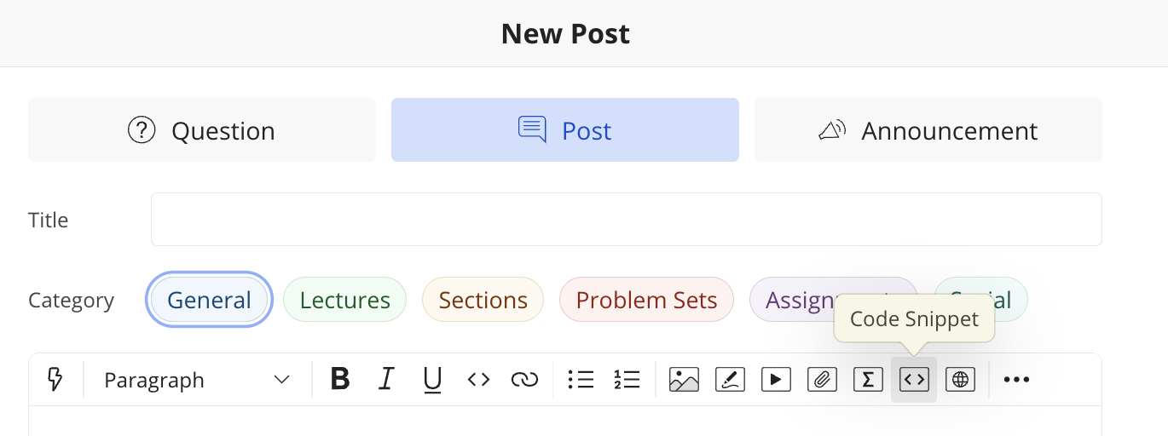
Include Your Code on the Discussion page
To include runnable Python code in your question, click the code snippet option and paste your code inside it.
You can copy your code directly into the code snippet box so that the TA and professor can better understand and address your questions. If you’d like to switch the programming language, click the Python button.

Slide 7
Usage of the Discussion Page
Note: In this course, important announcements will be posted on the discussion page of this platform (rather than on MyCourses announcements). Please check the discussion page frequently.
We also strongly recommend that you post your questions on the discussion page instead of sending emails, as the TA and professor can respond more quickly.
In addition, we encourage peer assistance: you are welcome to answer questions from your classmates. Your contributions on Ed Discussion will be considered when assigning participation grades.

Slide 8
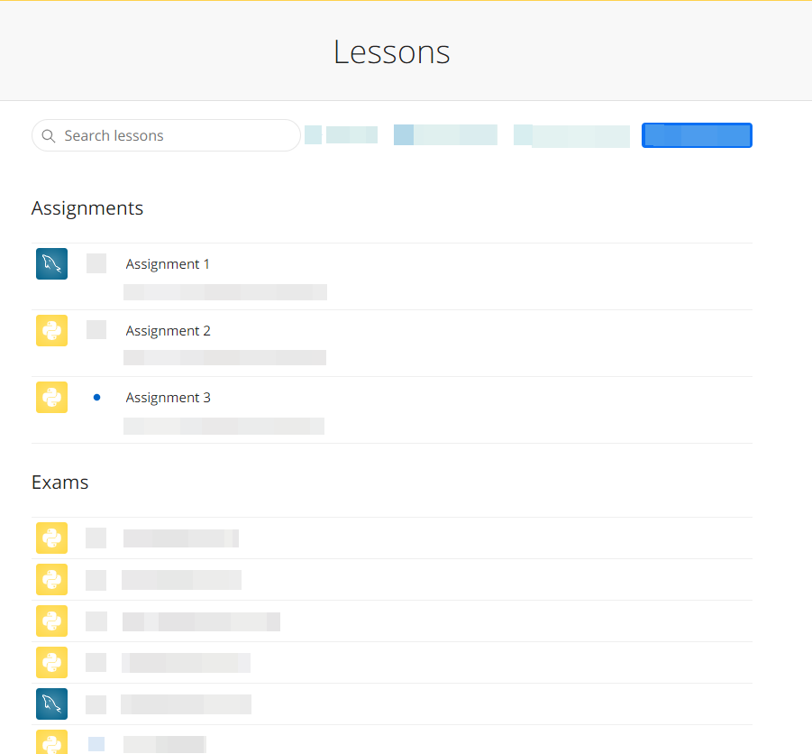
The Interface of Lessons Page
When you click on the Lessons page, you will see a list of assignments, quizzes, and exams.
Please note that it is normal for this page to appear empty at the beginning of the semester. Assignments and quizzes will become visible as the course progresses.
For example, you can click here to access into the Assignment 1.

Slide 9
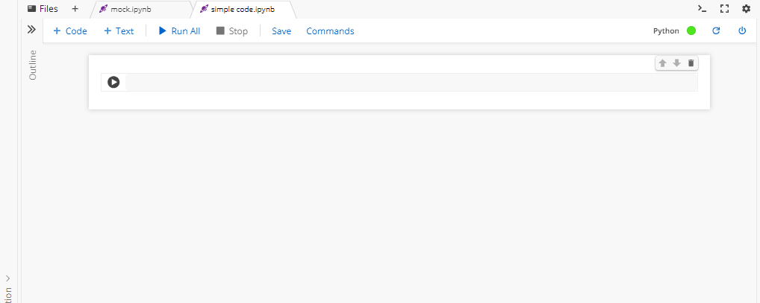
Jupyter NoteBook (1)
A Jupyter-style notebook allows you to run a Python kernel in your browser.
Jupyter Notebook will also be the main format used for assignments in this course.
You can add a new code cell by clicking + Code button.
Code cells are: These are where you actually write and run Python code.
When you press Ctrl+Enter (or click the "Run" button), the notebook executes the code and shows the output directly below the cell.
You can add a new text cell by clicking + Text button.
Text cells are: These are not for code. Instead, they are used for explanations, notes, instructions, or formatting.
Text cells use Markdown syntax.
Run All runs every code cell from top to bottom.
Stop interrupts long-running code.
Save saves the notebook.
Commands opens a command palette for actions/shortcuts.
You can change the order of cells by clicking the up or down arrows
To remove a cell, click the trash icon.

Slide 10
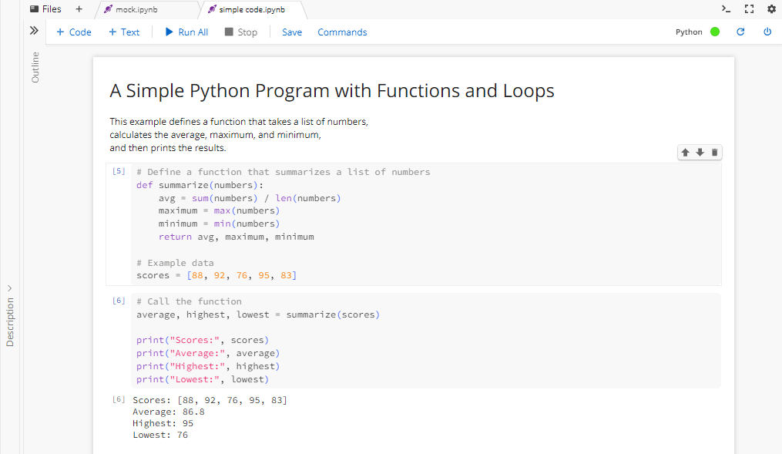
Jupyter NoteBook (2) – An example
The text cell, which is used for explanations, notes, instructions, or formatting. All content in the text cell will not be executed by Python.
The code cells can execute the Python code and outputs (if any) will be shown below the cell.

Slide 11
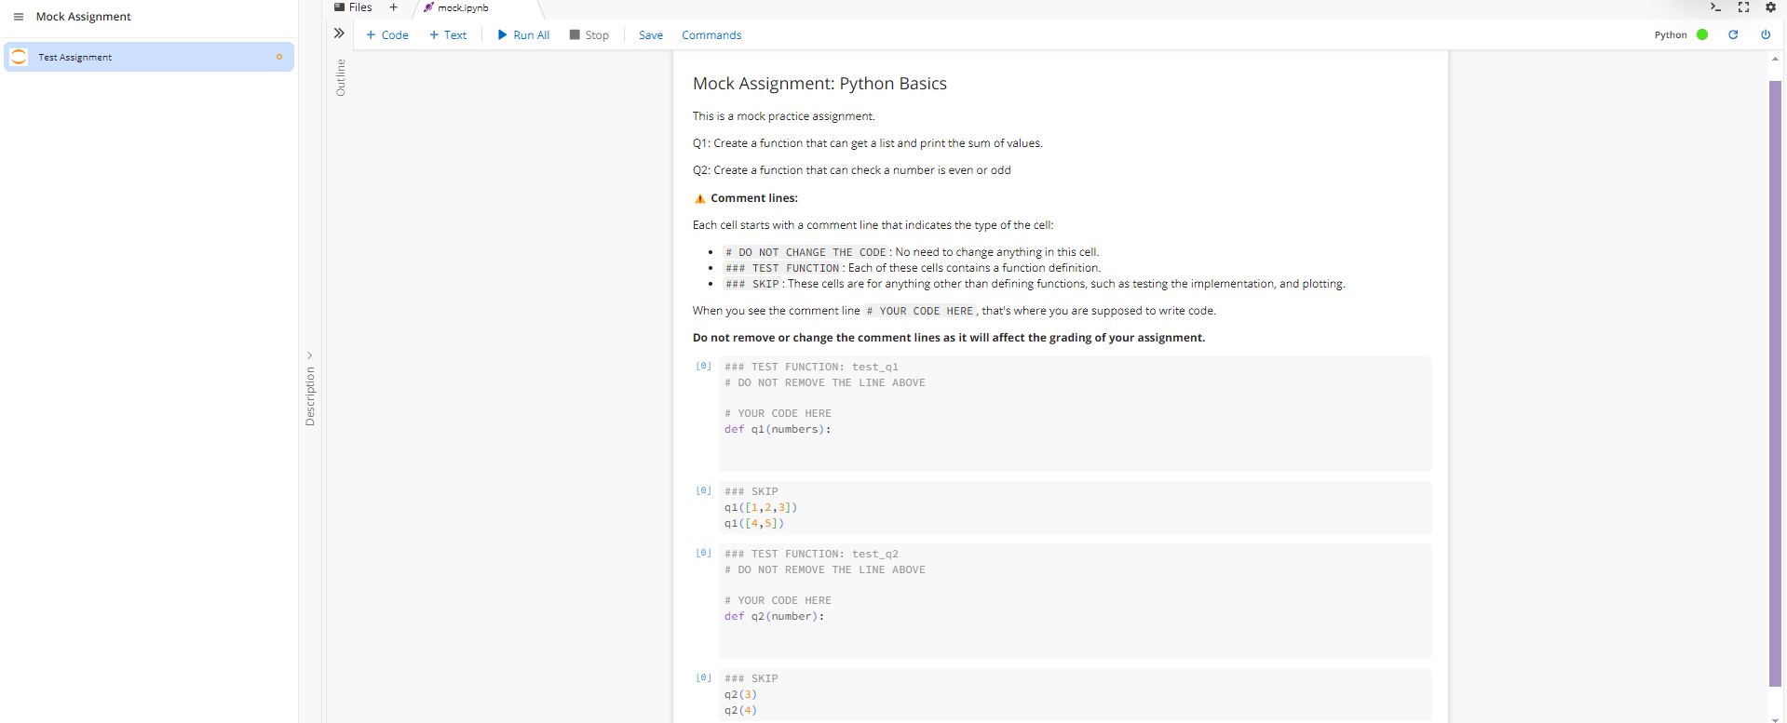
Assignment Page
You can execute your code unlimited times before submitting.
Click the “Submit” button to submit your assignment.
This section contains the background and requirements of the assignment. Please read it carefully before you begin working on it
As indicated in the line (# YOUR CODE HERE). You should add the code here.
The Python-related assignments are using Jupyter Notebook. For more information about Jupyter, please check slides before.
As indicated in the line above (# DO NOT REMOVE THE LINE ABOVE), please do not delete any line before that.
Please make sure you strictly follow the assignment requirements. Failure to do so may affect your grade.
The ###SKIP commands usually indicate that the code below is used to help test your program. You do not need to modify it. If it raises errors when you run it, this usually means there is an issue with your own code earlier in the assignment.
You can also use it to check your code. For example, in this case, the expected output is 6 and 9.
Notes:
Do not remeber

Slide 12
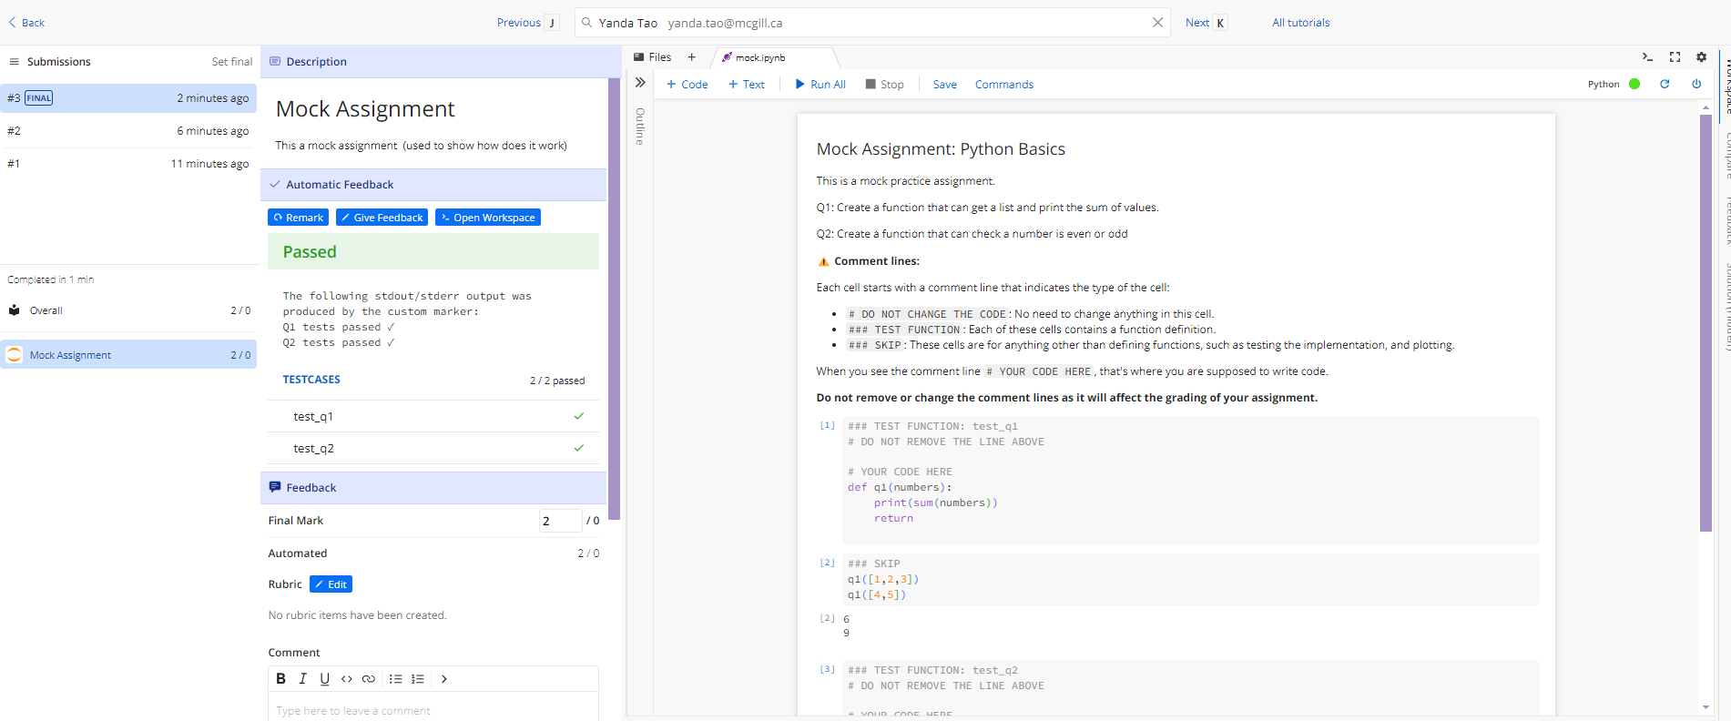
Assignment Result Page
After you submit the code, the platform will automatically test it and show whether it meets our expectations. The results are displayed in the TESTCASES area.
In most cases, the TESTCASES results accurately reflect whether your solution is correct. However, in rare cases, the system may incorrectly mark a correct submission as incorrect. The grader will fix this during the grading process, so you don’t need to worry too much if you believe your submission is correct, but the system shows an error message.
In the feedback section, the TA will update your grade after a couple of weeks and may include comments on your submissions.
Notes:
Grading Page

Slide 13
Datacamp

Slide 14
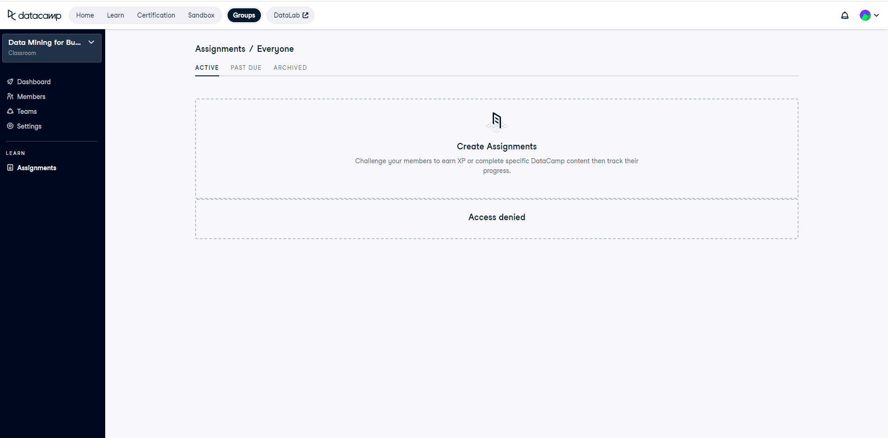
Introduction of Datacamp
Click this to access the active assignments.
The active assignment will show here.

Slide 15
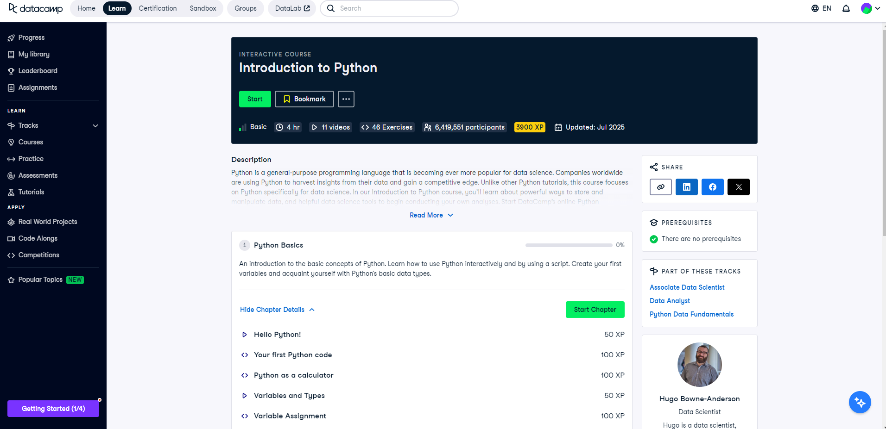
Assignment (Example)
Start the course here.

Slide 16
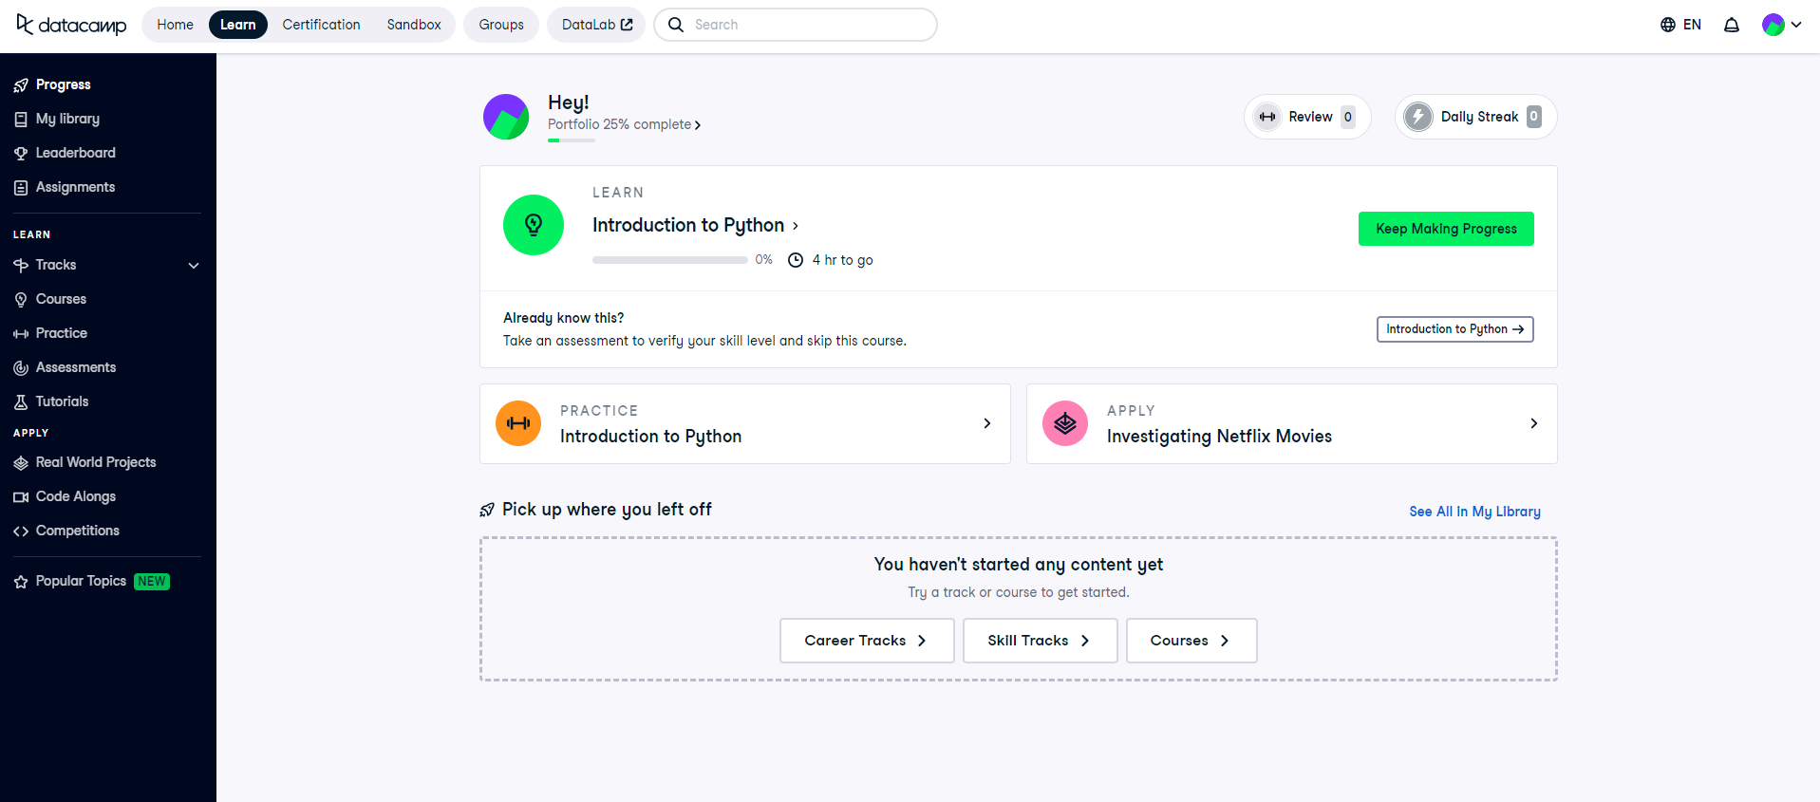
Additional Resources
If you would like additional resources beyond the course, Datacamp would be the best place. You can click the Learn tab to access the additional learning resources.
Notes:
Arrows too busy

Slide 17
Additional Resources
Inside of the learn tab, you can find the learning resources in both “Practice” or “Assessments”.
Notes:
Arrows too busy

Slide 18
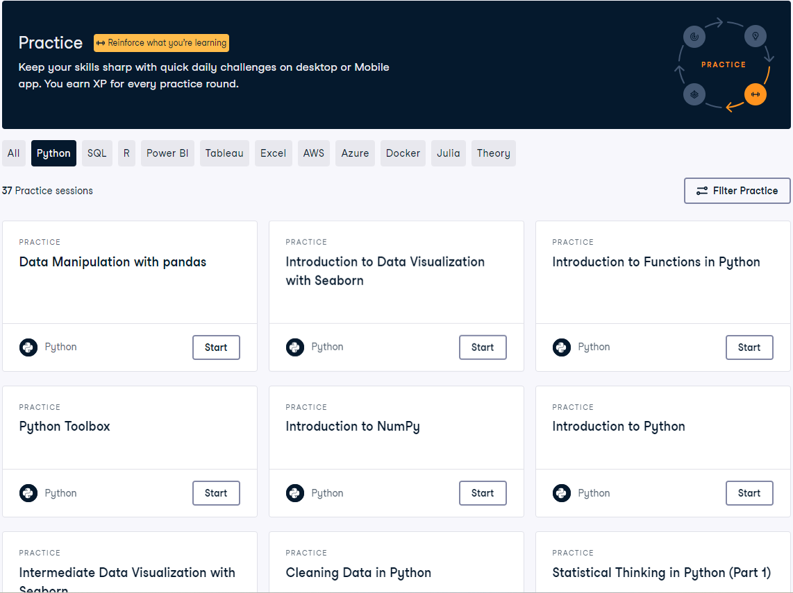
Additional Resources (Practice)
In the Practice page, you can select the topic you are most interested in.
Please make sure you select the correct programming language: Python or SQL.
Notes:
Earn some grades

Slide 19


Thank you!
Any Questions?

