Slide 1





www.insightz.tech
ca@insightz.tech
C:\disk\di(1)\acronisapp-live\uploads\kickoff_9.pptx
C:\disk\di(1)\acronisapp-live\uploads\kickoff_undefined.pptx
C:\disk\di(1)\acronisapp-live\uploads\kickoff_12.pptx
+65 61000 848
sales@insightz.tech
https//insightztechnology.com
Confidential © Insightz Technology 2025 All rights reserved

Slide 2
OBJECTIVES
  Introduce Insightz​
  Align teams on MDR Capabilities​
  Define Roles, Responsibilities and Expectations​
  Outline next steps
Confidential © Insightz Technology 2025 All rights reserved

Slide 3
MISSION
At Insightz Technology, we believe security should be simple. Our mission is to provide top-tier cybersecurity solutions that eliminate unnecessary costs and complexity.
By staying ahead of industry trends, we deliver AI-driven security tailored to each business’s unique needs to ensure the most effective and adaptive protection.
VISION
Our vision is to make cybersecurity accessible to all organizations regardless of size or resources.
We strive to deliver comprehensive, affordable protection with instant deployment and a seamlessly intuitive interface. We eliminate complexity while tailoring security to each business’s unique needs.
Confidential © Insightz Technology 2025 All rights reserved

Slide 4

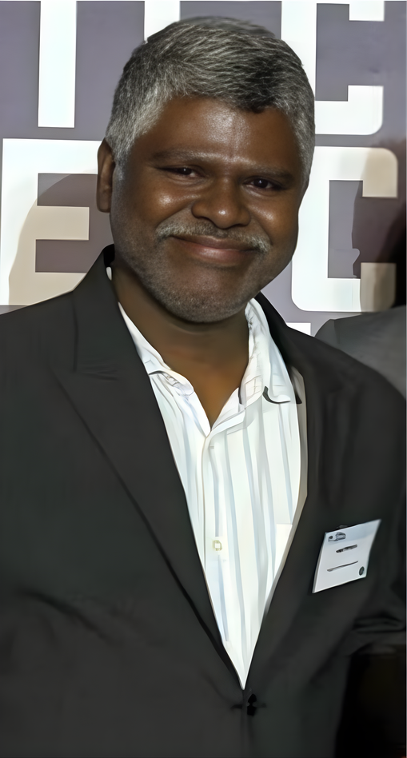
MEET THE FOUNDERS
Over 20 years of IT infra and security consultancy knowledge and experience.​
Seasoned expert in cybersecurity analytics. ​
Extensive knowledge and leadership skills make him an invaluable asset to the company and its clients.​
Over 20 years of experience in vendors’ relations​
Deep understanding of the intricacies of the cybersecurity landscape
Pivotal roles at 3COM, HPE and Ingram Micro.​
LIONEL LOH
THIRU PITCHAI
FOUNDER | CEO | DIRECTOR
CO-FOUNDER (INZ XDR 2.0 PLATFORM | CTO | DPO
Confidential © Insightz Technology 2025 All rights reserved

Slide 5


ACRONIS PARTNERSHIP WITH INSIGHTZ TECHNOLOGY
INSIGHTZ TECHNOLOGY IS AN INTERNATIONAL CYBERSECURITY COMPANY​
SPECIALIZING IN EARLY DETECT AND RESPONSE MONITORING​
  10+ year proven track record in the industry​
  24x7x365 ISO27001 compliant SOC​
  Insightz has built and maintains IT security solutions forsome of the world’s largest private and public organizations(Managed SIEM, DLP, EDR, PAM, IR, etc.)​
  50+ employees, incl. IT advisory, managed services,development and engineering​
  Insightz enhance Acronis EDR telemetry with proprietarySIEM and SOAR systems for additional analysis​
  Based in Singapore with regional office in India andPhilippines.​
Confidential © Insightz Technology 2025 All rights reserved

Slide 6
WHAT THIS SERVICE DELIVERS
CUSTOMER-FOCUSED, NOT TECHNICAL
  24/7 security monitoring and threat detection
  Rapid investigation and response to security incidents
  Continuous protection against advanced cyber threats
  A dedicated security team that acts as an extension of your IT team
Confidential © Insightz Technology 2025 All rights reserved

Slide 7






HOW OUR MDR SERVICE WORKS
POWERED BY
MONITOR
DETECT
INVESTIGATE
RESPOND
REPORT
  24/7 visibility across endpoints, servers, and workloads
  Continuous collection of security telemetry and activity logs
  Baseline normal behavior to identify anomalies
  External & Web Application Vulnerability Scan
  Ongoing health and agent status monitoring
  Advanced threat detection using Acronis EDR​
  Identification of malware, ransomware, and suspicious behavior​
  Correlation of events to reduce false positives
  Security analysts review and validate alerts​
  Contextual analysis to determine scope and impact​
  Root-cause analysis to understand how the incident occurred
  Immediate containment actions to limit spread​
  Malware isolation, process termination, and remediation​
  Guided or managed response based on agreed playbooks​
  Customer notification and escalation for critical incidents
  Clear incident notifications with actionable details​
  Post-incident summaries and recommendations​
  Ongoing security insights and trends​
  Regular service reports on detections and seen activity
Confidential © Insightz Technology 2025 All rights reserved

Slide 8





INSIGHTZ INTELLIGENT OPERATIONS CENTRE (OIC) (24X7X365)
SOC TEAM 1
SECURITY MONITORING - LOW/MED FIDELITY ALERTS
SOC TEAM 2 ANALYSTS
THREAT DISCOVERED - HIGH/CRITICAL FIDELITY ALERTS
CUSTOMER ADVISORS
(CA)
CUSTOMER
SOC IR TEAM
INCIDENT RESPONDER - THREAT INTEL/FINDING/HUNTING RECOMMENDATION ACTIONS
ONBOARDING SPECIALIST
Confidential © Insightz Technology 2025 All rights reserved

Slide 9



COMMUNICATION
CHANNELS
DAILY COORDINATION AND REAL-TIME COLLABORATION VIA MICROSOFT TEAMS AND WHATSAPP
OFFICIAL UPDATES, INCIDENT NOTIFICATIONS, AND SCHEDULED REPORTS ARE SHARED VIA EMAIL
Confidential © Insightz Technology 2025 All rights reserved

Slide 10
SCOPE OF WORK
WHAT OUR MDR SERVICE DELIVERS
1. Review and analysis of all Customer's events within SLA (below) of the event being reported to the EDR console. ​
  30min – Critical​
  1hour – High​
  8hour – Medium​
  24hour – Low/Informational
2. MDR onboarding ​
3. 24/7/365 monitoring to identify cyberthreats by Insightz SOC. ​
4. Event triage and prioritizing with real-time alerting ​
5. Rapid cyberthreat detection and isolation by Insightz SOC team. ​
6. To mitigate, stop and prevent security incidents. ​
Confidential © Insightz Technology 2025 All rights reserved

Slide 11
SCOPE OF WORK
WHAT OUR MDR SERVICE DELIVERS
7. Detailed multichannel security escalations (via Email and WhatsApp alerts) ​
8. 24/7 security threats remediation by Insightz team. ​
9. Attack rollback and recovery from backups (requires agreement with MSP and authorization from End Customers to allow this action. ​
10. Endpoint risk profile assessments. ​
Includes Insightz | Blackpanda IR-1 *Exclude Acronis EDR Licenses. **Excludes logs storage (Customer to store at their own logs container if required for compliance). ^Customer to assign a Point-Of-Contact​
Confidential © Insightz Technology 2025 All rights reserved

Slide 12
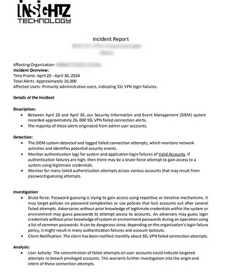
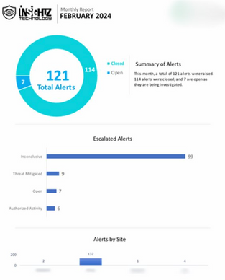
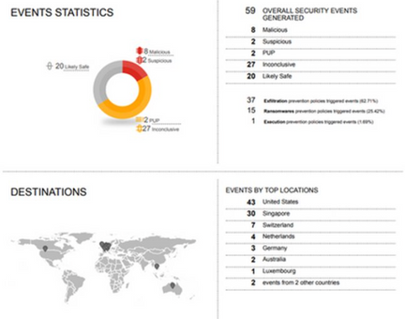
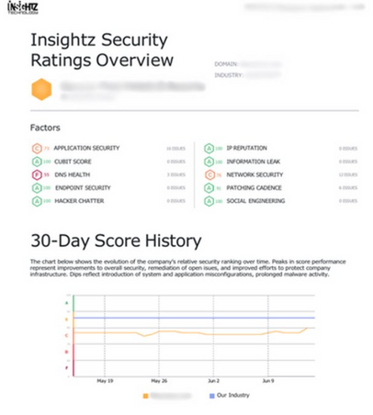
TYPES OF REPORTS
MONTHLY SERVICE REPORT
THREAT HUNT FINDING REPORTS
THREAT INTEL
REPORTS
INCIDENT REPORTS
We will provide reports on persistent malware, unusual processes, and C&C communications. This will include any malware threat intelligence from InsightzMDR predictive engine.
We will provide a daily status update on corrective actions and detail any new findings or recommendations. A final report will detail all incidents, supported by evidence and recommendations to eliminate threat.​
We will provide you with monthly reporting of metrics and context surrounding analysis activities, technology health and event summaries.​
We will develop custom rules as required, to scan the network and perform required preventive action.​
Confidential © Insightz Technology 2025 All rights reserved

Slide 13


WHAT WE DO VS WHAT YOU DO
WHAT WE HANDLE
• 24/7 monitoring and alert triage ​
• Threat analysis and investigation ​
• Incident response actions (as agreed) ​
• Security reporting and recommendations
WHAT HAPPENS NEXT
1. Environment review & scope confirmation ​
2. Agent deployment / integrations ​
3. Baseline & tuning period ​
4. Go-live with full MDR coverage ​
5. Ongoing monitoring & reporting
CUSTOMER PROVIDES
• System access approvals ​
• Key contacts for escalation ​
• Business context for critical systems ​
• Approval for response actions (if required)
Confidential © Insightz Technology 2025 All rights reserved

Slide 14
INSIGHTZ DISTRIBUTION LIST
INSIGHTZ POCS
DESCRIPTION | PERSON IN CHARGE | EMAIL ADDRESS
POINT OF CONTACT | CUSTOMER ADVISOR | ca@insightz.tech
ONBOARDING TEAM | MSP TEAM | msp@insightz.tech
CHIEF TECHNOLOGY OFFICER | THIRUPPATHI MUTHIAH PITCHAI | muthiah@insightz.tech
CHIEF EXECUTIVE OFFICER | LIONEL LOH | lst@insightz.tech
Confidential © Insightz Technology 2025 All rights reserved

Slide 15
THANK YOU!
www.insightz.tech
ca@insightz.tech
+65 61000 848
sales@insightz.tech
https//insightztechnology.com
Confidential © Insightz Technology 2025 All rights reserved

