Slide 1
Rose
Final Year Project 1
1141327595 Intan Ferrlia Bt Ikram Shah.

Slide 2
Contents
Project Introduction 3. Q n A
a. Project Statement
b. Justification
Case Studies
Background Research
2. Installation Planning 4. Appendix
Plan A
Installation Planning
Floor plan
Interactionn Flow
Technological Specification
Software
Equipment and Budget
Plan B
Installation Planning
Floor plan
Interactionn Flow
Technological Specification
Software
Equipment and Budget
Plan C
Installation Planning
Floor plan
Interactionn Flow
Technological Specification
Software
Equipment and Budget

Slide 3
1. Project Introduction
Project Statement
Draft Sketchces
Justification
Case Studies
Background Research

Slide 4
Project Statement
Rose are living thing same as cared and love and attention of their own because without that living things can’t lives longer somehow without other mechanism they can’t live on their own.
An obsession beauty of roses symbolise human wants to grow beautiful.

Slide 5
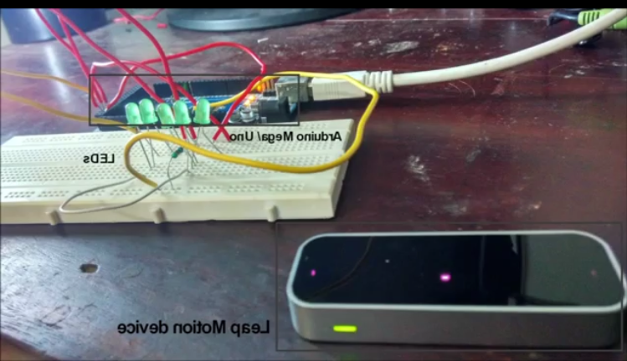
b. Justification
Case Studies
Title:Gesture recognition using arduino and leap motion
https://m.youtube.com/watch?v=VmLS9psMCSY

Slide 6
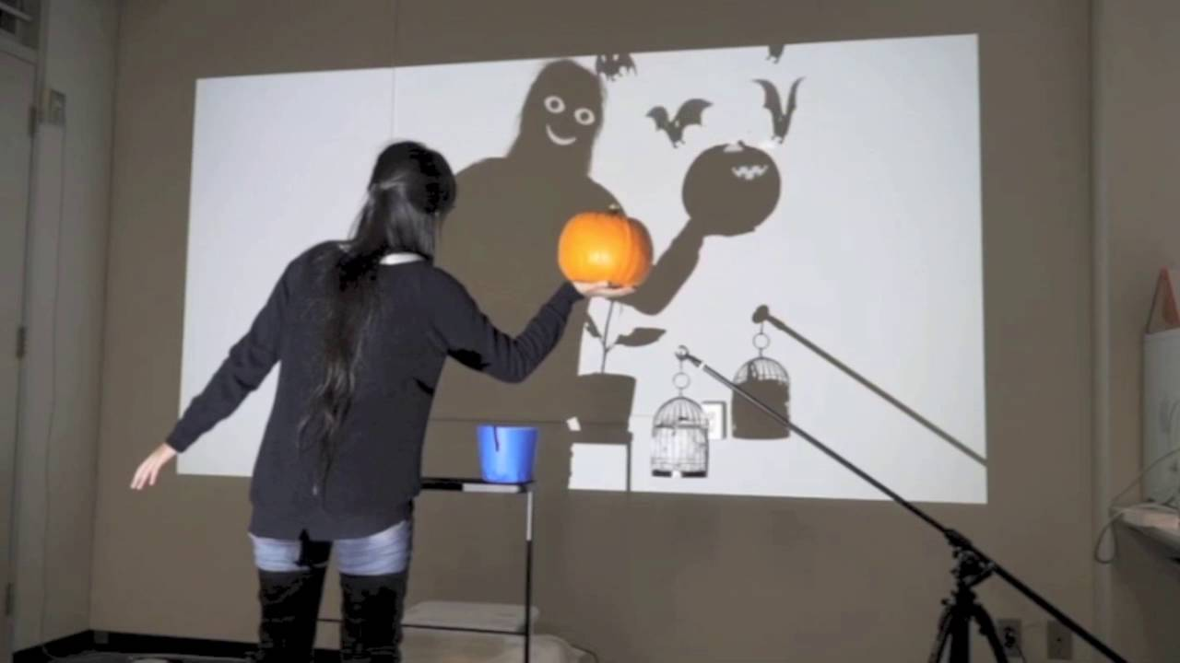
c. Justification
ii.Case Studies
Title: Interaction with virtual shadow through real shadow using two projectors
https://m.youtube.com/watch?v=dEMOszUYZnw

Slide 7
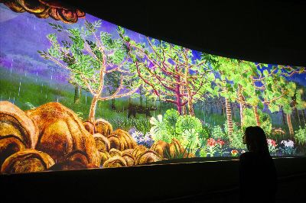
c. Justification
iii. Case Studies
Title: Story of forest
https://m.youtube.com/watch?v=OMv92Dpcgfl

Slide 8
c. Justification
Background Research.
I think rose other flower can symbolism as person second life (metaphorically)
if we know the strength and the weakness of it.
Selflove : Give yourself lve before giving what you can't share with other
Love : A strong feeling of affection
Adore : Love and respect or worship
Rose : a flower / plant. Generally symbolize love

Slide 9
2. Installation Plannings
Plan A
Installation Planning
Floor Plan
Interaction Flow
Technological Specification
Software
Equipment and Budget
b. Plan B
Installation Planning
Floor plan
Interaction Flow
Technological Specification
Software
Equipment and Budget
c. Plan C
Installation Planning
Floor plan
Interactionn Flow
Technological Specification
Software
Equipment and Budget

Slide 10
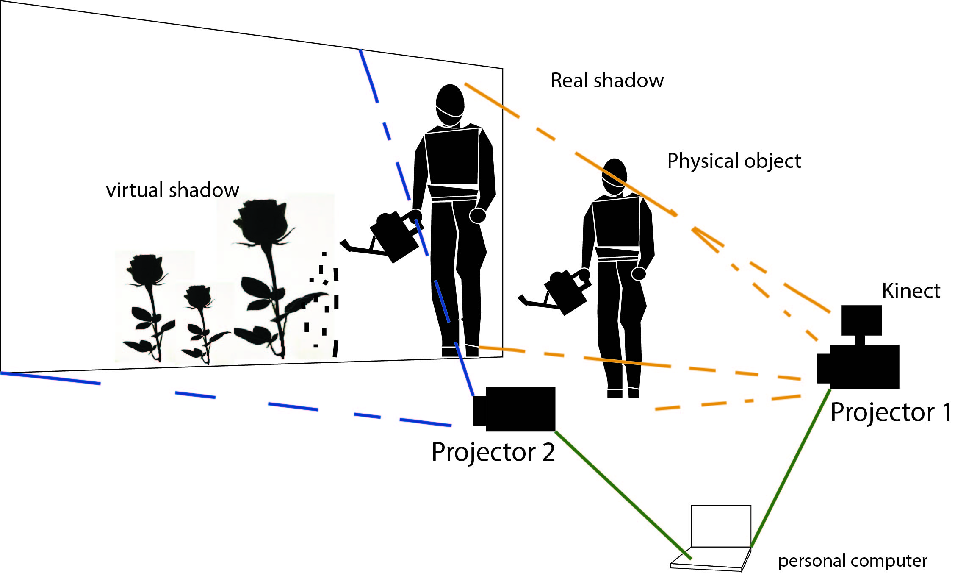
a. Plan A
Installation Planning
Floor plan

Slide 11
a. Plan A
Installation Planning
Interaction flow
Scanning real shadow physical object (human holding watering flower bucket) for real shadow with Kinect and recognizing them.
Constructing scene
Generating virtual object for virtual shadow
Tilt the watering flower bucket virtual water & roses growing
How it works?
Audience will take the watering flower bucket standing in front of projecter 1 to create real shadow on the screen. Later the Kinect will detect the real shadow and a water shadow will comes out from the screen after the water finish for few seconds the flower rose will grow.
Light source
Viewpoint for 3DCG
Screen
Projection plane for 3DCG
Real object
Virtual objects

Slide 12
a. Plan A
ii. Installation Planning
Technical Specification
Software
Equipment & Budget
Visual studio
Processing
EQUIPMET | BUDGET
Projectors | borrow from university
Personal Computer | Own
Kinect | borrow from fcm
Total | 0.00

Slide 13
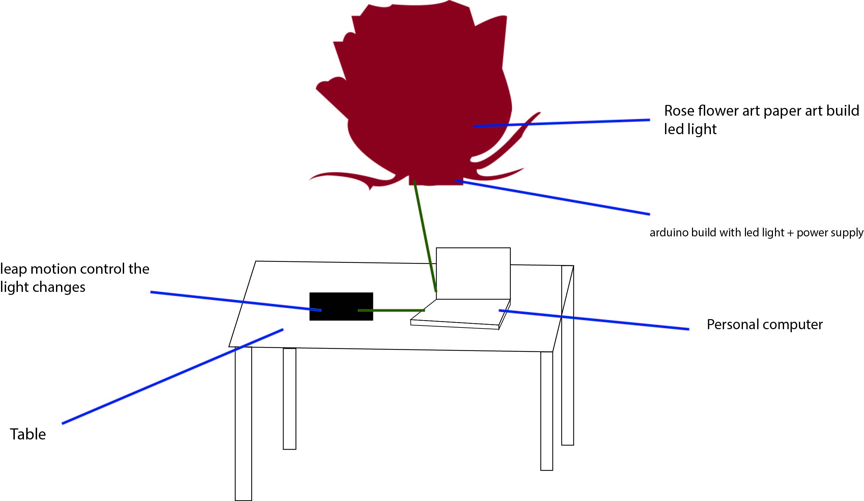
Plan B
Installation Planning
Floor plan

Slide 14
Plan B
Installation Planning
Interaction Flow
The leap motion control the changes color of the flower roses
How it works
Audience will move their hand into 4 type of gesture up, down, left & right. All these type of gest has been set into 4 type of color that define the famous color of roses which is red, yellow, white & black.
The first gesture that audience will do will determine what color roses they are.
Red
Yellow
White
Black
Leap motion 4 gesture
Change color
Gesture
Processing
LED

Slide 15
b. Plan B
ii. Installation Planning
Technical Specification
Software
Equipment & Budget
Arduino IDE
EQUIPMENT | BUDGET
Arduino kit | RM204.00
Leap Motion | Borrow from fcm
Usb Cable | own
Flower art diy | RM200.00 approximately
Glue | own
Scissor | own
Total | RM404.00

Slide 16
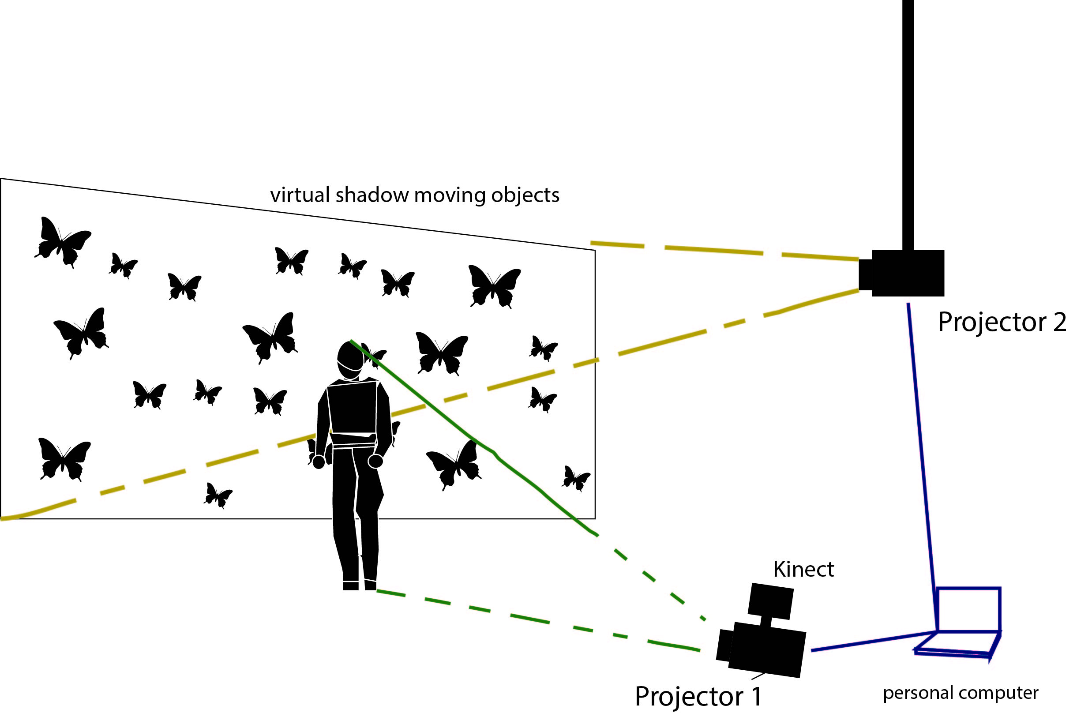
b. Plan C
Installation Planning
Floor plan

Slide 17
c. Plan C
Installation Planning
Interaction Flow
Moving object such as butterfly shown on screen.
Scanning the real shadow the butterfly attract to the shadow.
A projected moving object (butterfly) will shown on the screen , moving repeatedly then audience stand infront of the screen the shadow of the audience will be shown on the screen. The moving butterfly will attracted to the audience shadow and went t the shadow. If the shadow move form the screen the butterfly will randomly fly again.
Screen
projected moving object
Light source
Projected real object
Virtual object
Real object

Slide 18
c. Plan C
ii. Installation Planning
Technical Specification
Software
Equipment & Budget
Visual studio
Processing
EQUIPMENT | BUDGET
Projectors | borrow from university
Personal Computer | Own
Kinect | borrow from fcm
Total | 0.00

Slide 19
3. Q n A

Slide 20
4.Appendix
https://github.com/INTANFERRLIA/FYP1-ROSE/blob/master/README.md

