Slide 1
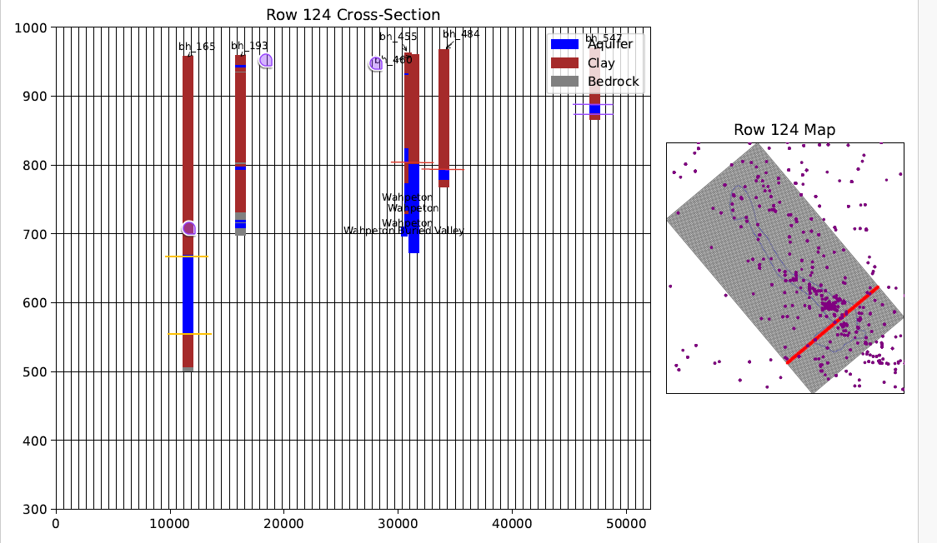
In this example there is no UC
WSS (mixed sand/clay)
WSS
Model_unit_4lay
WSP (sand)
WBV
DC
UC (clay)
WBV (sand)
DC (clay)
Model Bot
WR (sand)

