Slide 1
Predictive Accuracy Conditioned on Test Distribution
Identically Distributed (IID) Test
Mean Quadratic Weighted Kappa (QWK)
XGBoost IID (0.466 QWK)
Across Datasets and Probes
XGBoost OOD (0.336 QWK)
Out-of-Distribution (OOD) Test
Hidden Layers of Models

Slide 2
Predictive Accuracy of Probes for Qwen3-4B
Mean Quadratic Weighted Kappa (QWK)
Across Datasets
Hidden Layers of Qwen3-4B

Slide 3
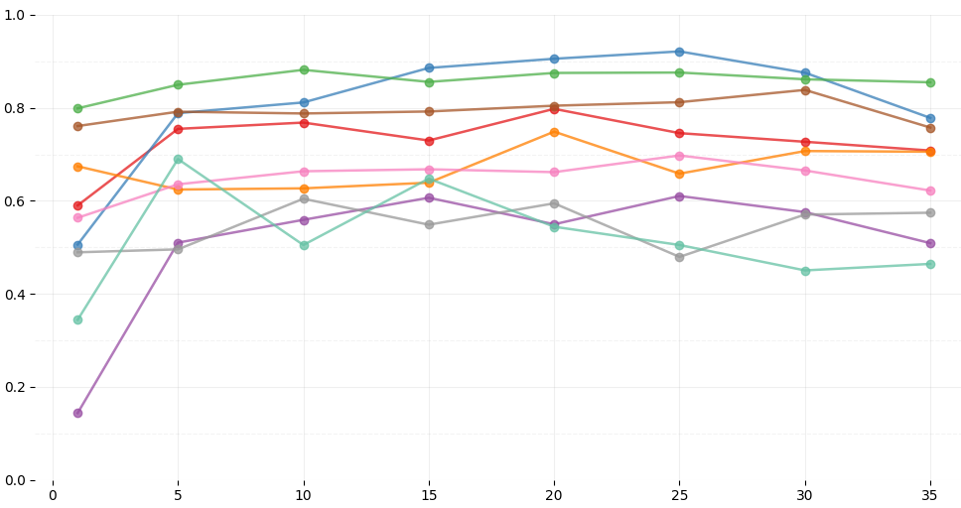
Quadratic Weighted Kappa of MLP Regression Probe on Qwen3-4B
Identically Distributed (IID)
Out-of-Distribution (OOD)
Quadratic Weighted Kappa (QWK)
Hidden Layers of Qwen3-4B
Hidden Layers of Qwen3-4B

Slide 4
Language Models
Qwen3-Embedding-0.6B
Qwen3-Embedding-4B
Qwen3-Embedding-8B
UniversalCEFR Data
Validation Conditions
ZAEBUC, Arabic, n=209
Merlin, Czech, n=439
CEFR-ASAG, English, n=299
ICLE500, English, n=488
ELLE, Estonian, n=1352
Merlin, German, n=1033
Merlin, Italian, n=806
COPLE2, Portuguese, n=942
PEAPL2, Portuguese, n=481
Identically Distributed
Validate performance on 20% hold-out data
Out-of-Distribution
Validate performance on leave-one-out dataset.
Embedding Probes
XGBoost Baseline
Linear Regression
Ordinal Regression
MLP Regression
Logistic Regression
MLP Classifier
XGBoost with features:
Document Length
Average Sentence Length
Average Word Length

Slide 5



Language Models
Qwen3-Embedding-0.6B
Qwen3-Embedding-4B
Qwen3-Embedding-8B
Google-Gemma-0.3B
Intfloat-E5-Large-0.6B
Intfloat-E5-Mistral-7B
Nvidia-Llama-Nemotron-8B
Significant Performance Drop
Quadratic Weighted Kappa (QWK)
Across combinations of probe and layer
Out-of-Distribution
XGBoost (0.466)
XGBoost (0.336)
XGBoost
Violin plot showing performance distribution of each trained model.
Document Length
Average Sentence Length
Average Word Length

Slide 6
Training Data Bias
Training Data
= Large Language Model
= Probe Architecture
= Data Distribution
= All Variables
LLM Architecture Bias
Large Language Model
Probe Data Bias
Probe
Probe Training Data
Prediction Error
Probe Test Data

Slide 7
Training Data Bias
Training Data
= Large Language Model
= Probe Architecture
= Data Distribution
= All Variables
LLM Architecture Bias
Large Language Model
LLM Bias
Corpus Topic Confound
Probe Architecture Bias
Probe
Probe Training Data
Prediction Error
Probe Test Data

Slide 9
Predictive Accuracy of Probes

