Slide 1

IMBOT
„An automatic data checker for 1-second submissions to INTERMAGNET“
Roman Leonhardt, Conrad Observatorium, ZAMG
Notes:
<Foliennummer>

Slide 2
Background
Since 2014 INTERMAGNET welcomes data submission in one second resolution
For archiving and providing such data, the IMAGCDF format was introduced, based on NASA CDF
Currently 36 observatories are submitting definitive one second data
So far, one second data products are not checked and/or provided to end users by INTERMAGNET

Slide 3
One second submissions for 2016
36 data sets
different packing routines
several formats (IAGA02, CDF1.0, 1.1)
variable coverage
<Foliennummer>

Slide 4
One second submissions for 2016
Typical issues encountered for 2016 submissions:
Wrong coverage:
- files do not cover recommended time intervals - files contain data from last month/day, one second missing
Wrong file names: at least according to naming convention
Meta information incomplete
Corrupted files (2)
Wrong data content (1)
Minor deviations from one-minute definitive data
Noise level exceeds 100pT/sqrt(Hz) for about 10% of the data sets
<Foliennummer>

Slide 5
IMBOT – the principle
IMBOT stands for INTERMAGNET robot
IMBOT will analyse and re-format one-second data submissions into IM requested structures
IMBOT works completely automatic
IMBOT should minimize the workload for data providers, checkers, and users
IMBOT needs to be based on a transparent evaluation process
IMBOT should significantly reduce the time between submission and publication
<Foliennummer>

Slide 6
IMBOT – how does it work
Upload converted
IMAGCDF data
converts data
data completness
meta information
checks contents
definitive status
GIN
Definitive data
upload by FTP
IMBOT gets
new/modified data
IMBOT
Send report and
ask for revision
Obs
Level 0
Level 1
IMBOT assigns
levels
Level 2
Send report
INTERMAGNET
Data checker
Send report and
assign referee

Slide 7
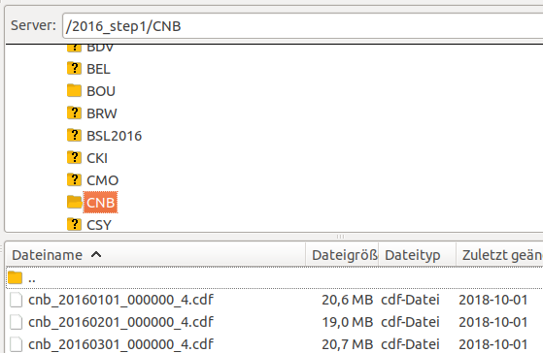
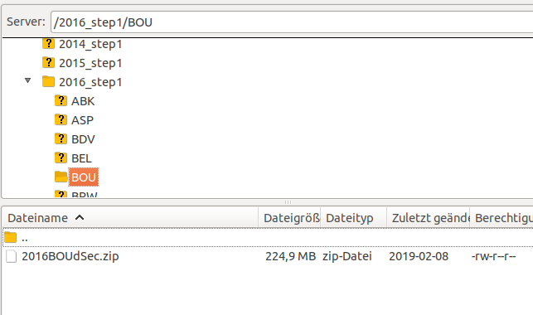
IMBOT – how does it work
GIN
Definitive data
upload by FTP
Many different packing methods and data formats are used for uploading data
Obs

Slide 8
IMBOT – how does it work
Upload converted
IMAGCDF data
GIN
IMBOT gets
new/modified data
IMBOT
IMBOT identifies all new and modified data sets from the GIN
IMBOT extracts data sets and eventually converts the files to monthly IMAGCDF files as requested by IM
Unreadable data or corrupted files lead to level 0. The submitter is asked to provide appropriate data
Converted data is uploaded to the GIN
Level 0
Data not readable
or significant problem

Slide 9
IMBOT – data checking
converts data
data completness
meta information
checks contents
definitive status
Submitted files and formats
accepted are all readable formats (e.g. IAGA2002, IMAGCDF)
Meta information
meta information contained and consistent between all different files
Data content
Correct coverage and content
Data quality
not used as a criteria, but information provided in the report
Data consistency
data consistent with minute submission, definitive status
IMBOT
Level 0
Level 1
IMBOT assigns
levels
Level 2

Slide 10
IMBOT – how does it work
IMBOT creates an analysis report
The report is uploaded along with the converted data and send to data submitters and, in case of level 2, to a human data checker
IMBOT creates a meta data review template (for level 0 and level 1)
For missing meta information only the review template must be filled out and uploaded
Report and review template are also send out by e-mail
Send report and
ask for revision
Obs
Level 0
Level 1
Level 2
Send report

Slide 11
IMBOT – the e-mail
Dear data submitter,
you receive the following information as your e-mail address is connected to submissions of geomagnetic data products from unkown XXX observatory.
Your one-second data submission from 2018 has been automatically evaluated by IMBOT, an automatic data checker of INTERMAGNET.
The evaluation process resulted in
LEVEL 1
Your data has provisionally been accepted by INTERMAGNET. Congratulations!
In order to continue the evaluation process some issues need to be clarified. Please read the attached report and instructions.
If you have any questions regarding the evalutation process please check out the general instructions (github link) or contact the IMBOT manager.
Sincerely,
IMBOT
-----------------------------------------------------------------------------------
Instructions to update file and or meta information for re-evaluation of your data:
….

Slide 12
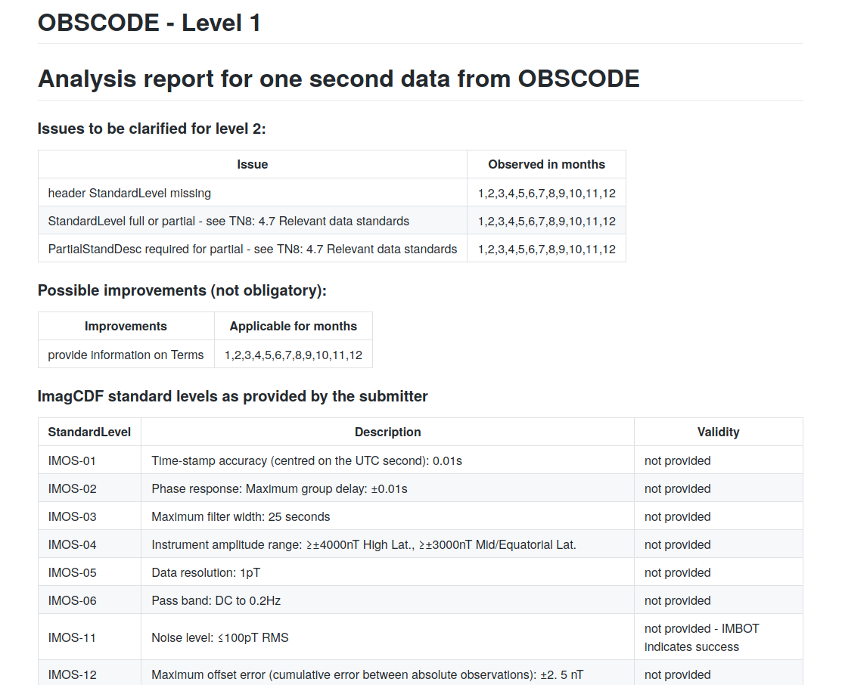
IMBOT – the report
https://github.com/geomagpy/IMBOT/blob/master/examples/level1_underreview.md

Slide 13
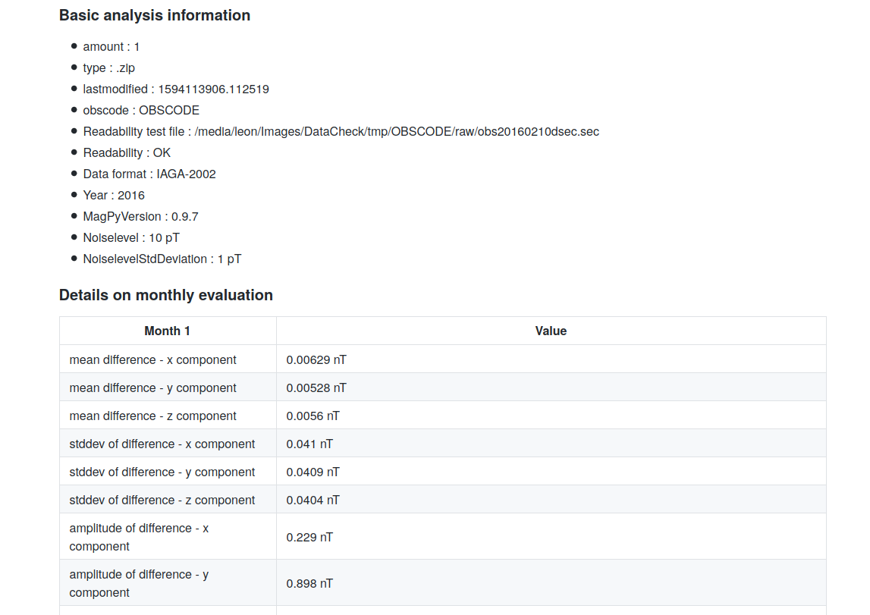
IMBOT – the report

Slide 14
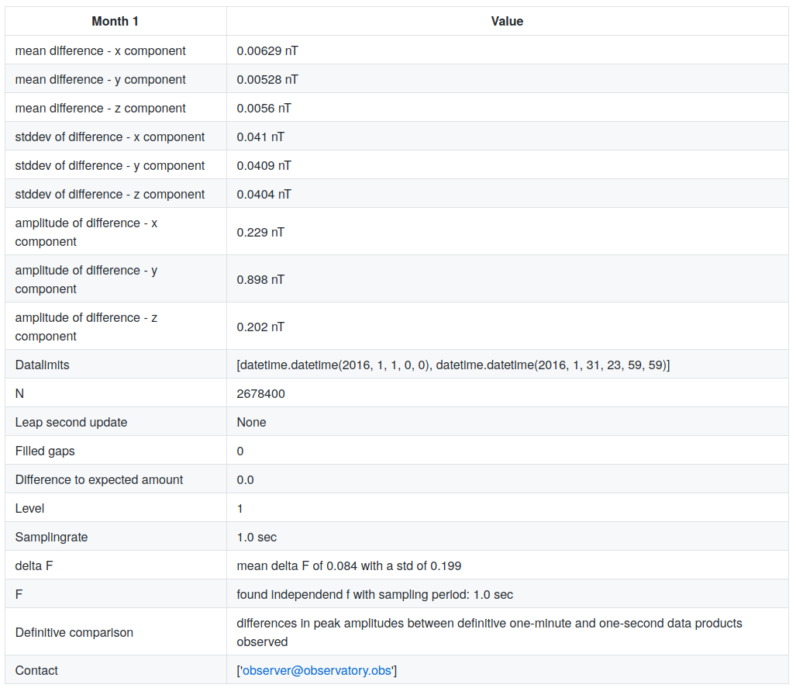
IMBOT – the report

Slide 15
IMBOT – the review template
## Parameter sheet for additional/missing metainformation
## ------------------------------------------------------
## Please provide key - value pairs as shown below.
## The key need to correspond to the IMAGCDF key. Please
## check out the IMAGCDF format description at INTERMAGNET
## for details. Alternatively you can use MagPy header keys.
## Values must not contain special characters or colons.
## Enter "None" to indicate that a value is not available
## Comments need to start in new lines and every comment line.
## must start with a hash.
## Please note - you can also provide optional keys here.
##
## Example:
## Providing Partial standard value descriptions as requested:
# StandardLevel : partial
# PartialStandDesc : IMOS11,IMOS14,IMOS41
# Provide a valid standard level (full, partial), None is not accepted
StandardLevel : partial
# If Standard Level is partial, provide a list of standards met
PartialStandDesc : IMOS-01,IMOS-02,IMOS-03,IMOS-04,IMOS-05,IMOS-11,IMOS-14,IMOS-41
# If data is not available please confirm by MissingData : confirmed
MissingData : confirmed

Slide 16
IMBOT – the e-mail
Dear data submitter,
you receive the following information as your e-mail address is connected to submissions of geomagnetic data products from Mawson MAW observatory.
Your one-second data submission from 2018 has been automatically evaluated by IMBOT, an automatic data checker of INTERMAGNET.
The evaluation process resulted in
LEVEL 2
Your data has provisionally been accepted by INTERMAGNET. Congratulations!
Your data fulfills all requirements for a final review. A level 2 data product is already an excellent source for high resolution magnetic information. Your data set has been assigned to an INTERMAGNET data checker for final evaluation regarding data quality.
Your data checker is Max Mustermann.
Please note that INTERMAGNET data checkers perform all check on voluntary basis beside their usual duties. So please be patient. The data checker will contact you if questions arise.
If you have any questions regarding the evalutation process please check out the general instructions (github link) or contact the IMBOT manager.
Sincerely,
IMBOT

Slide 17
IMBOT – 2016 analysis
<Foliennummer>

Slide 18
IMBOT – 2016 analysis
<Foliennummer>

Slide 19
IMBOT – analysis summary
IMBOT can test and convert all submitted data sets within hours
Data checks indicate „valid“ data for the majority of all submissions
By simply submitting a meta information update sheet, 75% of all submitted data sets will achieve level 2 classification
IMBOT provides additional information e.g. on noise levels, individual deviations from submitted one-minute products, which is not used for automatic level classification, but might help the observatory to locate issues and improve data quality
Data content of converted files is identical to original raw data (checked)
It is suggested that such reports are available also for end users
<Foliennummer>

Slide 20
IMBOT – application
A complete analysis needs approximately 30min to 1.5h for each observatory (dependend on IMBOT servers hardware).
IMBOT is currently running, automatically analyzing all new submissions from 2018 and 2019 (uploading converted data to GIN is disabled)
IMBOT is modular and can be easily extended and applied to other data submissions (e.g. variation data, one-minute submissions)
Level assignement can be modified easily (requiring a decision of the IM data comitee). Further tresholds can be included
It is suggested that already level 1 data is provisionally accepted by IM as this data might already be useful for end users
It is suggested that the current data level is fixed if no revision is submitted within three months
<Foliennummer>

Slide 21
IMBOT – application
IMBOT fulfills all requirements as listed in the introduction
It is possible to run IMBOT in test-mode with selected observatories and/or with a group of selected recievers of messages and reports
If accepted by INTERMAGNET, IMBOT can be started any time provided…
that a list of human data checkers is available and their responsibilities are clarified
that GIN storage volume is capable of maintaining twice the amount of data for a short period (only in the beginning)
<Foliennummer>

Slide 22




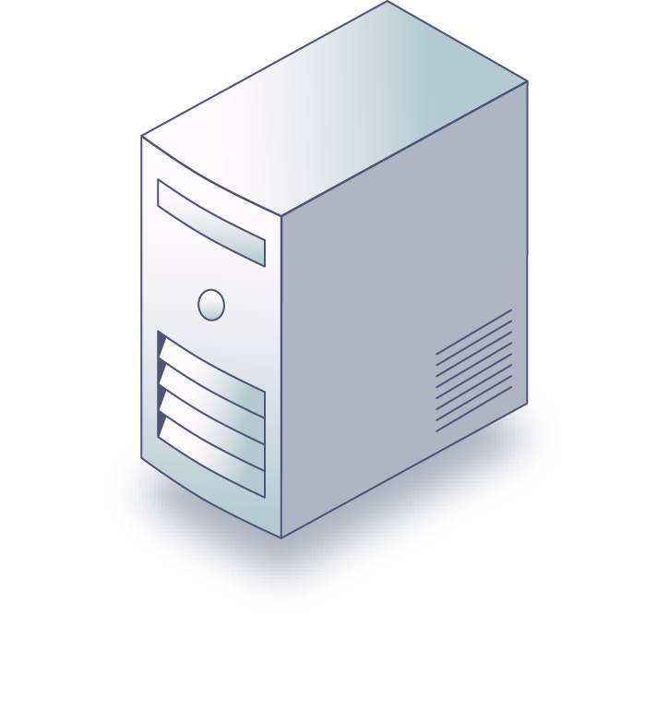


IMBOT
<Foliennummer>

