Slide 1
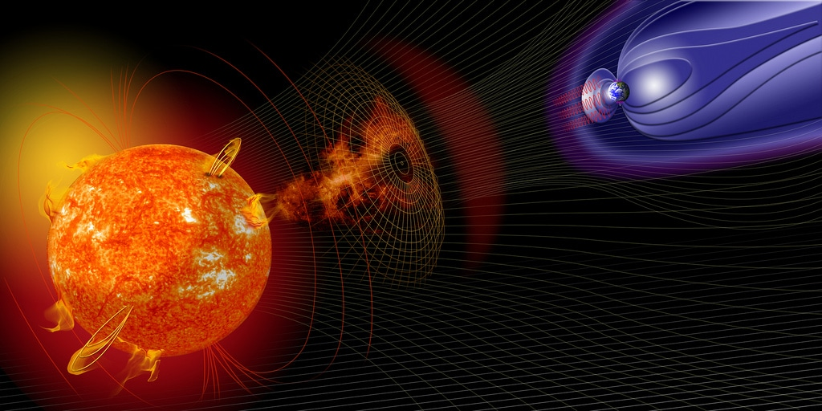
IMBOT
„An automatic data checker for 1-second submissions to INTERMAGNET“
Roman Leonhardt, Conrad Observatorium, ZAMG
Notes:
<Foliennummer>

Slide 2
Background
Since 2014 INTERMAGNET welcomes data submission in one second resolution
For archiving and providing such data, the IMAGCDF format was introduced, based on NASA CDF
Currently 36 observatories are submitting one second data
So far, one second data products are not checked and/or provided to end users by INTERMAGNET

Slide 3
One second submissions for 2016
36 data sets
Various formats
<Foliennummer>

Slide 4
One second submissions for 2016
Typical issues encountered for 2016 submissions:
<Foliennummer>

Slide 5
IMBOT – the principle
IMBOT stands for INTERMAGNET robot
IMBOT will analyse and re-format data submission into IM requested structures
IMBOT works completely automatic
IMBOT should minimize the workload for data providers, checkers, and users
IMBOT needs to be based on a transparent and open evaluation process
IMBOT should significantly reduce the time between submission and publication
<Foliennummer>

Slide 6
IMBOT – how does it work

Slide 7
IMBOT – 2016 analysis
<Foliennummer>

Slide 8
IMBOT – 2016 analysis
<Foliennummer>

