Slide 1
Report on definitive data timelines Definitive Data Subcommittee
Intermagnet Meeting, Sopron, 28-29 May, 2023

Slide 2
One-minute definitive data collection Summary of 2019-2022 (last 4 years) (situation in mid-May, 2023)
!

Slide 3
One-minute definitive data collection Summary of 2020, 2021, 2022 (situation at the beginning of mid May 2023)
Definitive 2020
(1.5 year after deadline)
Received binary (step1): 111 IMOs
After cross-checking (step2): 101 *1
Fully accepted ( web? ): 101
*1 CYG, DED, JAI, KHB, ORC, PEG, SON, VAL, VOS, YAK have not reached yet step2
Definitive 2021
(8 months after deadline)
Received binary (step1): 104
After cross-checking (step2): 83 *2
Fully accepted (web? ): 81 *3
*2 ASC, BSL, CBB, CYG, EYR, FCC, GAN, GCK, GDH, GUA, JAI, ORC, PEG, PET, SHU, SIT, SPG, TUC, UPS, VOS, YKC have not reached yet step2
*3 NVS, IRT have not reached yet step2
Definitive 2022
(2.5 months before deadline)
Received binary (step1): 30 IMOs (BRW, BSL, DUR, EBR, FRD, FUR, GDH, GUA, GUI, HER, HLP, HON,
HUA, IZN, KMH, LER, NEW, ORC, PPT, SBL, SHE, SHU, SJG, SPT,
TAM, TSU, TUC, VNA, WIC)
After cross-checking (step2): 6 IMOs (EBR, FUR, IZN, LER, SPT, VNA)
Fully accepted ( web? ) 6 IMOs ( -- II -- )

Slide 4
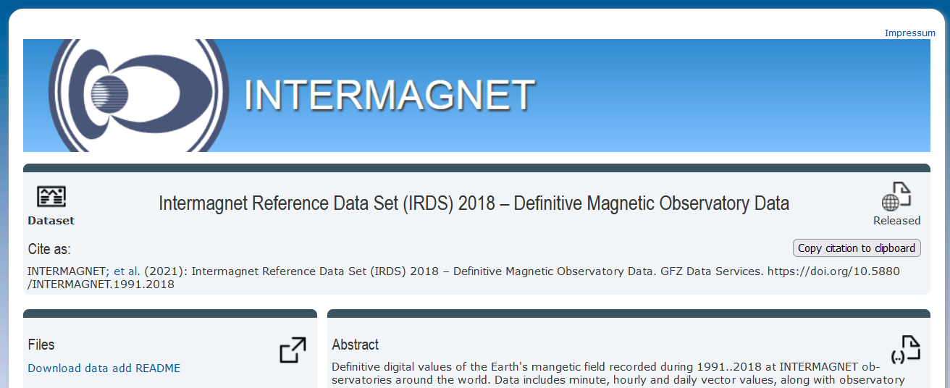
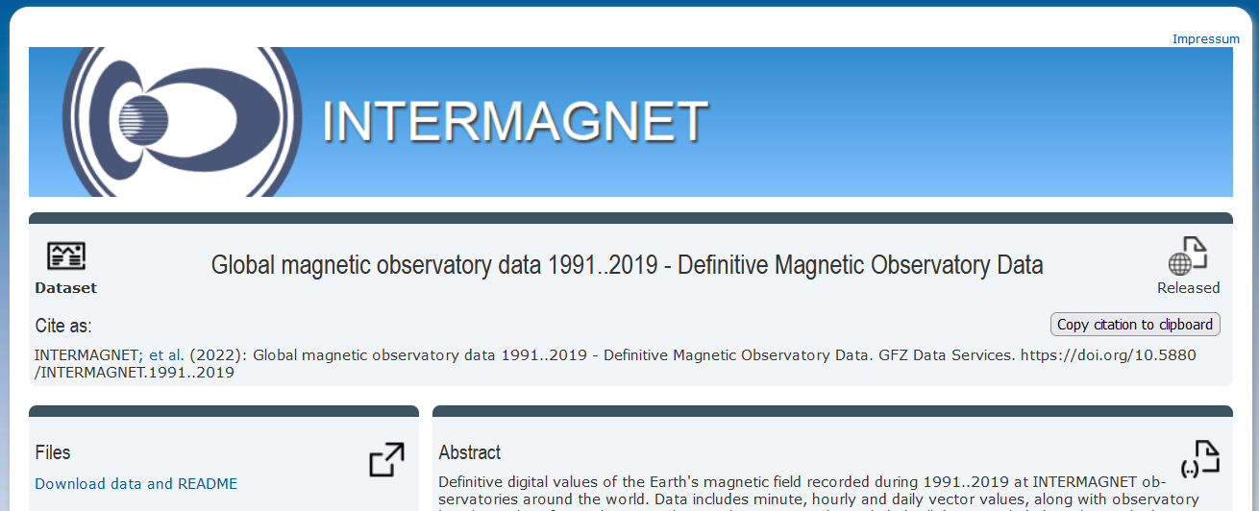
Recent IRDS/DOI publications of 1-min definitive (not presented on previous INTERMAGNET meetings)
IRDS2018 (1991-2018) DOI fully released in 2021
IRDS2019 (1991-2019) DOI fully released in 2022
=================================================================
The compilation IRDS2020 (1991-2020) is in progress
2018 110 IMOs
1991-2018 148 IMOs
2019 110 IMOs
1991-2019 150 IMOs
2020 100 IMOs
1991-2020 150 IMOs

Slide 5
Summary of released DOI so far
Published years | Web address | Number of IMOs All years / last year | Publication year
2013 | https://doi.org/10.5880/INTERMAGNET.2013 | 112 / 112 | 2017
2014 | https://doi.org/10.5880/INTERMAGNET.2014 | 112 / 112 | 2019
1991-2015 | https://doi.org/10.5880/INTERMAGNET.1991.2015 | 145/ 117 | 2020
1991-2016 | https://doi.org/10.5880/INTERMAGNET.1991.2016 | 147/ 116 | 2021
1991-2017 | https://doi.org/10.5880/INTERMAGNET.1991.2017 | 148/ 114 | 2021
1991-2018 | https://doi.org/10.5880/INTERMAGNET.1991.2018 | 148/ 110 | 2021
1991-2019 | https://doi.org/10.5880/INTERMAGNET.1991..2019 | 150/ 110 | 2022

Slide 6
Thank you for your attention !

