Slide 1
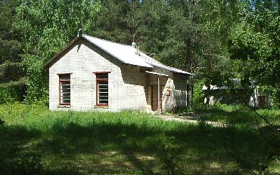
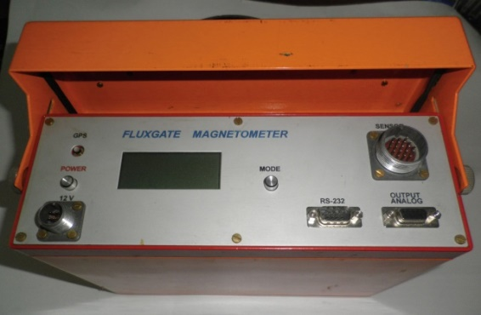
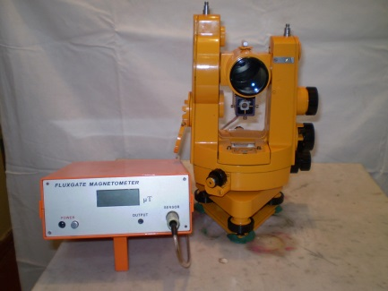
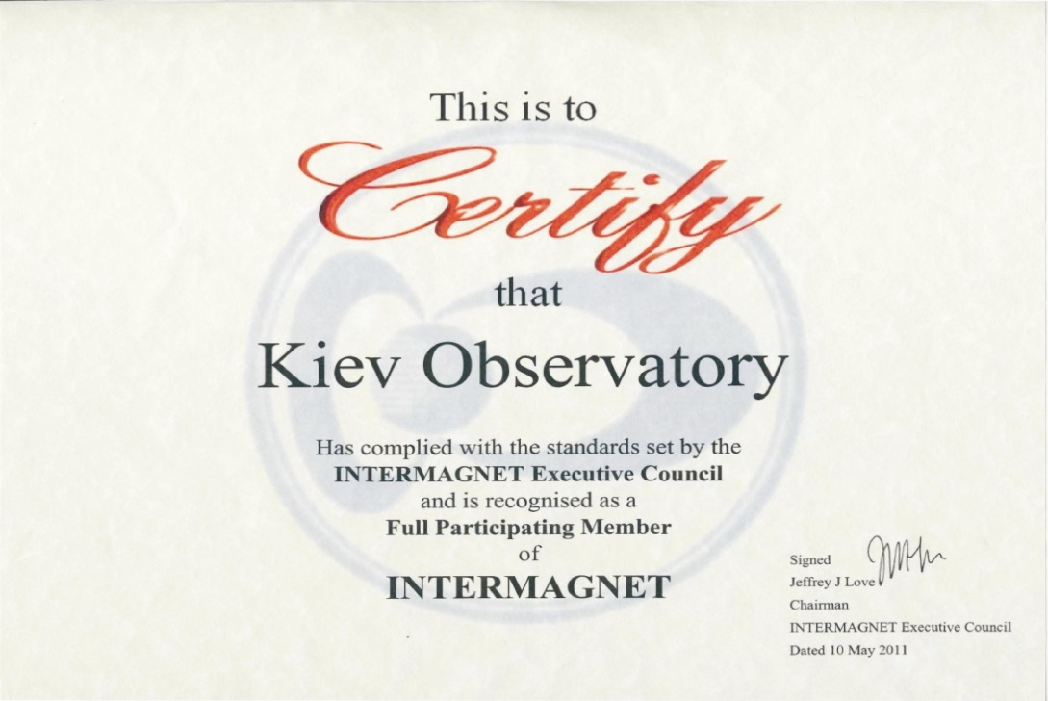
Geomagnetic observatory Kiev
Geomagnetic Observatory KIV began its work in May 1958 in connection with the International Geophysical Year.
In 2004, thanks to the INTASS project, the geomagnetic observatory was equipped with new digital devices and started working according to the INTERMAGNET protocol.
In 2011, Kyiv became a full member of INTERMAGNET.
Data from the observatory are used to construct maps of the magnetic field, as well as to construct models of the geomagnetic field, including IGRF
<number>

Slide 2
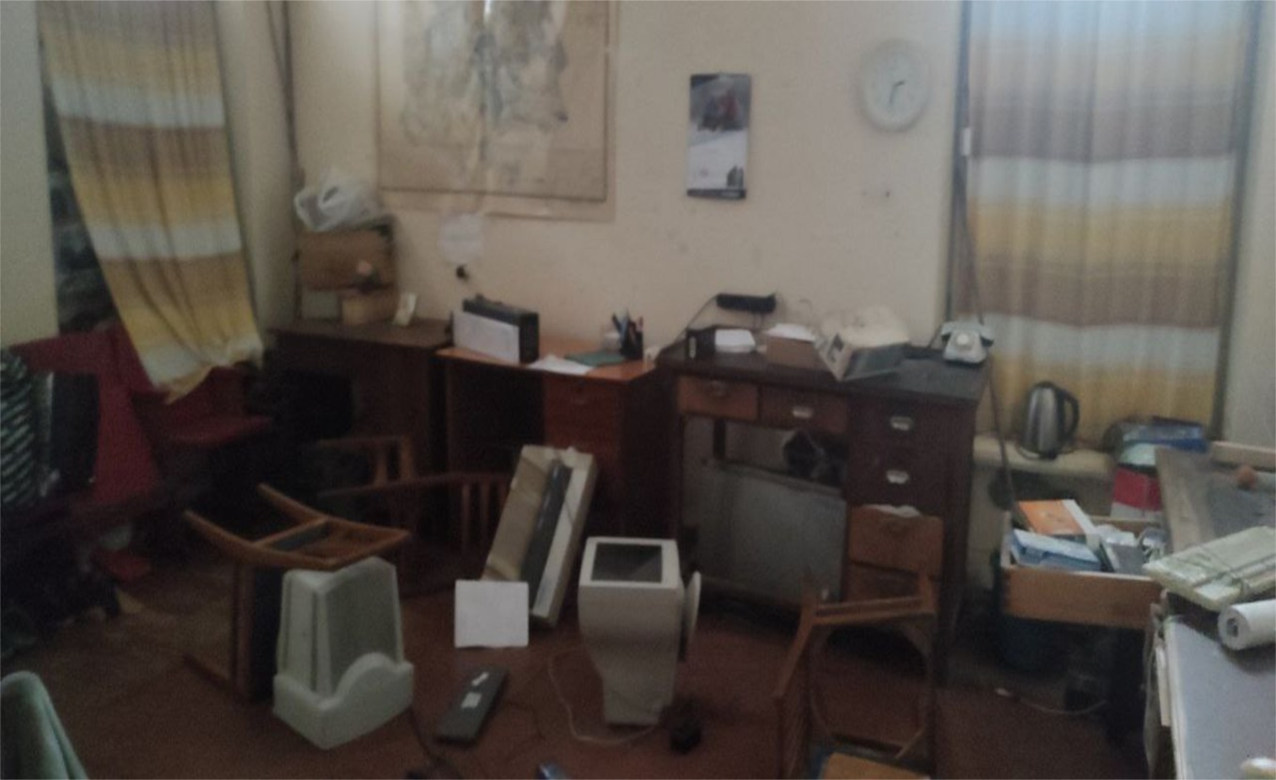
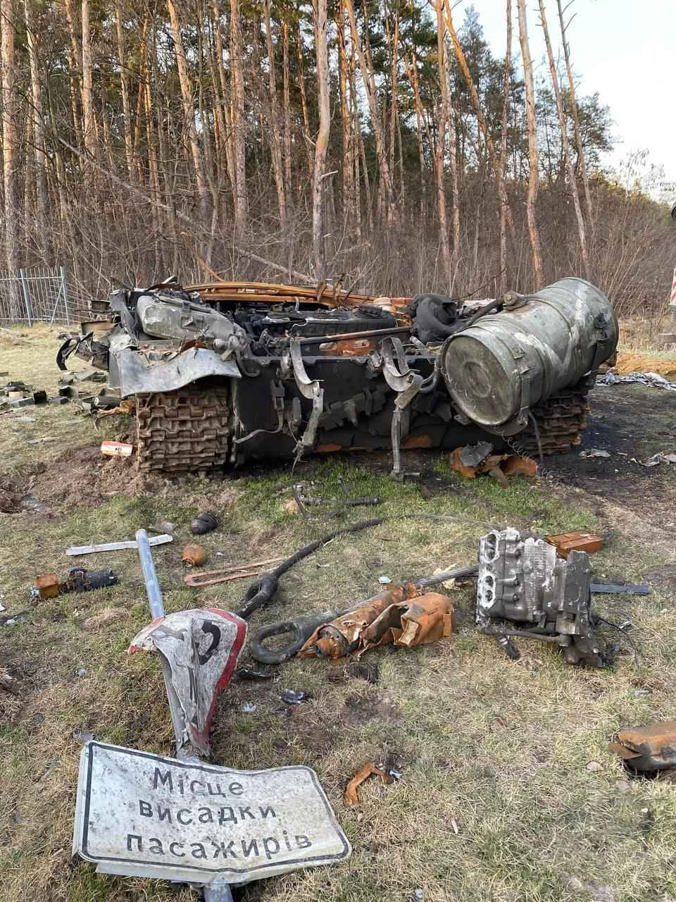
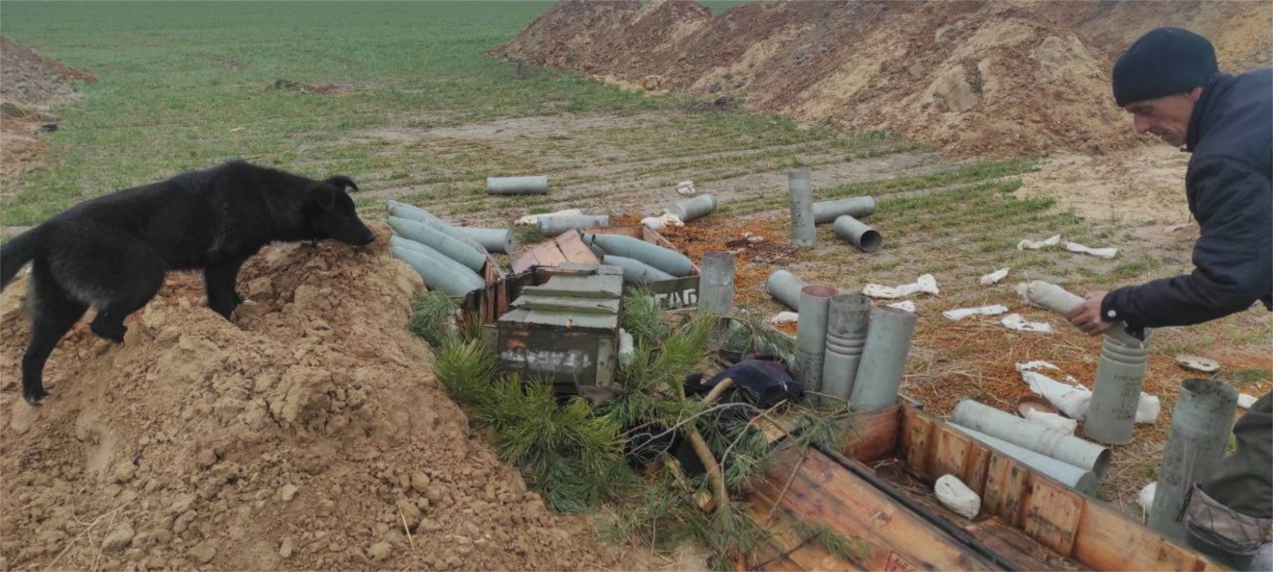
The Observatory "Kyiv" was destroyed by the Russian military in February 2022 and is currently not working.
The buildings and equipment of the observatory were broken and necessary need
repair.
<number>

Slide 3
For further functioning of geomagnetic observatory Kyiv is necessary:
- new computers;
- new proton magnetometers;
- restore magnetovariation stations;
- restore DI fluxgate magnetometer.
We hope that, together with the international community, we will restore the work of the Kyiv observatory.
<number>

Slide 4
Head of the geomagnetism department
of Institute of Geophysics by S.I. Subbotin name
National Academy of Sciences of Ukraine
Professor Mykhailo Orlyuk
Head of geomagnetic observatories of Ukraine
оf Institute of Geophysics name by S.I. Subbotin name
National Academy of Sciences of Ukraine
Dr. Sc. Yuri Sumaruk
<number>

