Slide 1
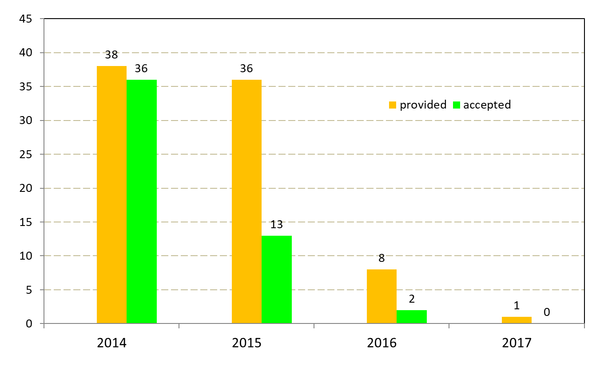
Data collection 1-sec definitive 2014, 2015, 2016, 2017
(state of 2018-06-15)
IMOs
year
Deadlines:
2014 data - 2016-10-01
2015 data - 2017-10-01
2016 data - 2018-10-01
2017 data - „call for data” will be sent Jan/Feb 2019

Slide 2
Remarks on 1-sec definitive data collection
2014
requested and provided: IAGA2002
Used utilities:
- DataCheck1s.jar + autoplot
- iaga2002_to_iaf21.exe (conversion IAGA2002 to IAF)
- imcdview.jar
IAGA2002 were converted to IAF, next IAF were compared with accepted 1-min definitive
2015, 2016, 2017
Requested: CDF
Provided: CDF, IAGA2002
Checked IAGA2002 data sets (the same method as for 2014 data)
There were difficulties to check CDF
The most conversions from CDF to IAF were unsuccessful, both using
gm_convert-1.0 and gm_convert-1.0 or MagPy

