Slide 1
Space Weather in WMO/OSCAR
Presented in Ottawa, 19 July 2019

Slide 2
Space Weather in WMO
http://www.wmo.int/pages/prog/sat/spaceweather-intro_en.php
June 2008 - WMO Executive Council noted the potential synergy between meteorological and Space Weather services to operational users and agreed to support international coordination of Space Weather activities.
Updates (July 2019):
WMO is currently going through the reform process.
- Updated Statement of Guidance for SW Observations (approved May 2018)
- New four-year plan for WMO activities related to Space Weather (SW) in 2020-2023
has been presented in June 2019 at the 18th World Meteorological Congress, and 71th Session of Executive Council.
One of global tasks for WMO Space Weather group is:
To integrate Space weather–surface based observations into WMO Integrated Global Observing System (WIGOS)

Slide 3
Introduction
WMO Global Observing System (WIGOS) Tools:
----RRR - Rolling Review of Requirements:
User requirements for observations are compared with the capabilities of present and planned observing systems. The output of this is reviewed by relevant experts and used to prepare a Statement of Guidance (SOG), the main aim of which is to identify the most important gaps between user requirements and system capabilities in order to guide the future developments.
-----OSCAR – Observing System Capability Analysis and Review
OSCAR-Space is the WMO repository of WIGOS metadata for all space-based observing missions (including space weather satellites)
OSCAR-Space is done (https://www.wmo-sat.info/oscar/spacecapabilities )
OSCAR-Surface is the WMO repository of WIGOS metadata for all surface-based observing stations and platforms, including space weather observations
- currently is under development
https://oscar.wmo.int/surface//index.html#/
SW surface-metadata on WIGOS SW observing capabilities are gradually appearing!!

Slide 4

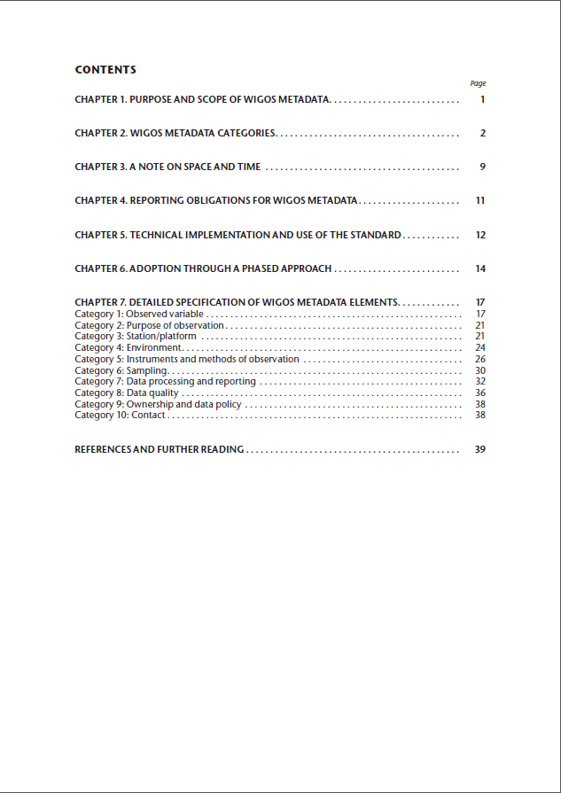
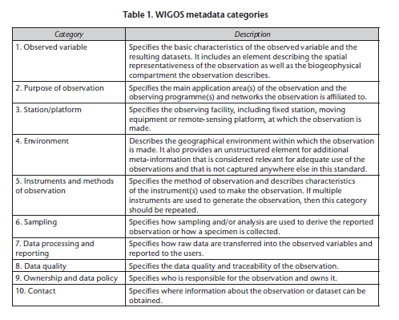
WIGOS METADATA STANDARD
https://library.wmo.int/index.php?lvl=notice_display&id=19925#.XTIckHlYa9I

Slide 5
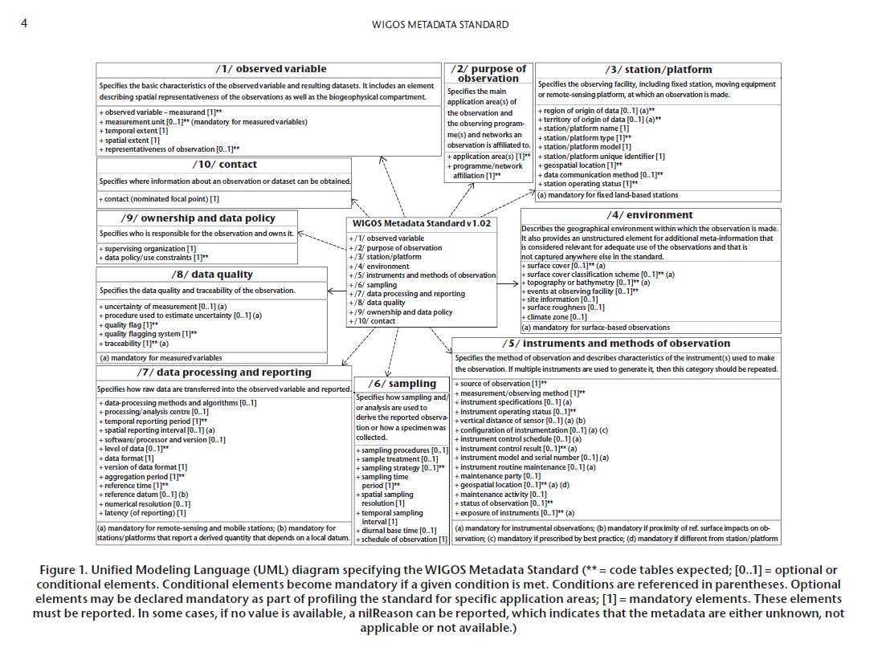

Slide 6
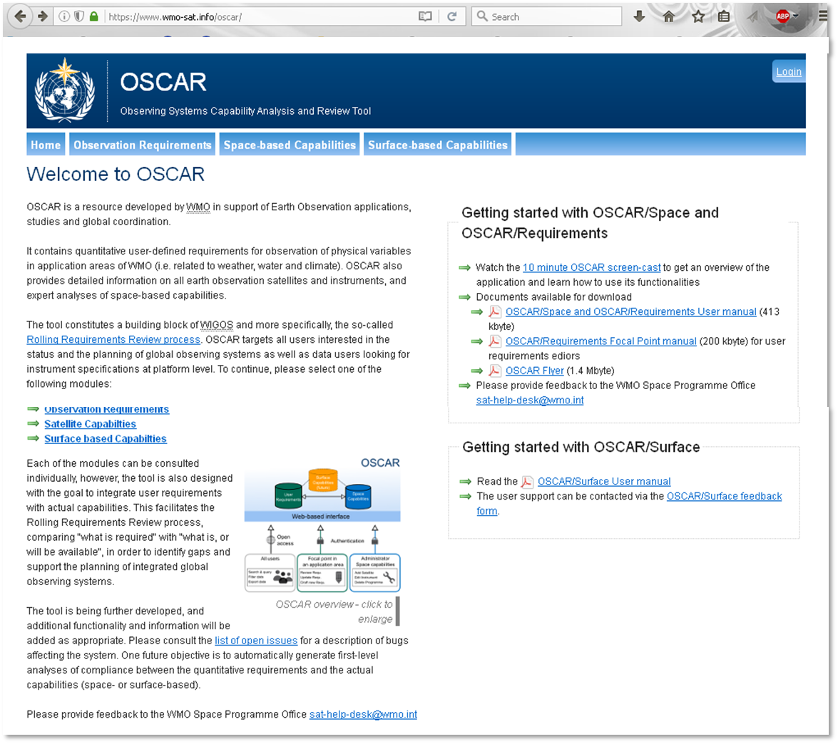
OSCAR-Observing System Capability Analysis and Review

Slide 7
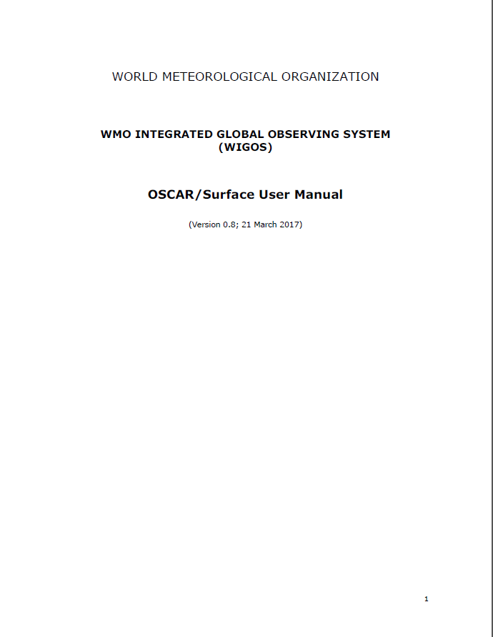
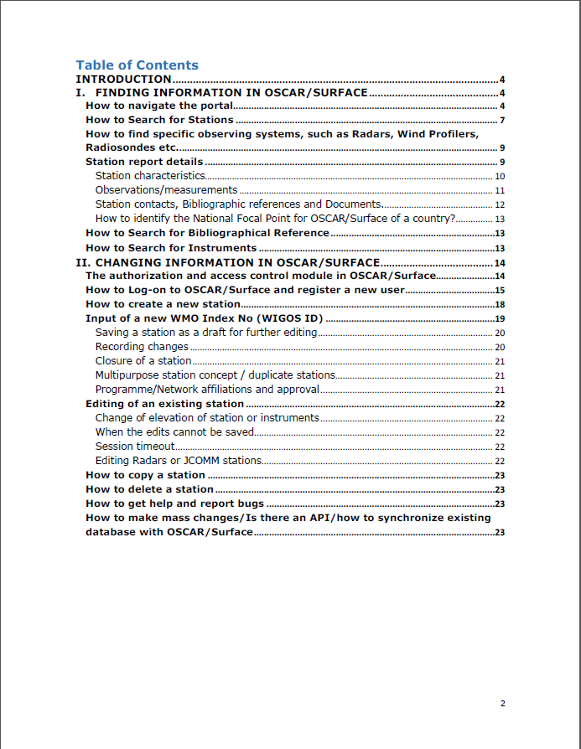
OSCAR-Surface User Manual:
https://library.wmo.int/index.php?lvl=notice_display&id=20824#.XTIXY3lYa9I
Instruction from Manual:
How to find specific observing systems, such as Radars, Wind Profilers,
Radiosondes etc.
One way to find stations by observation technology is to search by “network affiliation”.
Another way is to use the “station class”. As with all information in OSCAR/Surface, the
accuracy of the search results depends heavily on the quality of the metadata inserted into the
system.

Slide 8
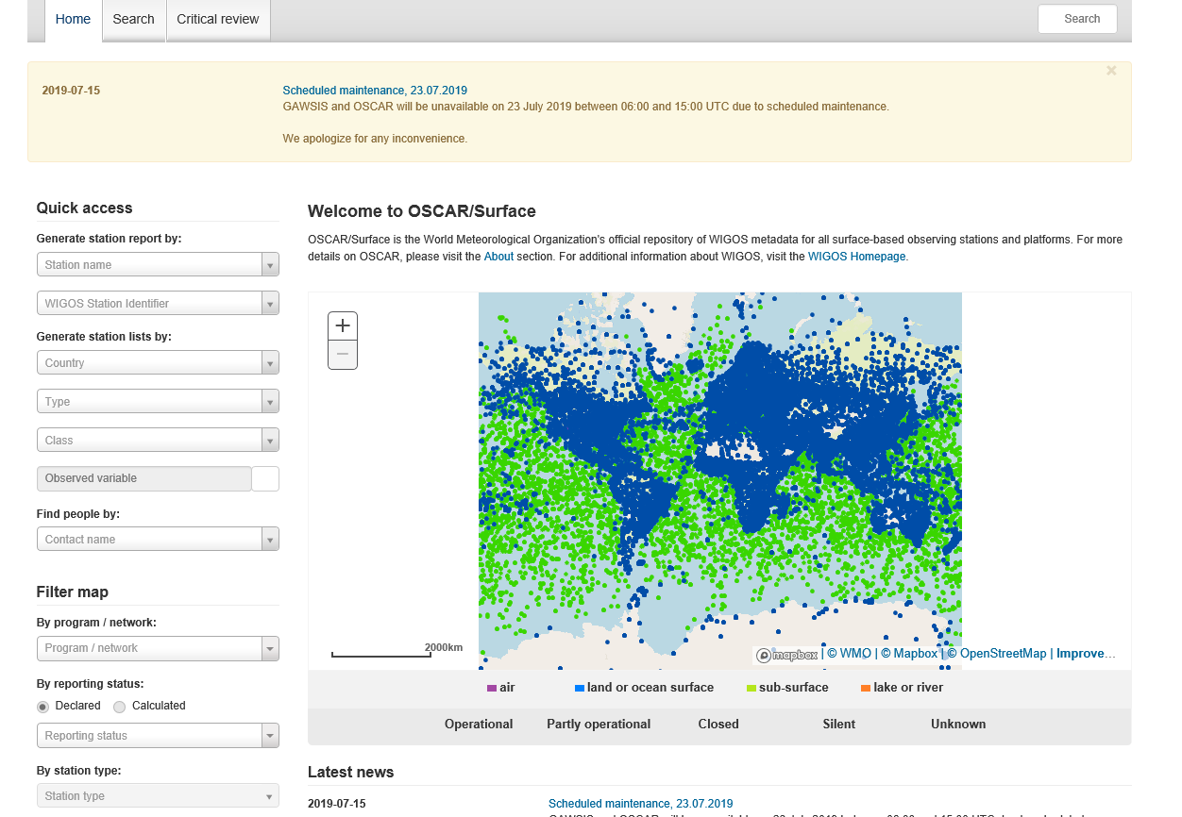
EXAMPLE: GEOMAGNETIC OBSERVATORIES in OSCAR
https://oscar.wmo.int/surface/#/
Instruction from Manual:
How to find specific observing systems, such as Radars, Wind Profilers,
Radiosondes etc.
One way to find stations by observation technology is to search by “network affiliation”.
Another way is to use the “station class”. As with all information in OSCAR/Surface, the
accuracy of the search results depends heavily on the quality of the metadata inserted into the
system.

Slide 9
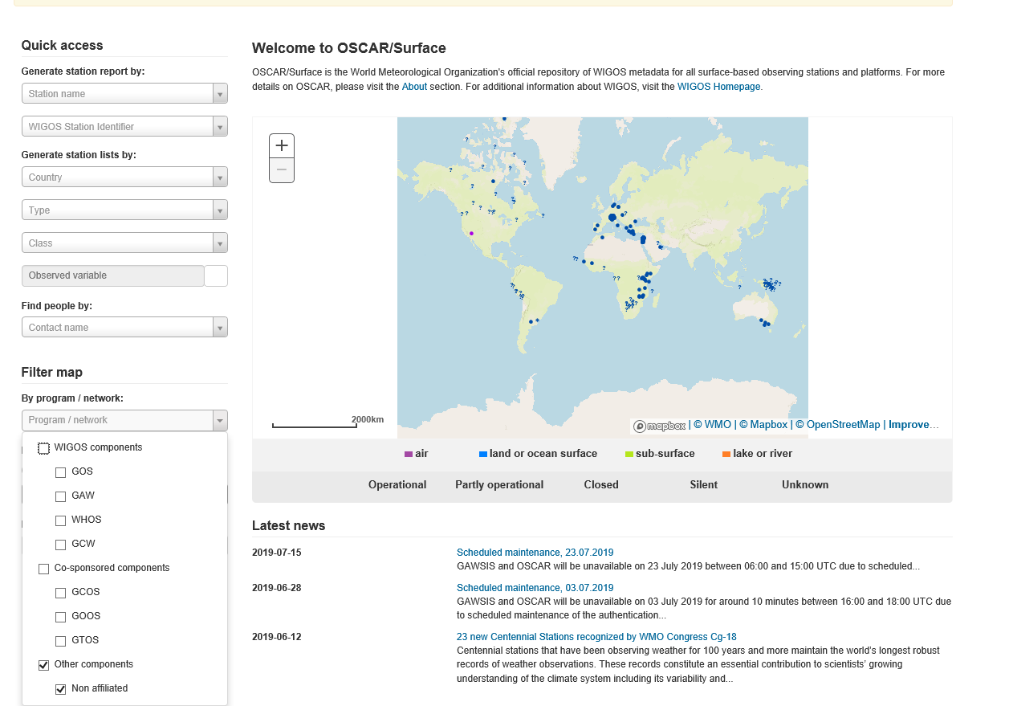
EXAMPLE: GEOMAGNETIC OBSERVATORIES in OSCAR
https://oscar.wmo.int/surface/#/

Slide 10
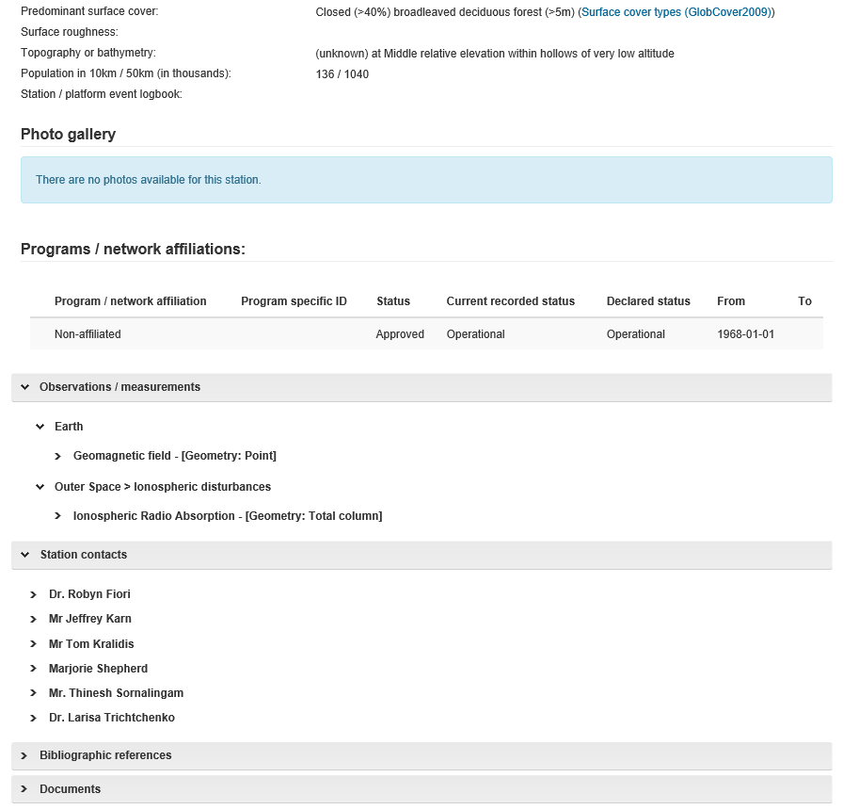
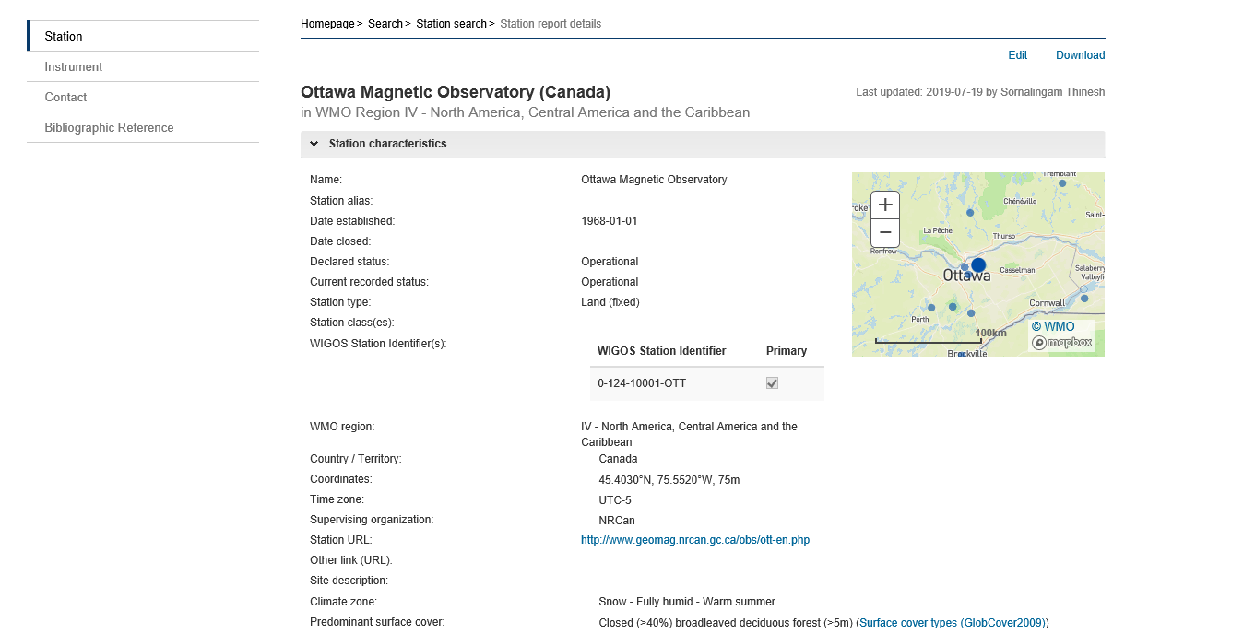
EXAMPLE: GEOMAGNETIC OBSERVATORIES in OSCAR

Slide 11
EXAMPLE: GEOMAGNETIC OBSERVATORIES in OSCAR
https://oscar.wmo.int/surface/#/
What are these?

Slide 12
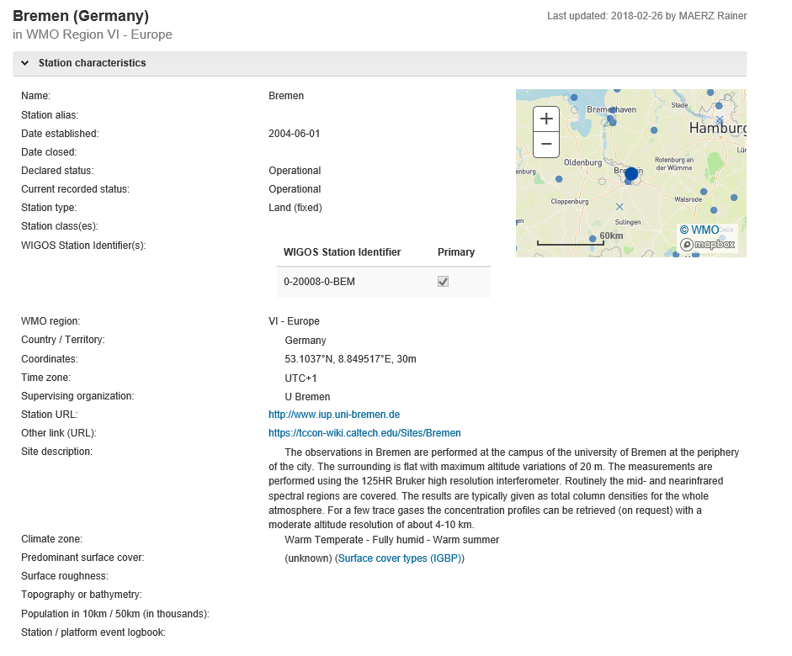
What are these?
University-based
atmospheric observations

Slide 13
EXAMPLE: GEOMAGNETIC OBSERVATORIES in OSCAR
https://oscar.wmo.int/surface/#/
How to find specific observing systems, such as Radars, Wind Profilers,
Radiosondes etc.
One way to find stations by observation technology is to search by “network affiliation”.
Another way is to use the “station class”. As with all information in OSCAR/Surface, the
accuracy of the search results depends heavily on the quality of the metadata inserted into the
system.
Station Class-
space weather stations
are not defined in the WMO “class” list

Slide 14
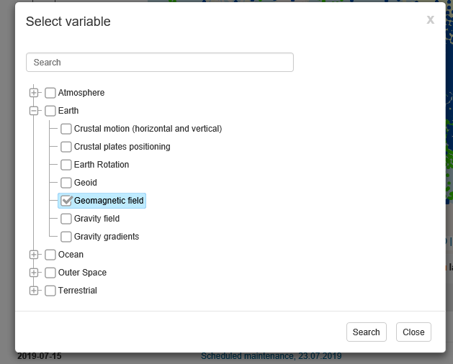
EXAMPLE: GEOMAGNETIC OBSERVATORIES in OSCAR
Try to find by “observed variable”

Slide 15
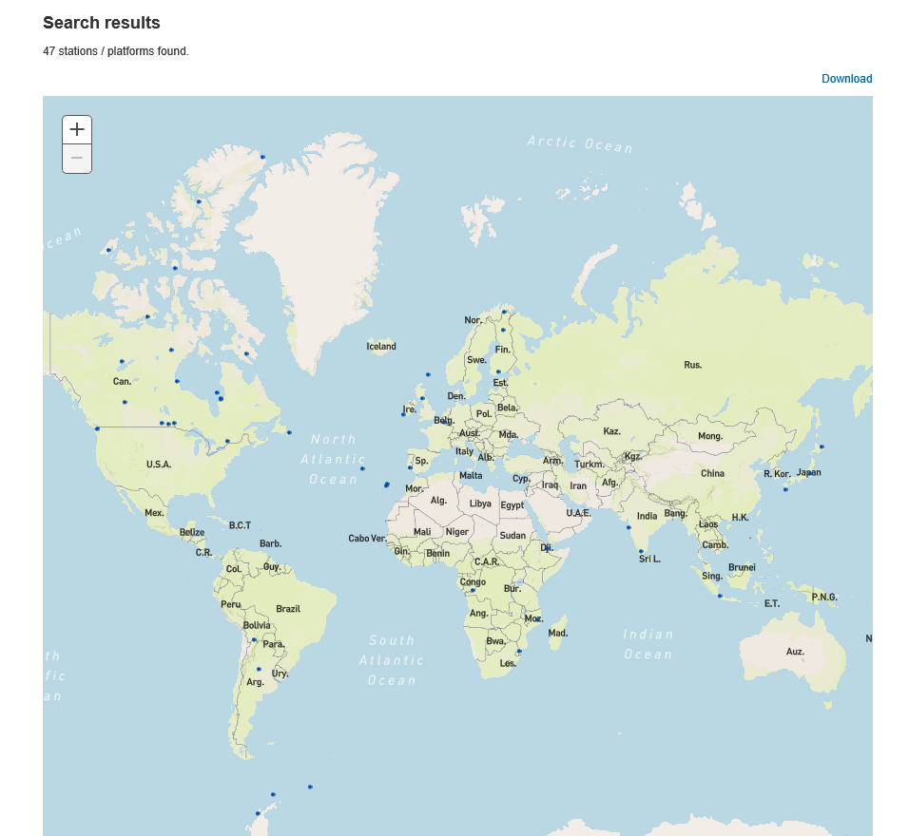
EXAMPLE: GEOMAGNETIC OBSERVATORIES in OSCAR

Slide 16
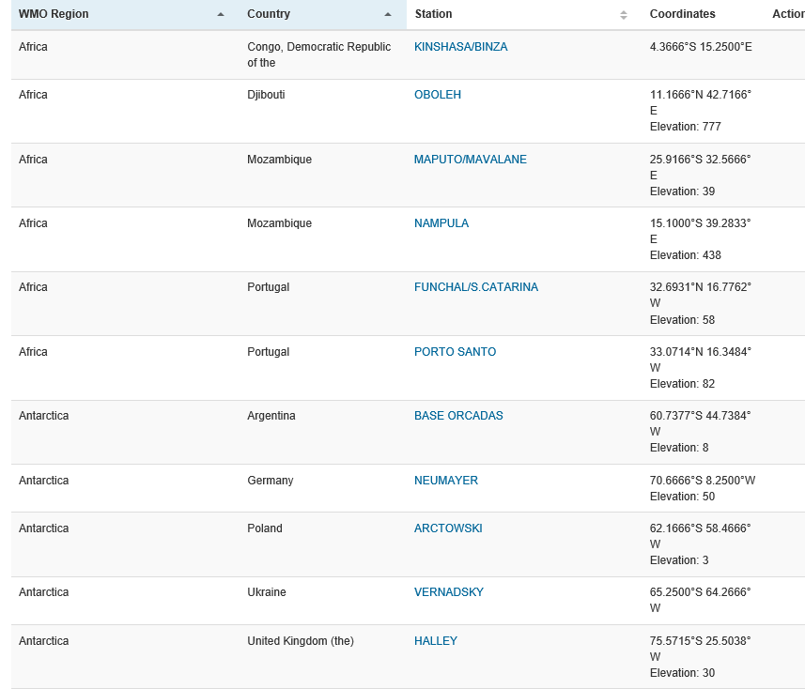
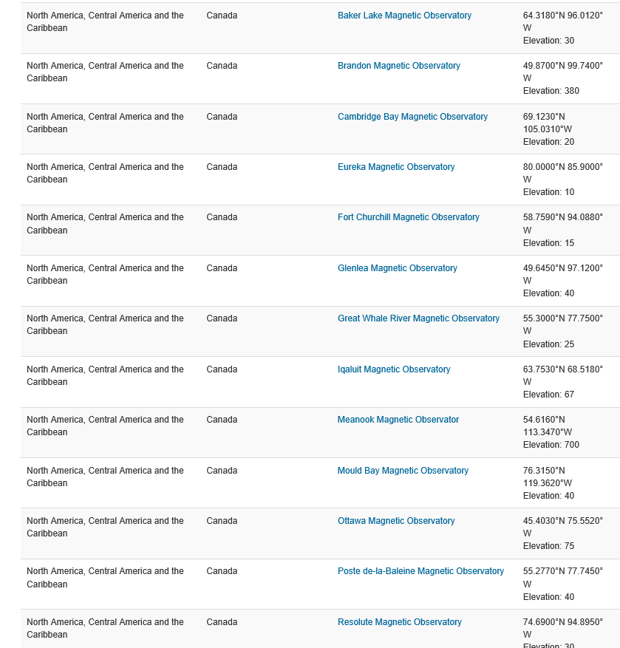
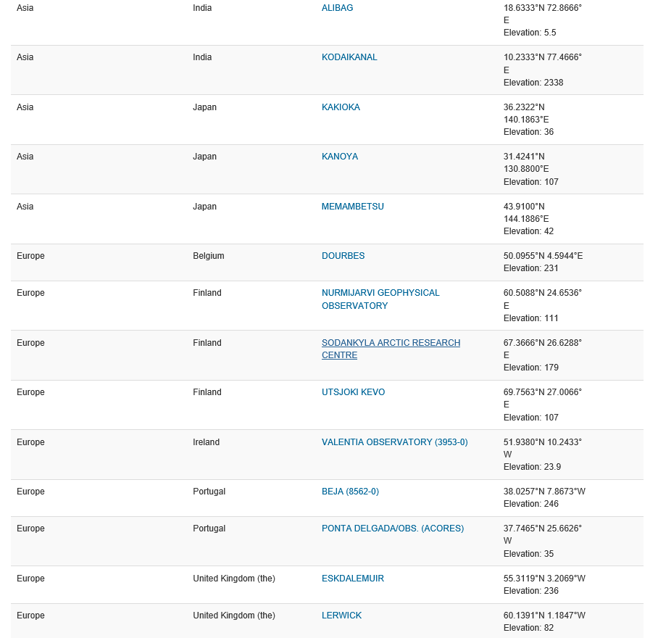
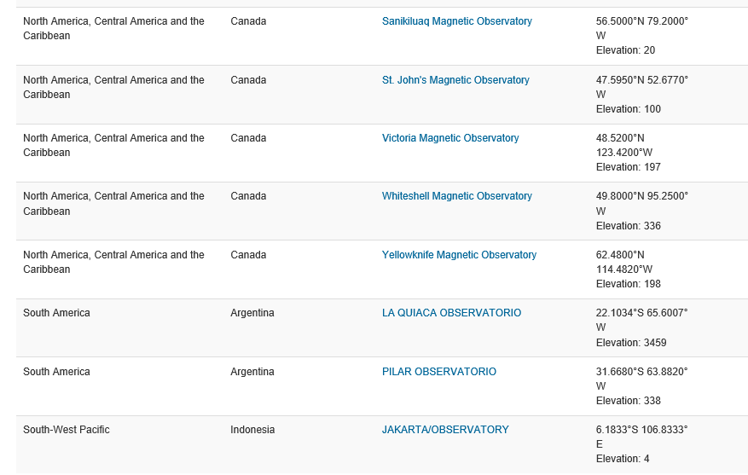
EXAMPLE: 47 GEOMAGNETIC OBSERVATORIES in OSCAR

Slide 17
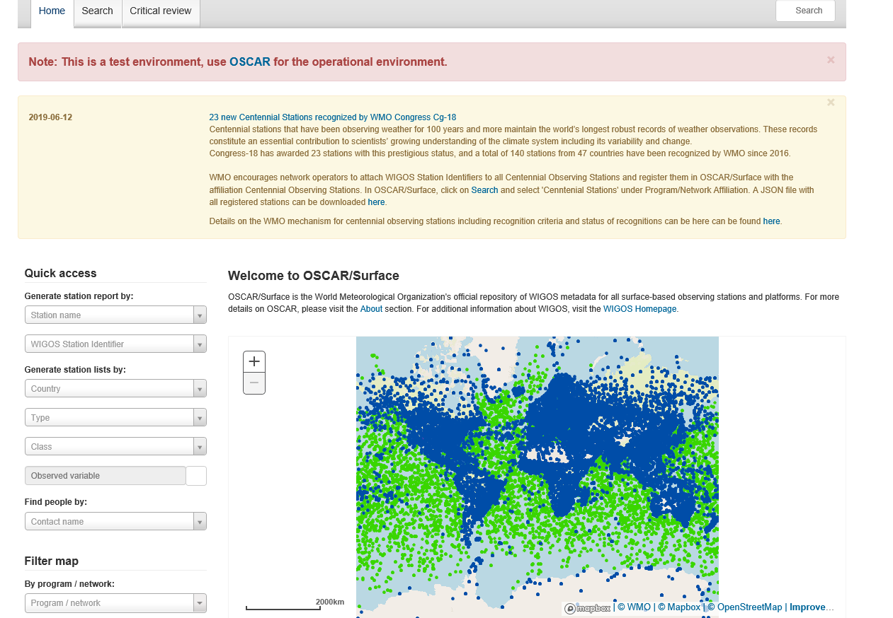
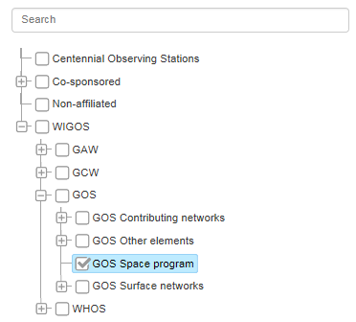
DEVELOPMENTS FOR SPACE WEATHER IN OSCAR-SURFACE
Programme affiliation: to add Space Programme,
Station class: to add station classes (not only geomagnetic)

Slide 18
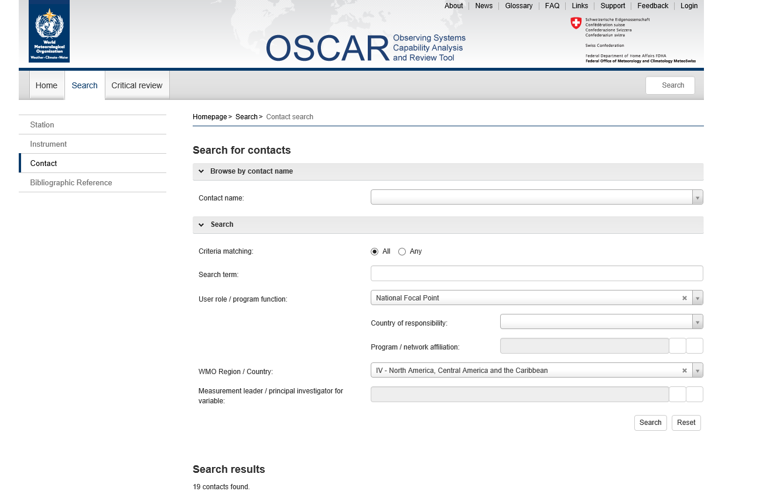
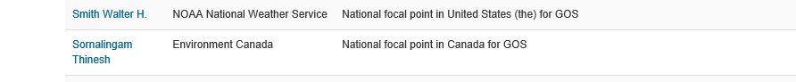
STEPS TO PLACE GEOMAGNETIC OBSERVATORIES in OSCAR:
TO FIND THE NATIONAL POINT OF CONTACT
(GOS-Global Observing Systems) in OSCAR-Contacts
EXAMPLE FOR USA and CANADA IS BELOW

Slide 19
Questions, suggestions are to be directed to larisa.trichtchenko@canada.ca

