Slide 1
Preparation Status for Sending/Receiving INTERMAGNET Data via MQTT in Kyoto GIN
Shun Imajo

Slide 2
Current status
(A) Configure the MQTT broker in Kyoto → Done
Subscription allows anonymous access
Publishing is limited to pre-created users (currently only "geomag")
Both ports 1883 and 8883 are listening.
(B) Set up a bridge (outgoing) to transfer data published to the Kyoto broker to the Edi broker → Done
Tested with Edi's test broker (not yet tested with the production broker)
QoS is set to Level 1
Tested using manual commands mosquitto_{pub,sub}
(C) Prepare a system to subscribe to data published on the Edi broker and save it locally in Kyoto → pending
Tried configuring an incoming bridge but it did not work successfully
Considering methods like running the mosquitto_sub command periodically
(E) Prepare a system to publish data sent by ways other than MQTT (e.g., email) from observatories using MQTT → In progress
We have created a standalone program for conversion from IAGA2002 format to MQTT-compatible JSON format.
Handles header keys case-insensitively.
Automatically determines the timestamp format by detecting the data interval (1-second or 1-minute).
(F) Create accounts so that each sender can publish to the Kyoto broker → Not yet, but we plan to start with Kakioka Observatory as the first case.

Slide 3
MQTT broker in Kyoto GIN
Data sender
(MQTT client)
Kyoto GIN
Edinburgh GIN
C (pending)
A (done)
publish
MQTT broker
MQTT broker
F (not yet)
bridge
B (done)
publish
subscribe
E (under construction)
Email, sftp, or other methods
Data user
IAGA2002 to JSON
Data sender
(no MQTT)
Local system

Slide 4
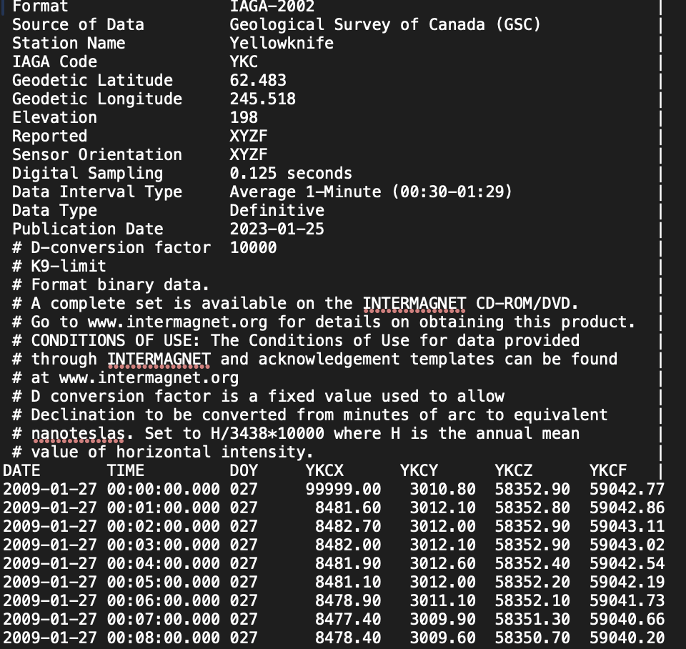
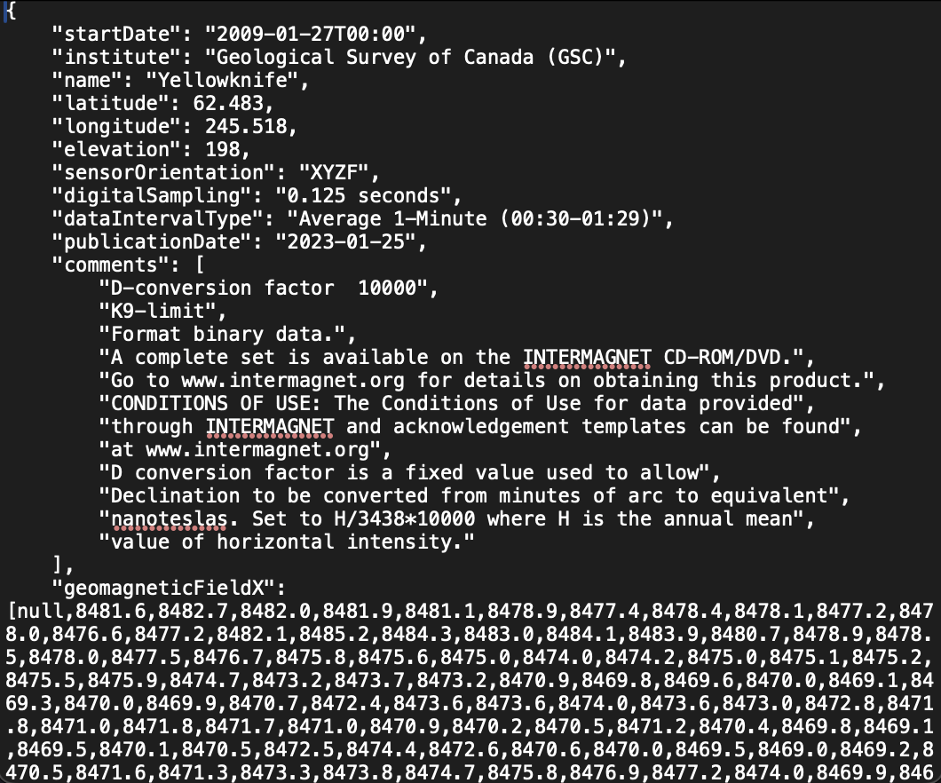
Simple program for converting IAGA2002 to JSON
Usage: (just input as stdin)
$ python3 iaga2002_to_json.py < ykc20090127dmin.min > ykc20090127dmin.json

Slide 5
Future Outlook
The highest priority work is preparation of the system for automatic format conversion and publication of data to Edi Broker via MQTT (task marked with E).
Starting this month (September), our IT assistant's working hours will increase, and we aim to establish the system for sending data to Edinburgh via MQTT by the end of the year.
It is expected to take considerable time to enable each station to use MQTT.
We plan to work with Kakioka as the first case.
We also need to build a system to store the data we receive via MQTT into our server.
Notes:
She is very competent and does solid work, but because of that, she doesn't work very fast. She also has other work that needs to be done.

