Slide 1
Monthly means to review definitive data and check the INTERMAGNET archive

Slide 2
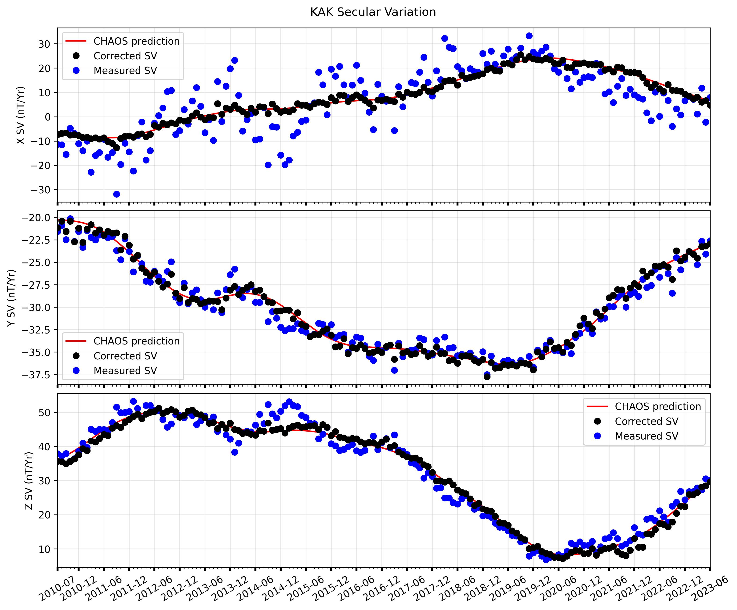

Slide 3
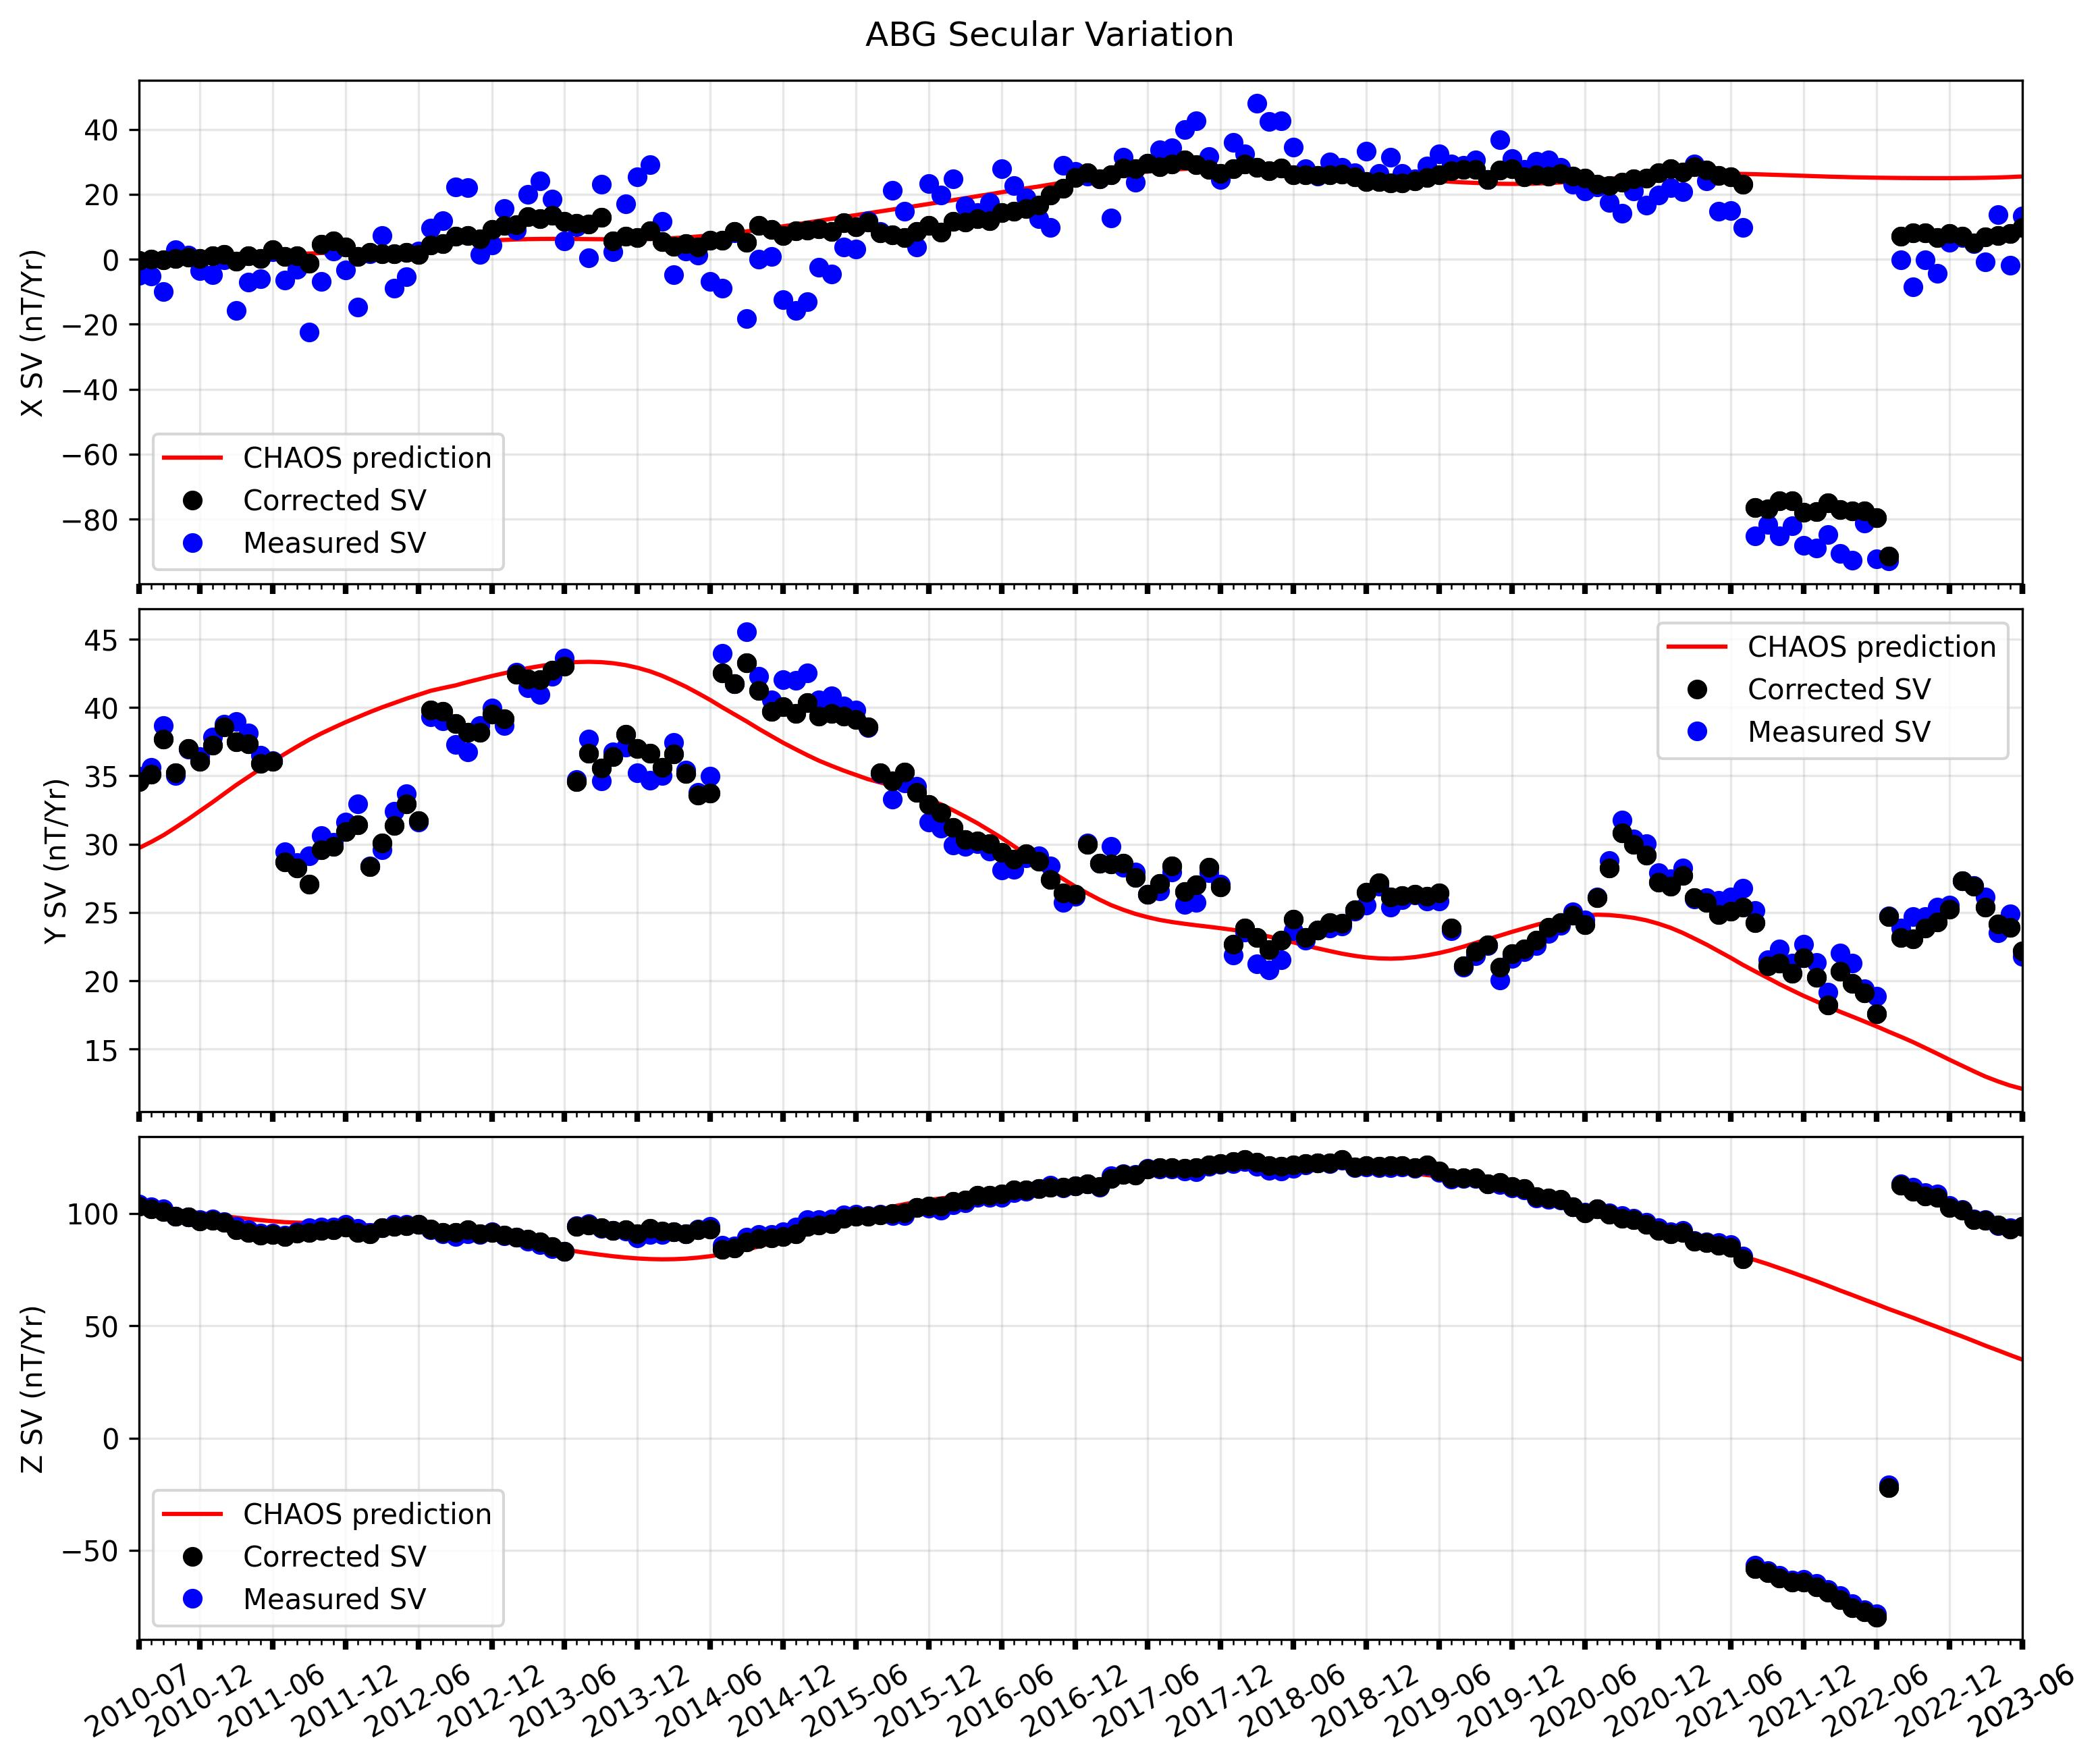

Slide 4
