Slide 1
Intermagnet Real-Time Data
Simon Flower

Slide 2
Intermagnet real-time data
US Observatories
Golden
Canadian Observatories
Ottawa
Kyoto
Rsync
Email
Rsync
Paris
Rsync
Other Intermagnet observatories
Email
Rsync
Email
Web service
Edinburgh

Slide 3
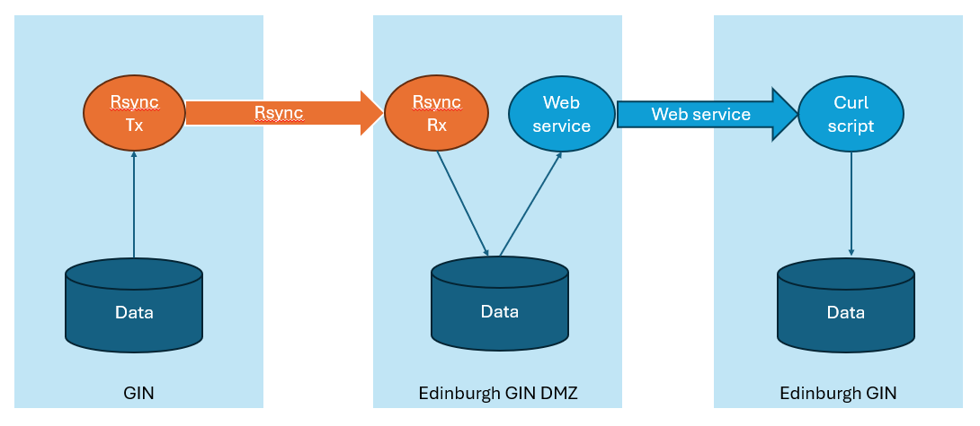
Where is the latency?
Rsync
Rsync is insecure – complex systems are needed to mitigate this.
Transfers are based on files of data, each file one day long.
Rsync itself is able to transfer differences between day files.
But the way it is implemented at the Edinburgh GIN requires transfer of the entire day file.
Therefore each update requires the entire day file to be recreated
Email is inherently slow and not well suited to streaming data
The Edinburgh GIN web service is faster than email, but more complex than, and not as fast as, MQTT or Seedlink

Slide 4
Why is Rsync slow?
IPGP, Kyoto, NRCan, USGS
BGS
GIN
Edinburgh GIN DMZ
Edinburgh GIN
Rsync Tx
Rsync Rx
Web service
Curl script
Rsync
Web service
Data
Data
Data

Slide 5
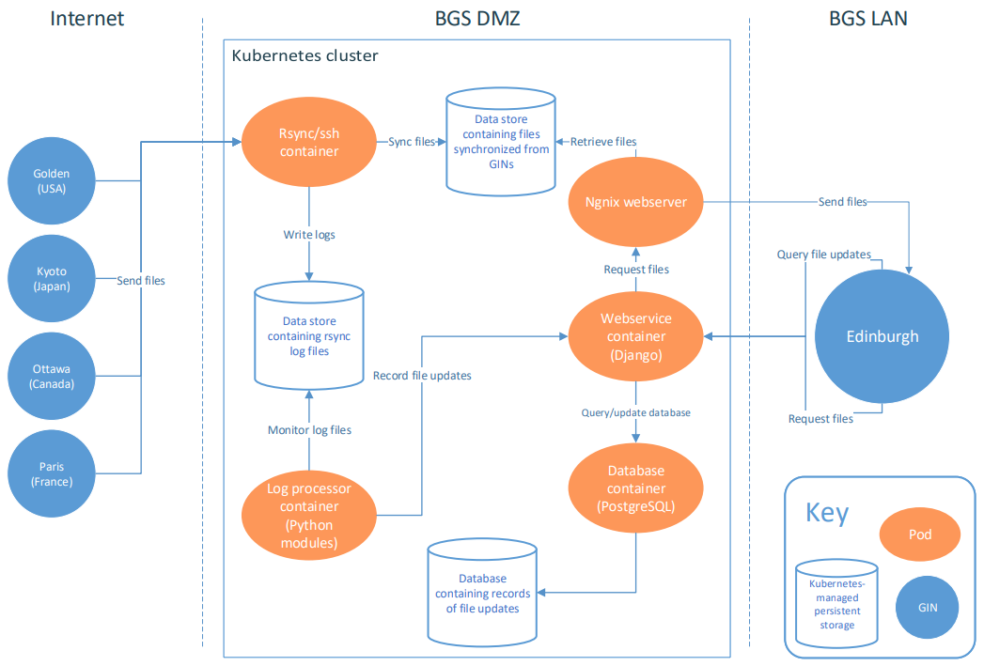
Why is Rsync complex?

Slide 6
What can replace Rsync?
1. Seedlink
A streaming protocol, created in the Seismic community and already used for observatory data transfer at NRCan and USGS.
This is much simpler to implement at the Edinburgh GIN than Rsync.
2. MQTT
A message passing protocol, widely used in the Internet of Things and already used at some observatories.
For both observatories and GINs, MQTT is much simpler to implement than any other data transfer method.

Slide 7
What can replace Rsync?
Both Seedlink and MQTT offer:
Transfers of small numbers of samples (rather than whole day files)
Very low latency
Greater security (MQTT uses TLS)
Much simpler to implement at the Edinburgh GIN
And for MQTT, simple to implement at observatories

Slide 8
Faster Intermagnet real-time data
US Observatories
Golden
Canadian Observatories
Ottawa
Kyoto
Seedlink
MQTT
Email
Seedlink
Other Intermagnet observatories
MQTT
Paris
MQTT
Email
MQTT
MQTT
Email
Web service
Edinburgh

Slide 9
Work already completed
Seedlink and MQTT software running at Edinburgh GIN for the last 6 months
Results with MQTT:
2 Belgian observatories successfully submitting provisional data via MQTT
1 Polish observatory sending test data via MQTT
Results with Seedlink:
2 Canadian observatories sending test data via Seedlink
Some problems (now resolved) with network security at BGS

Slide 10
What work is needed?
Golden GIN and Ottawa GIN
Seedlink is already used at NRCan and USGS
Are NRCan and USGS ready to provide data to Edinburgh using Seedlink?

Slide 11
Proposed implementation at Kyoto and Paris GINS
Kyoto and Paris GINs
MQTT Broker
MQTT
Edinburgh GIN
MQTT
Observatories
New MQTT conversion software
Email
Data
Existing email ingestion software

Slide 12
What work is needed?
Kyoto GIN and Paris GIN
Set up an MQTT “Broker” to allow forwarding of MQTT traffic from their GINs to Edinburgh.
Create software to forward data by MQTT (replacing rsync transfer).
Everyone
Encourage and support observatories to convert to MQTT for real-time data submission.
The latency in the network will depend on how often observatories make MQTT transmissions to Intermagnet.

