Slide 1
Collaborative Git
INTERSECT Bootcamp
Lauren Milechin
Notes:
Show of hands, who has used git?
Who has used git to work on the same code with others? How has that been?

Slide 2
Outline
Introduction
Branches
Pull Requests
Git Workflows

Slide 3
Challenges of Collaborative Development
Sharing code such that
Everyone has the latest version
Everyone can contribute equally
Keeping organized within the team
Everyone is on the same page
Communication
Notes:
There are a few challenges that come up when working on shared code. We want to make sure everyone has access to and knows what is the latest version, and we want to make sure everyone has an equal opportunity to contribute. It can also be difficult to keep organized while code is being actively developed and make sure everyone is on the same page about the state of the code.

Slide 4



Challenges of Collaborative Development
Sharing code such that
Everyone has the latest version
Everyone can contribute equally
Keeping organized within the team
Everyone is on the same page
Communication
Notes:
There are a few challenges that come up when working on shared code. We want to make sure everyone has access to and knows what is the latest version, and we want to make sure everyone has an equal opportunity to contribute. It can also be difficult to keep organized while code is being actively developed and make sure everyone is on the same page about the state of the code.
We can use sites like GitHub, GitLab, BitBucket, and similar to share code with others. These sites also enable teams to contribute to software projects that they are working on together by hosting the code in a centralized location that everyone has access to. This allows everyone to view the latest version, and make updates as needed. It also provides a mechanism for outside collaborators to contribute to the project, say for open source software.
In this lesson we will be briefly going over some more advanced git tools that become essential when working collaboratively. These are branches and pull requests. In a collaborative environment, branches allow more than one person to work on the code independently, separate from the centralized main branch. Pull or merge requests provide a transparent mechanism to bring the changes made on a branch into the main branch, and encourage communication amongst the maintainers on whether the changes should be pulled in or if further changes are needed.
While technology helps, it is not the solution on its own. We will also discuss git workflows, which describe the strategy of how branches and pull requests should be used to stay organized and productive. We will show a few common workflows, and give general guidance on how to choose what will work well for your project and team.

Slide 5
AI Coding Agents and Git
Agents work better when your code is version controlled with git
Access to more context through git history and file diffs (how the file has changed)
Testing is more efficient: it can compare results between current and previous versions
Agents can help with git, but still need oversight
Can run git commands, write commit messages, make and review pull requests
Won’t follow conventions or best practices unless you instruct it to
Agent config files (AGENTS.md, CLAUDE.md, copilot-instructions.md) help, but not perfect

Slide 6

AI Coding Agents and Git
The advice is to add a CLAUDE.md file to repositories so agents know how you like to work in the repo. But every time I try to test it with a new feature Claude ignores it and instead starts working. Is there something I am doing wrong?
Nothing wrong on your end — this is a known gap. CLAUDE.md gets read as background context during exploration (it's just another file among several I read to understand the codebase), so its prose gets absorbed as "useful info" rather than treated as a mandatory gate that has to fire before the first edit. Imperative instructions buried in markdown compete with everything else in context, and "read the rules" and "act on the rules" aren't the same event to me unless something forces the connection — which is exactly what happened here: I read the workflow section, then went straight to editing files without treating it as a checklist to execute.
Notes:
Conversation I had with Claude when I started exploring CLAUDE.md files

Slide 7
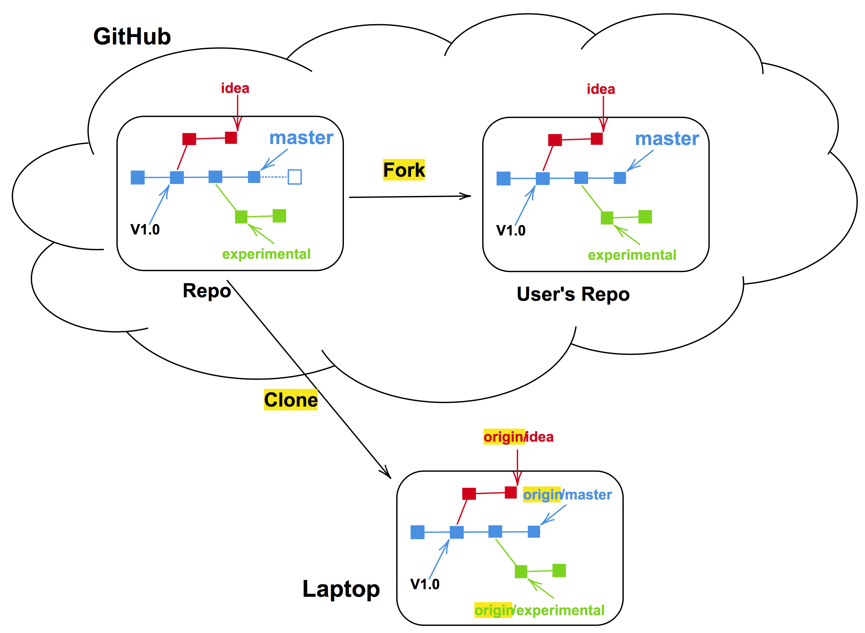
Review- Terminology
Repository (repo): The project, contains all data and history (commits, branches, tags).
Remote/central (repository): The copy of the repository on a remote server, such as GitHub. Accessible to anyone who has access to the repository on the server.
Local (repository): A copy of the repository in another place, such as a laptop or your home directory on a cluster. Generally accessible to one person.
Commit: Snapshot of the project, gets a unique identifier (e.g. c7f0e8bfc718be04525847fc7ac237f470add76e).
Tag: A pointer to one commit, to be able to refer to it later. Like a commemorative plaque that you attach to a particular commit (e.g. phd-printed or paper-submitted).
main
main
origin/main
Definitions and Figure from Code Refinery: https://coderefinery.github.io/git-collaborative/concepts/

Slide 8
Review- Terminology
Branch: Independent development line. The main development line is often called main or master.
Cloning: Copying the whole repository to your laptop - the first time. This creates a local copy of the repository.
Forking: Taking a copy of a repository (which is typically not yours) into your GitHub/GitLab account - your copy (fork) stays on GitHub/GitLab and you can make changes to your copy.
Pull: Bring changes from a remote repository to your local repository.
Push: Bring changes from your local repository to the remote repository.
main
main
origin/main
Definitions and Figure from Code Refinery: https://coderefinery.github.io/git-collaborative/remotes/

Slide 9
Review- Basic Git Pattern
Clone the repository (run once)
Pull any new changes on the remote
Make changes
Commit your changes
Push your changes to the remote repository
Repeat steps 3-5 as needed.
git clone URL
git pull
git add filename git commit -m "short descriptive commit message"
git push

Slide 10
Activity (10 mins)
We will work in small groups for this module
Follow along
One person in each group
Create a repository from the template
https://github.com/INTERSECT-training/intersect-training-practice
Use this Template -> Create a New Repository
Give access to each member in your group
Everyone
Accept invite to collaborate
Clone the repository to your computer with git clone

Slide 11
Outline
Introduction
Branches
Pull Requests
Git Workflows

Slide 12
Branches
Independent development lines
Different purposes (feature, development, production)
Varying lifetimes (short vs long-lived)
Commits from one branch can be merged into another
m1
m2
m3
m4
Main Branch Only
f1
f2
f3
f1
f2
f3
m1
m2
m3
m4
m1
m2
m3
m4
g1
g2
g3
Main Branch with Feature Branch
Main Branch with 2 Feature Branches
Notes:
Branches are independent development lines. Working independently, you can likely get away with using git without creating any branches, as in the first diagram in the figure below. However, when you begin to work with others, branches allow team members to work on the code without impacting the work of other developers or users.
Branches can have a few different purposes. Branches created to develop a specific feature are referred to as feature branches, and are often short-lived. Branches can also be used for longer-term purposes, such as having separate development and production branches. How you organize and use branches in your project is referred to as a branching strategy, which we will cover more when we talk about git workflows.
Changes made in one branch can be brought into another branch with a merge. For example, when a feature branch is completed it may be merged into the main branch. And, if while you are working on a feature branch the main branch changes, you can merge the changes from the main branch into your feature branch while you are still working.

Slide 13
Creating Branches
Good practice to first pull any recent changes to the repository
Create a branch
git checkout main
git pull
f1
git checkout -b my_new_branch
git checkout -b my_branch
m1
m2
m1
m2
Notes:
You can create a branch on your local clone of the repository. If didn't just clone the repository it is always good to make sure you have any recent changes to the main branch by checking out the main branch and running "git pull":
```bash
git checkout main
git pull
```
Then, to create a branch we can run:
```bash
git checkout -b my_new_branch
```
This will create the branch `my_new_branch` and move you to the new branch. If you run `git status` at this point it will display `On branch my_new_branch`. Making and committing any changes will only update `my_new_branch`.
Use short, descriptive names
The first time you push your branch to the remote repository, you will need to publish the branch by running run:
```bash
git push --set-upstream origin my_new_branch
```
After this any commits can be pushed with a simple `git push`.

Slide 14
Creating Branches
Good practice to first pull any recent changes to the repository
Create a branch
New commits will be added to this branch
git checkout main
git pull
git checkout -b my_new_branch
f1
f1
f2
f3
git commit
(x2)
m1
m2
m1
m2
Notes:
Creating commits on a branch. From left to right: a repository with two commits on the main branch and one on a feature branch, followed by an arrow with the text "git commit (x2)", followed by the same repository with to additional commits on the feature branch. A smiley face is used on each diagram to show where you are in the repository, each on the last commit on the feature branch.
You can create a branch on your local clone of the repository. If didn't just clone the repository it is always good to make sure you have any recent changes to the main branch by checking out the main branch and running "git pull":
```bash
git checkout main
git pull
```
Then, to create a branch we can run:
```bash
git checkout -b my_new_branch
```
This will create the branch `my_new_branch` and move you to the new branch. If you run `git status` at this point it will display `On branch my_new_branch`. Making and committing any changes will only update `my_new_branch`.
The first time you push your branch to the remote repository, you will need to publish the branch by running run:
```bash
git push --set-upstream origin my_new_branch
```
After this any commits can be pushed with a simple `git push`.

Slide 15
Creating Branches
Good practice to first pull any recent changes to the repository
Create a branch- use short, descriptive names
New commits will be added to this branch
Publish your branch
Add new commits to the remote repository
git checkout main
git pull
git checkout -b my_new_branch
git push --set-upstream origin my_new_branch
git push
Notes:
You can create a branch on your local clone of the repository. If didn't just clone the repository it is always good to make sure you have any recent changes to the main branch by checking out the main branch and running "git pull":
```bash
git checkout main
git pull
```
Then, to create a branch we can run:
```bash
git checkout -b my_new_branch
```
This will create the branch `my_new_branch` and move you to the new branch. If you run `git status` at this point it will display `On branch my_new_branch`. Making and committing any changes will only update `my_new_branch`.
The first time you push your branch to the remote repository, you will need to publish the branch by running run:
```bash
git push --set-upstream origin my_new_branch
```
After this any commits can be pushed with a simple `git push`.

Slide 16
Changing Branches
Changing branches using the command git checkout
For example, to change to the main branch, run
The git status command will display which branch you are on
git checkout main
f1
f2
f3
f1
f2
f3
git checkout main
m1
m2
m1
m2
Notes:
If you need to switch to another existing branch you can use the `git checkout` command. For example, to switch back to the main branch you can run:
```bash
git checkout main
```
Remember, if you aren't sure which branch you are on you can run `git status`. It is good practice before you start making changes to any of your files to check that you are on the right branch with `git status`, particularly if you haven't touched the code recently.

Slide 17
Merging Branches
f1
f2
f3
Bring changes from one branch into another with a merge
This command brings changes from branch_name to the current branch
To merge new changes from main into my_new_branch
m1
m2
m3
m4
git merge branch_name
git merge main
f1
f2
f3
f4
git checkout my_new_branch
git merge main
m1
m2
m3
m4
Notes:
Bring the changes from one branch into another branch by merging them. When you merge branches, changes from the specified branch are merged into the branch that you currently have checked out. For example,
```bash
git checkout my_new_branch
git merge main
```
will merge any changes introduced to `main` into the `my_new_branch`. Merging in this direction is especially useful when you've been working on `my_new_branch` for a while and `main` has changed in the meantime.
When development is complete on `my_new_branch`, it would be merged into `main`:
```bash
git checkout main
git merge my_new_branch
```
Git will do its best to complete the merge automatically. For example, if none of the changes have happened in the same lines of code, things will usually merge cleanly. If the merge can't complete automatically, this is called a merge conflict. Any conflicts in the files must be resolved before the merge can be completed.

Slide 18
Merging Branches
f1
f2
f3
Bring commits from one branch into another with a merge
This command brings commits from branch_name to the current branch
To merge new changes from main into a my_new_branch
When development is complete on my_new_branch it can be merged into main with
m1
m2
git merge branch_name
git merge my_branch
git checkout my_new_branch
git merge main
f1
f2
f3
m1
m2
m3
git checkout main
git merge my_new_branch
Notes:
Bring the changes from one branch into another branch by merging them. When you merge branches, changes from the specified branch are merged into the branch that you currently have checked out. For example,
```bash
git checkout my_new_branch
git merge main
```
will merge any changes introduced to `main` into the `my_new_branch`. Merging in this direction is especially useful when you've been working on `my_new_branch` for a while and `main` has changed in the meantime.
When development is complete on `my_new_branch`, it would be merged into `main`:
```bash
git checkout main
git merge my_new_branch
```
Git will do its best to complete the merge automatically. For example, if none of the changes have happened in the same lines of code, things will usually merge cleanly. If the merge can't complete automatically, this is called a merge conflict. Any conflicts in the files must be resolved before the merge can be completed.

Slide 19
Merge Conflicts
Git will do its best to merge automatically
Merge conflicts occur when when git can’t do this
Usually when the same line is changed in both branches
Merge conflicts must be resolved before completing the merge
Manually using a text editor
Using a visual mergetool
Communicate with collaborators if necessary
Ways to avoid
Modular code- work on one feature less likely to impact another
Regularly pull any changes from main and merge into feature branch
When development of a feature is complete, check for and merge any changes from main into the feature branch before merging the feature branch into main
Resources
https://coderefinery.github.io/git-intro/conflicts/
https://www.atlassian.com/git/tutorials/using-branches/merge-conflicts
Notes:
Git will do its best to complete the merge automatically. For example, if none of the changes have happened in the same lines of code, things will usually merge cleanly. If the merge can't complete automatically, this is called a merge conflict. Any conflicts in the files must be resolved before the merge can be completed.
Don’t be afraid of merge conflicts! These are a good thing. They are saying now is a good time to step back and make sure the changes you’ve made are what you intended. They are saying what you are merging may have unintended consequences. The can sometimes be a challenge to resolve, but the potential errors they are signaling may be more challenging to identify and resolve.

Slide 20
Merge vs Rebase
f1
f2
f3
Rebase sometimes an alternative to merging
For example
Two new main branch commits after branch is created
Rebase your feature branch onto the main branch with
This “replays” your branch commits at the end of the main branch
Rewrites history
Should never be done on a public branch or commit
m1
m2
m3
m4
git rebase main
git rebase main
f1*
f2*
f3*
m1
m2
m3
m4
Notes:
There is another way to introduce changes from one branch to another: rebasing. A rebase rewrites history. For example, if there are new commits on the main branch while you are working on a feature branch, you could merge those commits into your feature branch, as we describe above. This creates a new commit with two parent commits: one in your feature branch, one in the main branch. Alternatively, you can rebase your feature branch onto the new end of the main branch with `git rebase main`. Rebasing "replays" your feature branch commits onto the new commits of the main branch, as if you started your branch there.
Rebasing creates a cleaner history, without the extra merge commit. However, rebases never be done on public branches that others might be using or even looking at. It will result in your repository and everyone else's having different history, which can be confusing and difficult to fix. If no one else is looking at your branch, especially if you haven't published it yet, rebasing is safe.

Slide 21
Updating the Basic Git Pattern
Prepare to make changes
Create a new branch
Push your branch to the remote repository
Make changes
Commit your changes
Push your changes to the remote repository
Repeat steps 1-5 as needed
Merge any changes from main into your branch
Merge your branch
git status git pull
git push
git checkout –b my-branch
git checkout main git pull
git checkout my-branch git merge main
git push --set-upstream origin my-branch
git add filename git commit -m "commit message"
Notes:
1. **Prepare to make changes:**
1. **Run `git status` to make sure you are on the main branch and don't have any uncommitted edits. Take care of anything left behind and return to the main branch with `git checkout main` as needed.**
2. **Run `git pull` on the main branch to stay up to date with the remote repository. This helps avoid merge conflicts later.**
2. **Create a new branch with `git checkout -b branch_name`. Follow any naming conventions used by your group.**
3. Make the changes you need to make.
4. Commit your changes. This takes two steps:
1. `git add filename`: specify which files you'd like to include in the commit. Run `git status` for a reminder of what files have changed.
2. `git commit -m "Commit message"`: make the commit. Include a short but descriptive commit message.
5. Push your changes to the remote repository with `git push`. **Your first push on this branch will need an additional flag: `git push --set-upstream origin my_new_branch`**
6. Repeat steps 3-5 as needed.
7. **If any changes have been introduced to main, merge those into your branch with:**
```bash
git checkout main
git pull
git checkout branch_name
git merge main
```
8. **Merge your branch as needed. We will expand on this in the next two sections.**

Slide 22
Activity (15 mins)
Everyone
Create a new branch in your local clone: git checkout -b branch_name
Publish the branch to the remote repository: git push --set-upstream origin branch_name
Make a small change, commit, and push
Look at the remote repository, look at your branch and your team’s branches
All but one team member
Merge the branch
Did anyone run into merge conflicts? How might this have been prevented?
There should be one unmerged branch at the end of this activity
git pull
git checkout main
git merge branch_name
git push

Slide 23
Outline
Introduction
Branches
Pull Requests
Git Workflows

Slide 24
Pull Requests
A process on GitHub to request a branch be merged into another branch
You are asking for your branch to be “pulled” into another branch
GitLab uses the term “Merge Request”
Allows code review and testing before merge
Alerts team and others about changes in branch before merge
Discussions ensue with possible follow up commits
Can request reviewer (may want particular expertise, may want to give someone knowledge)
Set policies for merge
Enforce rules such as coding standards
Minimum number of reviewers
Protected branches – who can merge to certain branches etc.
David M. Rogers, Collaborative Software Development in Better Scientific Software tutorial, in ISC High Performance, Hamburg, Germany and online, 2023. DOI: 10.6084/m9.figshare.22790762.
Notes:
A Pull Request is a GitHub a process to request that a branch be merged into another branch. It's called a "Pull Request" because you are requesting that the change introduced be pulled into the other branch. In GitLab it is called a "Merge Request". Pull requests provide a process and an opportunity for code review before merging branches you don't own or manage by yourself, such as the main branch. They can also be a mechanism for proposing and discussing changes, and requesting additional changes be made before the branch is merged.

Slide 25
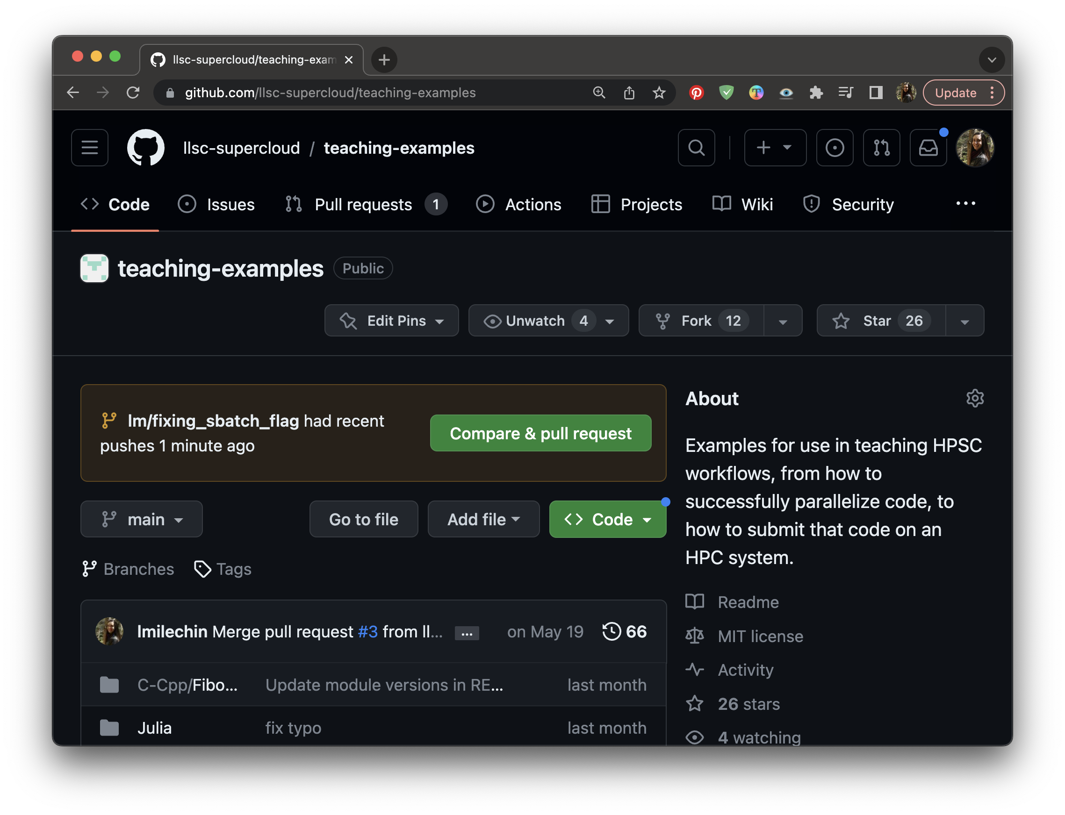
Creating a Pull Request
First make sure you’ve pushed all commits with git status and git push
Go to your branch in GitHub
If you pushed changes recently you may see a button that says “Compare and Pull Request”, click if it is there
If not click “Pull Requests”
If you click “Pull Requests” select “New Pull Request” and change the “compare” dropdown to your branch name
Notes:
First, make sure you don't have any commits you haven't pushed to GitHub. Go to your local repository and run `git status`. If you have any commits you haven't yet pushed, push them now with `git push`. Remember, if you haven't pushed from this branch to the remote repository yet, you will be prompted to publish your branch with `git push --set-upstream origin my_new_branch`.
Now navigate to your branch in GitHub. If you've pushed any commits recently you may see a callout that says your branch has recent pushes and provides a button that says "Compare and Pull Request". Pressing this will bring you to the form to create your Pull Request to the main branch. If you don't have this button, you can select "Pull Requests" at the top of the page and select "New Pull Request". From there select your branch under the "compare" dropdown. If you would like to merge your branch into a branch other than main, select that branch under the "base" dropdown. Then select "Create Pull Request".

Slide 26
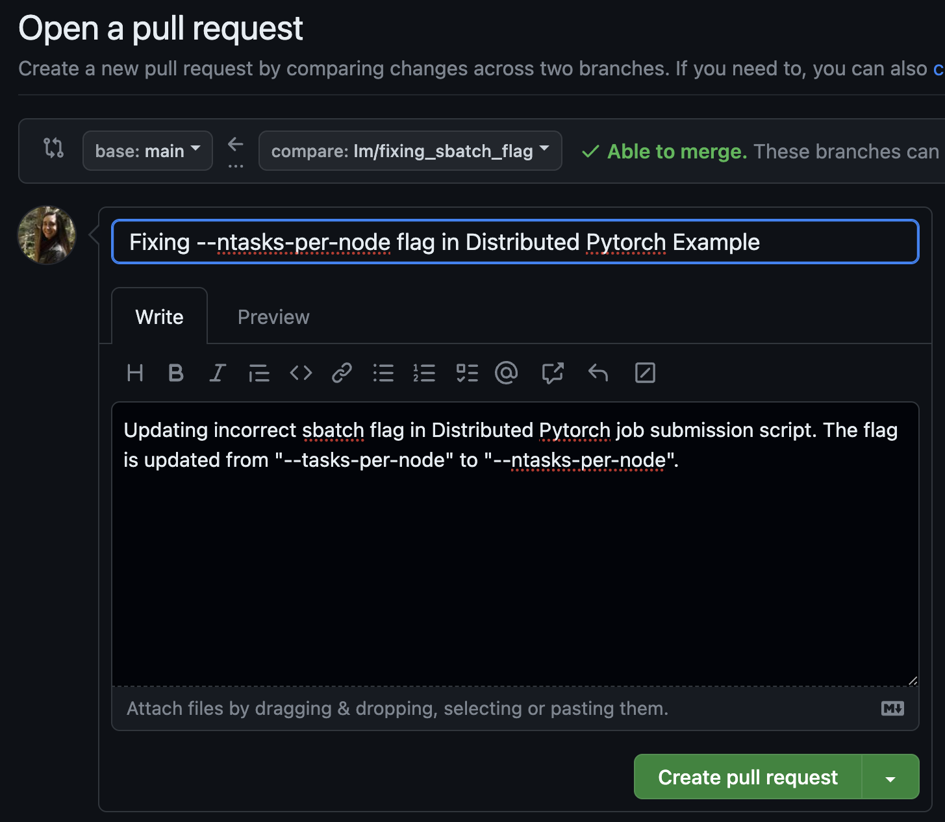
Creating a Pull Request
Fill out the form with
A title
A description of the changes you made and why you made them, include any other relevant information
When you are done click “Create pull request”
Notes:
At this point you will see a form. Fill out the form with a title and description for the Pull Request, and then click "Create Pull Request". We will go more in depth on how to make good pull requests in a later section.

Slide 27
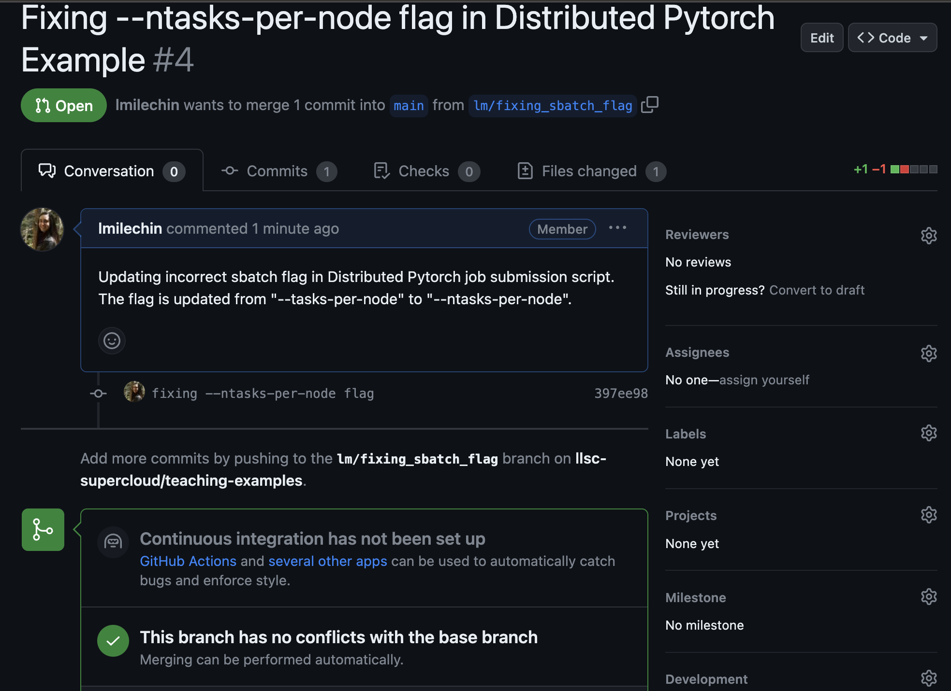
Anatomy of a Pull Request
The PR Number
The PR number is displayed next to the PR title
In the conversation tab you’ll see a timeline of comments and commits
The first “comment” is the initial description
Scroll to the bottom of the to add more comments
It will also show whether there are any merge conflicts
Resolve any conflicts locally and push the commit to update
Your Description
The commit for the change
Conflict Status

Slide 28
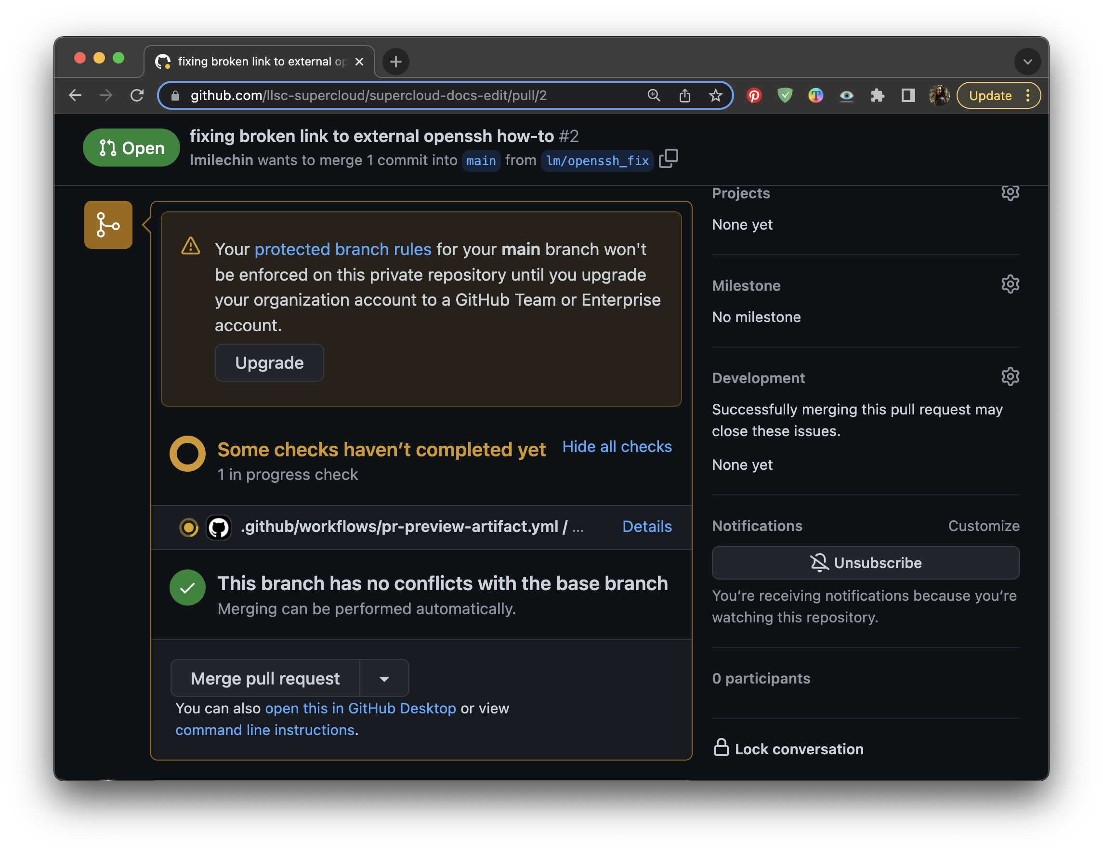
Anatomy of a Pull Request
The PR number is displayed next to the PR title
In the conversation tab you’ll see a timeline of comments and commits
The first “comment” is the initial description
Scroll to the bottom of the to add more comments
It will also show whether there are any merge conflicts
Resolve any conflicts locally and push the commit to update
Continuous Integration
GitHub Workflow to create Preview

Slide 29
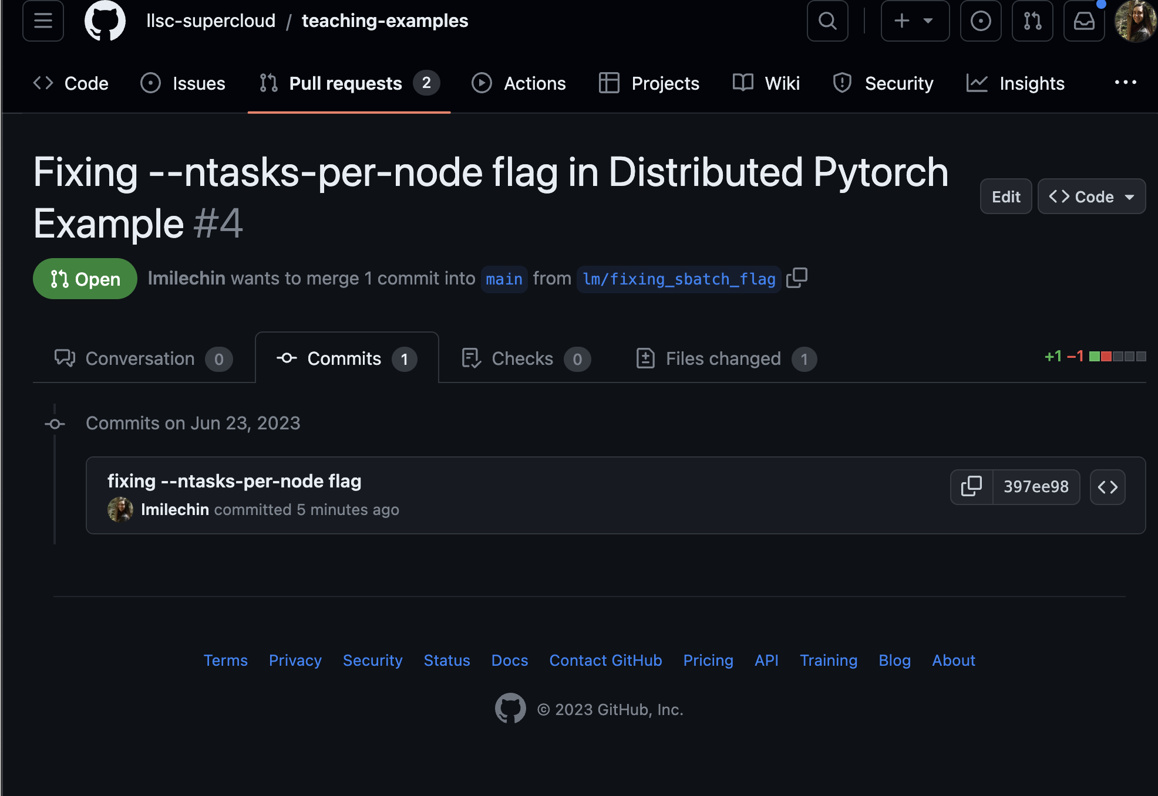
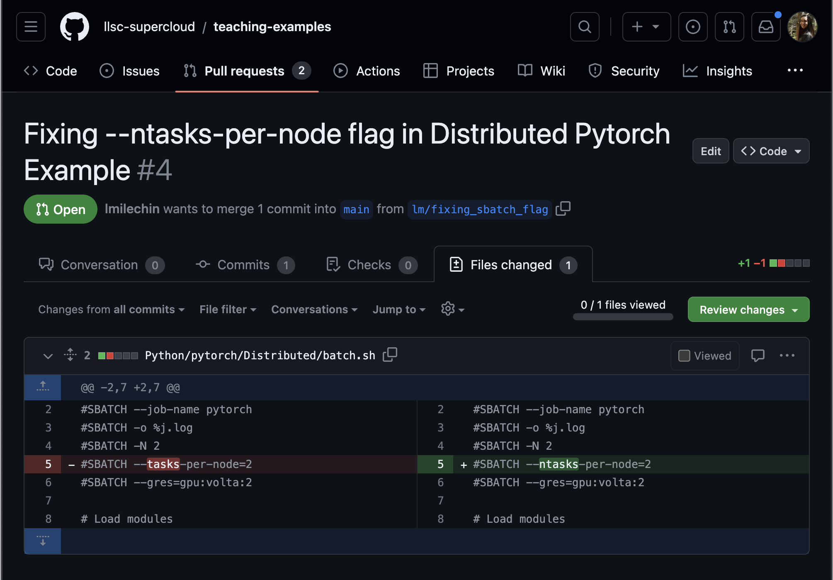
Anatomy of a Pull Request
The Commits tab shows all the commits in the PR
Click “Files Changed” to review changes

Slide 30
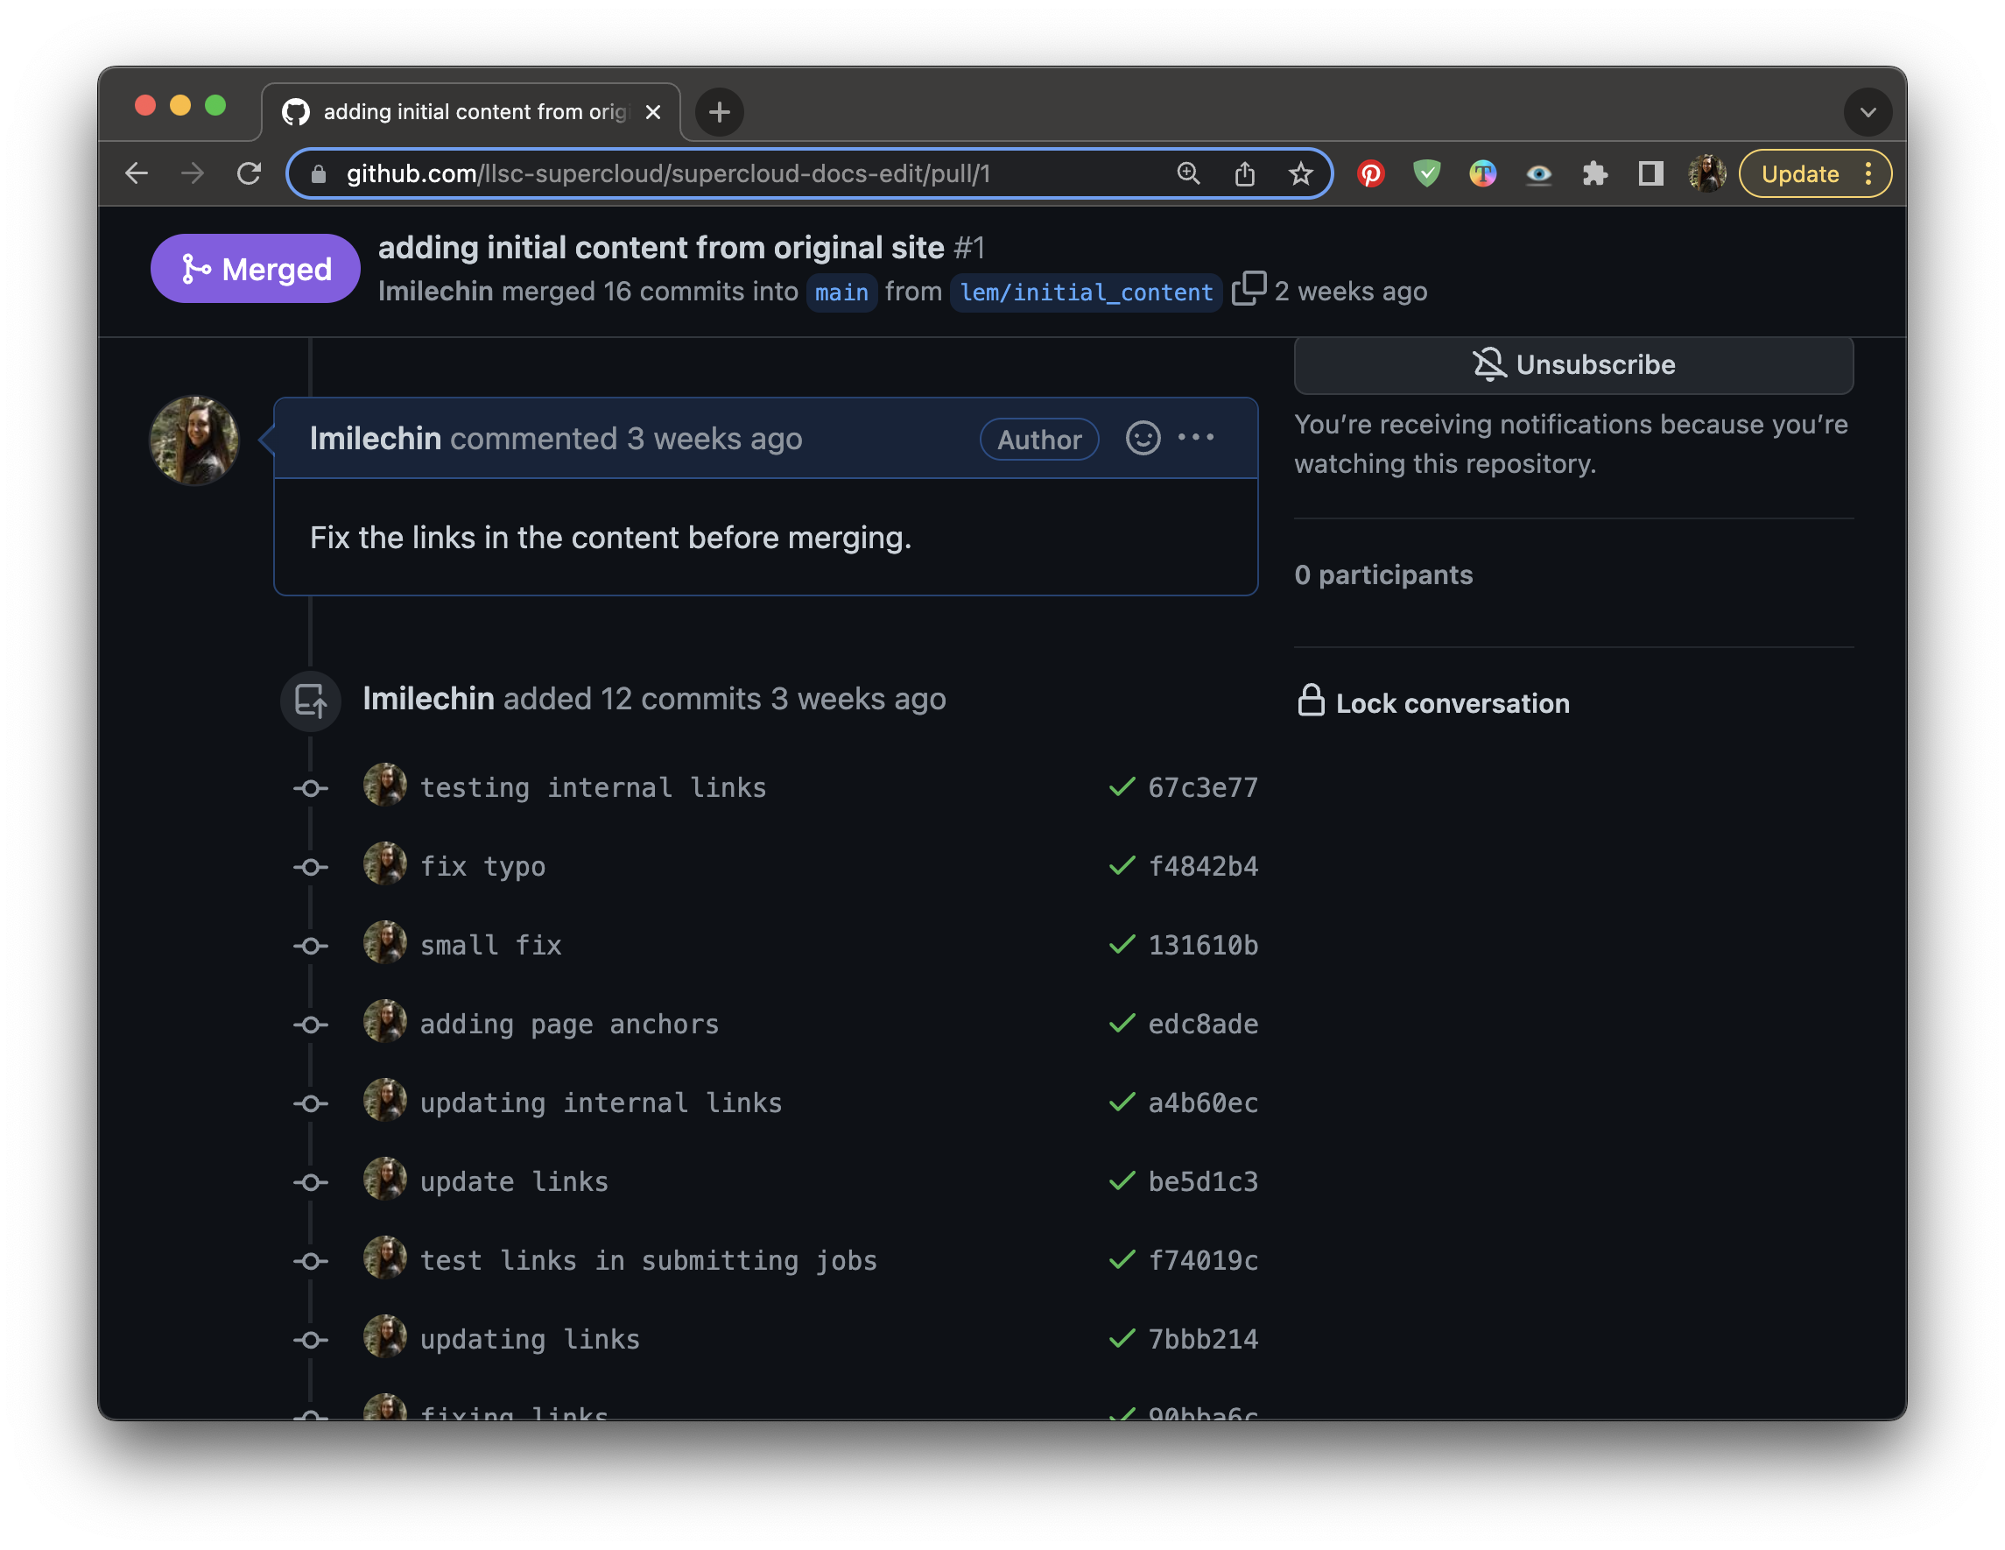
Updating a Pull Request
Others on the team should review the changes
Feedback can be given using the comment field at the bottom of the Conversation Tab
To update the PR, make updates in your branch and push the commits
New commits will be added to the PR automatically
Notes:
Once the Pull Request is created you and anyone with access to the repository can make comments on the request. These comments might be clarifying questions or requests for additional changes. If additional changes are needed, make those changes in your branch and push them. The commits will be added to the Pull Request automatically and appear on the main Conversation page.

Slide 31
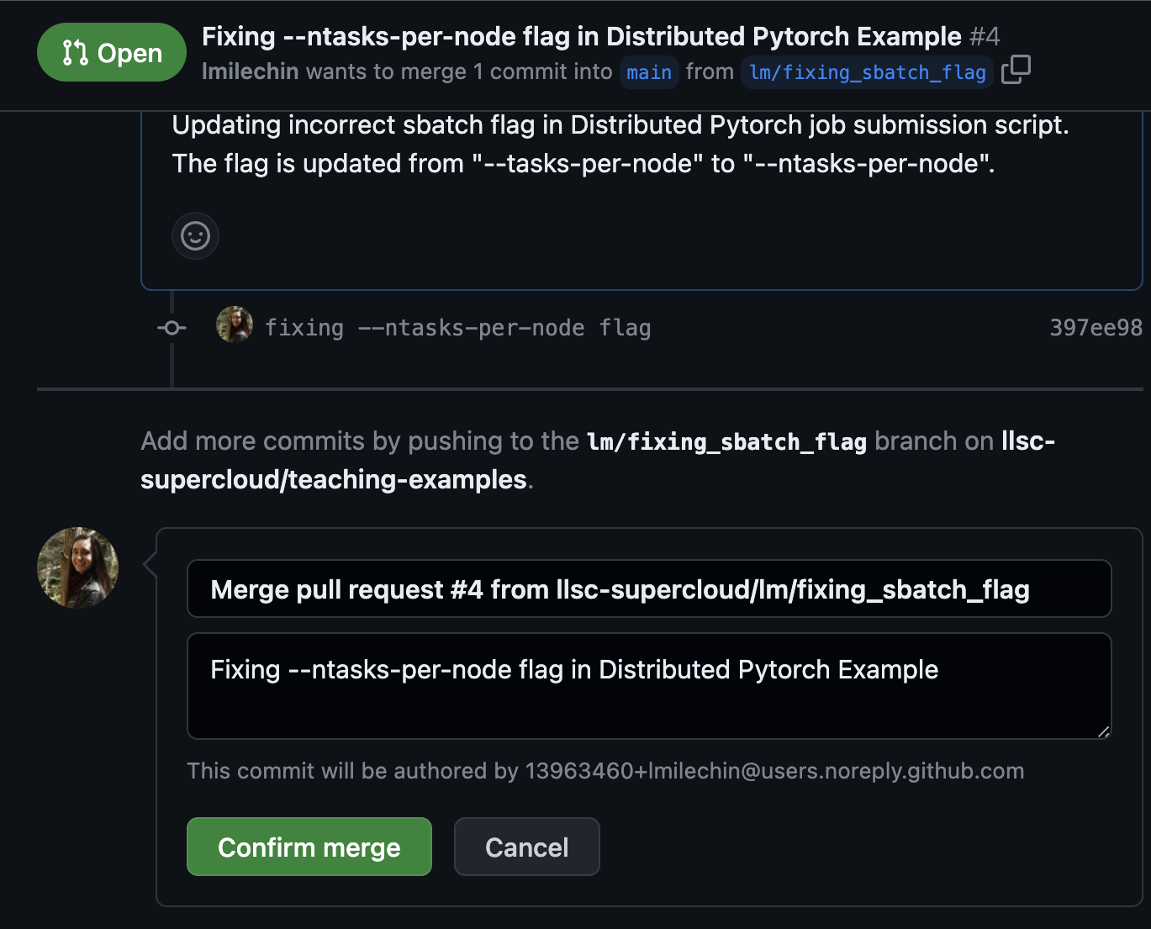
Accepting and Merging a Pull Request
Once the PR has been reviewed it is ready to merge
Click “Merge Pull Request” to merge, then click “Confirm merge”
After merging, you can click “delete branch” if you’d like, new material from here should be in a new branch
When the PR is merged the web page will be updated
Notes:
Once a Pull Request has been reviewed and ready to be accepted, it can be merged. First verify that the branch has no conflicts with the base branch (the one that will be merged into). Any conflicts should be addressed with additional commits. When ready to merge, click "Merge Pull Request", then click "Confirm merge". You will be given the option to delete the branch. Whether you delete the branch depends on its purpose and how you and your group want to handle branches that have been merged. Deleting feature branches helps keep clutter down and makes it easier to find relevant branches. However, if you have any longer term branches, such as a development or production branch, you wouldn't want to delete that.

Slide 32
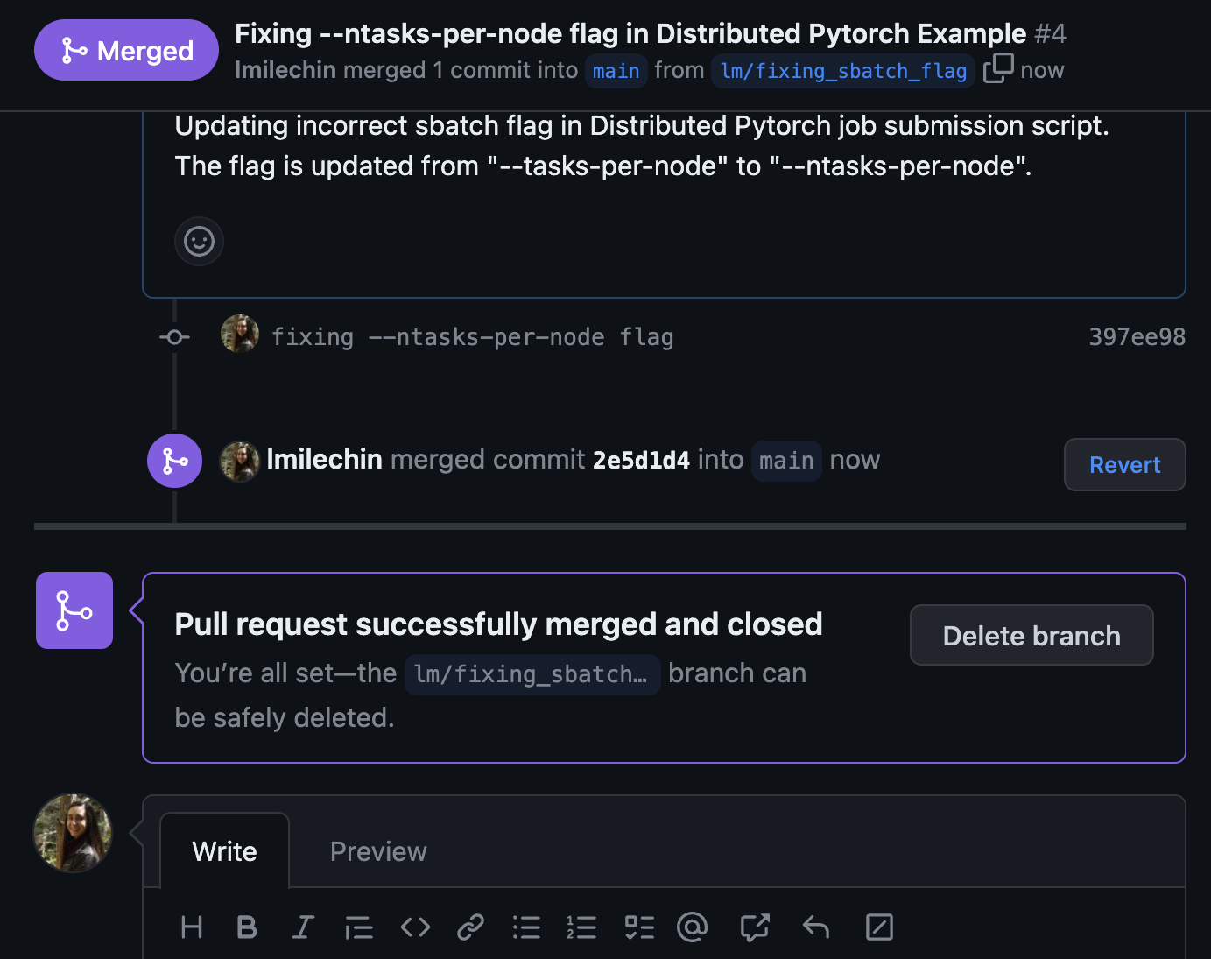
Accepting and Merging a Pull Request
Once the PR has been reviewed it is ready to merge
Click “Merge Pull Request” to merge, then click “Confirm merge”
After merging, you can click “delete branch” if you’d like, new material from here should be in a new branch
When the PR is merged the web page will be updated
Notes:
Once a Pull Request has been reviewed and ready to be accepted, it can be merged. First verify that the branch has no conflicts with the base branch (the one that will be merged into). Any conflicts should be addressed with additional commits. When ready to merge, click "Merge Pull Request", then click "Confirm merge". You will be given the option to delete the branch. Whether you delete the branch depends on its purpose and how you and your group want to handle branches that have been merged. Deleting feature branches helps keep clutter down and makes it easier to find relevant branches. However, if you have any longer term branches, such as a development or production branch, you wouldn't want to delete that.

Slide 33
Activity (15 mins)
Your team’s repository should have one unmerged branch, if not, create one now and publish the branch
Everyone: Log into GitHub
Branch owner: create a Pull Request
Team: Review the Pull Request
Look at the commits and files changed
Do the changes look okay? Comment if not
Are there any merge conflicts?
Branch owner: address any merge conflicts or comments
Team: comment when it looks good to merge
Once approved merge the pull request
In both this activity and the last one your branch was eventually merged into the main branch. How does this experience compare to the previous activity?
If you have extra time, the remaining team members can create their own Pull Requests with new branches.
Notes:
One team member should still have an unmerged branch from the previous exercise. If not, have one of you create a branch, introduce a small change, commit, push, then publish the branch.
Log into GitHub. The team member with the branch should create a pull request. Once it is created, everyone should look at the different parts of the PR and comment whether the branch looks okay to merge. The branch owner should make changes requested. If there are merge conflicts, those should be addressed (you can work together to address them). Once it is ready to merge, someone else on the team should merge the Pull Request.
In both this activity and the last one your branch was eventually merged into the main branch. How does this experience compare to the previous activity?
If you have extra time, the remaining team members can create their own Pull Requests with new branches.

Slide 34
Outline
Introduction
Branches
Pull Requests
Git Workflows

Slide 35
Git Workflows
A process for how your team is going to work with a repository, including
How you are going to use branches (branching strategy)
Feature branches, ”lifetime” branches (production, development, release branches)
What is considered the "latest version", or what is "production" vs "in development"
How branches are merged
When you are making pull requests and into what
Testing
Whether you are working in a single, central repository, or separate forked repositories
Help everyone stay on the same page about the state of the code
Enable communication
Tell us
What branches are protected
What is tested and when
What branches are stable
Notes:
When you are working with others in the same git repository, you'll find you'll need to come to an agreement on how you are going to work in the repository. This can include:
- How you are going to use branches
- What is considered the "latest version", or what is "production" vs "in development"
- How those branches are merged
- When you are making pull requests and into what
- Whether you are working in a single, central repository, or separate forked repositories
These questions are often answered by what we will call a git workflow. A git workflow helps you keep organized when working on a team, helps everyone stay on the same page about the state of the code, and helps enable communication. If you've ever emailed around documents you were working on with a team, you might understand the value of everyone on the team always having access to both the latest version, and any material still in progress.
When we talk about git workflows often we are really discussing is branching strategies. The branching strategy is how you are going to use branches to work with the code. This includes the purposes of each branch (ex: a feature branch vs a release branch), where a new branch is created, and how, when, and where branches are merged. Different branches and branch types will have different lifetimes as well. For example, once a feature branch has been merged it can often be deleted, however a dedicated development branch might exist for the entire project.
The git workflow should also dictate what is stable under what conditions, what is tested, and may also include testing strategies.

Slide 36
Centralized or Trunk-Based Workflow
Central repository with one main branch
Developers work in their local clone and push less frequently
Central repository meant to be stable
Resolve conflicts locally before pushing
Not the best for collaborative development
Central Repository
Local Clone
Local Clone
Local Clone
Local Clone
Notes:
With a centralized workflow you only have one main branch (or trunk, borrowing terminology from SVN, another version control system). Team members work in their local clone and push commits less frequently. The central repository is meant to be "clean" and should be stable. Git will also prevent you from pushing any changes that cause conflicts. If someone else as pushed a change that conflicts with one of your local commits, git will not let you push those changes and will require you resolve the conflict locally before pushing.
A centralized workflow with a single main branch is not the best for collaborative development, although it may work okay in small teams. We mention it to give a name to a process you might already be familiar with, and as a starting point for other workflows.

Slide 37
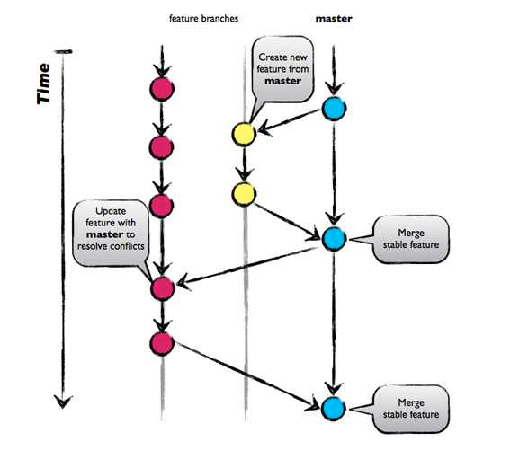
GitHub Flow
A feature branching workflow
Published as viable alternative to Git Flow (we’ll see this next)
No structured release schedule
Continuous deployment & continuous integration
Simpler workflow
Key Ideas
All commits in the main branch are deployable
Base feature branches off main
Push local repository to remote constantly
Open Pull Requests early to start dialogue
Merge into main after Pull Request review
https://scottchacon.com/2011/08/31/github-flow
David M. Rogers, Collaborative Software Development in Better Scientific Software tutorial, in ISC High Performance, Hamburg, Germany and online, 2023. DOI: 10.6084/m9.figshare.22790762.
Notes:
Since we've covered branching, a simple extension to the centralized workflow is a Feature Branching Workflow. The main branch is like the central repository in the centralized workflow, it is meant to be clean and stable. Instead in working directly in clones of the main branch, all development is done in feature branches, where each branch is created from the main branch to develop a specific feature. The branch is published soon after it is created in the remote repository and commits are regularly pushed. This allows other developers to see the branch and any changes early. Using feature branches also allows an individual developer to work on more than one feature at a time if needed. Say you are working on developing a feature that requires some time and thought, but in the process find a bug that should be fixed immediately. You can create a new branch, fix the bug, and merge it back into the main branch without introducing any of the partially developed code you are still working on in the other feature branch.
Once the feature is complete and tested, feature branches are merged back into the main branch through Pull Requests. Any merge conflicts should be handled in the feature branch before merging. This can be done by merging any new commits from the main branch into the feature branch, handling any conflicts that emerge. The changes are discussed and reviewed in the Pull Request, and once accepted hey are merged. Once merged, the lifecycle of a feature branch is general complete and it can be deleted if it is no longer needed.
This is also known as "GitHub Flow", as it is used by the developers of GitHub for sections of their website, including their documentation. GitHub even has a [dedicated page in their documentation](https://docs.github.com/en/get-started/quickstart/github-flow) describing the workflow. It is most useful for projects that have a rolling development cycle without specific versioned releases.

Slide 38
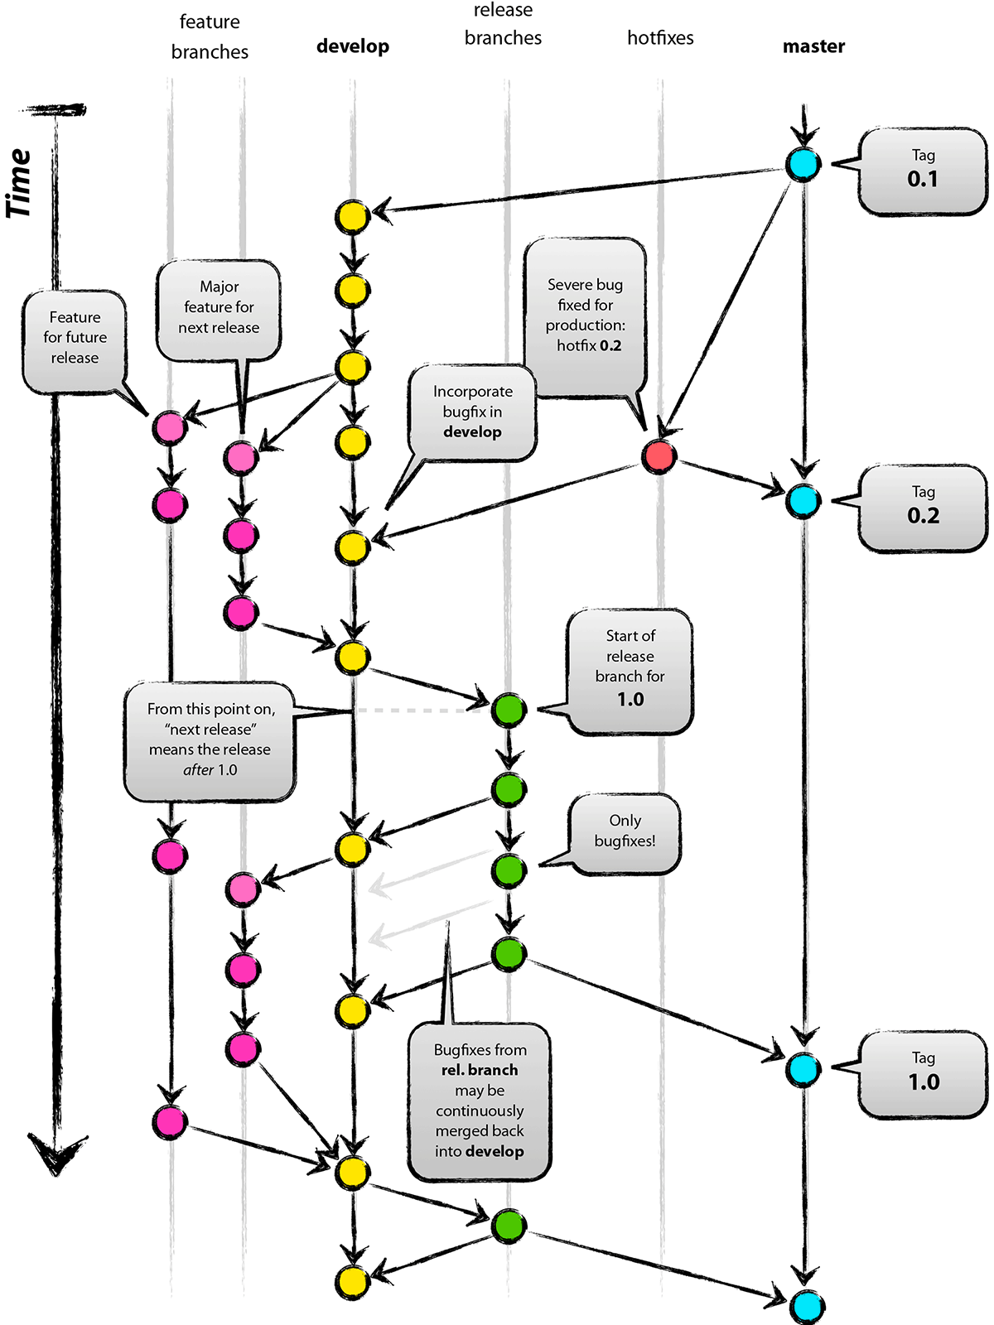

Git Flow
Full-featured workflow
Increased complexity
Designed for Software with official releases
Feature branches based off of develop
Git extensions to enforce policy
How are develop and main synchronized?
Where do merge conflicts occur and how are they resolved?
Author: Vincent Driessen
Original Blog: https://nvie.com/posts/a-successful-git-branching-model/
License: Creative Commons
David M. Rogers, Collaborative Software Development in Better Scientific Software tutorial, in ISC High Performance, Hamburg, Germany and online, 2023. DOI: 10.6084/m9.figshare.22790762.
Notes:
Git Flow is one of the most commonly used workflows. It is used for software projects that require robust, production-ready releases. It is suitable for larger teams where more than one person might work on the same feature.
Git Flow builds on a feature branching workflow, where instead of creating feature branches from the main branch, they are created from a separate permanent development branch. When a feature is complete, its branch is merged into the development branch. Individual release branches are created from the development branch, and once production-ready are merged into the main branch upon release and tagged. The main branch therefore contains only fully tested, stable, production code associated with a particular version. If the code has a bug in the main branch that needs to be fixed immediately, hotfix branches can be created off the main branched and merged directly back into the main branch without being added to the development branch or a release branch.
Git Flow was introduced with a blog post in 2010, which you can see [here](https://nvie.com/posts/a-successful-git-branching-model/) if you are interested.

Slide 39
GitLab Flow
main
pre-production
production
Published as viable alternative to Git Flow & GitHub Flow
Semi-structured release schedule
Simplifies difficulties in synchronizing infinite lifetime branches
Key Ideas
Main branch is staging area
Mature code in main flows downstream into pre-production & production infinite lifetime branches
Allow for release branches with downstream flow
Fixes made upstream & merged into main
Fixes cherry picked into release branch
feature
deploy
deploy
deploy
deploy
David M. Rogers, Collaborative Software Development in Better Scientific Software tutorial, in ISC High Performance, Hamburg, Germany and online, 2023. DOI: 10.6084/m9.figshare.22790762.
Notes:
Similar to GitHub Flow, GitLab Flow gets its name because it is the workflow used by GitLab. GitLab is a bit closer to the simplicity of GitHub Flow, but is more appropriate in cases where the rolling releases of GitHub Flow are not possible. GitLab Flow is similar to Git Flow in that feature branches are not merged directly into the production branch, however instead it has a separate named production branch and the feature branches are merged into the main branch, which is more like the development branch of Git Flow. Release branches are optional, and only recommended only when software is released to the outside world.
For more information, see GitLab's article on [GitLab Flow](https://docs.gitlab.com/ee/topics/gitlab_flow.html).

Slide 40
Forks in Workflows
So far we have assumed branches are created in the main repository- not feasible for some projects
Contributors:
Fork the repository and mainly interact with their fork
Create branches in fork and create a pull request from the fork to the original repository to merge changes
Anybody can propose contributions without asking for advance permission (to public projects)
Maintainer still has full control over what is merged
Challenge: contributors now have more than one remote to work with
This is used by almost all large (and small) open-source projects these days
Figure from Code Refinery: https://coderefinery.github.io/git-collaborative/distributed/
Notes:
In each of these example workflows we have assumed that anyone contributing to a repository has the ability to directly push commits to a repository. However, sometimes you want to enable developers to contribute to a project without giving them access to the repository itself. In this case, a forking workflow might be suitable. Any of the workflows we've talked about already could incorporate forking. With a forking workflow individual developers create their own fork of a repository and do their development within their fork. When a feature is complete, the developer creates a Pull Request into the appropriate branch of the original repository. The owners of the repository can then approve the Pull Request at their discretion. This is how many open source projects encourage contributions.

Slide 41
Tips for Using Forks
Set and name remotes to help keep track of original and forked repositories
View remotes with
Retrieve upstream changes with
Merge upstream changes into your fork’s main branch
Retrieve any upstream changes and merge into your main and feature branch frequently, especially before you create a Pull Request
git remote add upstream https://github.com/project_team/project.git
git remote add my-fork https://github.com/me/project.git
git remote -v
git fetch upstream
git checkout main # this is the main branch for your fork
git merge upstream/main
Notes:
With a forking workflow it can be easy to end up with an old version of the code, especially if it changes frequently. It can get confusing whether we are attempting to pull from or push to the fork or the original repository. Setting up remotes with easy to remember aliases makes this much easier. A "remote" is a named connection to a remote repository. You can add and remove remotes with the `git remote add` and `git remote rm` commands, respectively. For example:
```bash
git remote add upstream https://github.com/project_team/project.git
git remote add my-fork https://github.com/me/project.git
```
Here we are adding a remote called "upstream" for our central team repository and another called "my-fork" for our own fork. We can view our remotes with `git remote -v`. Now when you want to retrieve any changes from the upstream repository you can run `git fetch upstream`. To update your main branch with these update changes, you would merge them into your local forked repository:
```bash
git checkout main # this is the main branch for your fork that you have cloned locally
git merge upstream/main
```
Using remotes, fetching and merging upstream changes frequently, and running commands like `git status` and `git remote -v` can help you be successful using a forking workflow. Merging upstream changes directly before making a Pull Request and ensuring there are no merge conflicts is good etiquette and will make it more likely that your Pull Request will be accepted.

Slide 42
Guidelines for establishing a Git Workflow
Communicating it to your collaborators
Include workflow in Contributing Guide
Establish conventions for branch naming (issues, major/minor versions)
Refer to the Contributing Guide in your agent configuration file (AGENTS.md, CLAUDE.md, or copilot-instructions.md)
Enforce workflow
Branch protections
Limiting who can push/merge
Testing & review requirements
David M. Rogers, Collaborative Software Development in Better Scientific Software tutorial, in ISC High Performance, Hamburg, Germany and online, 2023. DOI: 10.6084/m9.figshare.22790762.
Notes:
Emphasis on Adopt what is good for your team
- Communicating this to your collaborators
- Including the workflow in the CONTRIBUTING document
- Conventions for branch naming
- How to enforce your workflow
- Branch protections
- Limiting who can push/merge
- Testing & review requirements
- Considerations for shared systems
- Be careful with clones on shared drives, you don't want to "share" a clone
- Separate "production" clone that you use for running
## Communicating with your Collaborators
Now that you've chosen a workflow for your project, how do you communicate it? This is most often done with a CONTRIBUTING document. The CONTRIBUTING document describes the git workflow you are using, any conventions for branch naming that you have, and anything else a collaborator should know in order to contribute. It should be tailored to your project and team, and so it might also include how to run the tests for the project, requirements before creating Pull Requests, or perhaps detailed instructions for how follow the workflow if your team is less familiar with git. One of the goals of a CONTRIBUTING document is to lower the barrier to entry to contributing to a project and a good one will encourage collaboration.
## Enforcing your Workflow
There are tools that you can use to make sure everyone follows the agreed upon workflow, which can make it easier to collaborate with others. First, you can add branch protections, which will enforce certain rules for certain branches. A common one is to not allow commits directly to the main branch, requiring changes to go through a Pull Request. There are many options for branch protection that you can read about on the [GitHub web page](https://docs.github.com/en/repositories/configuring-branches-and-merges-in-your-repository/managing-protected-branches/about-protected-branches). Similarly, you can limit who on the team is able to push or merge changes into a particular branch, or in the entire repository. It is also a good idea to have testing and review requirements, particularly for production branches. These requirements and branch protections should be documented in the CONTRIBUTING document as well.

Slide 43
Guidelines for establishing a Git Workflow
Adopt what is good for your team
Consider team culture and project challenges
Assess what is and isn’t feasible/acceptable
Start with simplest and add complexity where and when necessary
Be careful in shared spaces
Each person should work within their own clone
Separate “production” clone for running
David M. Rogers, Collaborative Software Development in Better Scientific Software tutorial, in ISC High Performance, Hamburg, Germany and online, 2023. DOI: 10.6084/m9.figshare.22790762.
Notes:
Emphasis on Adopt what is good for your team
- Communicating this to your collaborators
- Including the workflow in the CONTRIBUTING document
- Conventions for branch naming
- How to enforce your workflow
- Branch protections
- Limiting who can push/merge
- Testing & review requirements
- Considerations for shared systems
- Be careful with clones on shared drives, you don't want to "share" a clone
- Separate "production" clone that you use for running
## Communicating with your Collaborators
Now that you've chosen a workflow for your project, how do you communicate it? This is most often done with a CONTRIBUTING document. The CONTRIBUTING document describes the git workflow you are using, any conventions for branch naming that you have, and anything else a collaborator should know in order to contribute. It should be tailored to your project and team, and so it might also include how to run the tests for the project, requirements before creating Pull Requests, or perhaps detailed instructions for how follow the workflow if your team is less familiar with git. One of the goals of a CONTRIBUTING document is to lower the barrier to entry to contributing to a project and a good one will encourage collaboration.
## Enforcing your Workflow
There are tools that you can use to make sure everyone follows the agreed upon workflow, which can make it easier to collaborate with others. First, you can add branch protections, which will enforce certain rules for certain branches. A common one is to not allow commits directly to the main branch, requiring changes to go through a Pull Request. There are many options for branch protection that you can read about on the [GitHub web page](https://docs.github.com/en/repositories/configuring-branches-and-merges-in-your-repository/managing-protected-branches/about-protected-branches). Similarly, you can limit who on the team is able to push or merge changes into a particular branch, or in the entire repository. It is also a good idea to have testing and review requirements, particularly for production branches. These requirements and branch protections should be documented in the CONTRIBUTING document as well.

Slide 44
Activity (10 mins)
Discuss amongst your group which workflow will work best for your group
Set up your repository accordingly
Start a contributor guide that explains the workflow and any rules for contributing
If time allows, discuss any projects that your group members work on collaboratively with others. Is there a specified workflow for this project? How do you contribute to the project?
Notes:
One team member should still have an unmerged branch from the previous exercise. If not, have one of you create a branch, introduce a small change, commit, push, then publish the branch.
Log into GitHub. The team member with the branch should create a pull request. Once it is created, everyone should look at the different parts of the PR and comment whether the branch looks okay to merge. The branch owner should make changes requested. If there are merge conflicts, those should be addressed (you can work together to address them). Once it is ready to merge, someone else on the team should merge the Pull Request.
In both this activity and the last one your branch was eventually merged into the main branch. How does this experience compare to the previous activity?
If you have extra time, the remaining team members can create their own Pull Requests with new branches.

Slide 45
Backup

Slide 46
Current Trilinos Workflow
Test-driven workflow
Feature branches start and end with develop
All changes to develop must come from GitHub pull requests
Feature branches are merged into develop only after passing pull request test suite
Change sets from develop are tested daily for integration into main
Workflow designed so that
All commits in main are in develop
Merge conflicts exposed when integrating into develop
Merge conflicts never occur when promoting to main
main
develop
develop -> main testing
Pull request testing
Issue 1
Issue 2
https://trilinos.github.io/
David M. Rogers, Collaborative Software Development in Better Scientific Software tutorial, in ISC High Performance, Hamburg, Germany and online, 2023. DOI: 10.6084/m9.figshare.22790762.
Notes:
From the website: The Trilinos Project is a community of developers, users and user-developers focused on collaborative creation of algorithms and enabling technologies within an object-oriented software framework for the solution of large-scale, complex multi-physics engineering and scientific problems on new and emerging high-performance computing (HPC) architectures.
Trilinos is also a collection of reusable scientific software libraries, known in particular for linear solvers, non-linear solvers, transient solvers, optimization solvers, and uncertainty quantification (UQ) solvers.

Slide 47
Current Open MPI Workflow
Workflow designed so that
Support two most recent releases
Issues are addressed on all applicable branches
All PR’s reviewed by at least one core developer
Main and supported branches work at all times
Developers work on main or feature branches depending on complexity of the changes
Testing
CI testing on PR’s for any branch using Jenkins (limited set of compilers, hardware, tests)
Nightly testing on all branches using community-built MTT framework (more complex set of compilers, hardware, tests)
Additional testing for release candidates
Versioning:
Major versions - break compatibility
Minor versions – visible
Releases correct issues
main
Upcoming release (if exists)
Latest supported release
Previous supported release
Issue 1
Issue 2
https://www.open-mpi.org
https://www.open-mpi.org
David M. Rogers, Collaborative Software Development in Better Scientific Software tutorial, in ISC High Performance, Hamburg, Germany and online, 2023. DOI: 10.6084/m9.figshare.22790762.
Notes:
A High Performance Message Passing Library

Slide 48
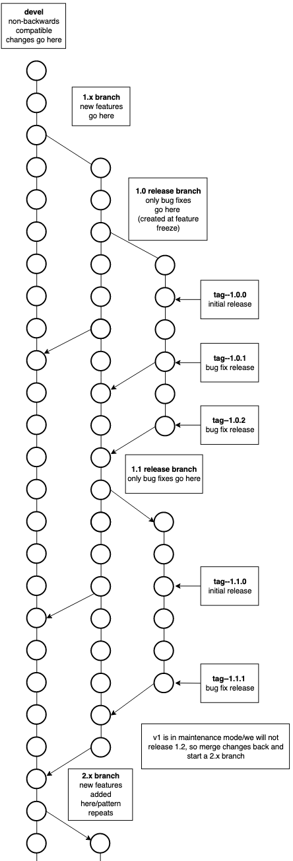
Current FleCSI Workflow
https://flecsi.github.io/flecsi
Workflow designed so that
All supported branches work at all times
Merge Requests are tested and reviewed
Testing
Customized unit-testing framework based on Google Test
Special gitlab-ci branch - images and configuration files
Versioning:
Incompatible - devel branch breaks compatibility with previous versions
Feature (1, 2 …) named for major version
Release - (1.x, 2.x …) named for major.minor version, correct issues, tags used for bug fixes.
David M. Rogers, Collaborative Software Development in Better Scientific Software tutorial, in ISC High Performance, Hamburg, Germany and online, 2023. DOI: 10.6084/m9.figshare.22790762.
Notes:
FleCSI is a compile-time configurable framework designed to support multi-physics application development for current and emerging HPC systems.
In the diagram there is a 1.x branch only for new releases, an initial 1.0 release branch with tag 1.0.0 as the initial release and tags 1.0.1, 1.0.2 for bug fixes, when 1.1 feature is release again an initial tag 1.1.0, then bug fix release tags 1.1.1 & 1.1.2 etc. Once a major version goes into maintenance mode and a new major feature branch begins; in this case 2.x and like branches and tags are created for 2.x

