Slide 1
Smart Farming
Internet of things – Application Engineering and development project
- Nehal Bhanushali

Slide 2
Problem Statement
Gopal is a fourth-generation family farmer who resides in Vidarbha, the eastern region of the Indian state of Maharashtra, known for its high farmer suicide rates.
The farmers in his village face problems like poor farm yield due to unpredictable climate, water shortage, pest, resistant plant weeds, and other wild life that attack farm crops.
More over these farmers need field technology specialists who provide tailored advice for crop protection, nutrition, smart sensors and seed technology.

Slide 3
Proposed Solution
Make farming more sustainable through robotics, computer vision and other sensors.
Creating a farming platform that connects farmers especially those who are poor and naïve to peers and business partners. Farmers can create micro blog posts, review products and avail training from experts and post queries. Thus, they can ensure that they are investing in the right gadgets and techniques for use around the farm.
Using gadgets, a farmer could concentrate on the other aspects of farming business like marketing ( Marketing is not covered in this application).
Also, the resource optimization by use of sensors and equipment helps cost saving. Farmers can lend gadgets and seeds to the fellow farmers who can not afford buying them.

Slide 4
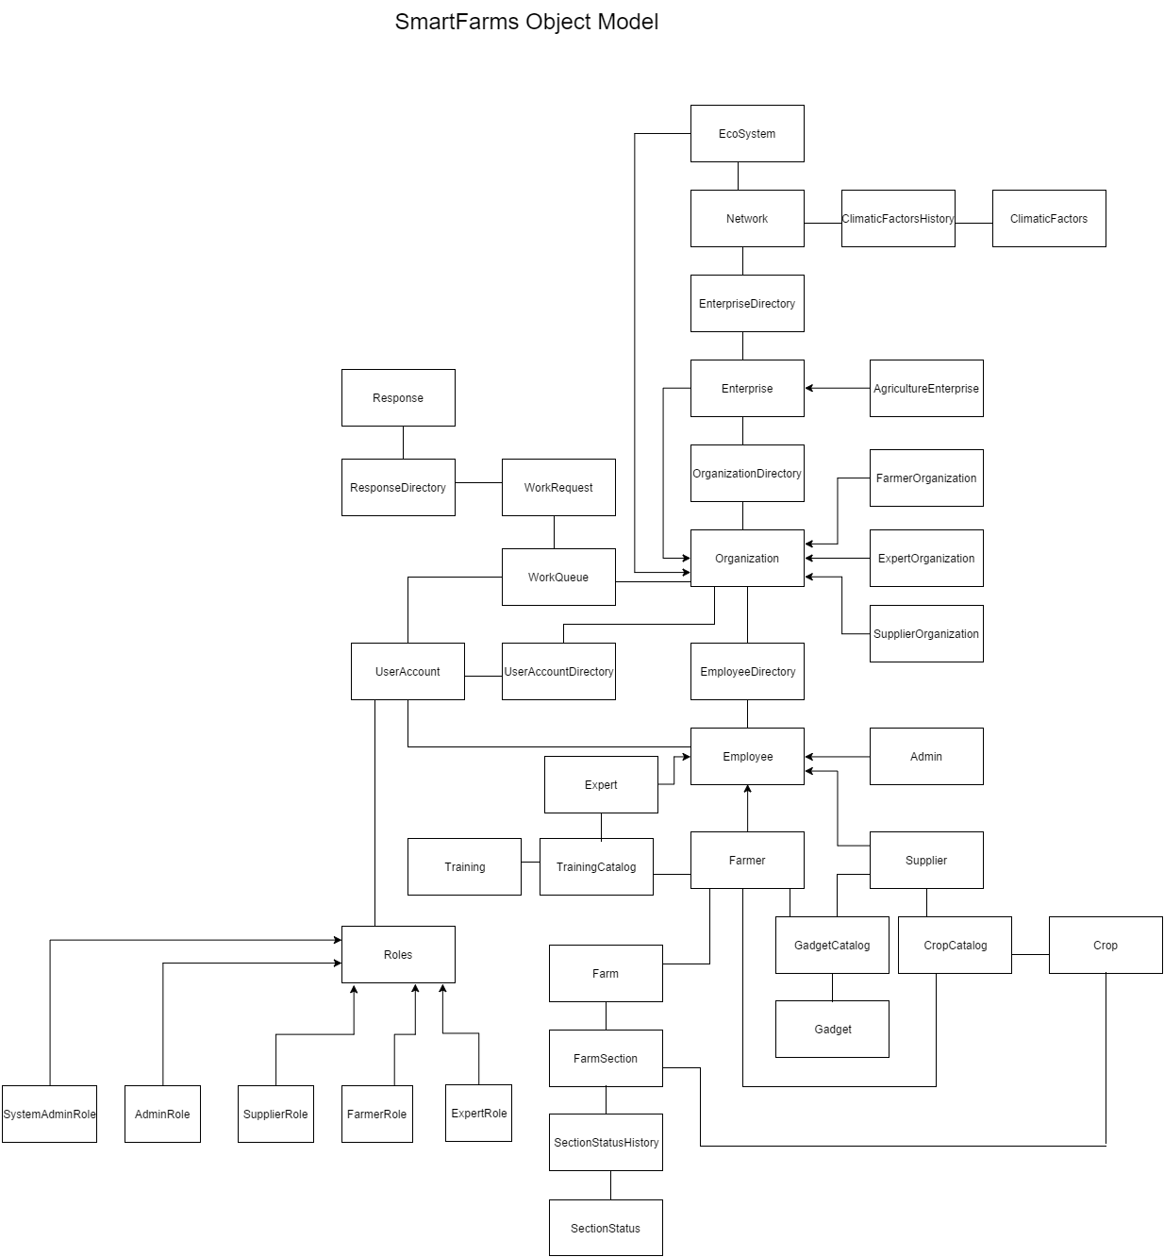
Object Model

Slide 5
Key Roles
Farmer : Farmer buys/ rents equipment/crop, interacts with gadgets, rates/reviews them, interacts with experts.
Expert : Share Best practices and provide training material to Farmers
Supplier : Provides gadgets and seeds.
Admin : Manages the Expert, Farmer and supplier Community, and all other dependent communities.
System Admin : Manages networks and Agriculture Enterprise Admins

Slide 6
Key Features
Moisture content monitoring and appropriate irrigation by Smart Irrigator
Capturing Climatic by Smart Weather Monitor
Detecting stray bird/animal and scaring them away by Smart Scare Crow Robot
Connectivity with experts.
Rating/ reviewing gadgets for peers.
Sharing equipment
Experts uploading Training material for farmers and responding to their queries

Slide 7
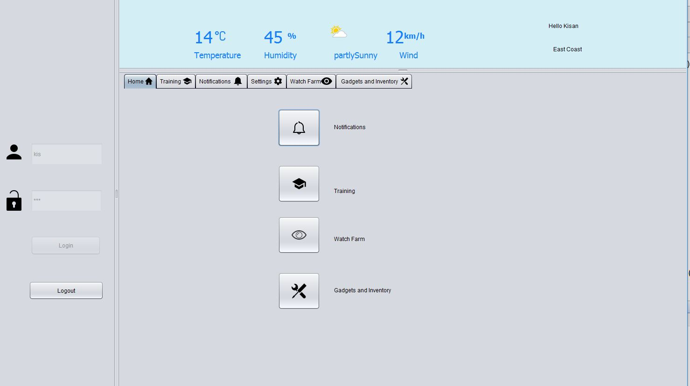

Slide 8
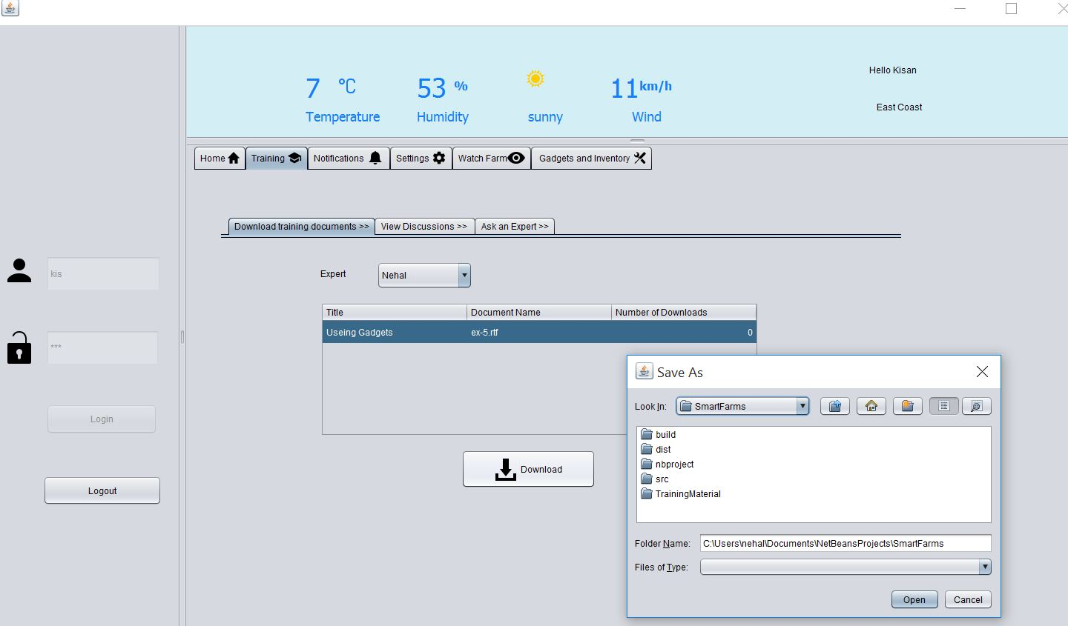

Slide 9
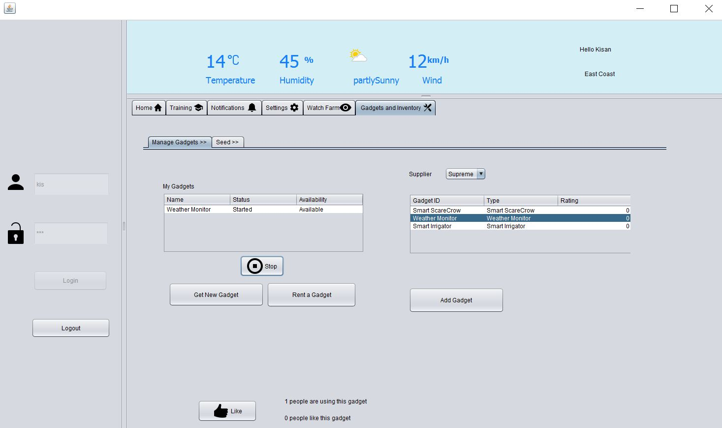
Screenshots

Slide 10
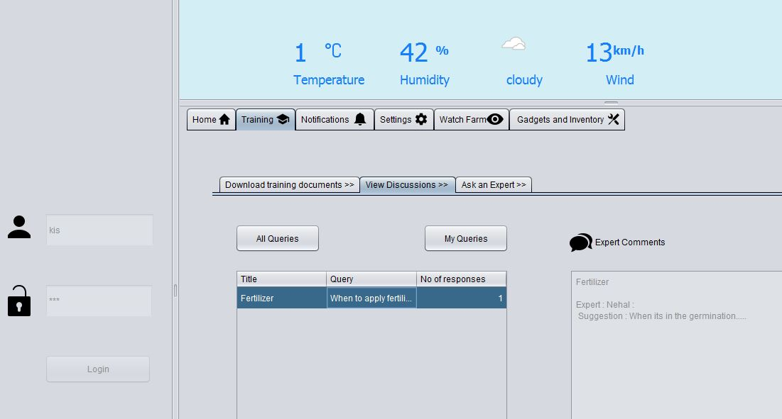
Screenshots

Slide 11
Thank you

