Slide 1

$${\left(x+a\right)}^{n}=\sum_{k=0}^{m}{\left({z \atop k}\right)x^{k}a^{n−k}}$$

Slide 2
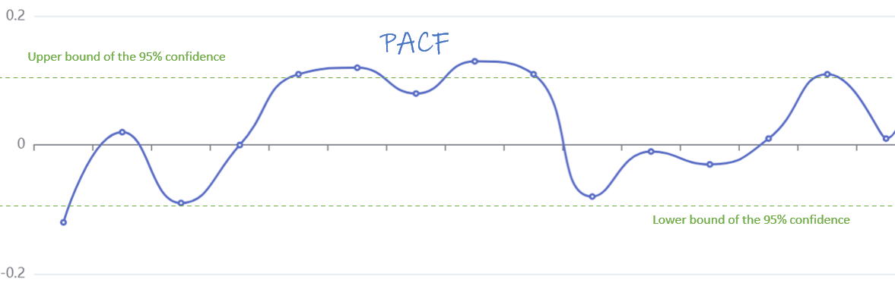
Residual

Slide 3
A
B
C
D
√
×
Candidates
Python
medal_counts.csv
GM(1,1)
predicted_num
CF
athletes_num
因素
Random Forest
Rank
因素
因素

Slide 4
Candidates
Python
medal_counts.csv
GM(1,1)
predicted_num
CF
athletes_num
events_num
Random Forest
Rank
Attendance_growth_rate
sum_of_previous_3sessions

Slide 5
New Participants Count
2028 Medal Table
Bootstrap method
No Medal Participants Count
confidence interval
Won Medal Participants Count
Gold/ Total
Events Count
Ridge Regression
Is_Host
Candidates
Python
medal_counts.csv
Event Count Calculation
GM(1,1)
Events’ Importance Evaluation
predicted_num
CF
athletes_num
events_num
Random Forest
Rank
Attendance_growth_rate
Host Adventage
sum_of_previous_3sessions

Slide 6
New Participants Count
2028 Medal Table
Bootstrap method
No Medal Participants Count
confidence interval
Won Medal Participants Count
Gold/ Total
Events Count
Ridge Regression
Is_Host

Slide 7
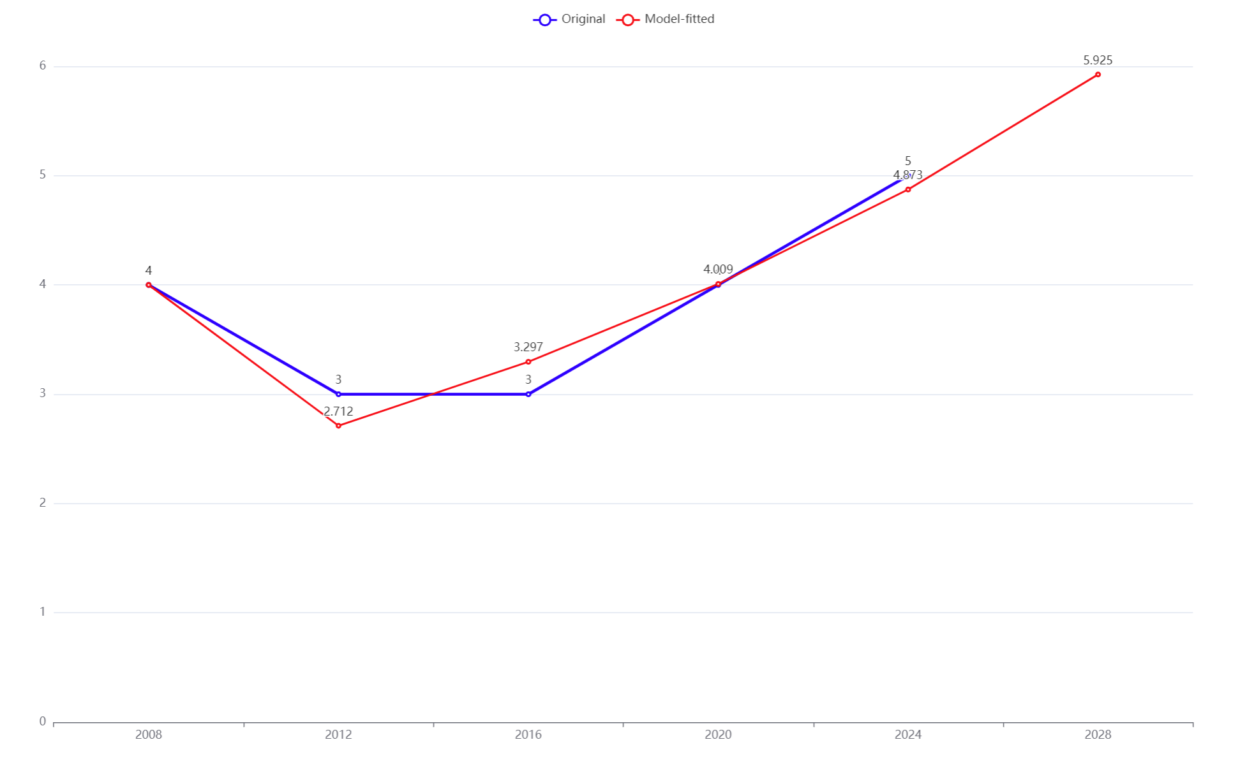
5.925

Slide 8
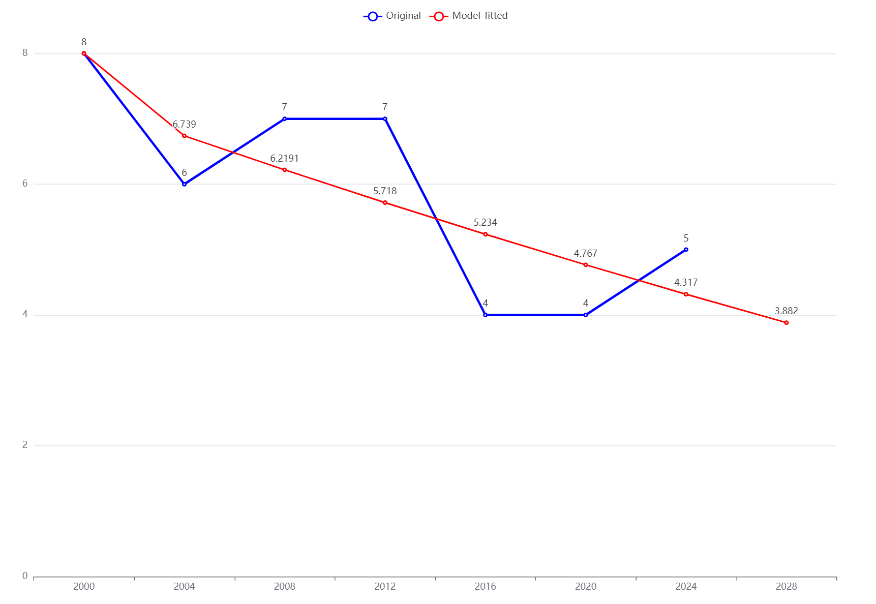
3.882

Slide 9
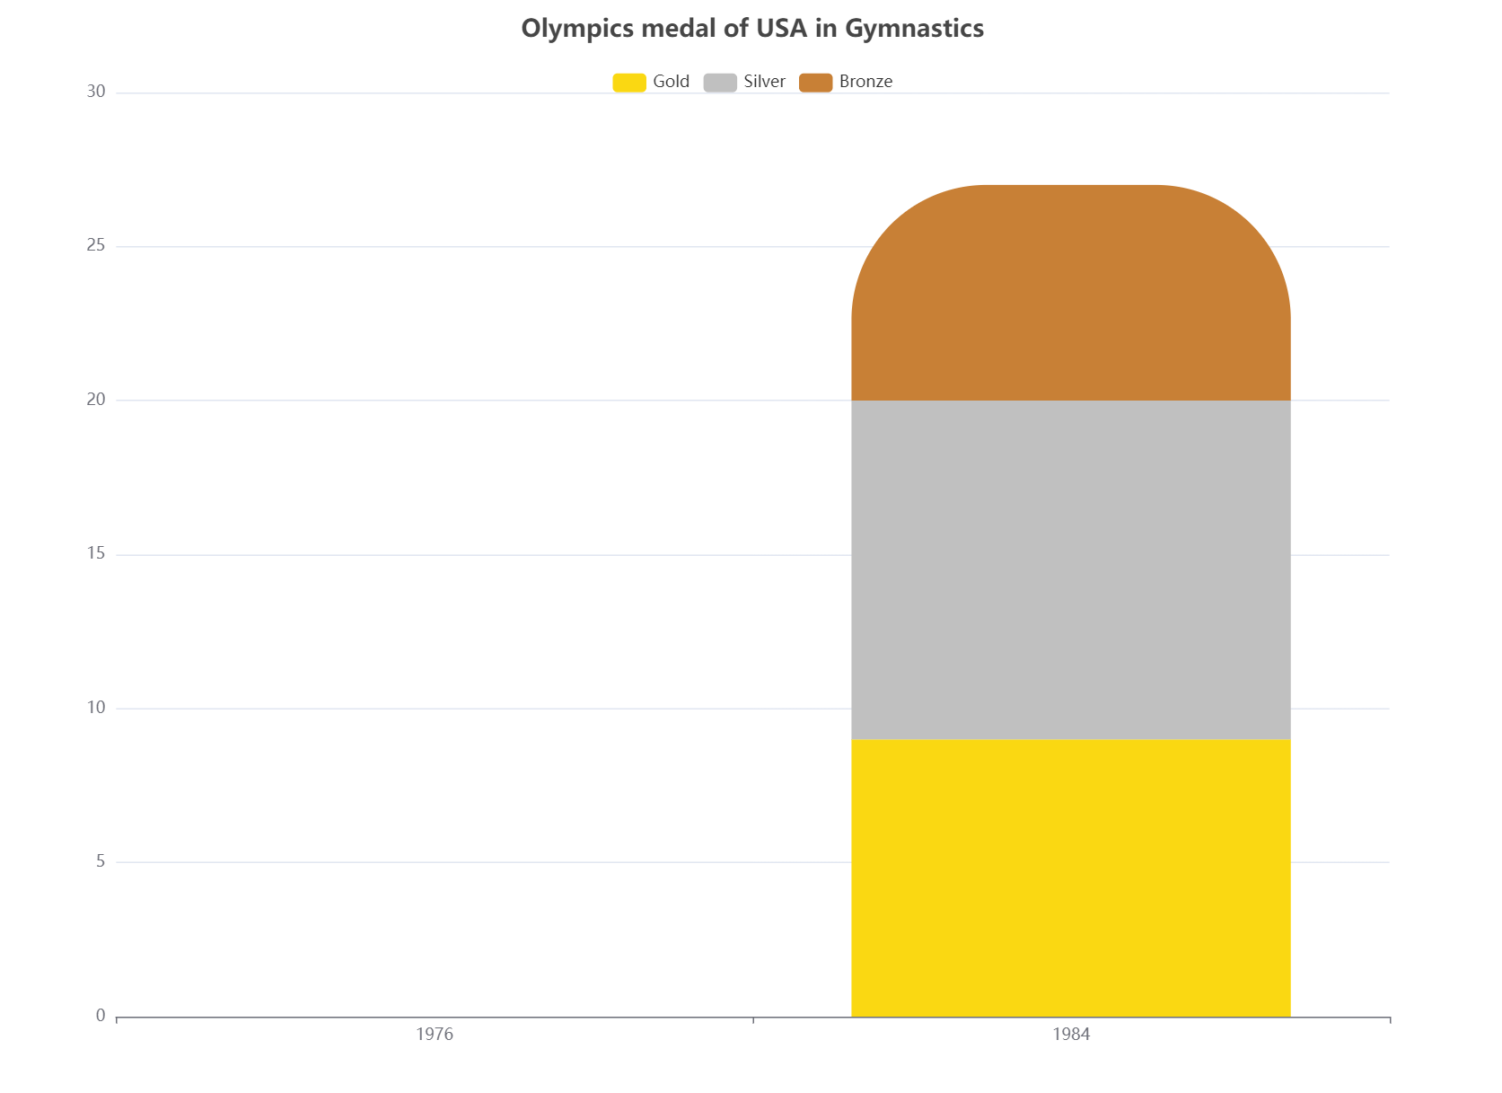
27
0

Slide 10
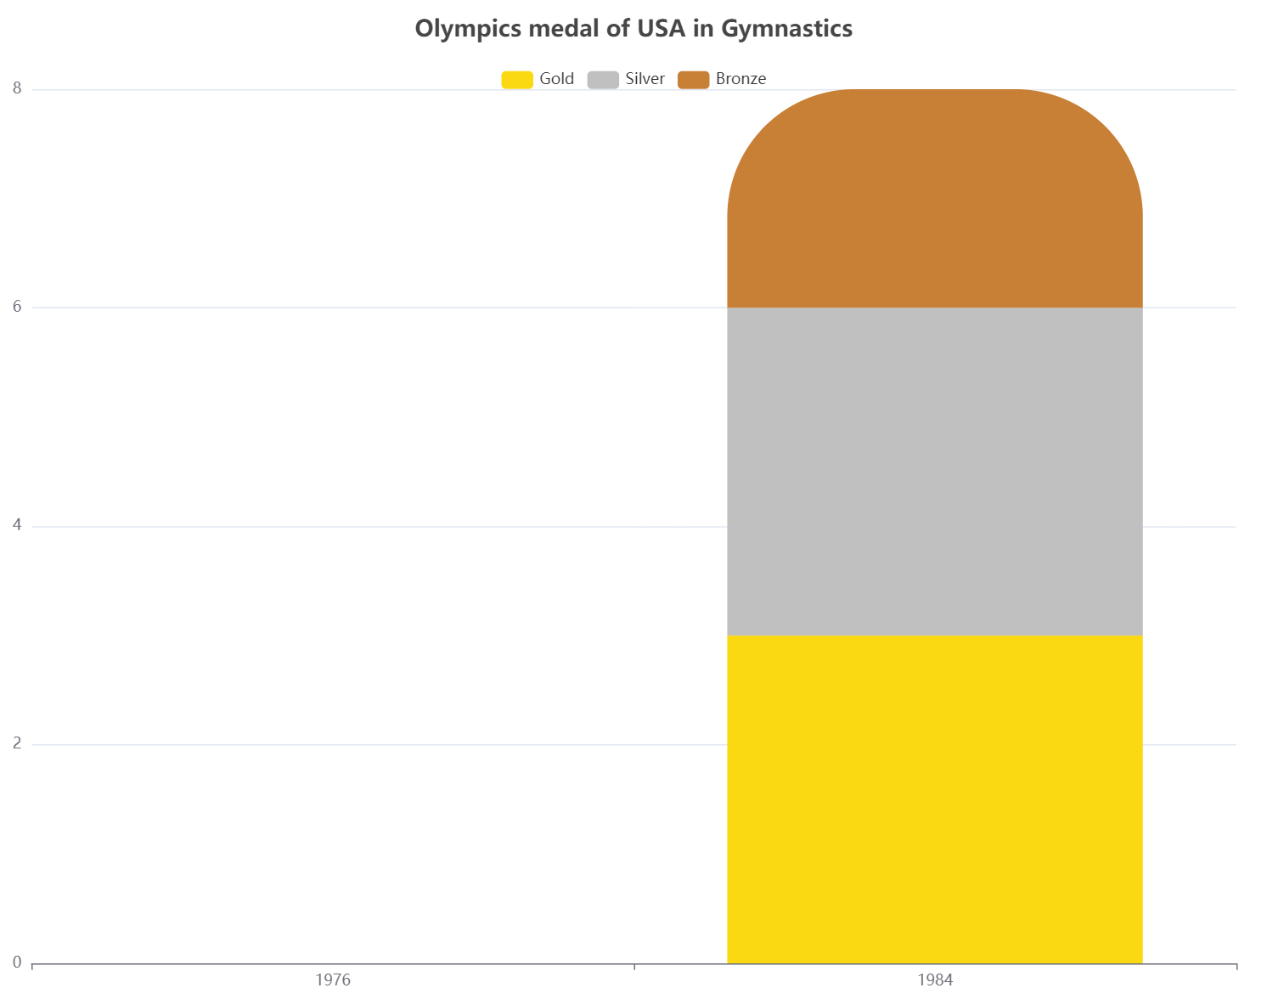
8
“Great Coach”
Effect
0

Slide 11
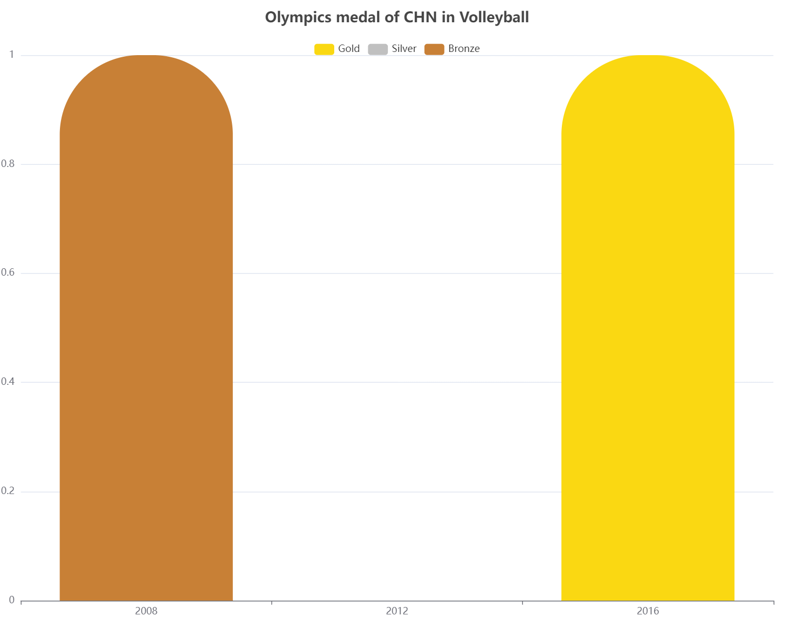
1Bronze
1Gold
“Great Coach”
Effect
0

Slide 12
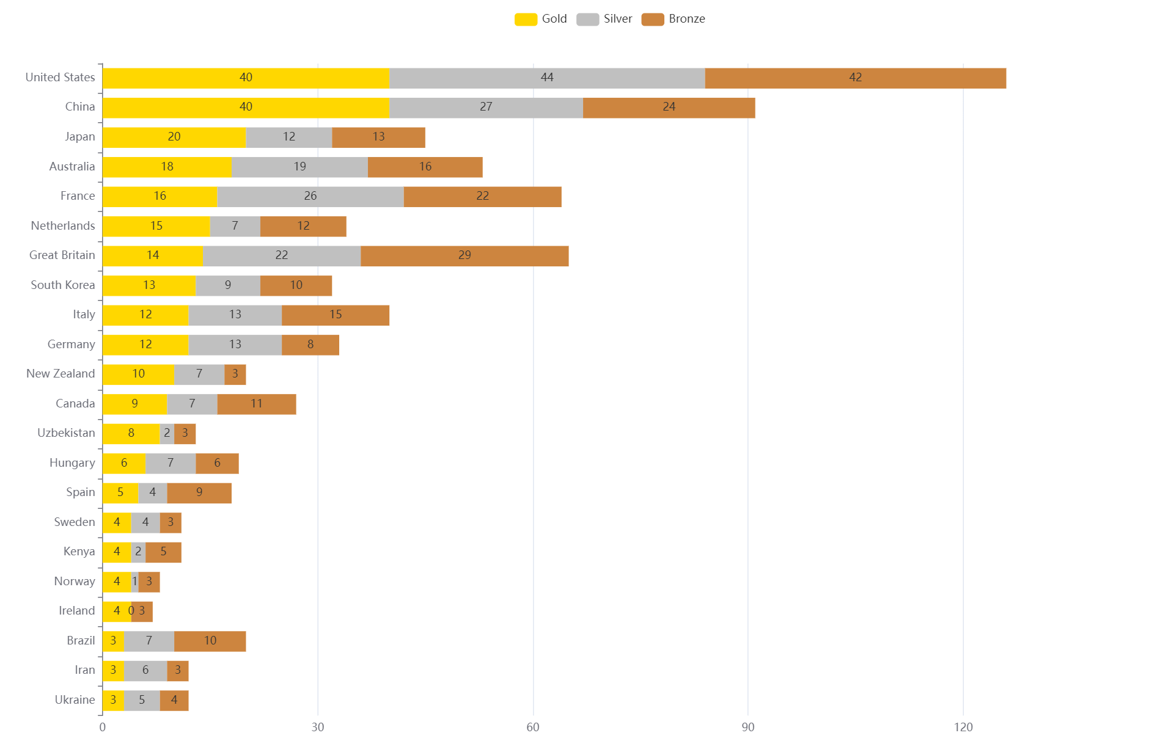

Slide 13
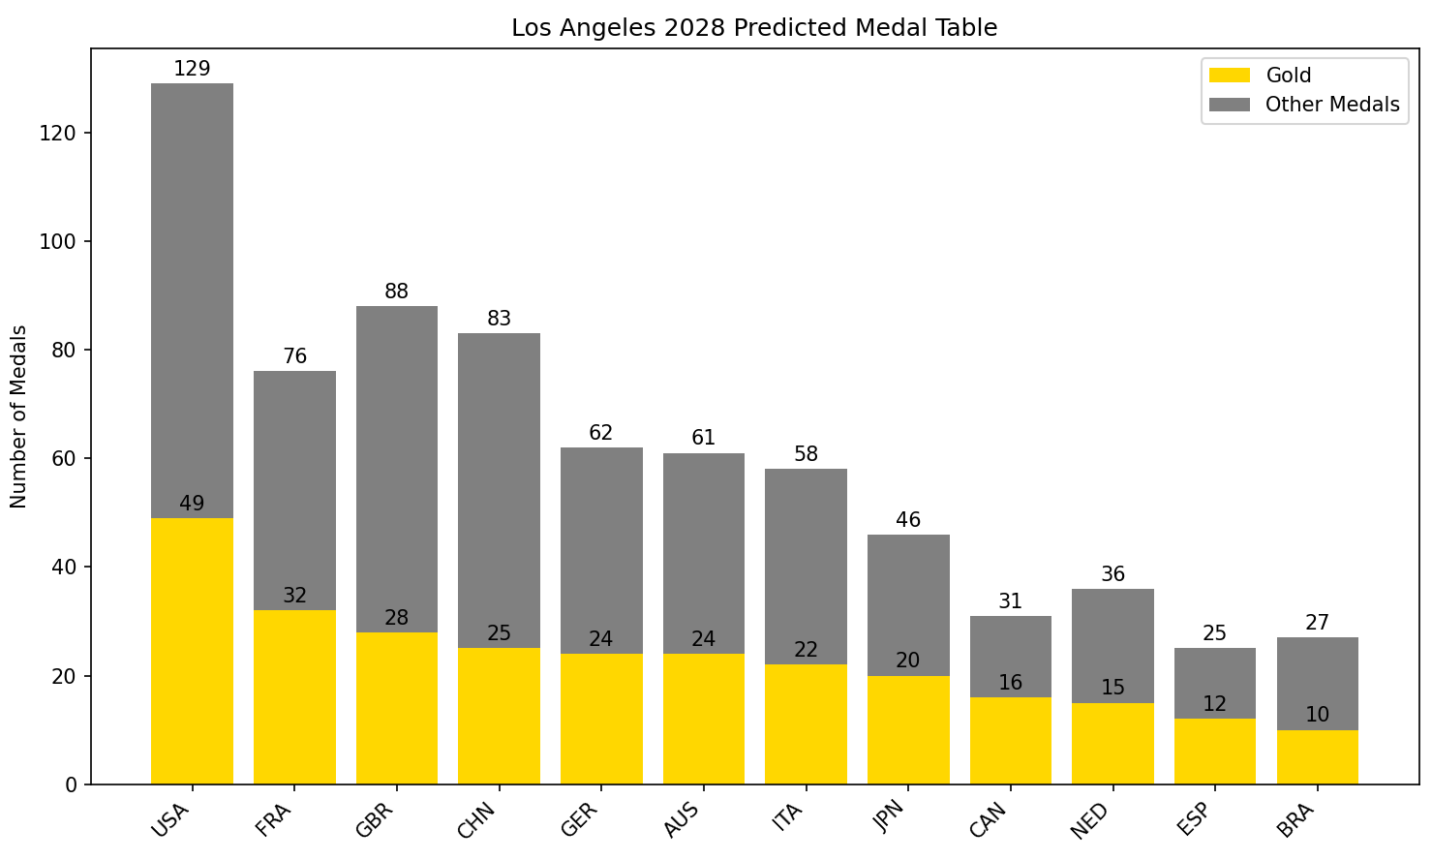
USA
CHA
JPN
FRA
GBR
GER
AUS
ITA
CAN
NED
ESP
BRA

Slide 14
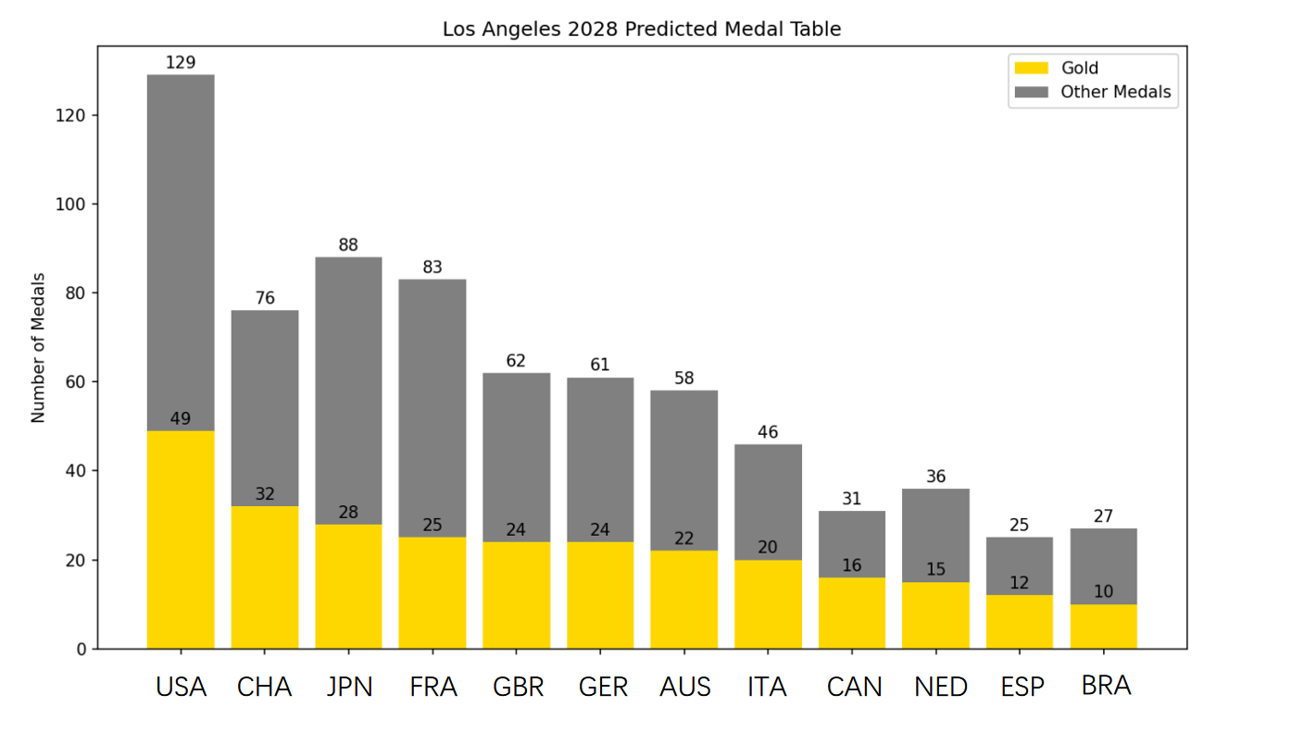

Slide 15
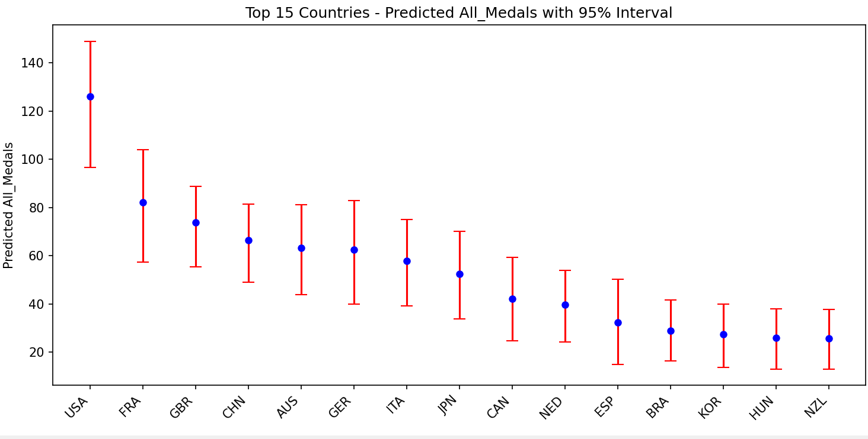
USA
CHA
JPN
AUS
GBR
GER
FRA
ITA
CAN
NED
ESP
SWE
NZL
HUN
BRA

Slide 16
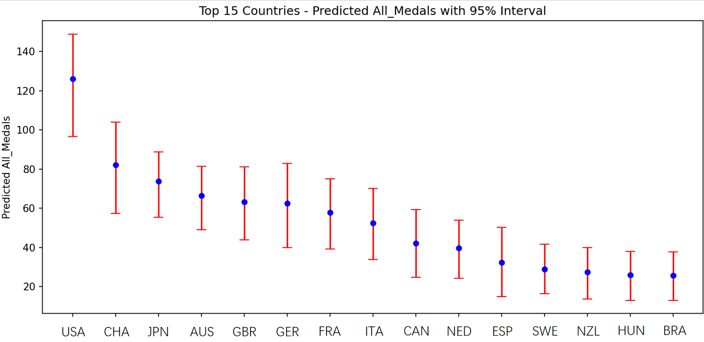

Slide 17
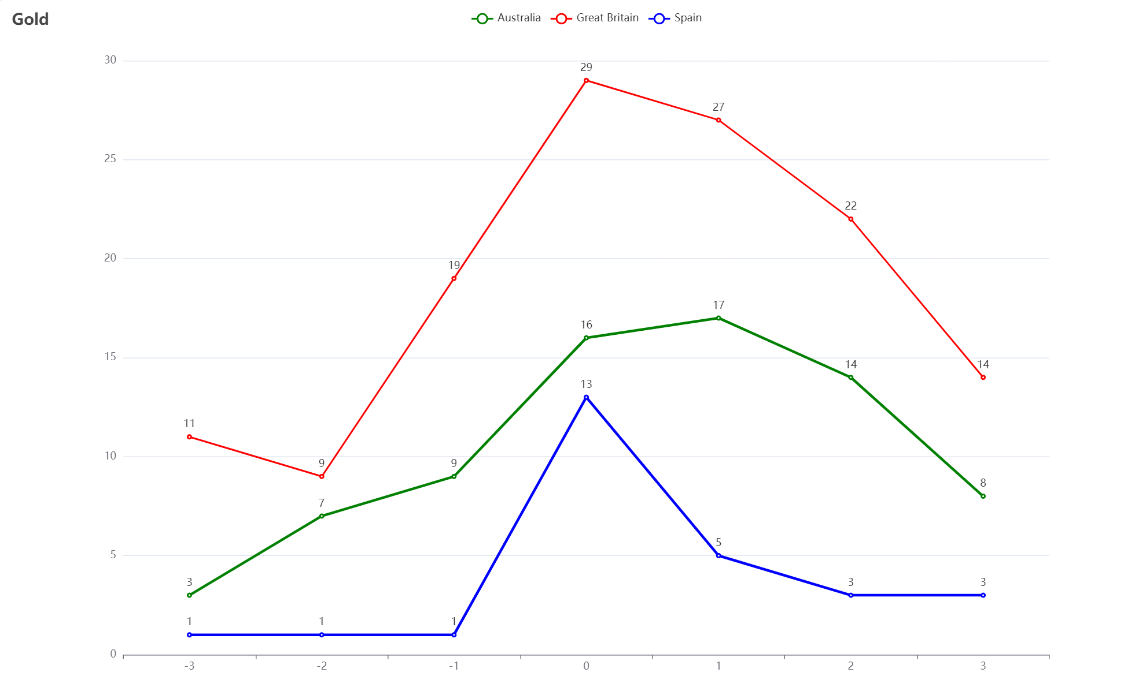
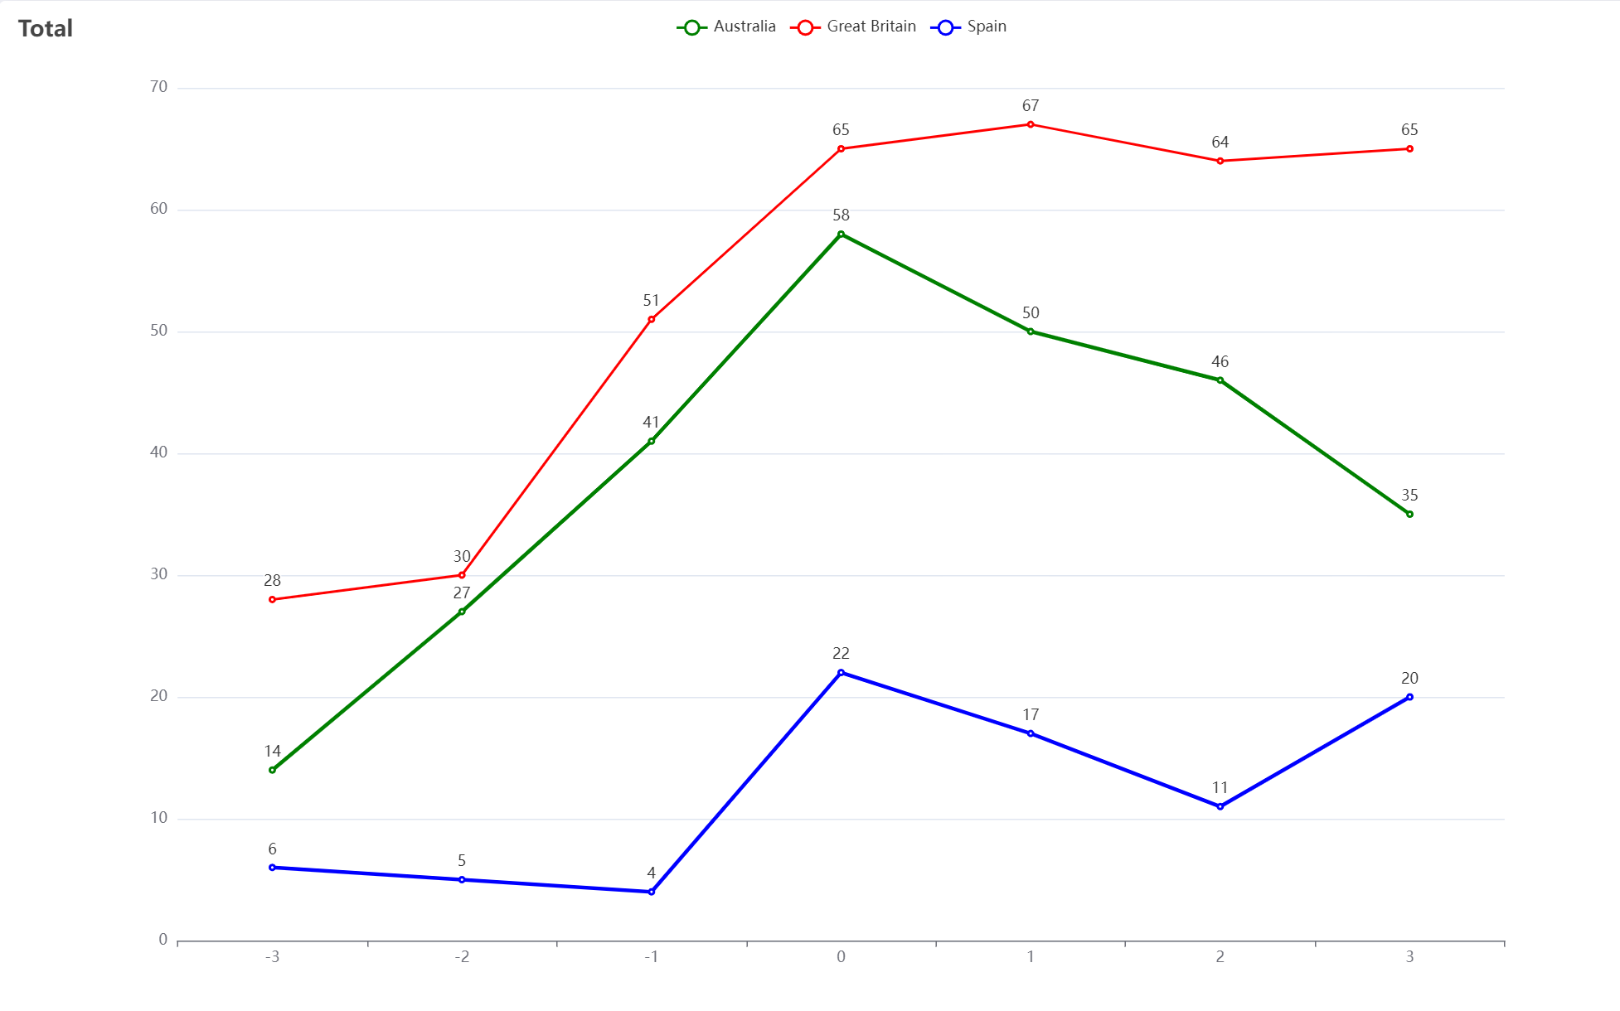

Slide 18
