Slide 1
INTO-CPS
SysML Modelling
Etienne Brosse, Softeam, FR
etienne.brosse@softeam.fr
04/04/2018

Slide 2
Contents
Introduction
  UML
  SysML
  FMI
INTOCPS/SysML Profile
  Block/FMI Definition
  Co Simulation Definition
  DSE Modelling

Slide 3
UML
Graphical modeling language
A standard in software engineering
Independent of processes/method used
Object Oriented Conception (OOC)
Concept of views/diagrams
  13 diagrams
  Two kinds: Structural and Behavioral

Slide 4
UML – Structural diagrams
Type | Example of use
Class | Structure at type level (class, association, etc.)
Object | Structure at object level (instance, link, etc.)
Package | Logical organization (packages, import link, etc.)
Composite Structure | Internal structure of a complex type (part, port, etc.)
Component | Complex structure (component, port, interface, etc.)
Deployment | Physical architecture of elements

Slide 5
UML – Behavioral diagrams
Type | Example of use
Use case | Expression of needs
Sequence | Example of sequential execution
State/Transition | State machine
Activity | Business process
Interaction Overview | Flow modeling and interactions between behaviors
Communication | Communication between objects
Timing | Evolution of an object over time

Slide 6
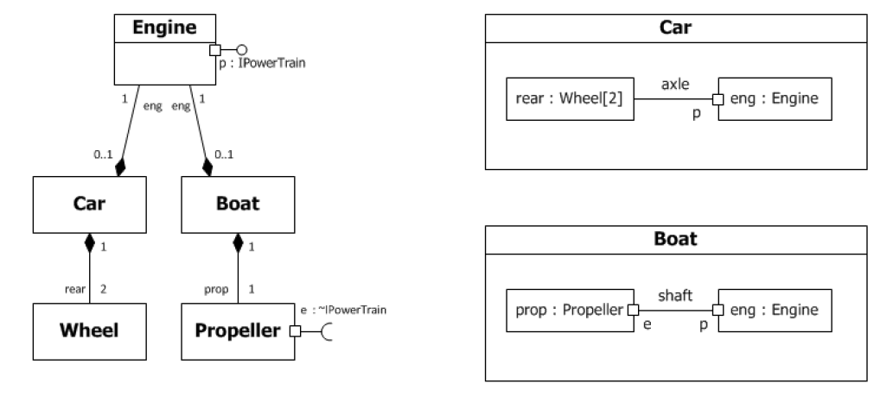
UML Example

Slide 7
UML Profile
Standard way of extending UML
Used by many standard
  SysML,
  MARTE,
  DoDAF,
  Etc.

Slide 8
SysML
Based on UML
Graphical modeling language
A standard in system engineering
Concept of views/diagrams
  9 diagrams
  Three kinds: Structural, Behavioral, and Requirement

Slide 9
SysML – Structural diagrams
Type | Example of use
Block | Structure between blocks (block, association, operations, etc.)
Internal block | Internal structure of a block (part, port, connectors, etc.)
Parametrics | Mathematical formula (constraints, parameters, etc.)
Package | Logical organization (packages, import links, etc.)

Slide 10
SysML– Behavioral diagrams
Dynamic views of the model.
Type | Example of use
Use case | Expression of needs
Sequence | Example of sequential execution
State/Transition | State machine
Activity | Business process

Slide 11
SysML – Requirements diagram
Type | Example of use
Requirements | Expression of requirements

Slide 12
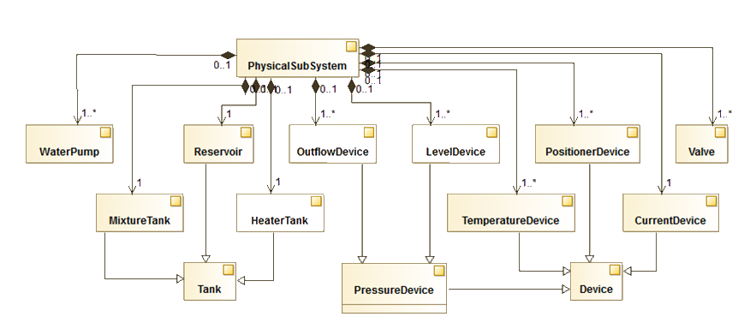
BDD Example

Slide 13
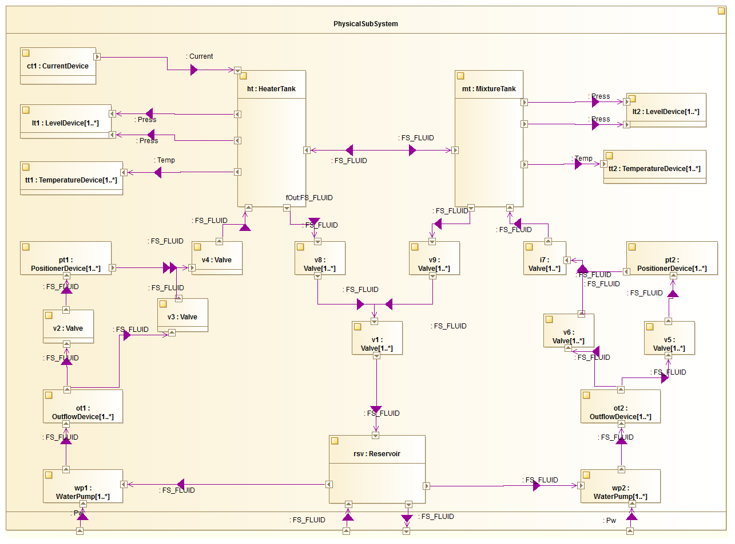
IBD Exemple

Slide 14
FMI
Standard for Co simulation
Implemented by a lot of tools
  Dymola, Simulink, INTOCPS Tools, …
Define Fonctional Mock-up Unit composed of
  ModelDescription (XML file)
  Behavior (Dll + C Code)

Slide 15
INTOCPS/SysML
Based on SysML
Graphical modeling language
CPS architecture is a set of FMU
Requirement, DSE, other concept are related to these FMUs
Concept of views/diagrams
  7 diagrams
  Two kinds: 2 Structural and 5 DSE

Slide 16
INTOCPS/SysML – Structural diagrams
Type | Example of use
Architectural | Structure between blocks/FMUs (block, composition, etc.)
Connection | Internal structure of a block (part, port, connectors, etc.)

Slide 17
INTOCPS Blocks
Extends SysML Block
Represents a sub-set of the system
  The system, a fmu, …
Four kind of blocks
  EComponent,
  System,
  CComponent,
  POComponent.

Slide 18
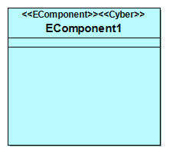
EComponent
Represents a FMU of the system
Core element
Can be Cyber, Physical, subsystem, etc.
Characterized by its properties
  Variables
  Input/output Flow Ports

Slide 19
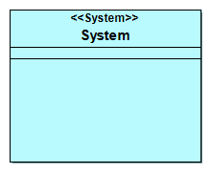
System
Represents the system itself
Top/Root of the design
Unique

Slide 20
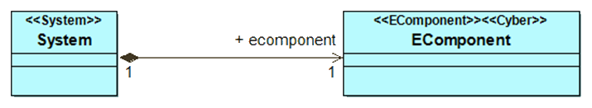
Composition
Composition relationship between blocks
A content can only be part of a single whole
System is composed of Ecomponent or CComponent

Slide 21
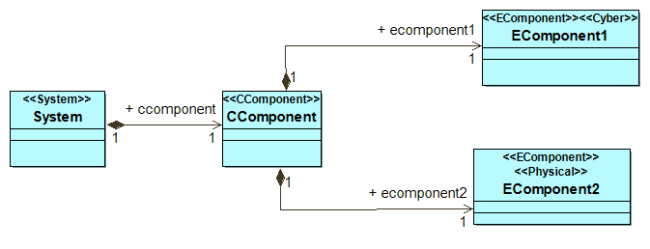
CComponent
Represents the a group of FMU/EComponent
Grouped by logic, domain, etc.

Slide 22
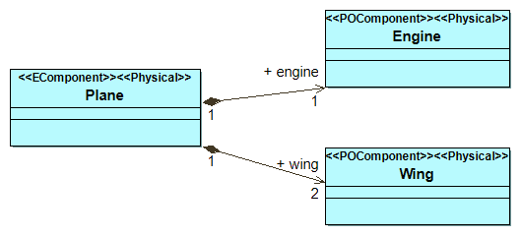
POComponent
Represents the sub part of a FMU/EComponent
Used for a Physical sub component

Slide 23
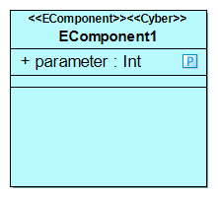
Variable
Attribute or property of a block.
Quantitatively characterizes the block.
Typed by:
  Primitive type (boolean, string, etc.)
  Enumeration
  Complex type (data type).
Multiplicity (1 by default).
Initial value.

Slide 24
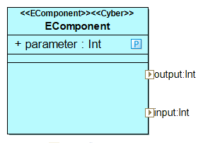
Flow port
Modeling of Blocks Input or Output
Properties
  Directions (in or out)
  Type

Slide 25
Value Type
Abstract Concept
Typing Ports and and Variable
Concrete Sub Classes:
  PType (Primitve Type),
  StrtType (Structured Type),
  Dtype (Derived Type),
  UnitType,
  Enumeration.

Slide 26
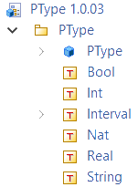
Primitive Type
Represent the available Primitive Type
Library of 5 primitive Types:
  Real,
  Integer,
  Natural,
  Boolean,
  String

Slide 27
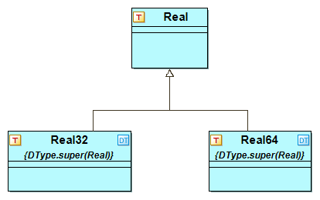
Derived Type (DType)
Type derived from Primitive Type
Specialised Primitive Type
Described by :
  Name (String),
  Super (Primitive Type).

Slide 28
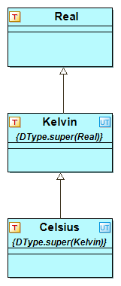
Unit
Specialised Derived Type
Described by:
  Name (String),
  Super (Primitive Type),
  Unit (String),
  Factor (Double),
  Offset (Double).
Unit = Factor * (Super) + Offset

Slide 29
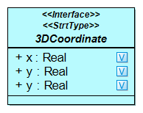
Structured Type
Type with attribute(s).
Allows definition of Time, Coordinate, Date for example.

Slide 30
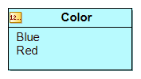
Enumeration
Collection of literals aka predefined values.

Slide 31
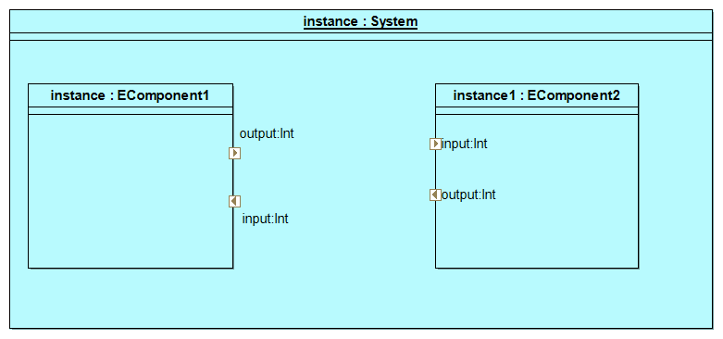
Block Instance
Instantiation of a given block
Associated with other block instance through ports and/or connectors

Slide 32
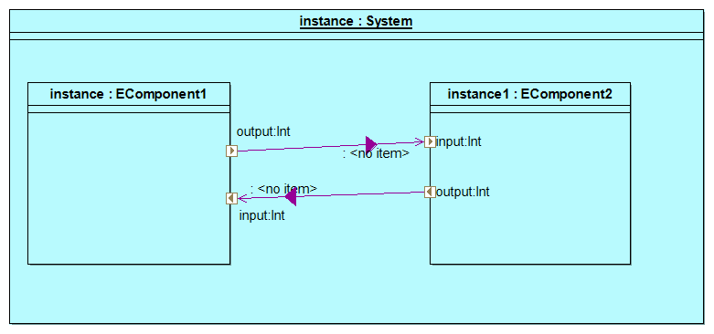
Connector
Links two instance of Flow Ports

Slide 33
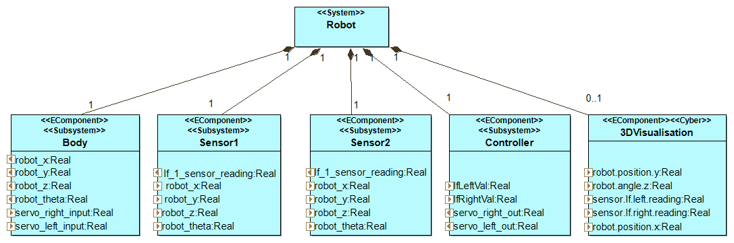
Example

Slide 34
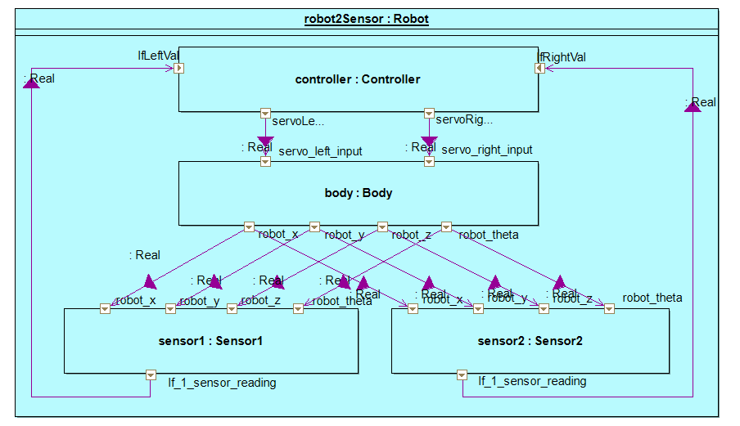
Example

Slide 35
INTOCPS/SysML– DSE diagrams
Type | Example of use
Parameter definition | Structure between parameter
Parameter connection | Connections between parameter
Objectif definition | Structure between objectives
Objectif connection | Connections between objectives
Ranking | Definition of the rank parameters

Slide 36
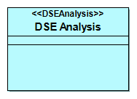
DSE Analysis
Top/root element for DSE Analysis.
Looks like System Block for DSE

Slide 37
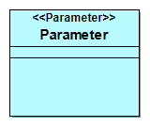
Parameter
Freedom degree of the DSE
Defined with a value range
  0.1, 0.2

Slide 38
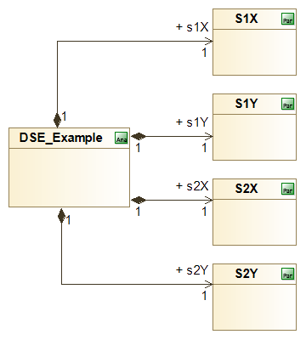
Parameter Definition example

Slide 39
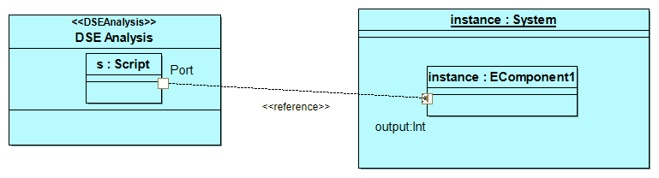
Reference
Link between DSE and Architecture
Made reference to Architecture part
Is Part of DSE

Slide 40
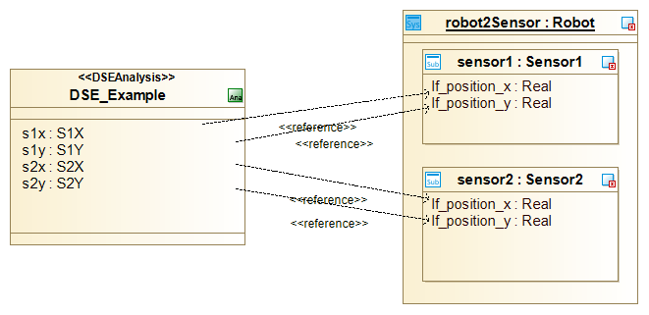
Parameter Connection Example

Slide 41
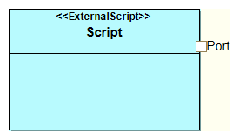
Objective
Objective of the DSE
Python script
Port as Parameter

Slide 42
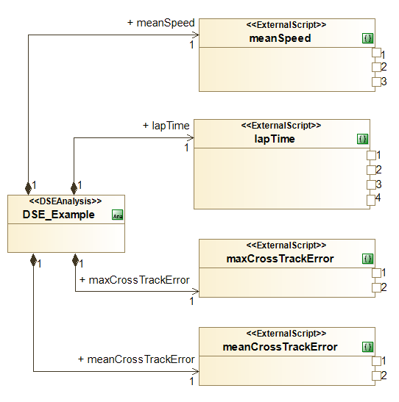
Objective Definition Example

Slide 43
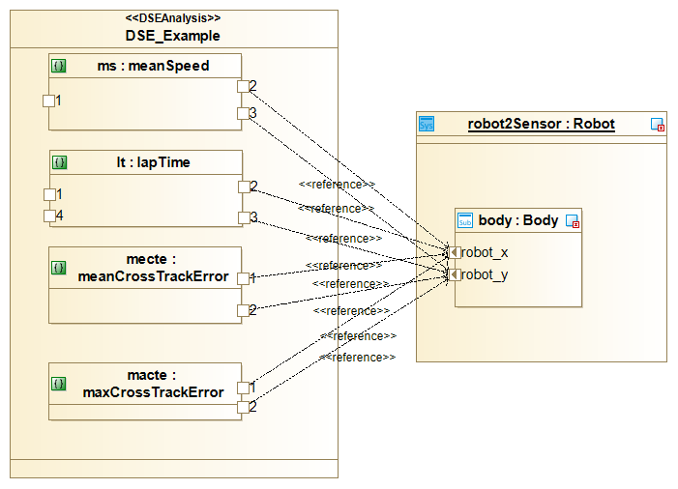
Objective Connection Example

Slide 44
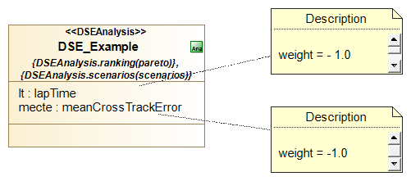
Ranking
Made at the DSE Analysis level
Use scenario(s)
Defined by :
  Method (Pareto)
  Set of objective
  Weight associated to the objectives

Slide 45
INTO-CPS/SysML
Modelling
Etienne Brosse, Softeam, FR
etienne.brosse@softeam.fr
04/04/2018

