Slide 1
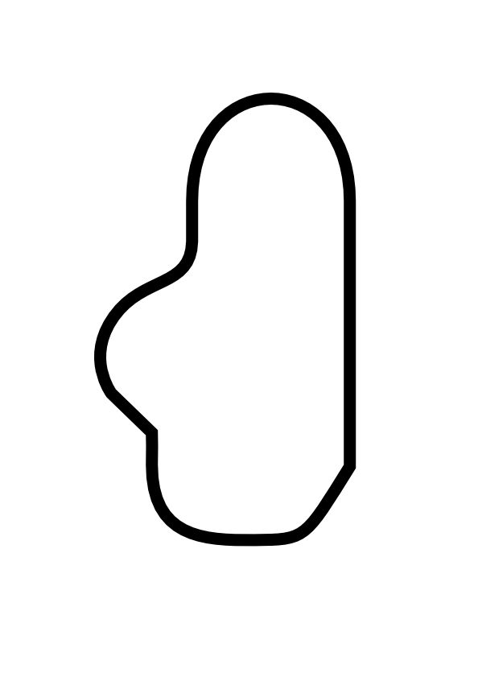
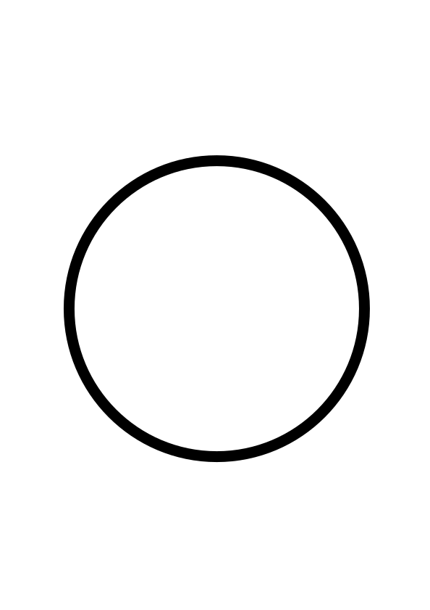
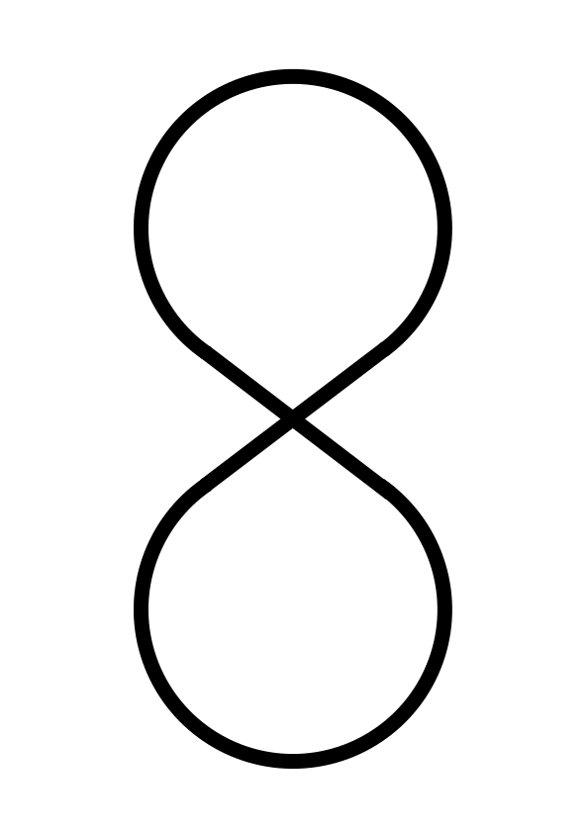
x-positions |  | y-positions
Hole # | Dist. (m) | Hole # | Dist. (m)
1 | Invalid | 1 | Invalid
2 | Invalid | 2 | Invalid
3 | 0.019 | 3 | Invalid
4 | 0.024 | 4 | 0.099
5 | 0.029 | 5 | 0.104
6 | 0.034 | 6 | 0.109
7 | 0.039 | 7 | 0.114
8 | 0.044 | 8 | 0.119
9 | 0.049 | 9 | 0.124
10 | 0.054 | 10 | 0.129
 |  | 11 | 0.134
 |  | 12 | 0.139
 |  | 13 | 0.144
 |  | 14 | 0.149
 |  | 15 | 0.154
 |  | 16 | 0.159
 |  | 17 | 0.164
 |  | 18 | 0.169
x-min | 0.019 | y-min | 0.099
x-max | 0.054 | y-max | 0.169
step | 0.005 | step | 0.005
Map 1
Map 2
Map 3

