Slide 1


20-sim Tutorial
Ken Pierce, Newcastle University
www.into-cps.org

Slide 2
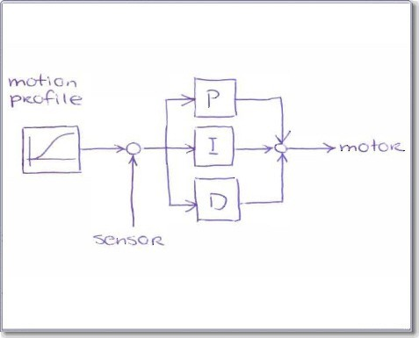
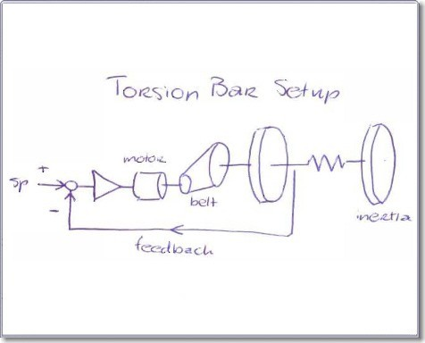
From Sketch to ...
Controller
Physical System

Slide 3
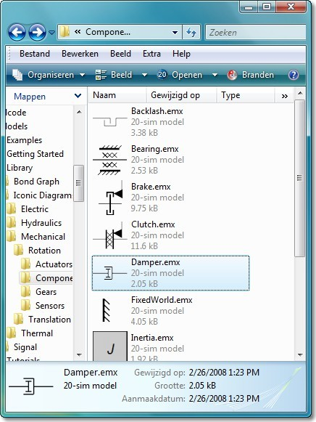
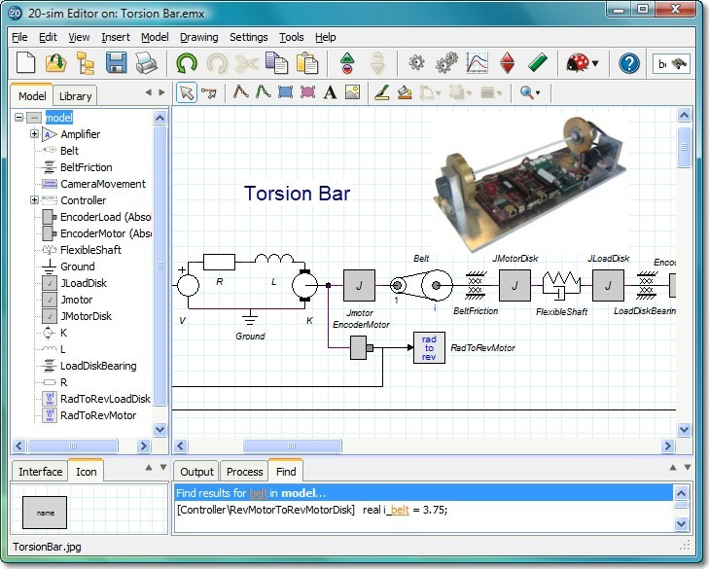
Modeling
Library
Editor

Slide 4
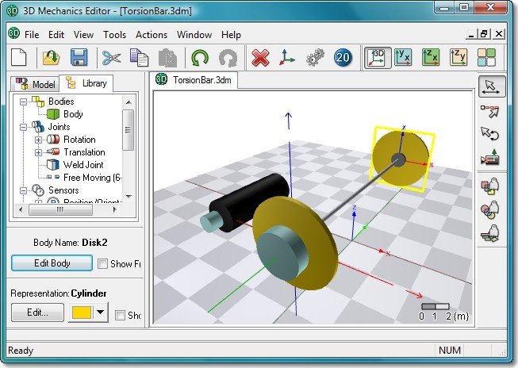
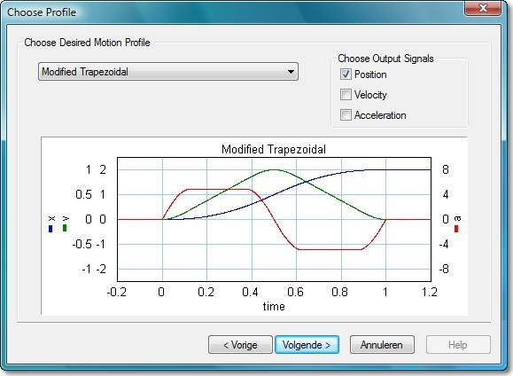
Modeling Tools
3D Mechanics Editor
Motion Profile Wizard

Slide 5
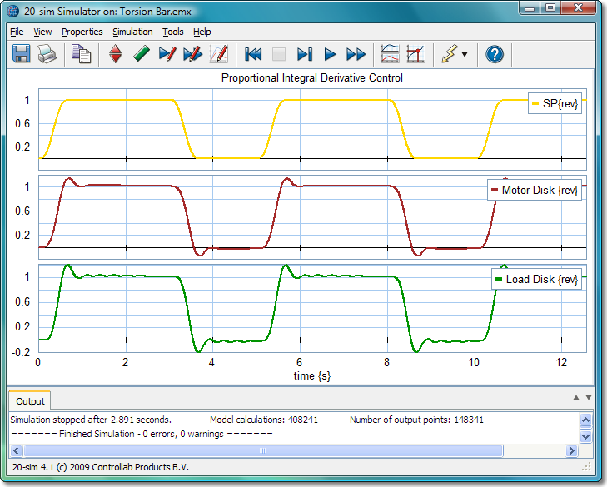
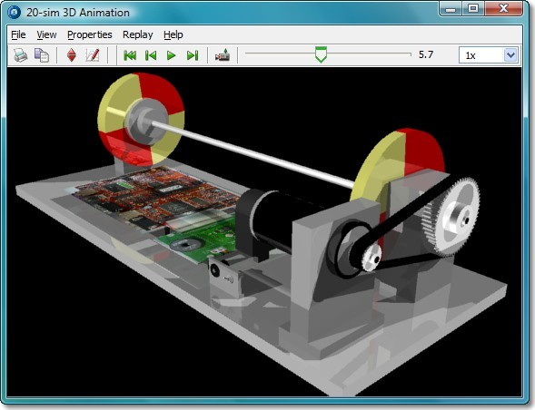
Simulation
Simulator
3D Animation

Slide 6
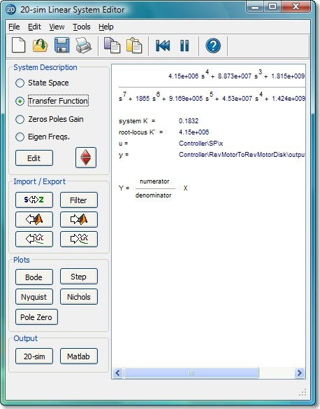
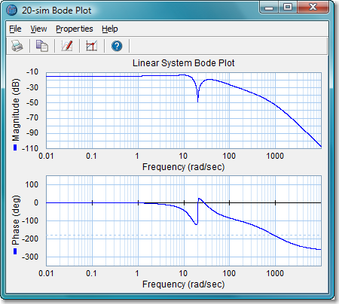
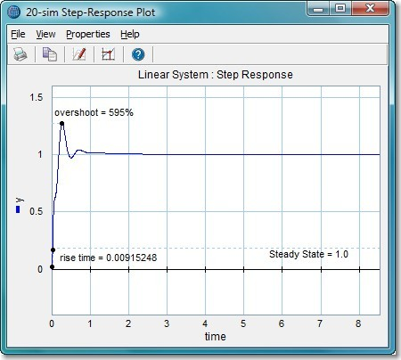
Frequency Domain
Linearized model
Bode plot and step response

Slide 7
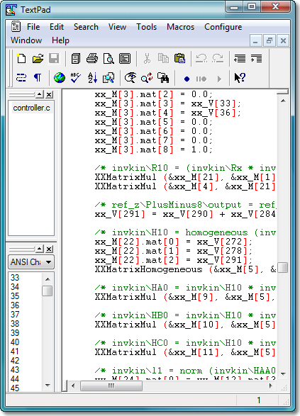
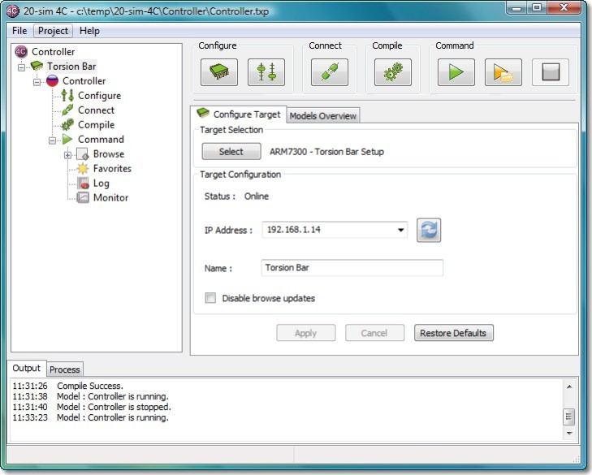
C-code Generation
C-code
20-sim 4C

Slide 8
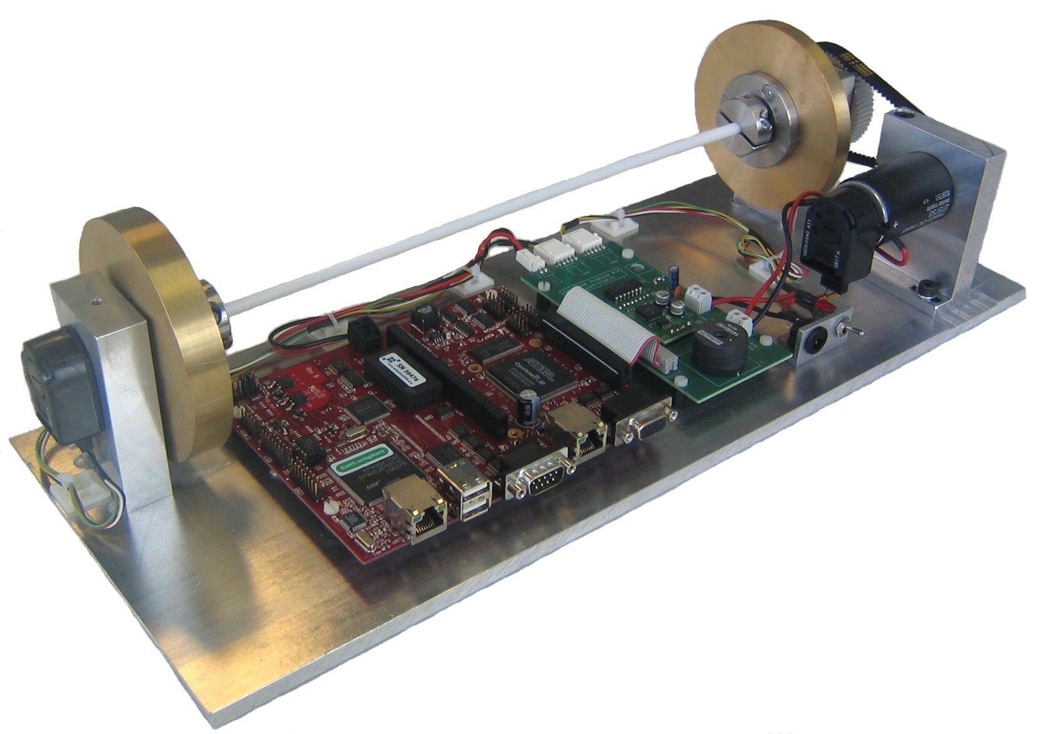
.. to Prototype

Slide 9
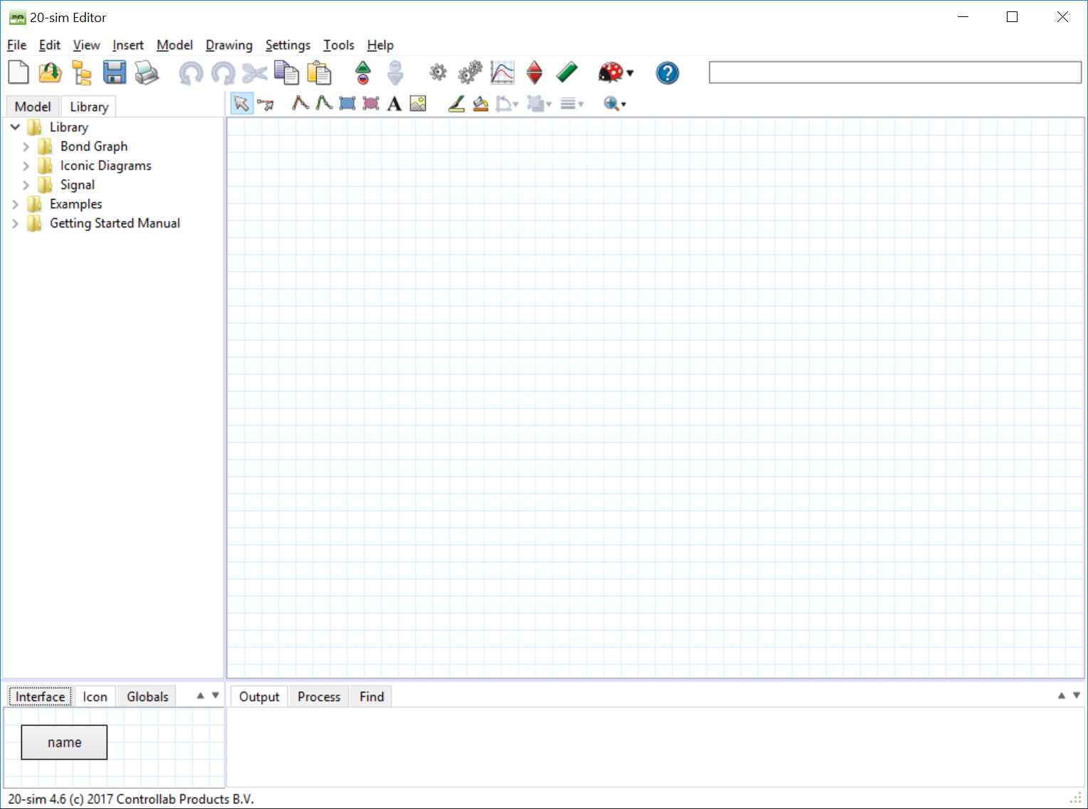
Demonstration
DEMO

Slide 10

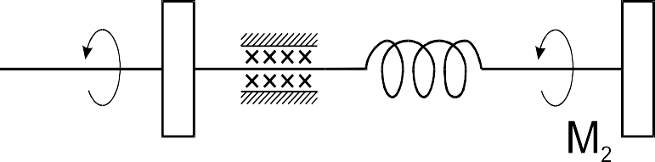







Mechanics

Slide 11
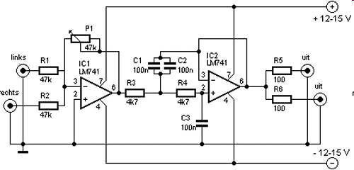
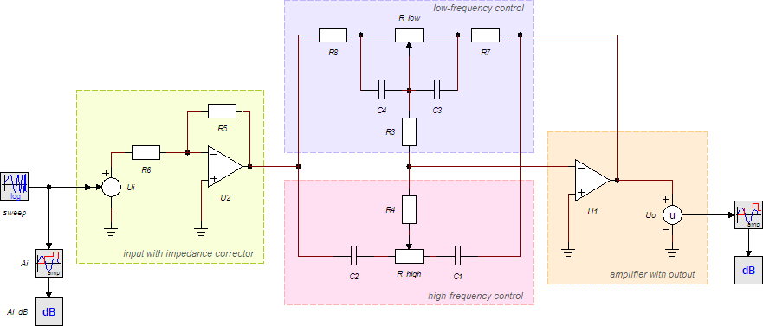
Electronics

Slide 12
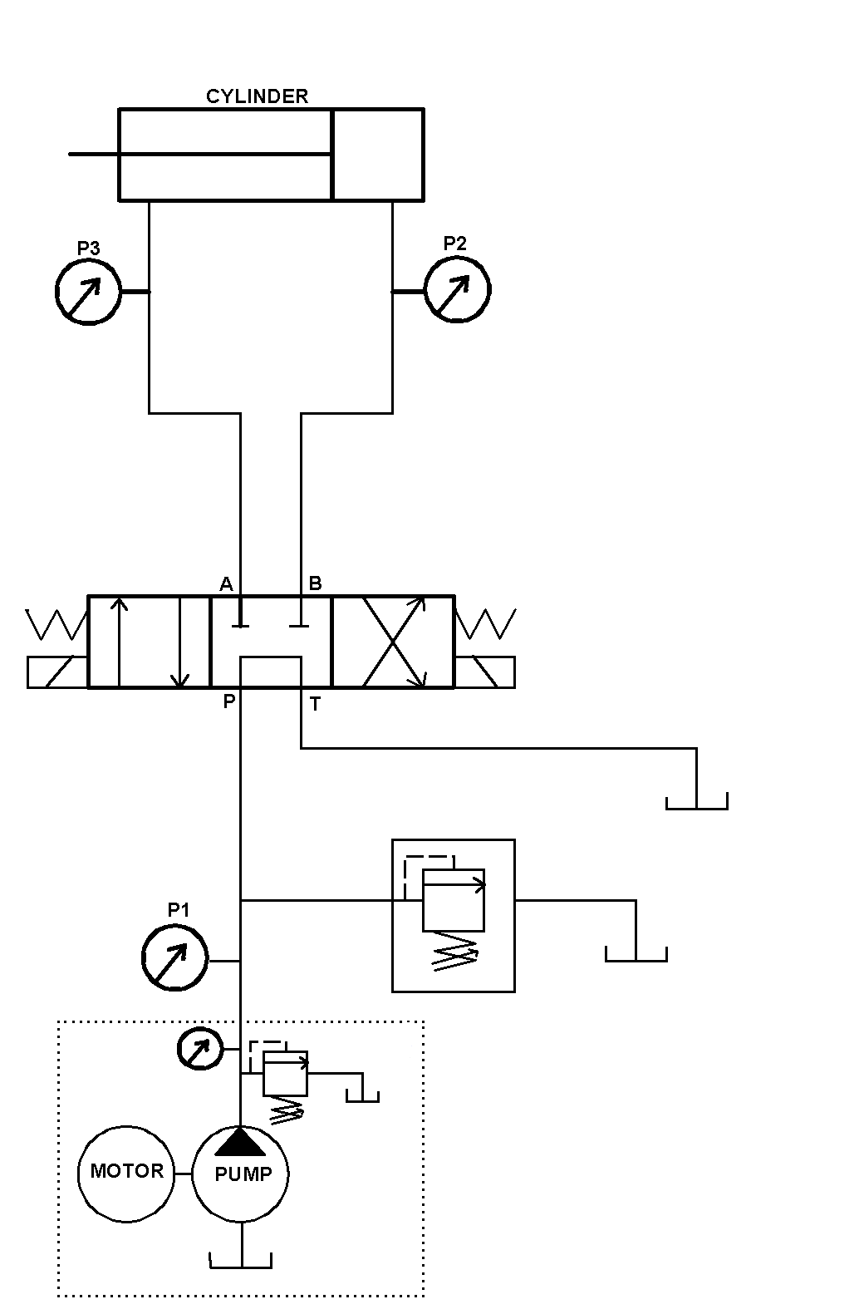
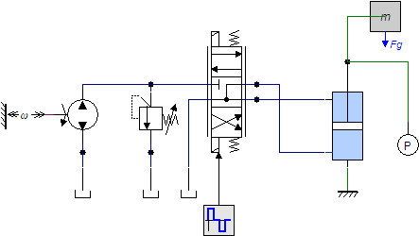
Hydraulics

Slide 13
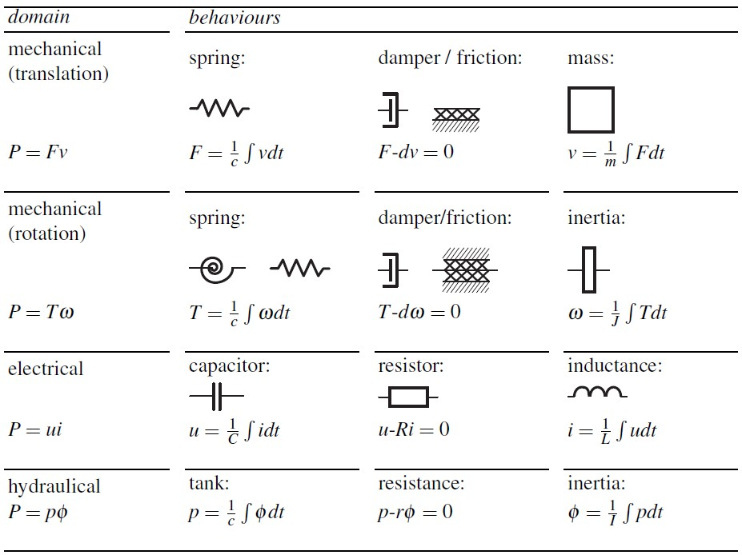
Domains

Slide 14
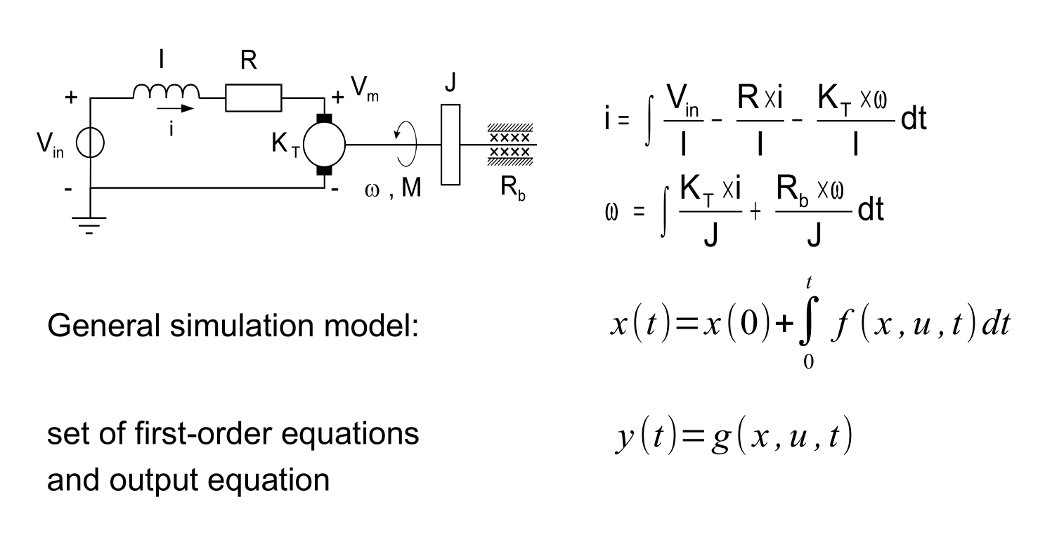
Differential Equations

Slide 15
Language Definition
Fixed during simulation
constants
//enter your constants here
parameters
//enter your parameters here
variables
//enter your variables here
initialequations
Vary during simulation
Calculated at the start
Optimized
// enter your initial equations here
equations
// enter your equations here
code
// enter your equations here
finalequations
Calculated every simulation step
Not optimized
Calculated at the end
// enter your final equations here

Slide 16
Language Example
constants
real g = 9.81 {m/s2};
parameters
real start_time = 10 {s};
// gravity: free fall
// start time of the fall
string out_string = 'run 1';
variables
real half_g {m/s2};
initialequations half_g = -0.5*g;
equations
if time < start_time then output = 0;
else
output = half_g*( (time-start_time)^2 );
end; finalequations
toMatlab ( output,out_string); // send output value to Matlab

Slide 17
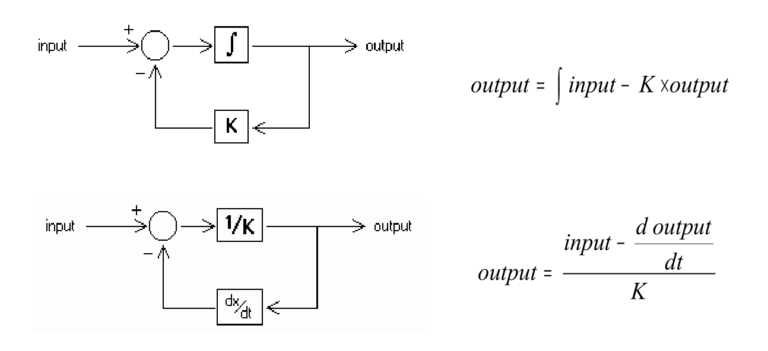
Integral Form & Differential Form
Integral form is preferred: much easier to simulate
20-sim will rewrite differential forms to integral form if possible
Write your own equations in integral form if possible!

Slide 18
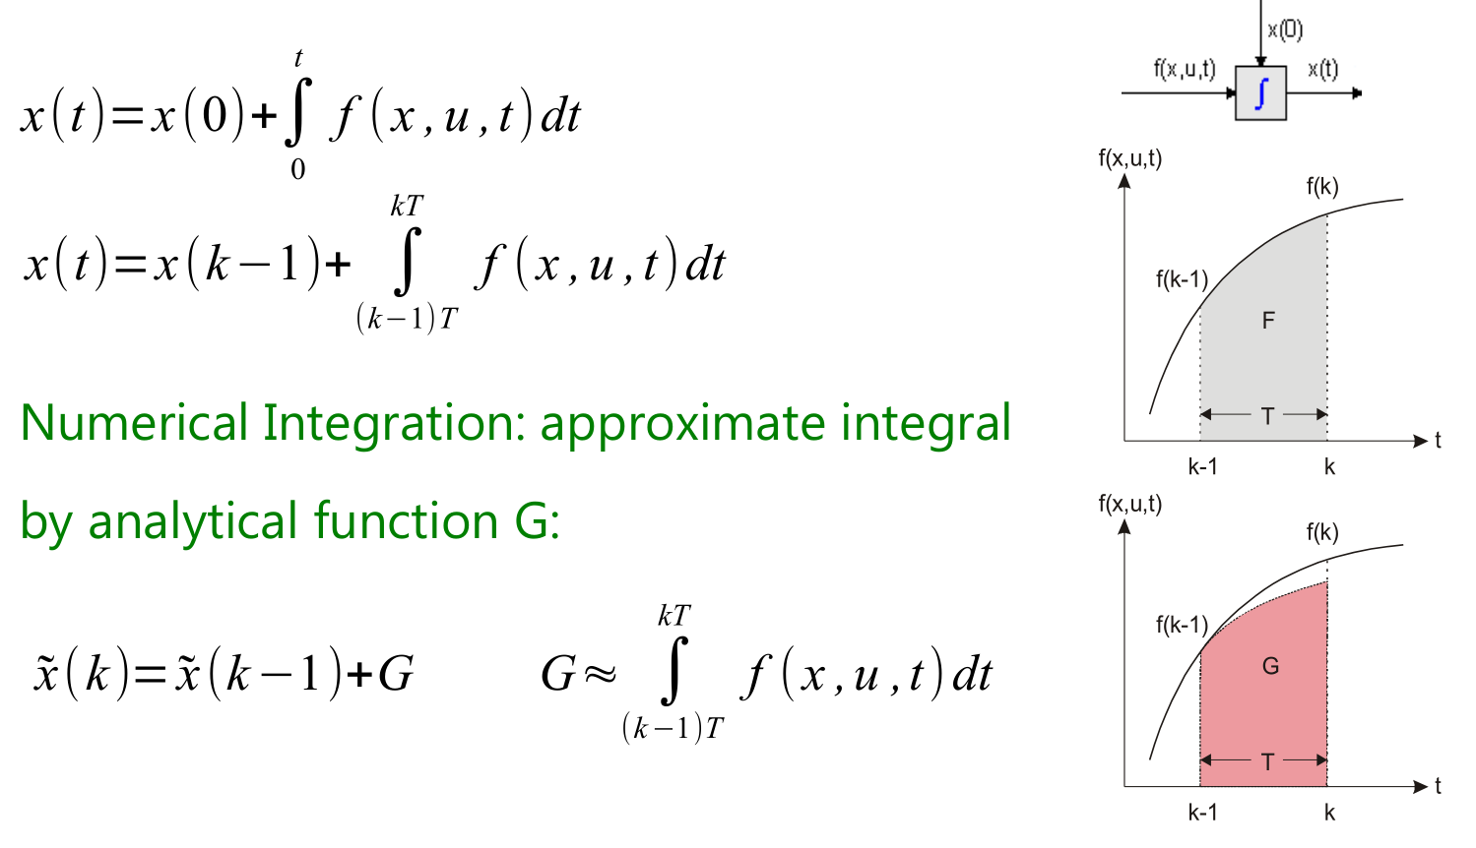
Numerical Integration

Slide 19
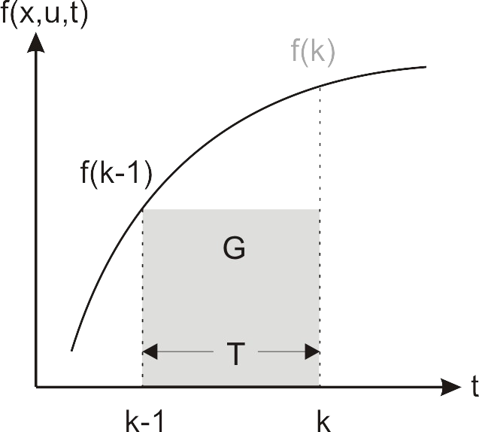
Euler
kT
x (t )=x (k −1)+ ∫
(k−1)T
f ( x , u , t ) dt
G=T⋅f (k −1)
x̃ (k)= x̃ (k −1)+T⋅f (k −1)

Slide 20
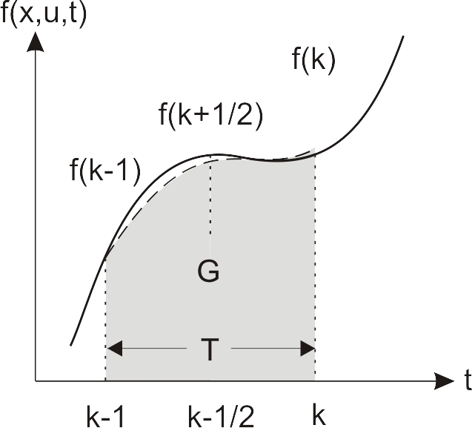
Runge-Kutta 4
kT
∫
(k− 1)T
x(k) = x(k − 1) +
f(x,u,t)dt
G = ^{T} ×(k + 2 ×k
+ 2 ×k + k )
6
1
2
3
4
k₁ = f(x(k-1),u(k-1),k-1)
T 1 1
k₂ = f(x(k-1)+ ₂ k₁,u(k- ₂ ),k- ₂ )
k₃ = f(x(k-1)+ ₂ k₂,u(k- ₂ ),k- ₂ )
k₄ = f(x(k-1)+T ×k₃,u(k),k)
T 1 1

Slide 21
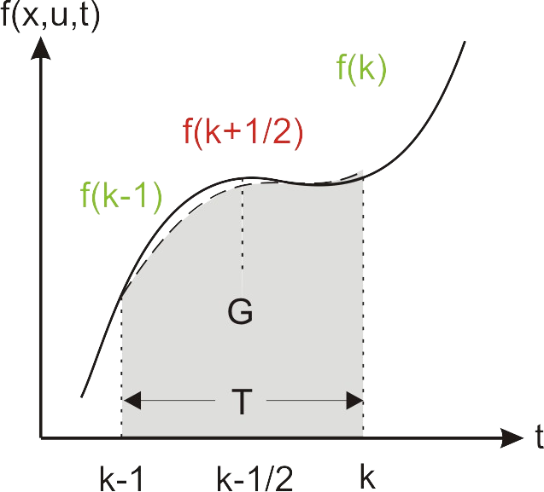
Major and Minor Steps
Major steps: f(k-1), f(k) Minor steps: f(k+1/2) Don't use code like:
●
●
●
if (time > 0) then x = x+1;
end;

Slide 22
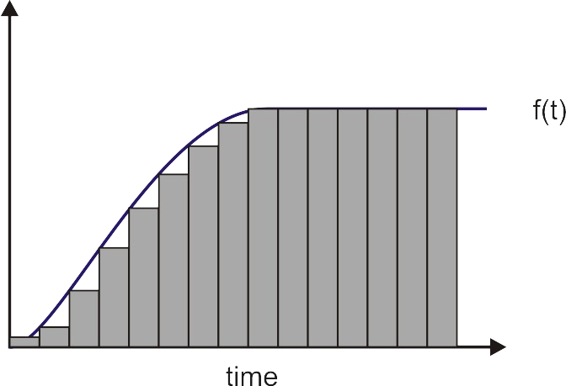
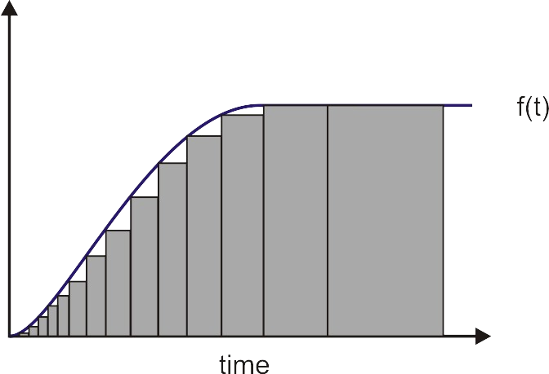
Fixed and Variable Step
Fixed Step
Variable Step

Slide 23
Stiff Models
Model has low frequency resonance high frequency resonances
Hard to simulate with fixed step methods
x {m }
●
0.005
0
●
-0.005
-0.01
0
2
4
6
8
10
tim e {s }

Slide 24
No Damping
Model has resonances which damp out poorly
Hard to simulate with some methods
●
x {m }
0.01
0.005
●
0
-0.005
-0.01
0
2
4
tim e {s }
6
8
10

Slide 25

Algebraic Loops
K
a
∫
Algebraic Loops:
u
x
function that is a function of itself
Require iteration to solve
Reduces simulation speed
●
kT
x(t )=x (k −1)+ ∫
(k−1)T
f ( x , u , t ) dt
●
f ( x , u , t )=a
a=k⋅u−a
●
algebraic loop

Slide 26
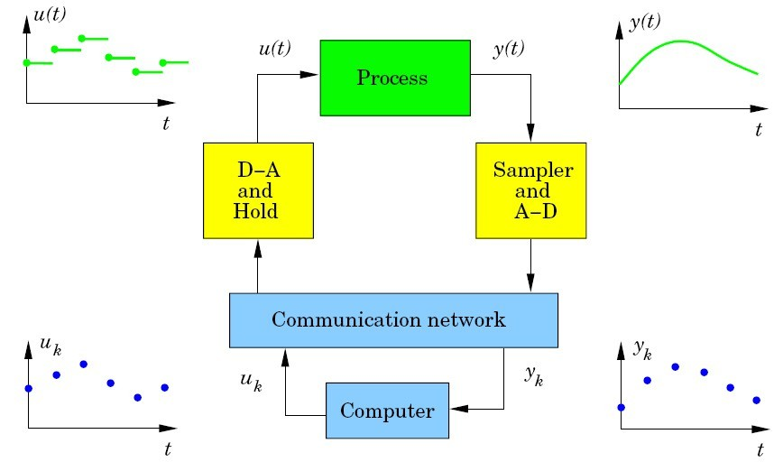
Computer Controlled Systems

Slide 27
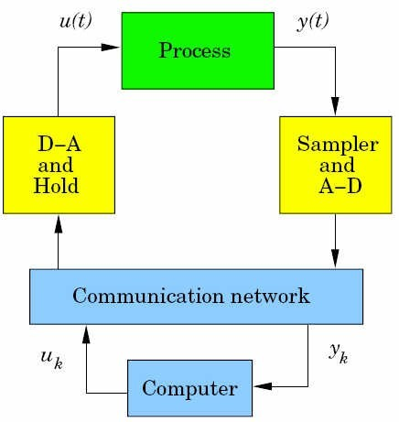
Discrete
Using certain functions will make a block to run in discrete-time.
sample: output of the function is discrete time, the input is continuous time
hold: the output is continuous time, the input of the function is discrete time

Slide 28
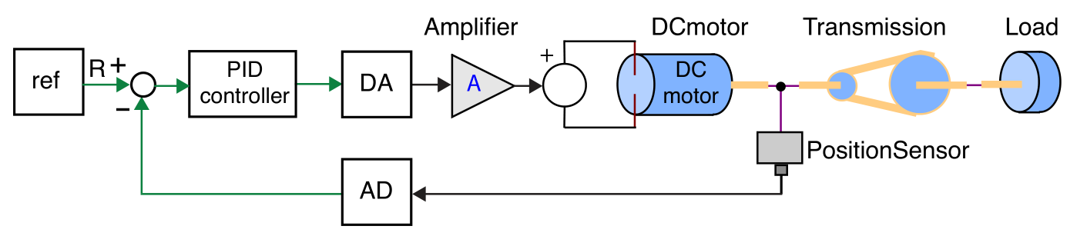
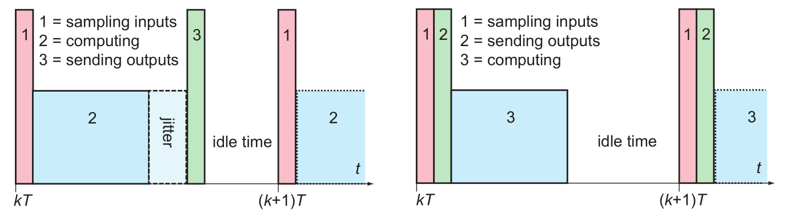
Sampling

Slide 29
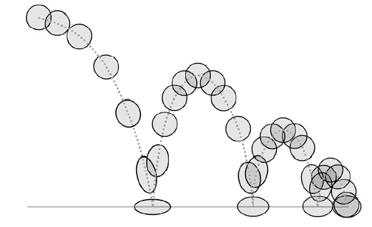
Events
Force integration method to do a calculation at a specific point:
event: find a zero crossing
eventup: find a zero crossing from negative to positive
eventdown: find a zero crossing from positive to negative
frequencyevent: do a calculation every period
timeevent: do a calculation at a specific time

