Slide 1


INTO-CPS SysML Modelling
Etienne Brosse, Softeam, France
Peter Gorm Larsen, Aarhus University

Slide 2
Contents
Introduction
UML
SysML
FMI
INTO-CPS/SysML Profile

Slide 3
Unified Modelling Language (UML)
Graphical modeling language
A standard in software engineering
Independent of processes/method used
Object Oriented Conception (OOC)
Concept of views/diagrams
13 diagrams
Two kinds: Structural and Behavioral

Slide 4
UML – Structural diagrams
Type | Example of use
Class | Structure at type level (class, association, etc.)
Object | Structure at object level (instance, link, etc.)
Package | Logical organization (packages, import link, etc.)
Composite Structure | Internal structure of a complex type (part, port, etc.)
Component | Complex structure (component, port, interface, etc.)
Deployment | Physical architecture of elements

Slide 5
UML – Behavioral diagrams
Type | Example of use
Use case | Expression of needs
Sequence | Example of sequential execution
State/Transition | State machine
Activity | Business process
Interaction Overview | Flow modeling and interactions between behaviors
Communication | Communication between objects
Timing | Evolution of an object over time

Slide 6
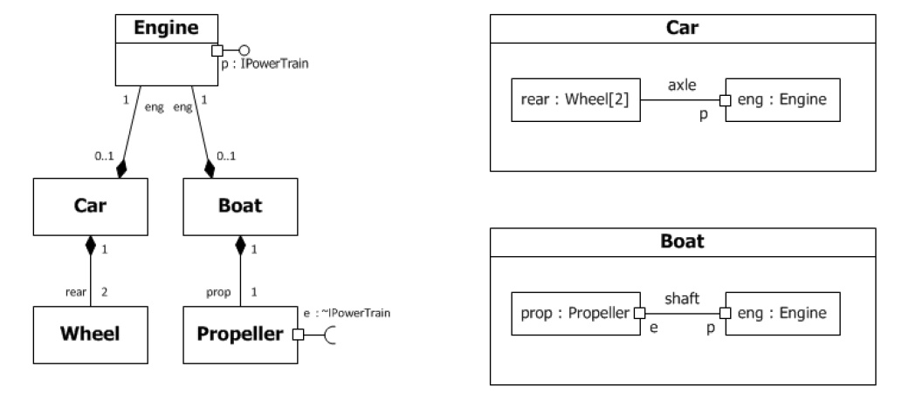
UML Example

Slide 7
UML Profile
Standard way of extending UML
Used by many standard
SysML,
MARTE,
DoDAF,
Etc.

Slide 8
SysML
Based on UML
Graphical modeling language
A standard in system engineering
Concept of views/diagrams
9 diagrams
Three kinds: Structural, Behavioral, and Requirement

Slide 9
SysML – Structural diagrams
Type | Example of use
Block | Structure between blocks (block, association, operations, etc.)
Internal block | Internal structure of a block (part, port, connectors, etc.)
Parametrics | Mathematical formula (constraints, parameters, etc.)
Package | Logical organization (packages, import links, etc.)

Slide 10
SysML– Behavioral diagrams
Dynamic views of the model.
Type | Example of use
Use case | Expression of needs
Sequence | Example of sequential execution
State/Transition | State machine
Activity | Business process

Slide 11
SysML – Requirements diagram
Type | Example of use
Requirements | Expression of requirements

Slide 12
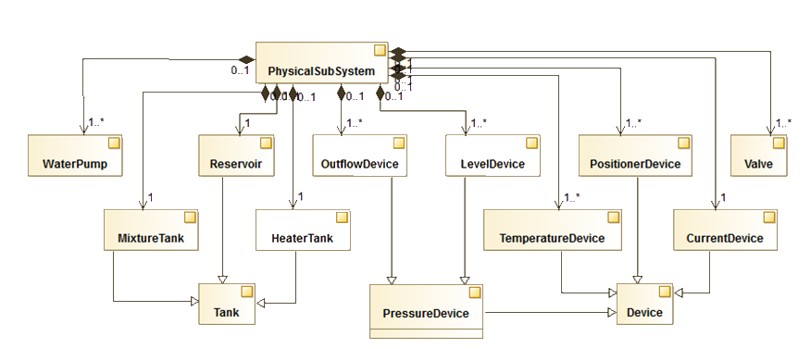
BDD Example

Slide 13
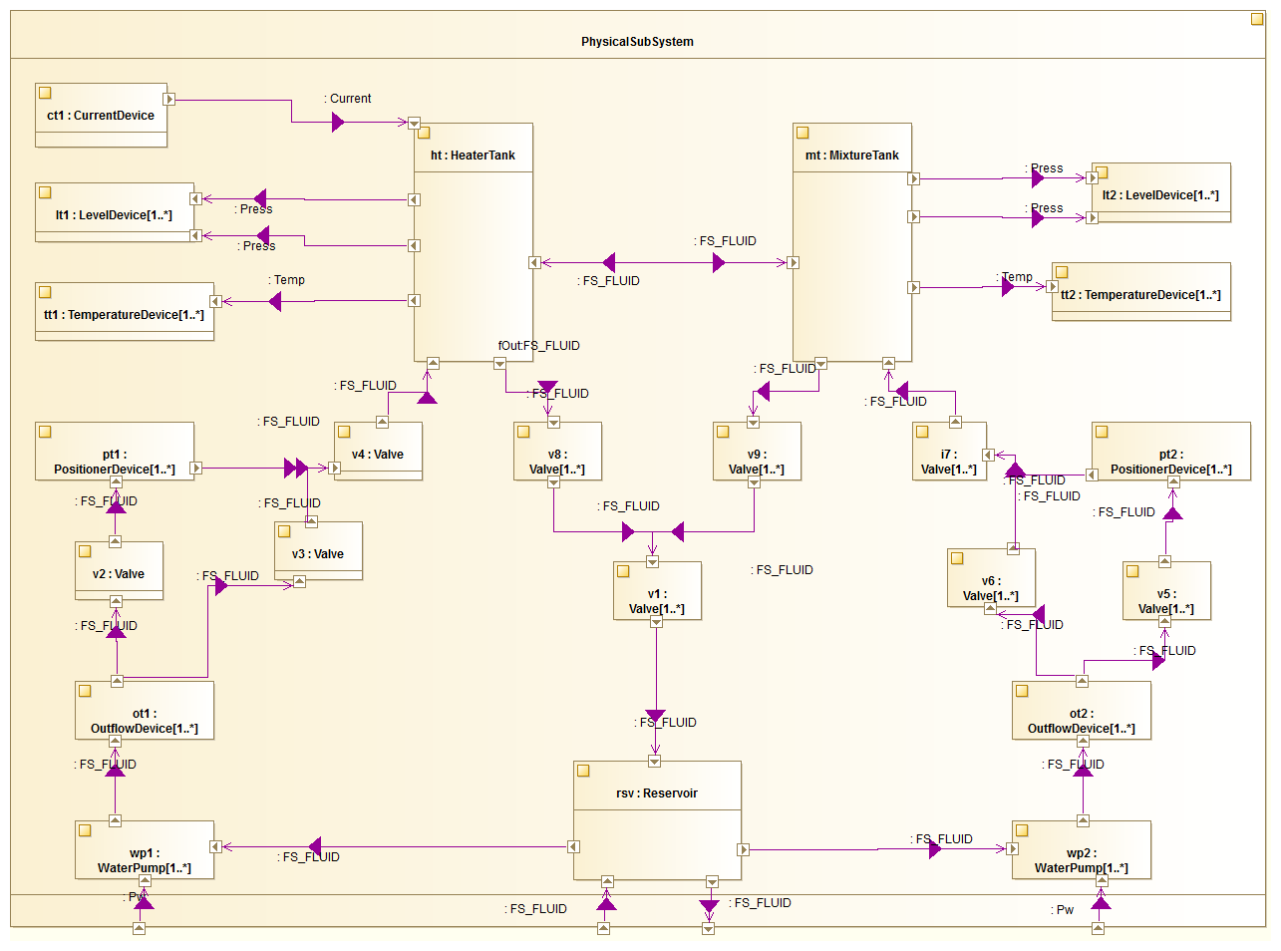
IBD Example

Slide 14
Functional Mockup Interface (FMI)
Standard for Co-simulation
Implemented by a lot of tools
Dymola, Simulink, INTO-CPS Tool suite, …
Define Functional Mock-up Unit composed of
ModelDescription (XML file)
Behavior (Dll + C Code)

Slide 15
INTO-CPS/SysML
Based on SysML
Graphical modeling language
CPS architecture is a set of FMU
Requirement, Design Space Exploration (DSE), other concept are related to these FMUs
Concept of views/diagrams
7 diagrams
Two kinds: 2 Structural and 5 DSE

Slide 16
INTOCPS/SysML – Structural diagrams
Type | Example of use
Architectural | Structure between blocks/FMUs (block, composition, etc.)
Connection | Internal structure of a block (part, port, connectors, etc.)

Slide 17
INTO-CPS Blocks
Extends SysML Block
Represents a sub-set of the system
The system, a fmu, …
Four kind of blocks
Ecomponent,
System,
CComponent,
POComponent.

Slide 18
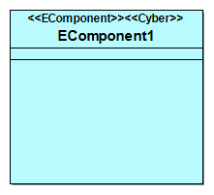
EComponent
Represents a FMU of the system
Core element
Can be Cyber, Physical, subsystem, etc.
Characterized by its properties
Variables
Input/output Flow Ports

Slide 19
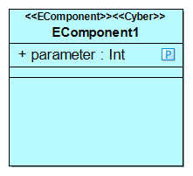
Variable
Attribute or property of a block.
Quantitatively characterizes the block.
Typed by:
Primitive type (boolean, string, etc.)
Enumeration
Complex type (data type).
Multiplicity (1 by default).
Initial value.

Slide 20
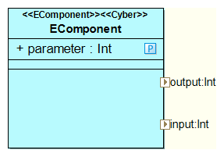
Flow port
Modeling of Blocks Input or Output
Properties
Directions (in or out)
Type

Slide 21
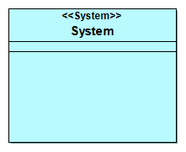
System
Represents the system itself
Top/Root of the design
Unique

Slide 22
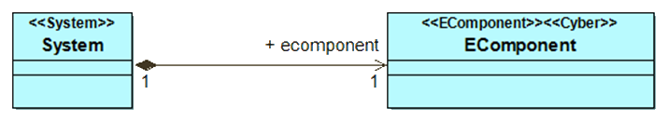
Composition
Composition relationship between blocks
A content can only be part of a single whole
System is composed of Ecomponent or CComponent

Slide 23
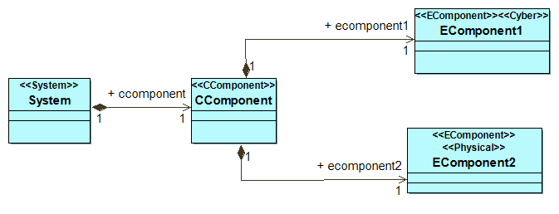
CComponent
Represents the a group of FMU/EComponent
Grouped by logic, domain, etc.

Slide 24
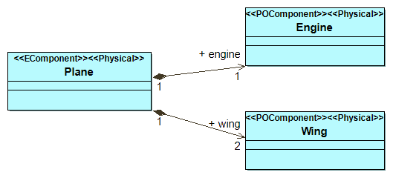
POComponent
Represents the sub part of a FMU/EComponent
Used for a Physical sub component

Slide 25
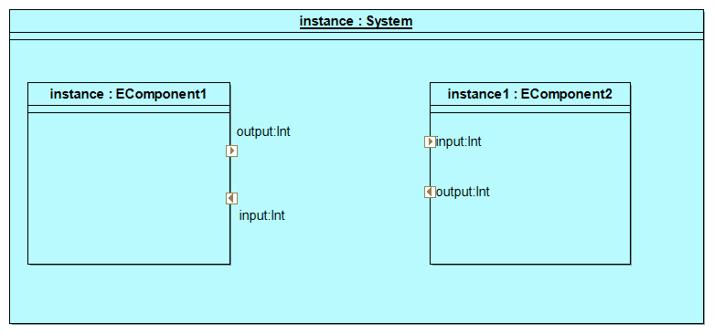
Block Instance
Instantiation of a given block
Associated with other block instance through ports and/or connectors

Slide 26
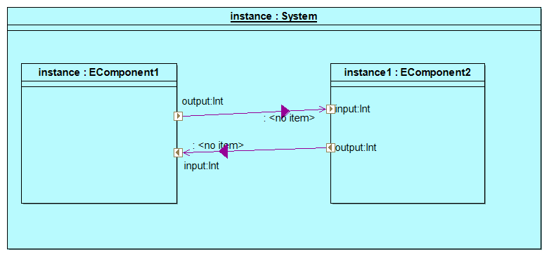
Connector
Links two instance of Flow Ports

Slide 27
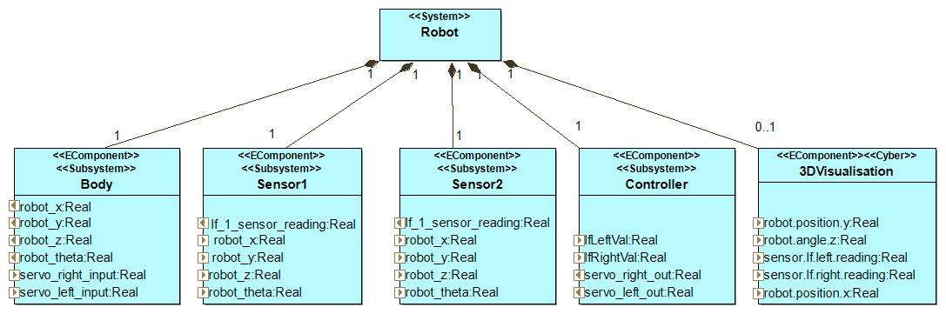
Example

Slide 28
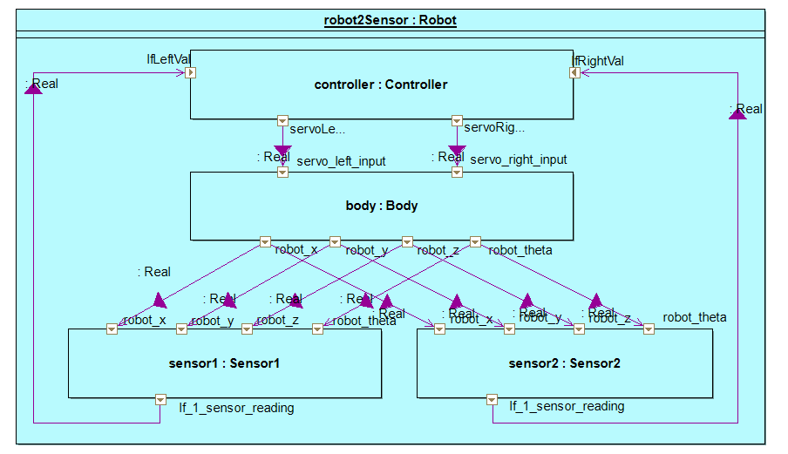
Example

Slide 29
INTOCPS/SysML– DSE diagrams
Type | Example of use
Parameter definition | Structure between parameter
Parameter connection | Connections between parameter
Objective definition | Structure between objectives
Objective connection | Connections between objectives
Ranking | Definition of the rank parameters

Slide 30
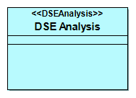
DSE Analysis
Top/root element for DSE Analysis.
Looks like System Block for DSE

Slide 31
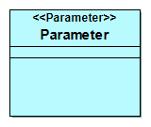
Parameter
Freedom degree of the DSE
Defined with a value range
0.1, 0.2

Slide 32
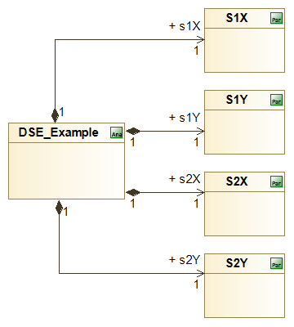
Parameter Definition example

Slide 33
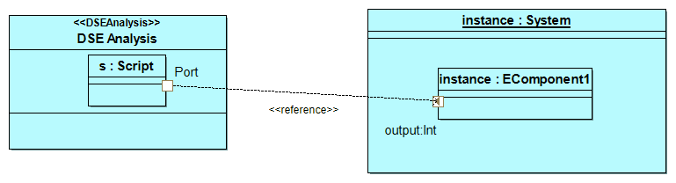
Reference
Link between DSE and Architecture
Made reference to Architecture part
Is Part of DSE

Slide 34
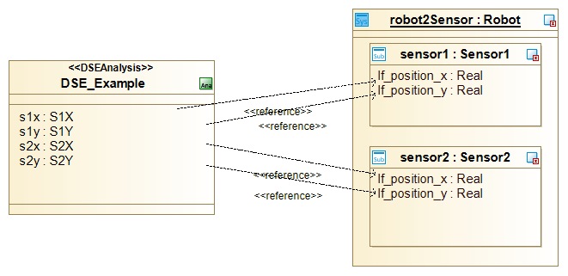
Parameter Connection Example

Slide 35
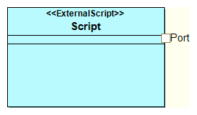
Objective
Objective of the DSE
Python script
Port as Parameter

Slide 36
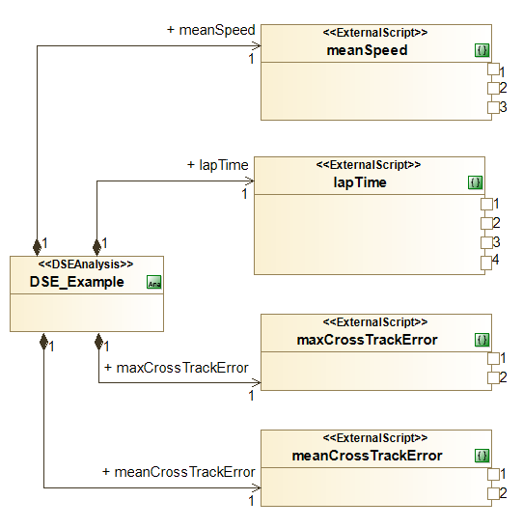
Objective Definition Example

Slide 37
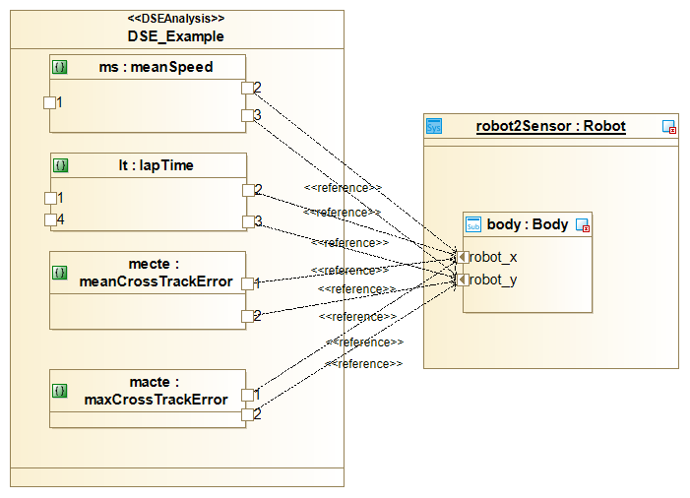
Objective Connection Example

Slide 38
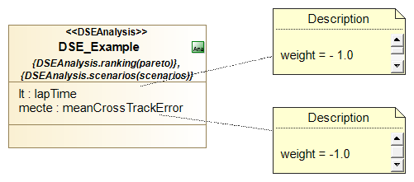
Ranking
Made at the DSE Analysis level
Use scenario(s)
Defined by :
Method (Pareto)
Set of objective
Weight associated to the objectives

